Slide 1
Laboratorio IoT
Prof. Paolo Napoletano
a.a. 2020/2021
Assignment I: Home monitoring + sunrise alarm
Team
Andrea Premate 829777

Slide 2
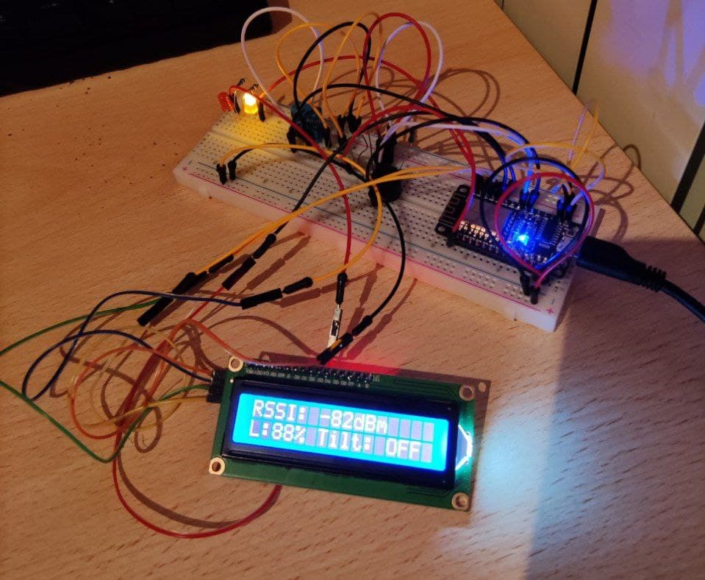
Materials
Description of the ingredients employed
1x Node MCU 1.0 (ESP8266)
1x DHT11 temperature and humidity sensor
1x 16x2 characters LCD display + PCF8574 I2C converter
1x buzzer TMB-12A05
1x photoresistor
1x SW-520D roll ball tilt sensor
2x led
Jumpers and resistors

Slide 3
Method
Description system: choices, parameters, use cases
Home monitoring system + sunrise alarm
Home monitoring: - RSSI - Temperature, humidity, perceived temperature - Brightness
Sunrise alarm: - While the device is upside down and there’s enough light, the alarm sounds. To turn off the alarm flip the device. Before going to sleep put the device upside down in order to set the alarm.
Alerts: - bad wifi signal alert -> yellow led - high perceived temperature alert -> red led

Slide 4
Final remarks
Results, Discussion, conclusion
All the sensed values, alerts and alarm are stored in a database(InfluxDb) and can be monitored thought: - LCD screen that alternates different views of the current state - Web page showing all the values of the current state - Board(InfluxDb) showing all the values recorded within the last week
The system works as expected.
Possible changes/adaptations: - Set the alerts’ thresholds through the web page. - Disable the alarm and keep the data of the last months to see how the sunrise time changes. Weather can affect the results.

