Slide 1
Prokaryotic-specific reactions
Human-specific reactions
Human & prokaryotic reactions
Metabolites
Notes:
Figure 1

Slide 2
a
c
new BLASTP
new BLASTP
n=2626
n=209
KEGG
KEGG
n=4143
n=589
Total (n=6769)
Total (n=798)
b
d

Slide 3
 |  |  |  | Prokaryotic species |  | Gut prokaryotic species
Reaction ID | KO ID | KO Name | KO description | KEGG | + BLASTP | KEGG | + BLASTP
R02678 / R04903 | K00128 | ALDH | Aldehyde dehydrogenase (NAD+) | 1380 | 1114 | 188 | 260
R02173 / R02908 | K00274 | MAO | Monoamine oxidase | 574 | 236 | 61 | 118
R00679 | K00466 | iaaM | Tryptophan 2-monooxygenase | 159 | 228 | 13 | 24
R03096 | K01426 | amiE | Amidase | 1207 | 601 | 181 | 302
R00685 | K01593 | TDC | L-tryptophan decarboxylase | 136 | 46 | 6 | 8
R00673 | K01667 | tnaA | Tryptophanase | 291 | 216 | 63 | 75
R04020 | K01721 | nthA | Nitrile hydratase subunit alpha | 181 | 96 | 14 | 7
R01974 | K04103 | ipdC | Indolepyruvate decarboxylase | 171 | 58 | 42 | 59
R10181 | K11816 | YUCCA | Indole-3-pyruvate monooxygenase | 7 | 7 | 0 | 0
R03096 | K21478 | icaB | poly-beta-1,6-N-acetyl-D-glucosamine N-deacetylase | 37 | 24 | 21 | 66
Notes:
Table 1

Slide 4
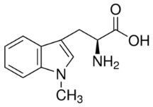

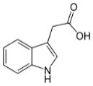
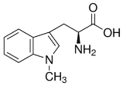
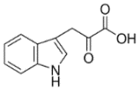
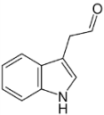

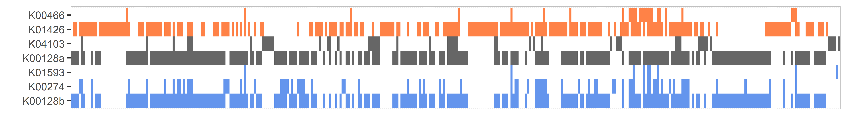
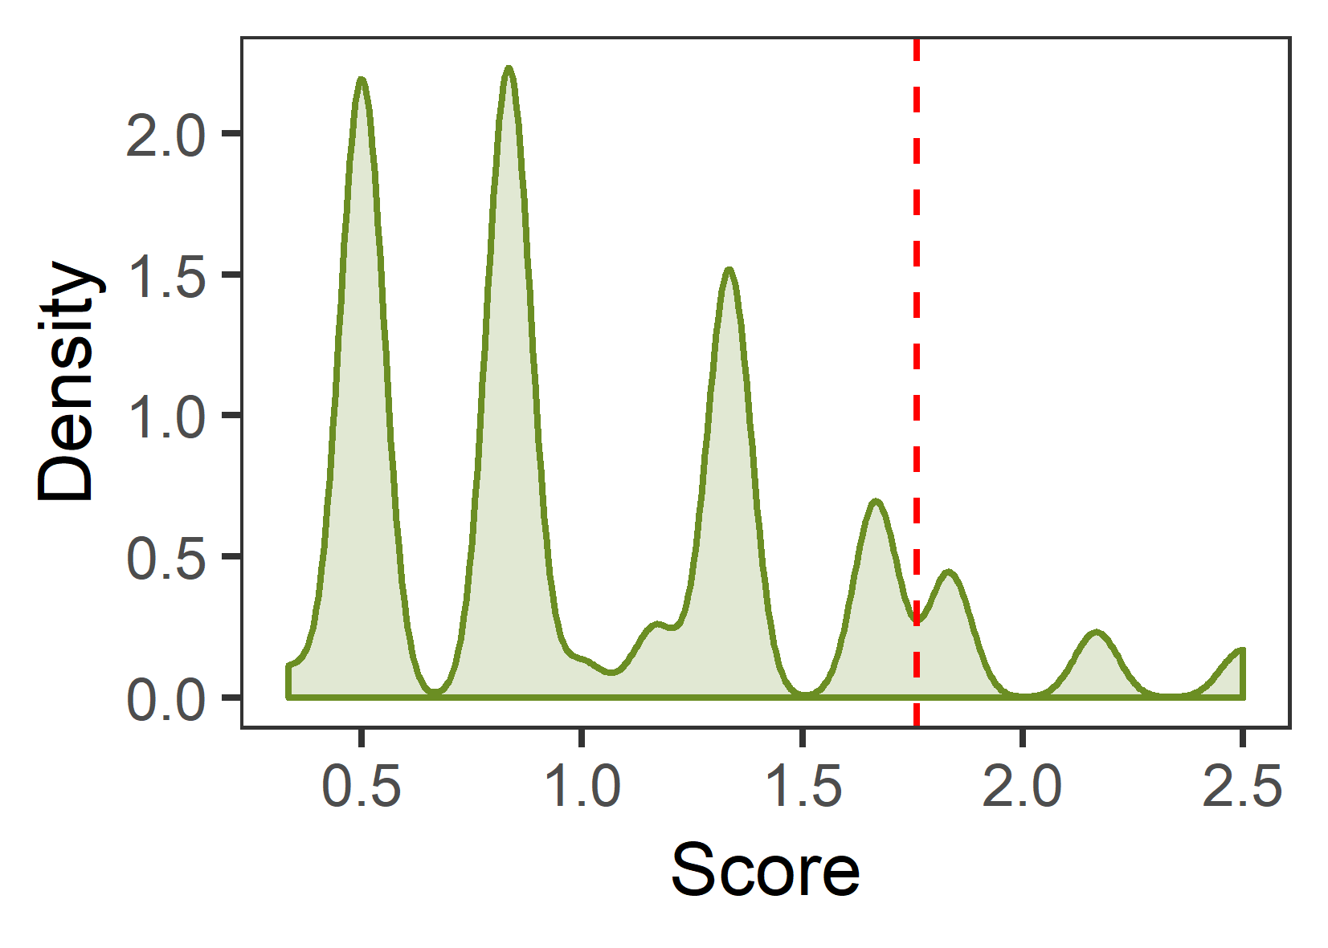
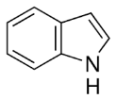
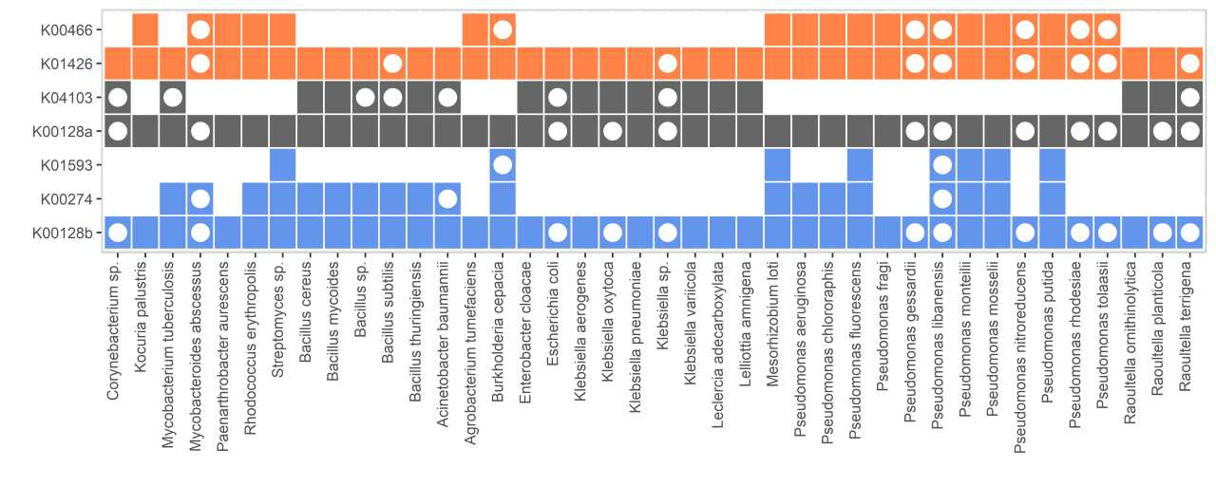
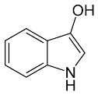
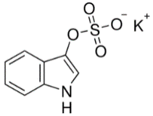
a
b
Indole-3-
acetamide
Indole-3-
acetate
L-Tryptophan
K01426*
Path-1
K00466*
Path-2
Indole-3-
pyruvate
L-Tryptophan
K03334**
K04103
K00128
Path-3
K01593*
Indole-3-
acetaldehyde
Tryptamine
K00274
prokaryotic metabolism*
c
d
Score filtering
e
Indole
hepatic oxidation
human metabolism**
Indoxyl
hepatic sulphation
3-indoxylsulphate
Actinobacteria
Firmicutes
Proteobacteria
Notes:
Blue is kegg only
Dark red is blast only

