Slide 1


GGE6505 Assignment 2
Getting Data with APIs
Nadav Avni, Andrea Reid

Slide 2

Kaggle

Slide 3
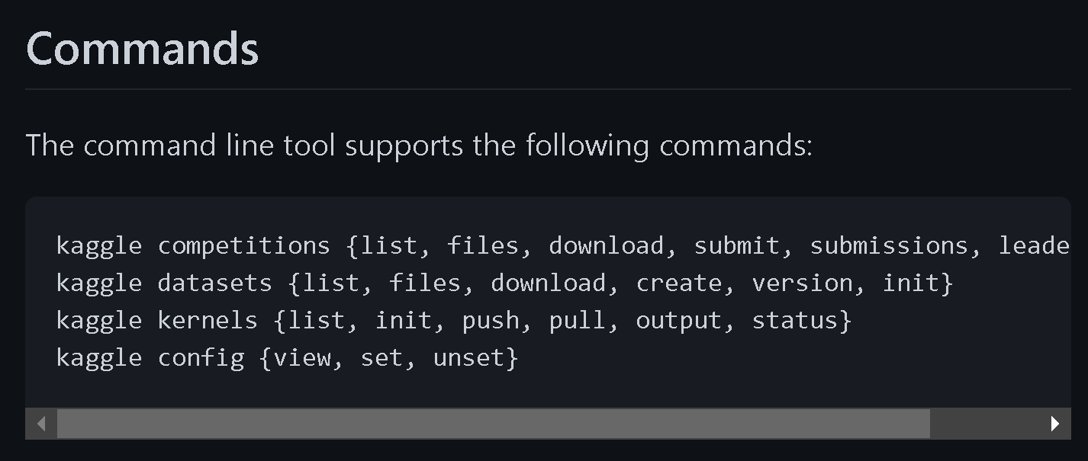
Why Kaggle?
Learning platform for data scientists
Open-source data, notebooks, and workflows
Access competitions to earn money
Easy to use with Kaggle API command line tool

Slide 4
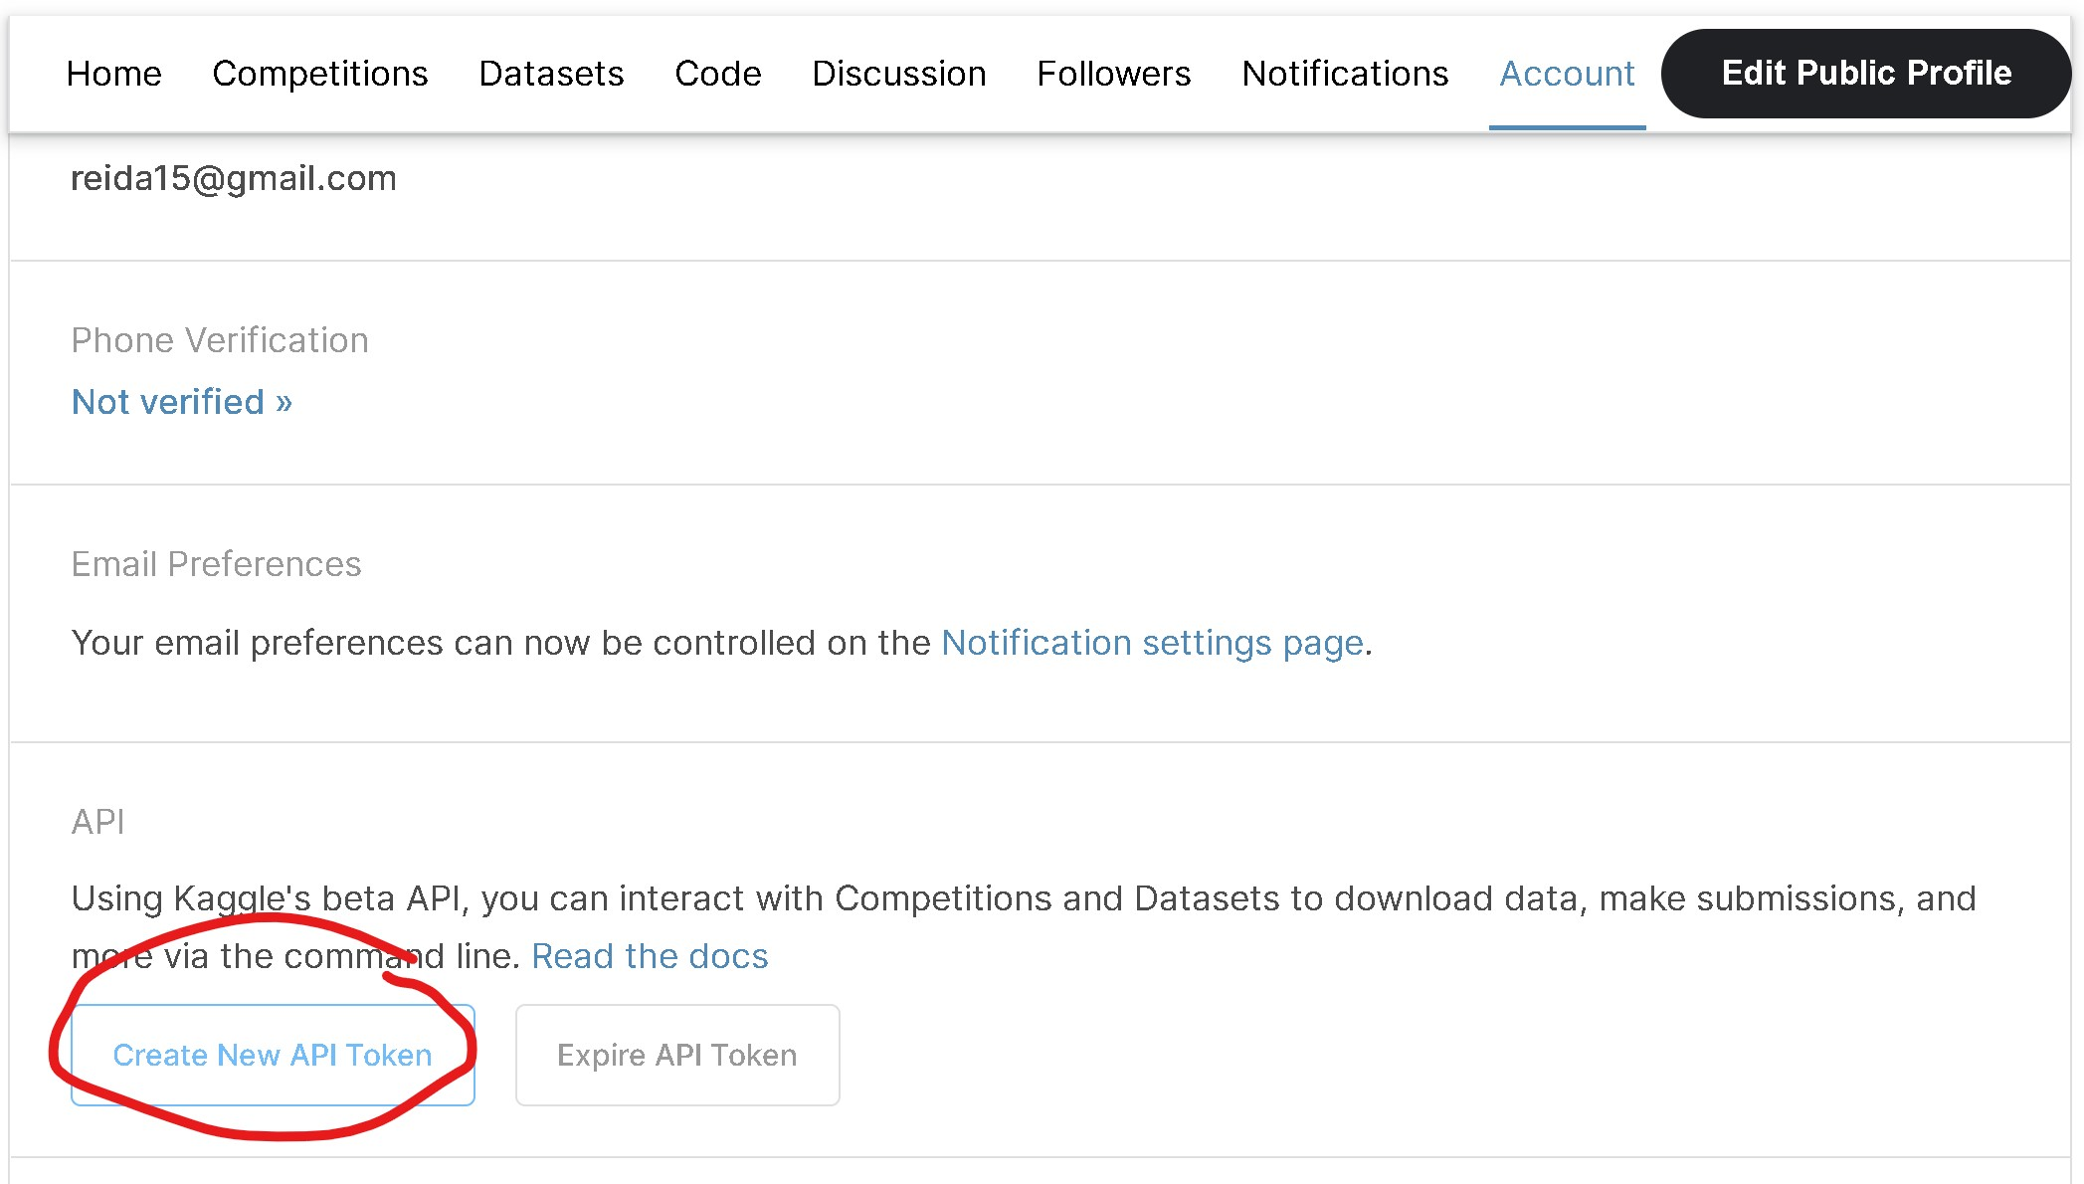
Authentication

Slide 5
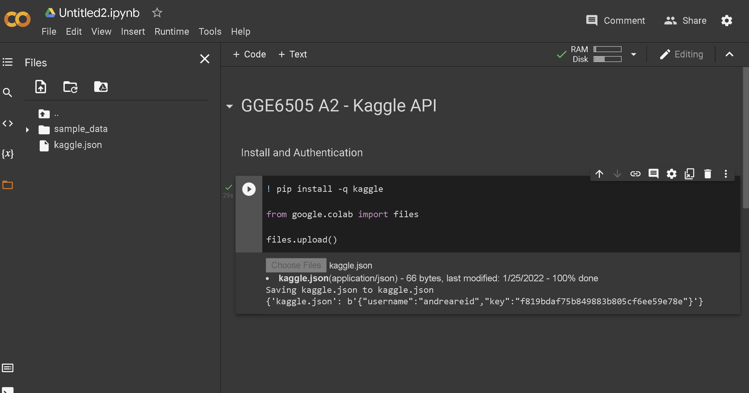
Authentication

Slide 6
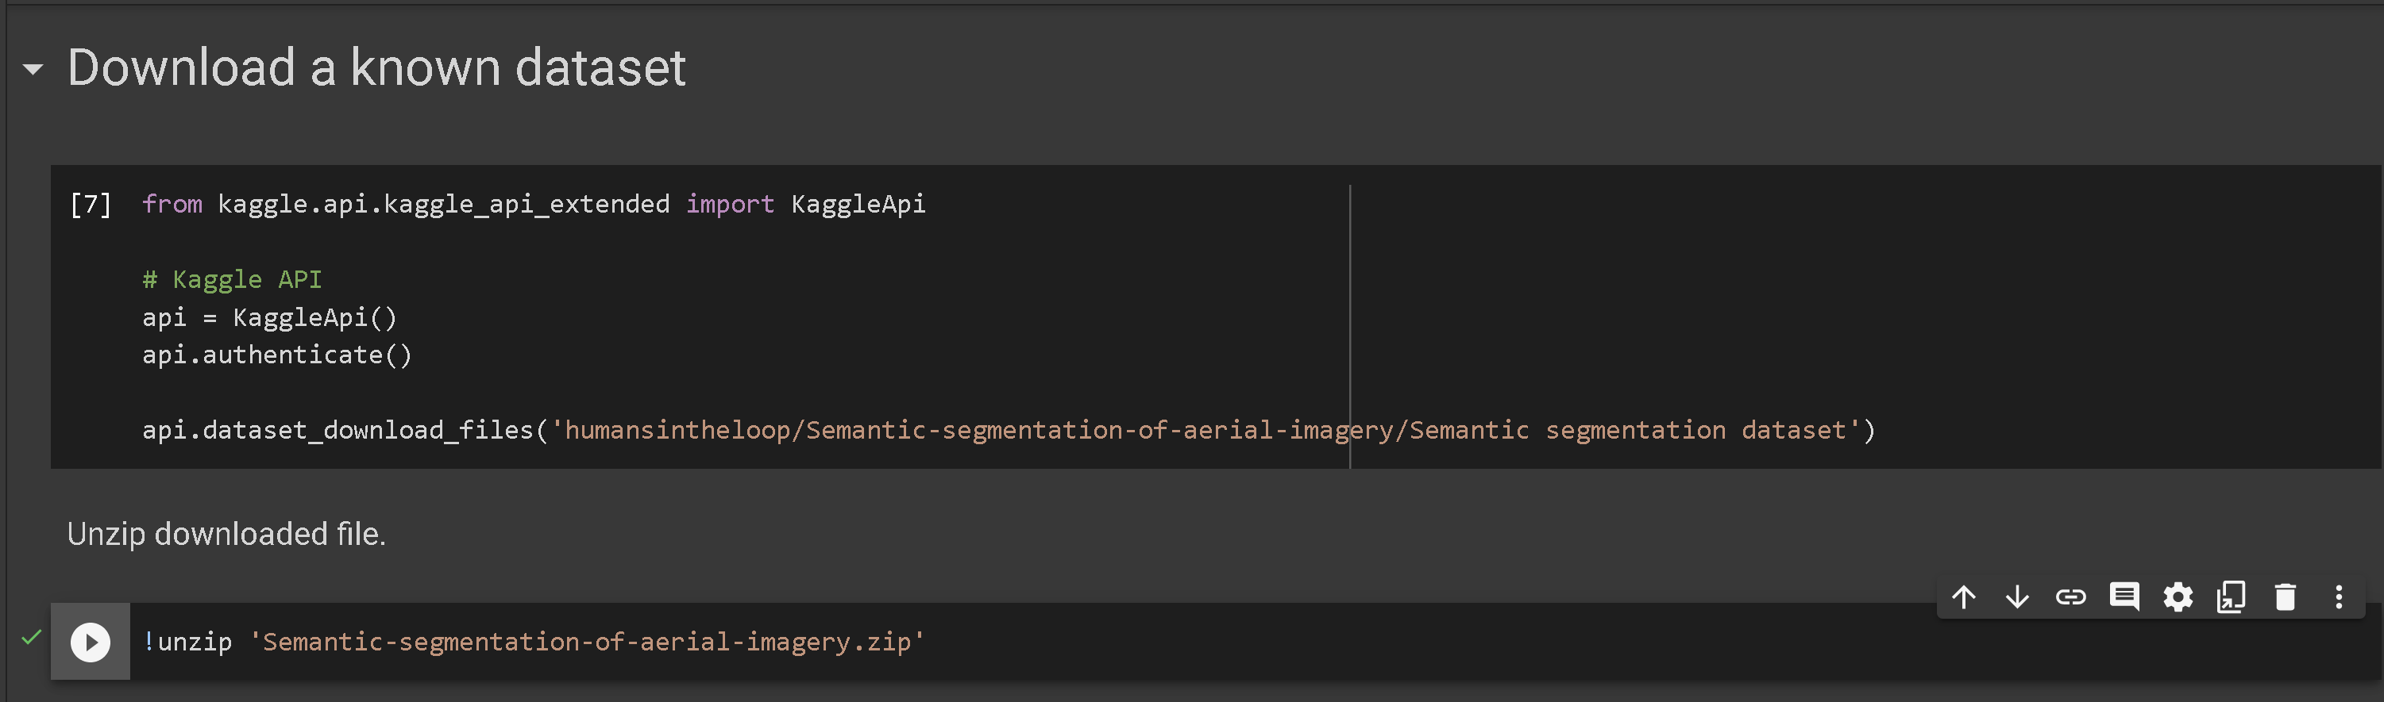
Access to Datasets

Slide 7
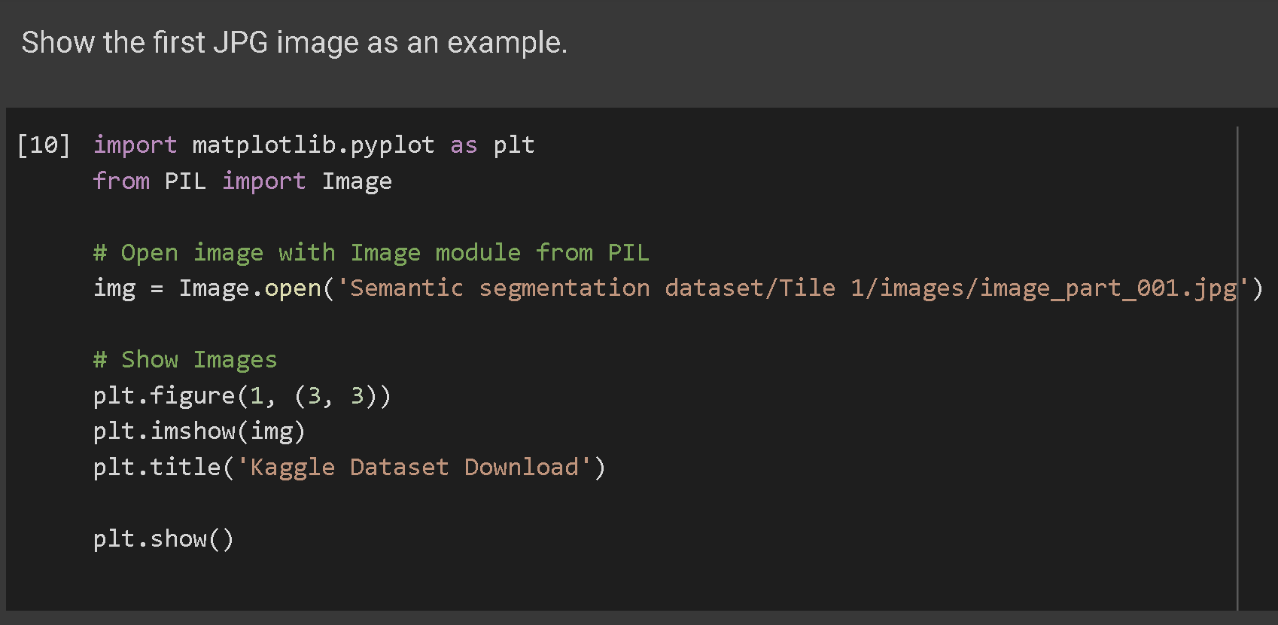
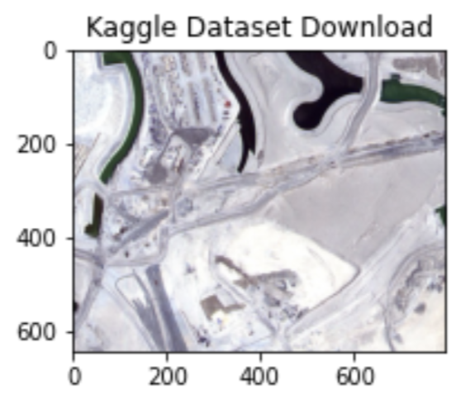
Access to Datasets

Slide 8
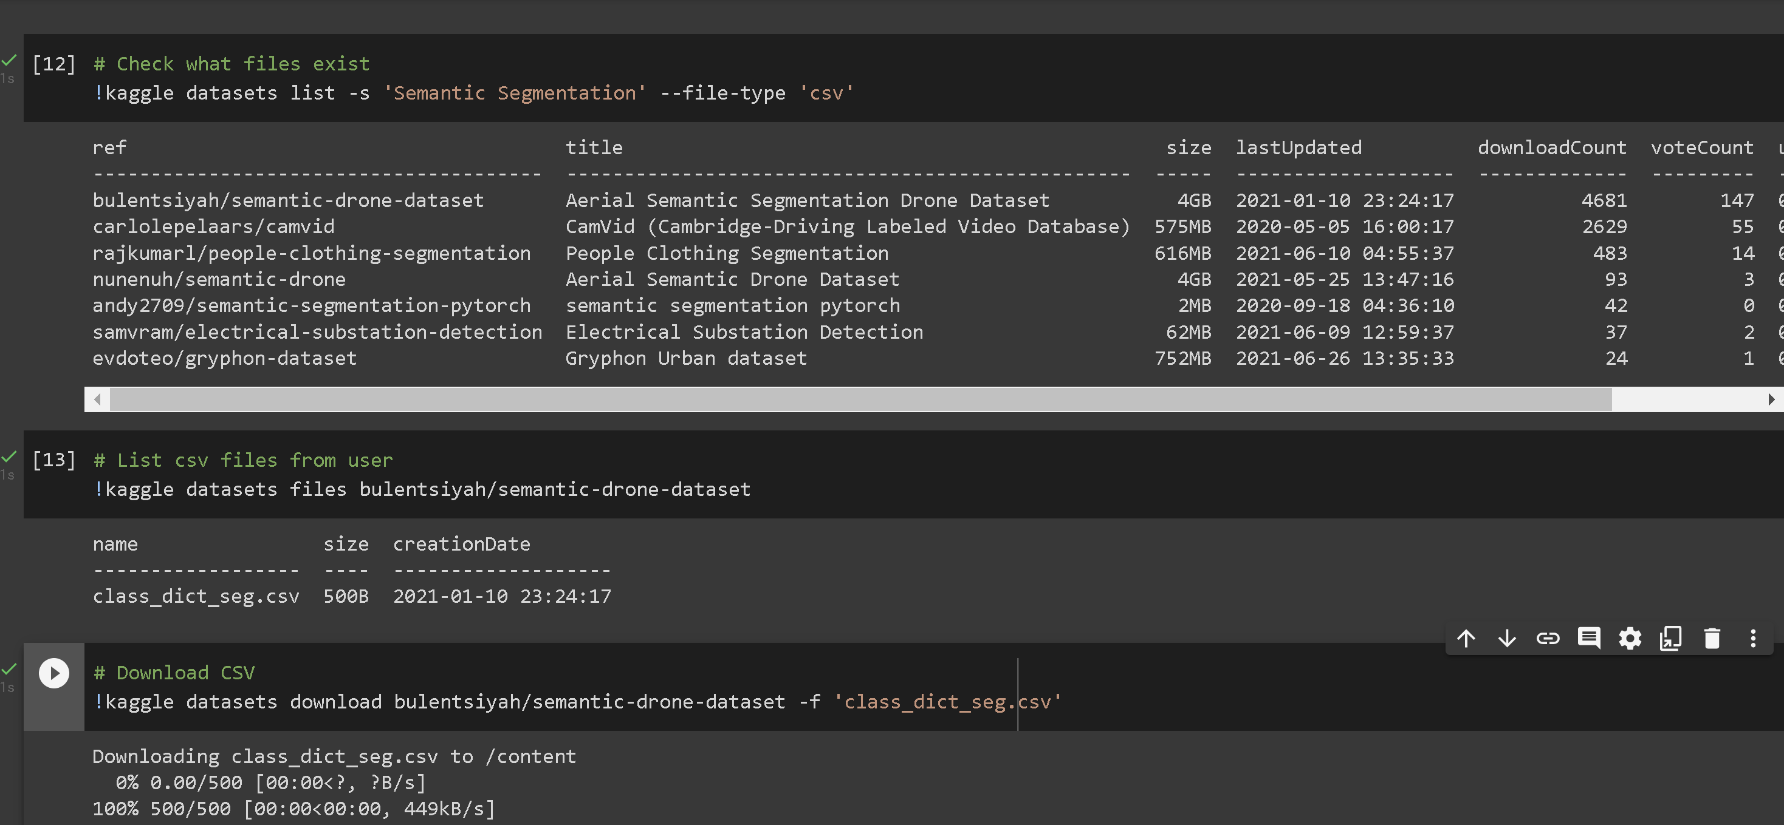
Download CSV

Slide 9
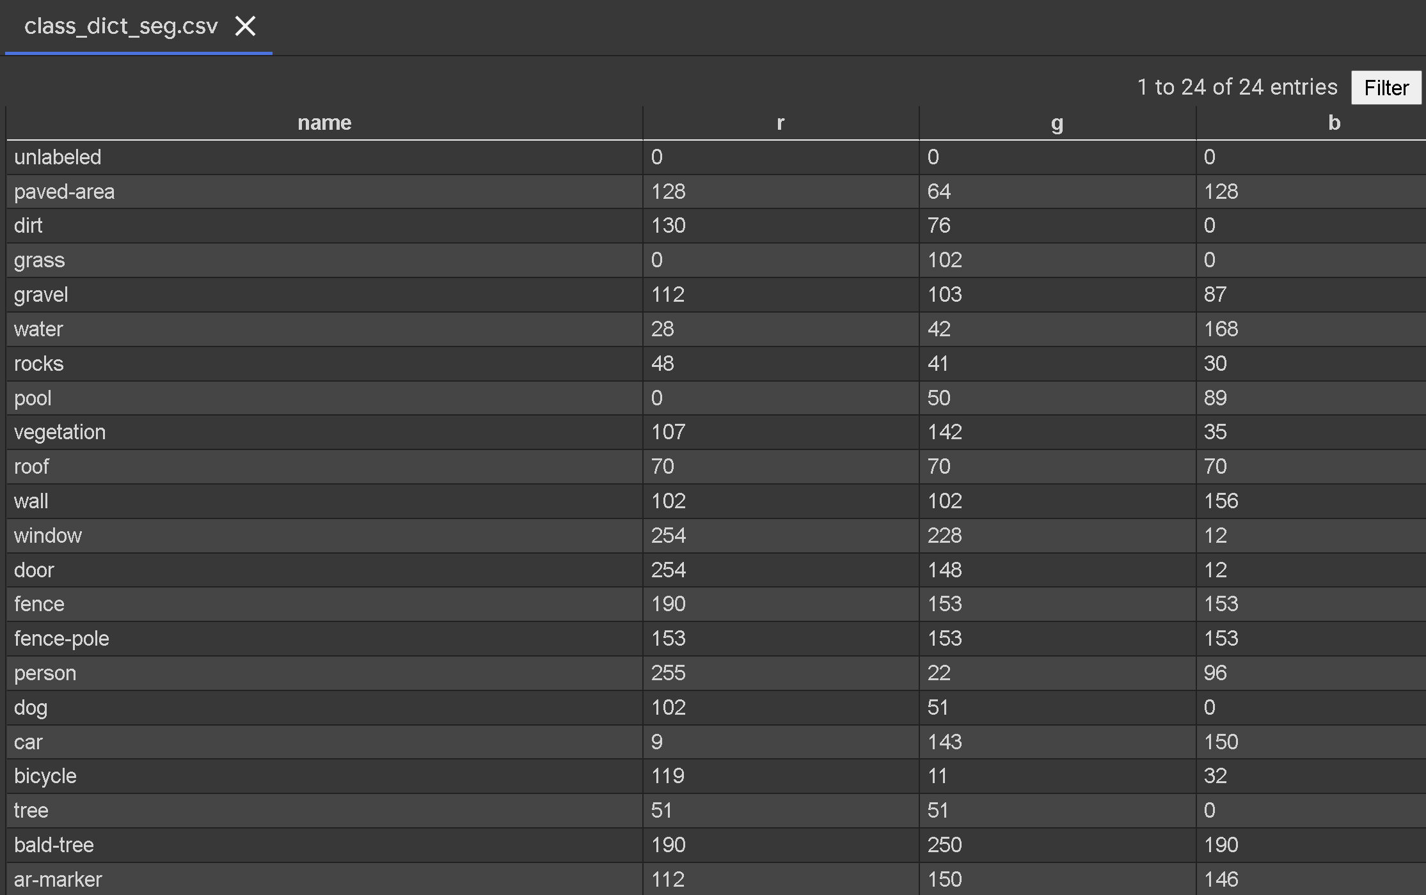
Download CSV

Slide 10
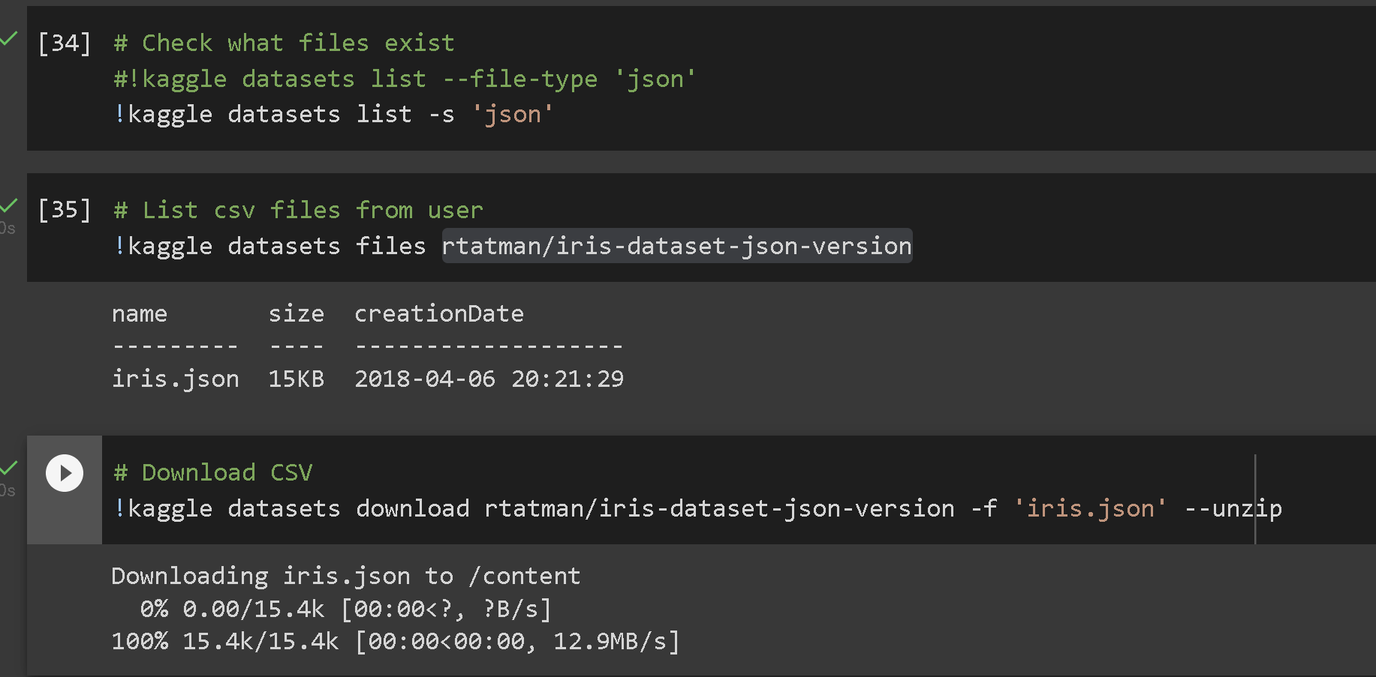
Download JSON

Slide 11
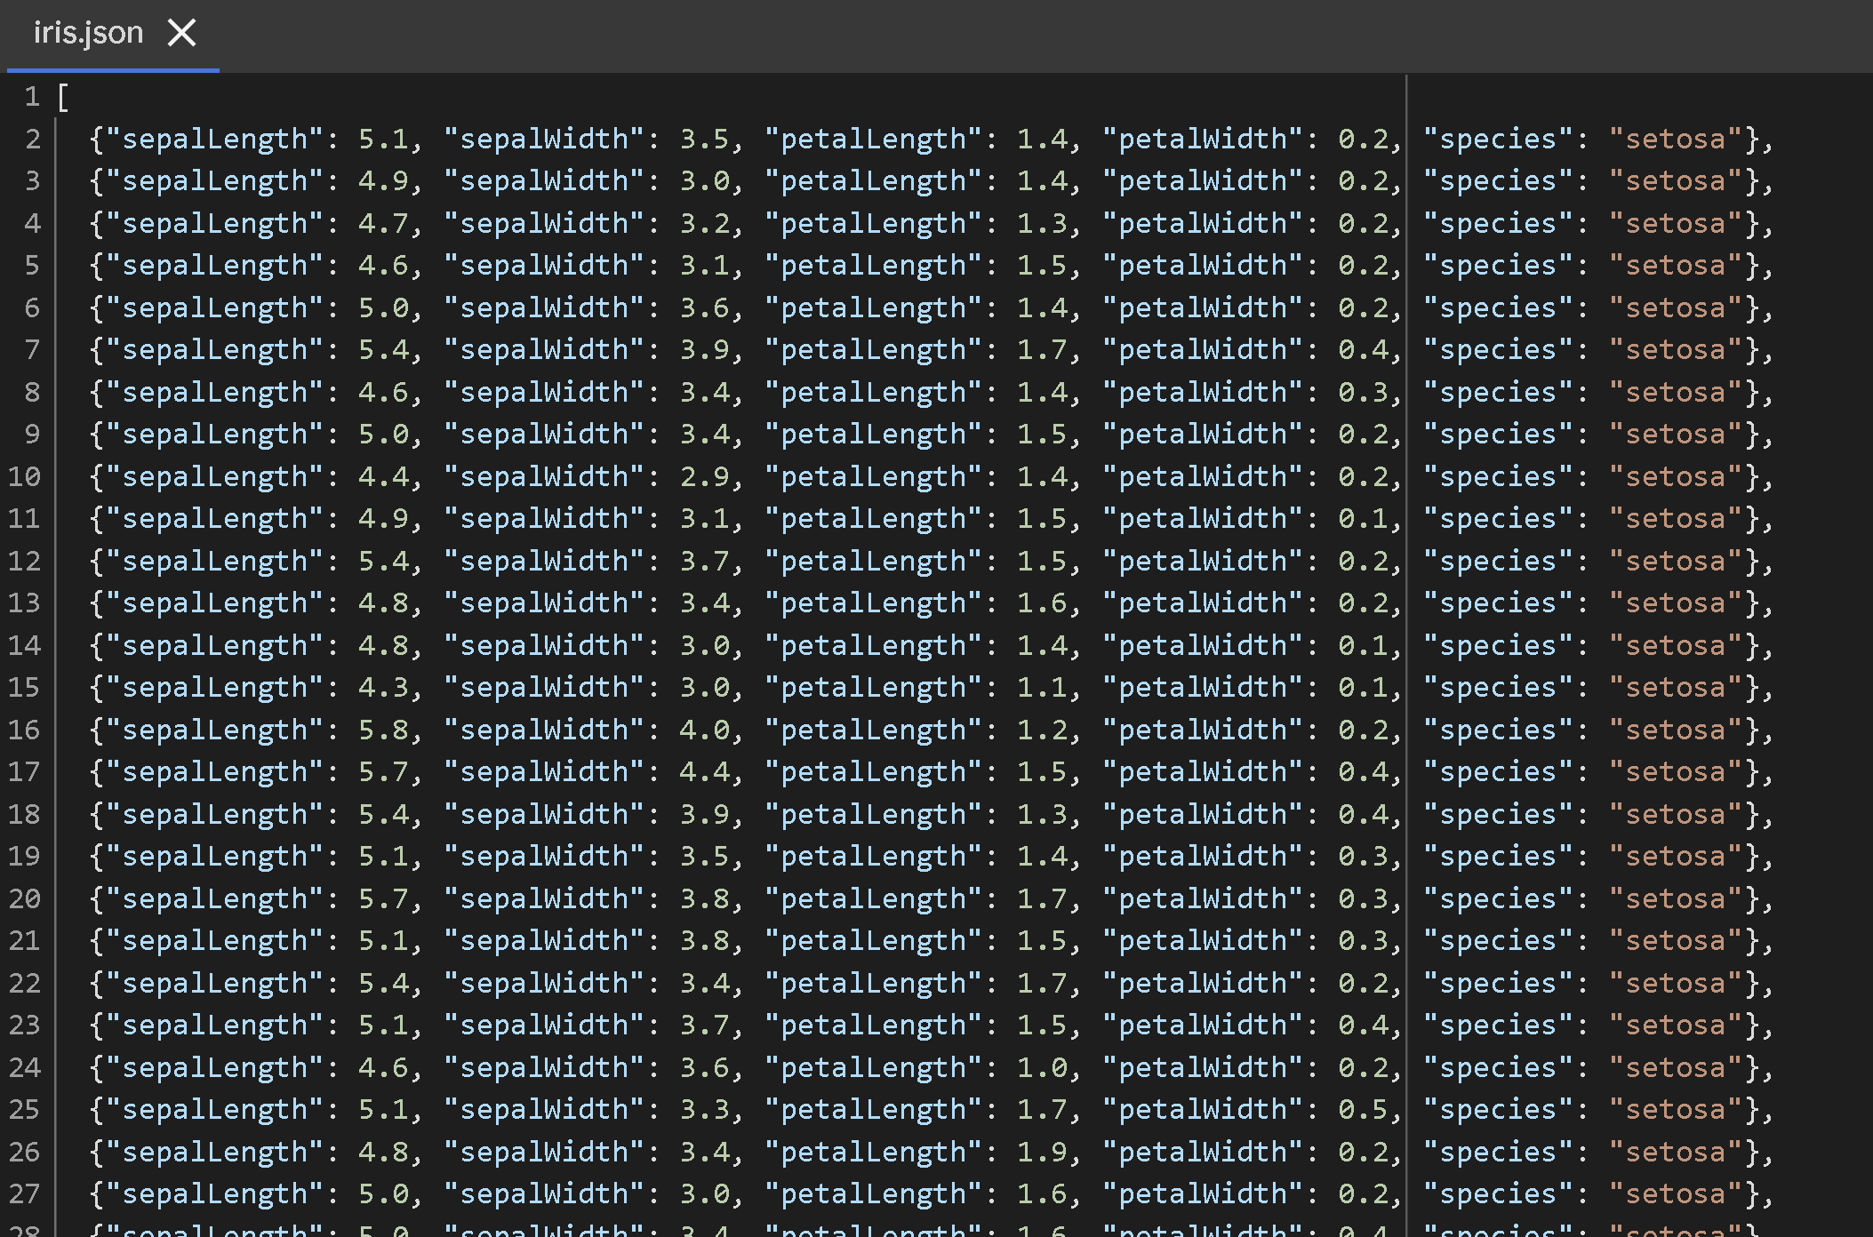
Download JSON

Slide 12
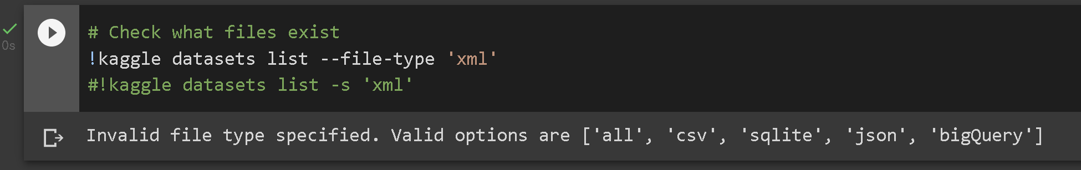
Download XML

Slide 13
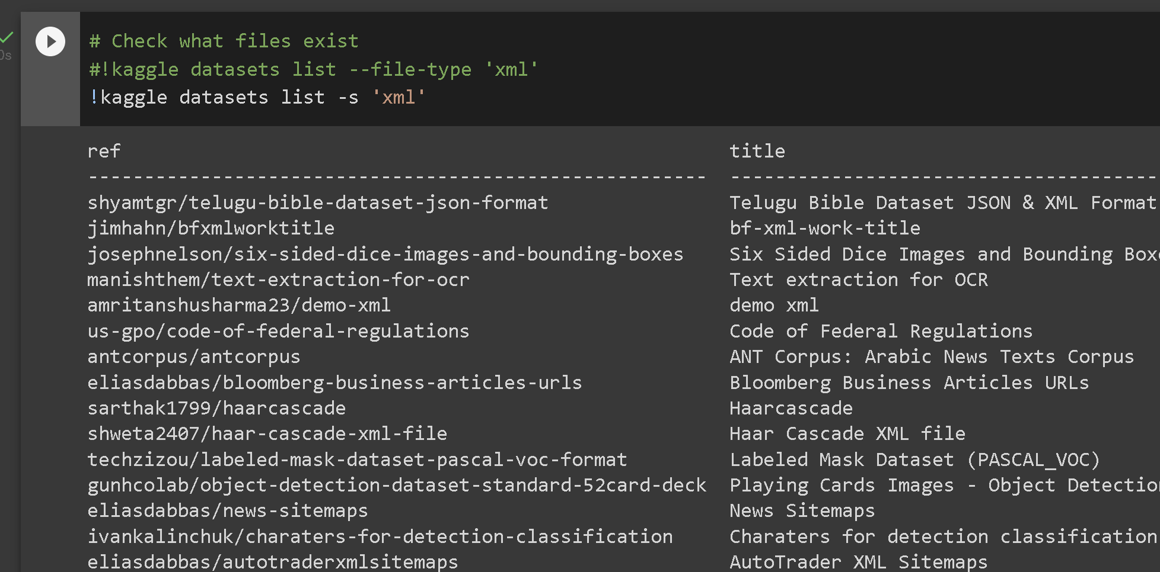
Download XML

Slide 14
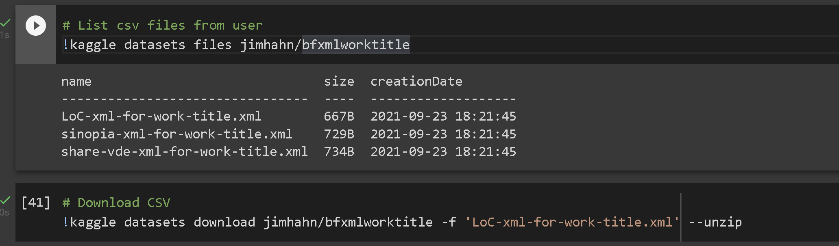
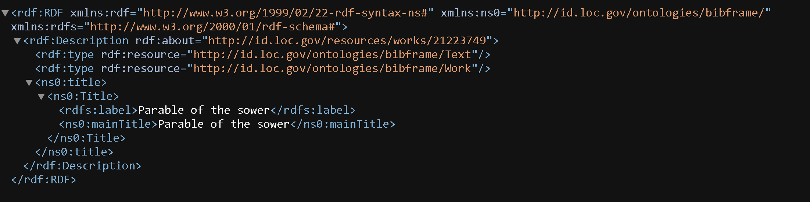
Download XML

Slide 15
Twitter Filtered Stream

Slide 16
Authentication

Slide 17

cURL Request and Rules Endpoint
cURL requests:

Slide 18
POST request
!curl -X POST 'https://api.twitter.com/2/tweets/search/stream/rules' \
-H "Content-type: application/json" \
-H "Authorization: Bearer $Access_Token" -d \
'{ "add" : [ { "value": "#snow -canada", "tag": "snow in canada" } ] }'

Slide 19
GET request
!curl -X GET -H "Authorization: Bearer $Access_Token" "https://api.twitter.com/2/tweets/search/stream?tweet.fields=created_at&expansions=author_id&user.fields=created_at" > stream_output.json

Slide 20
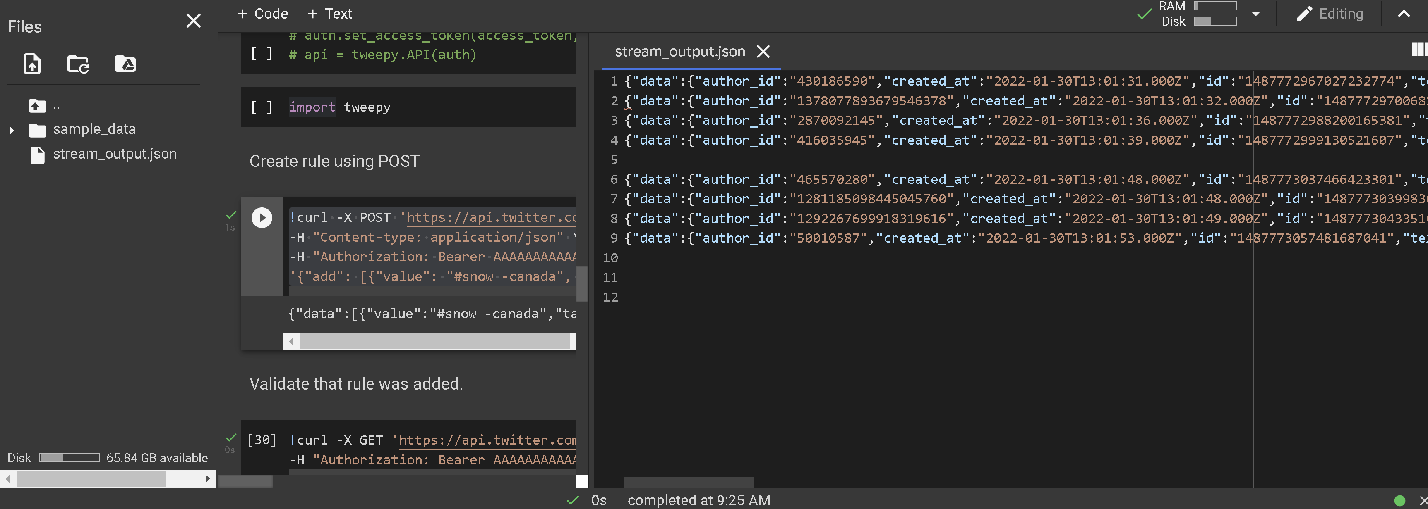
Start Streaming

