Slide 1
GGE6505 Assignment 2
Getting Data with APIs
Nadav Avni, Andrea Reid
KAGGLE API

Slide 2

Authentication

Slide 3
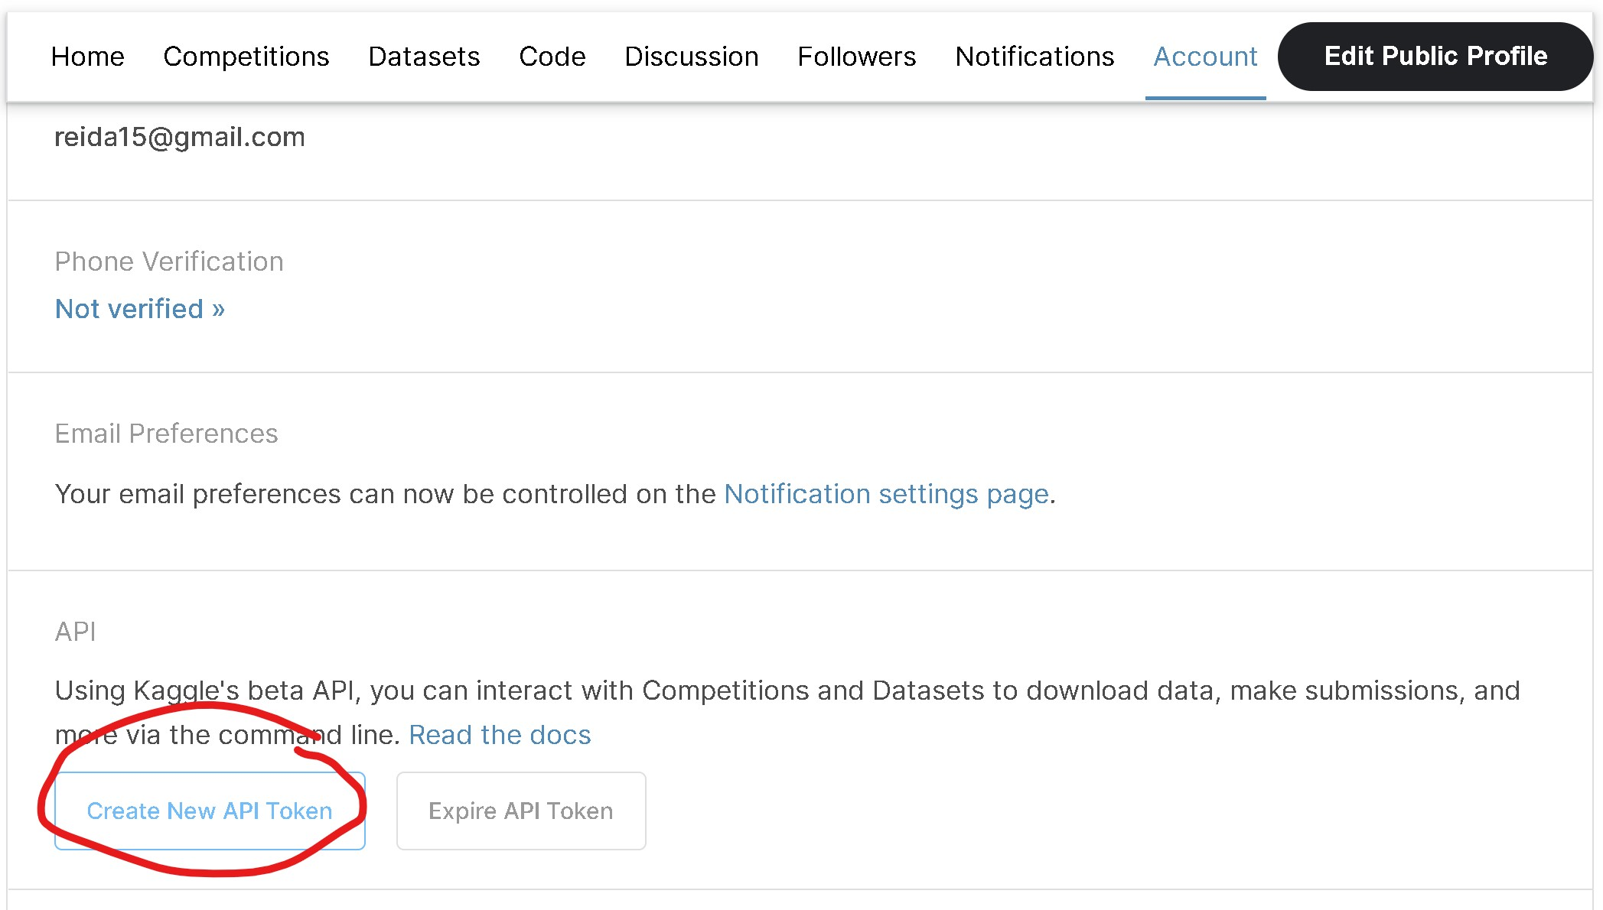
Authentication in Colab

Slide 4
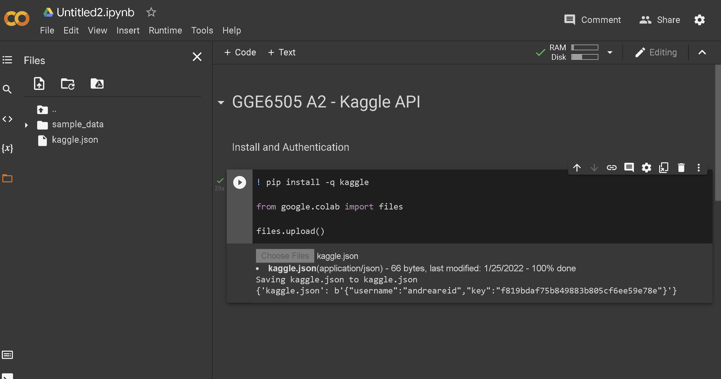
Authentication in Colab

Slide 5
Data Access

Slide 6
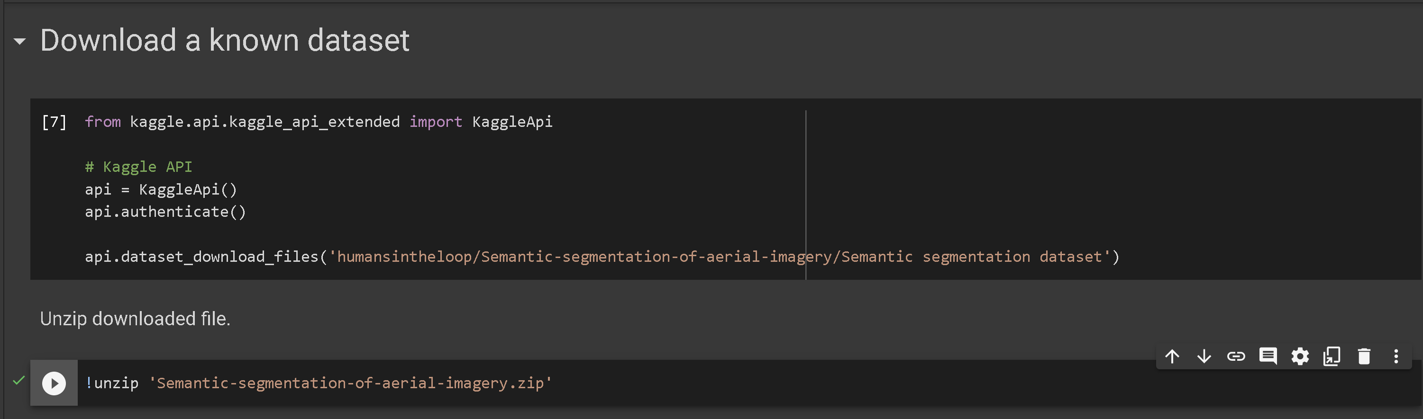
Search and Download Datasets

Slide 7
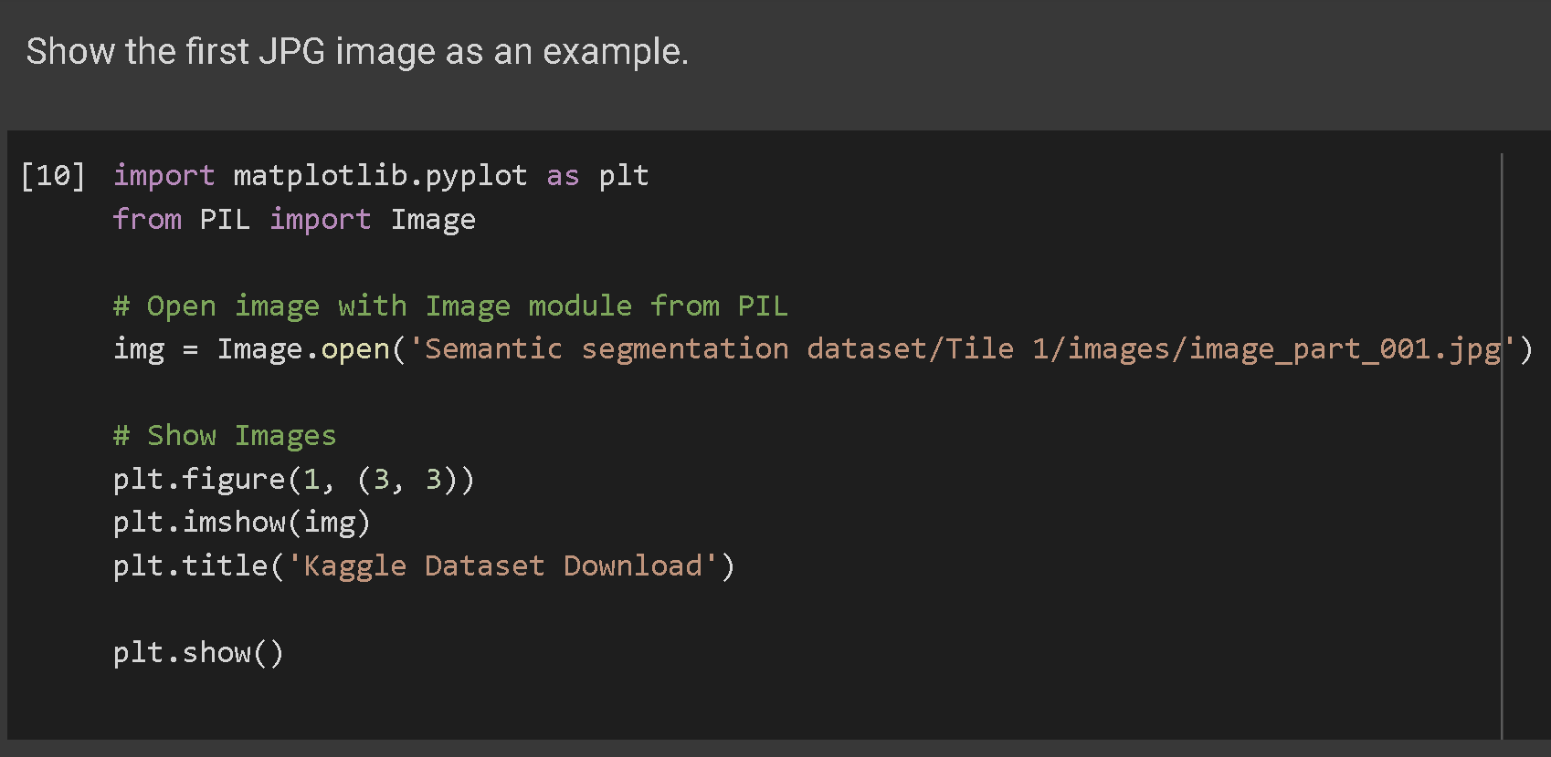
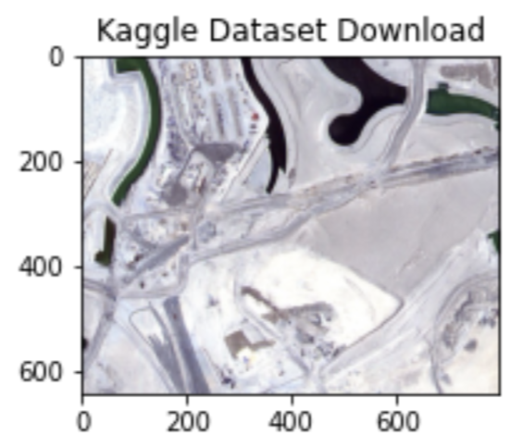
Search and Download Datasets

Slide 8
Different Data Types

Slide 9
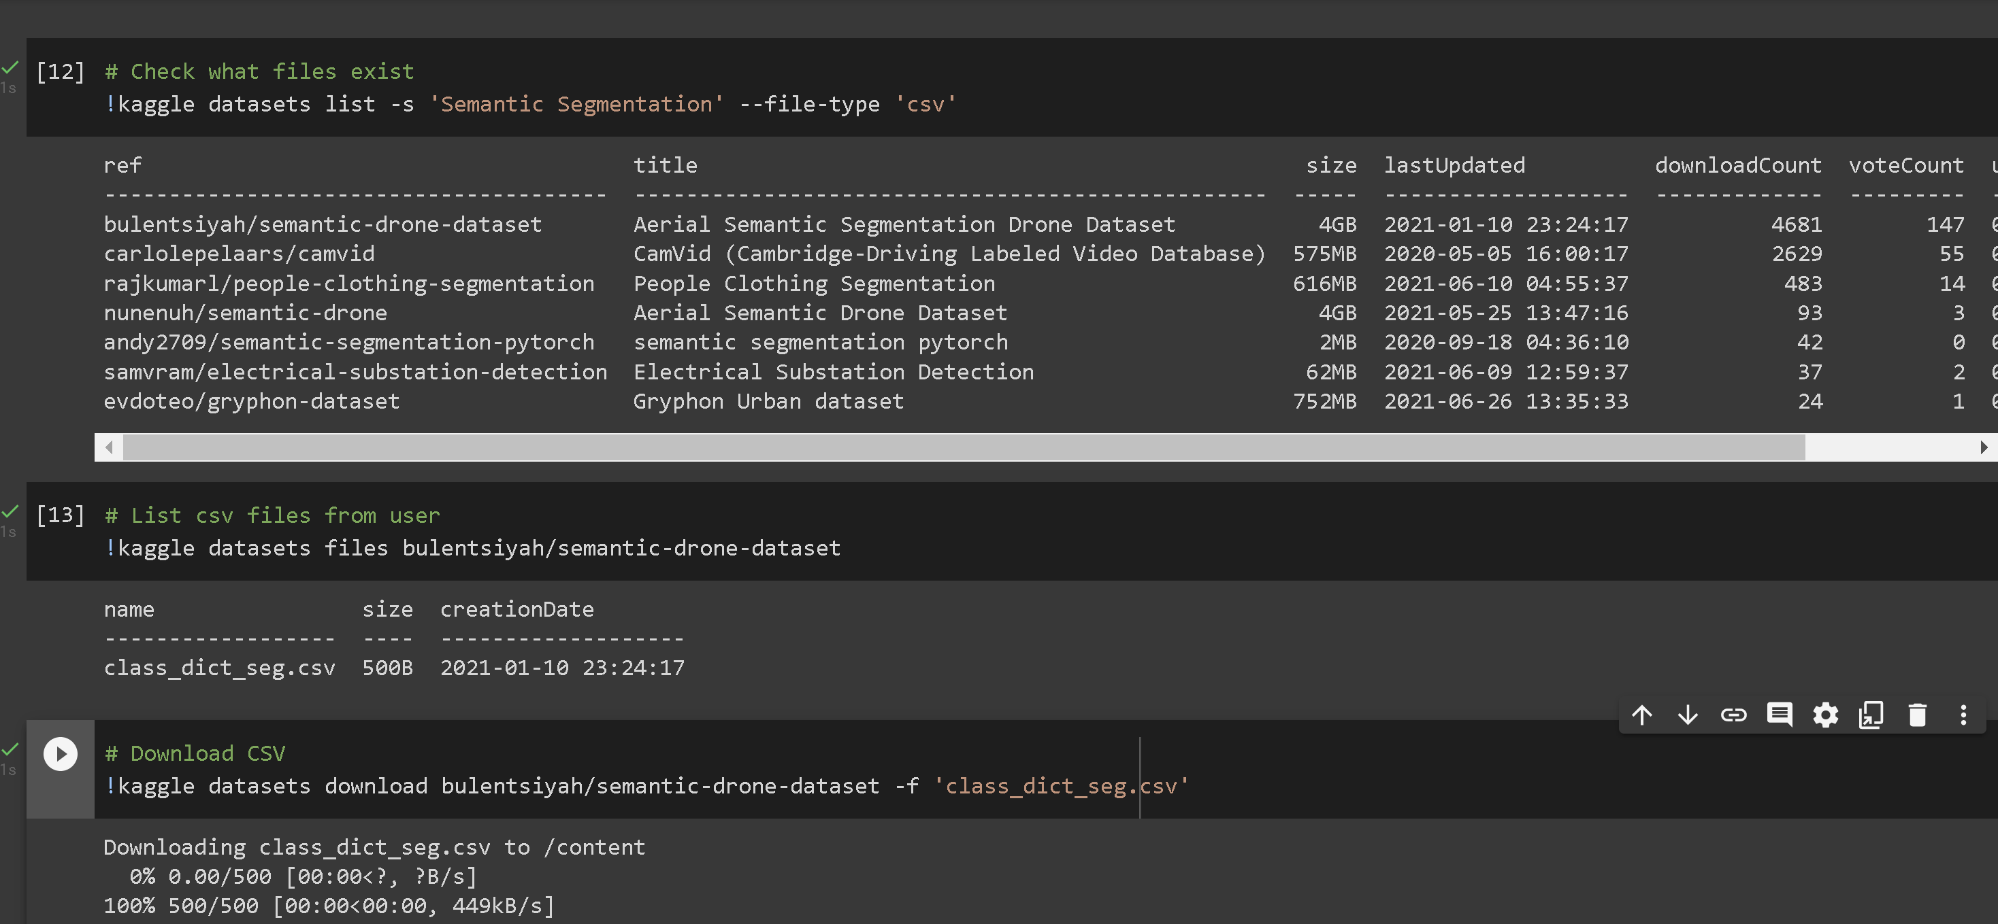
Download CSV

Slide 10
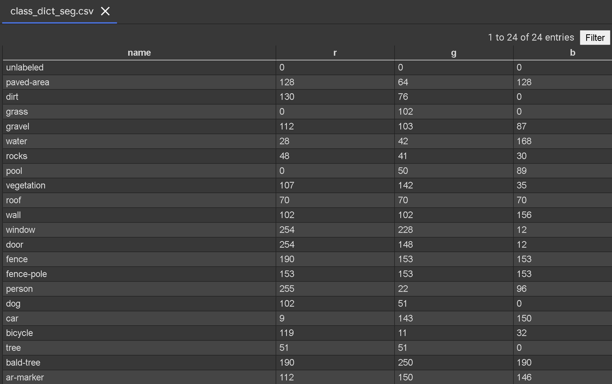
Download CSV

Slide 11
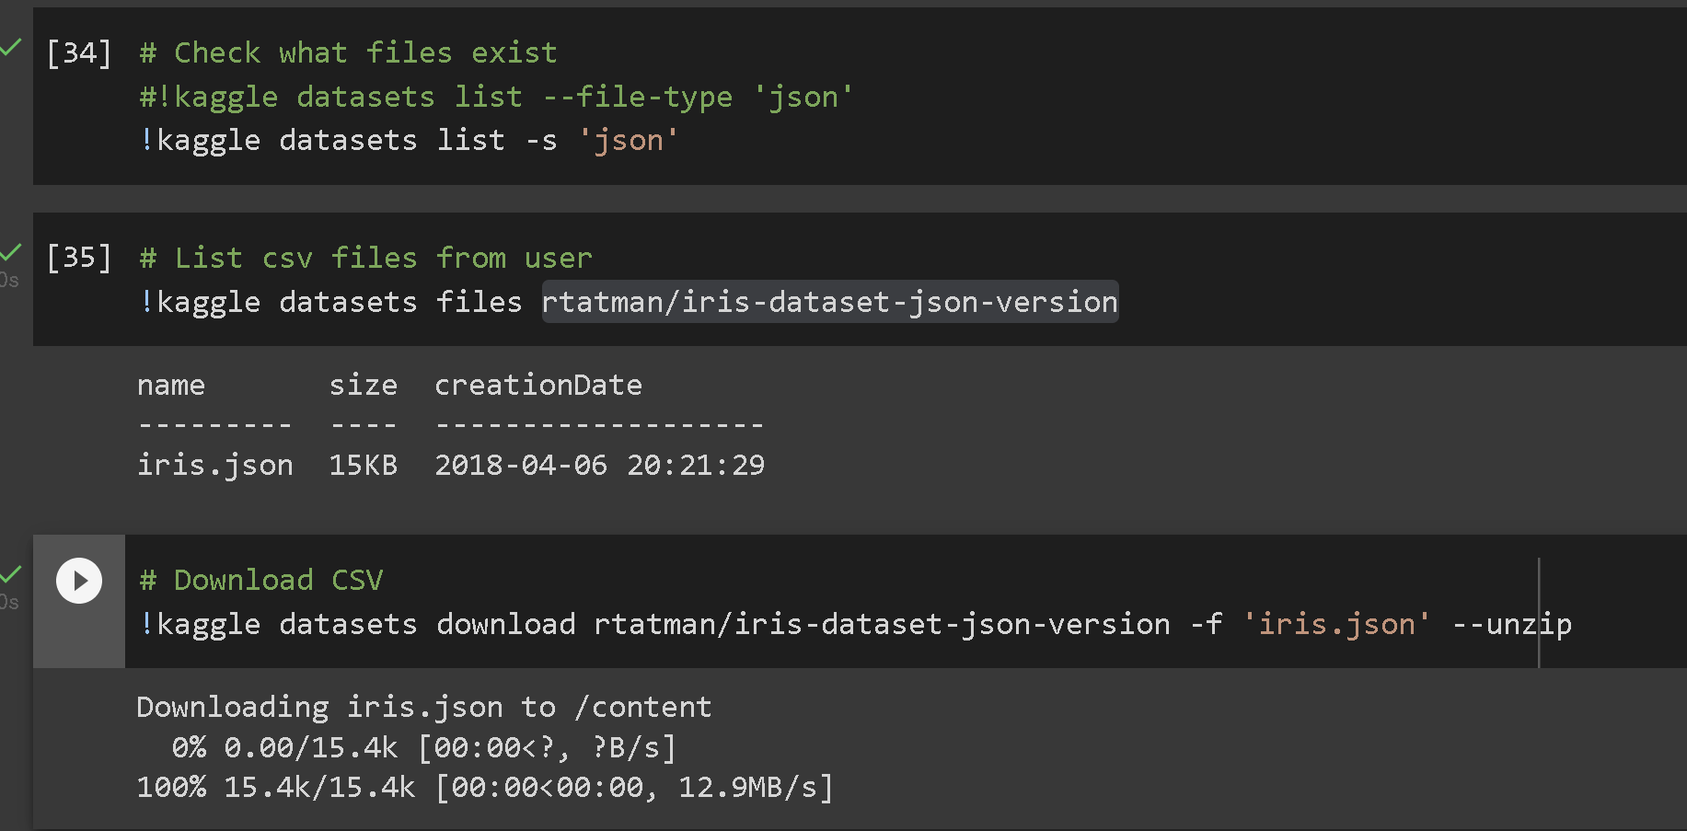
Download CSV

Slide 12
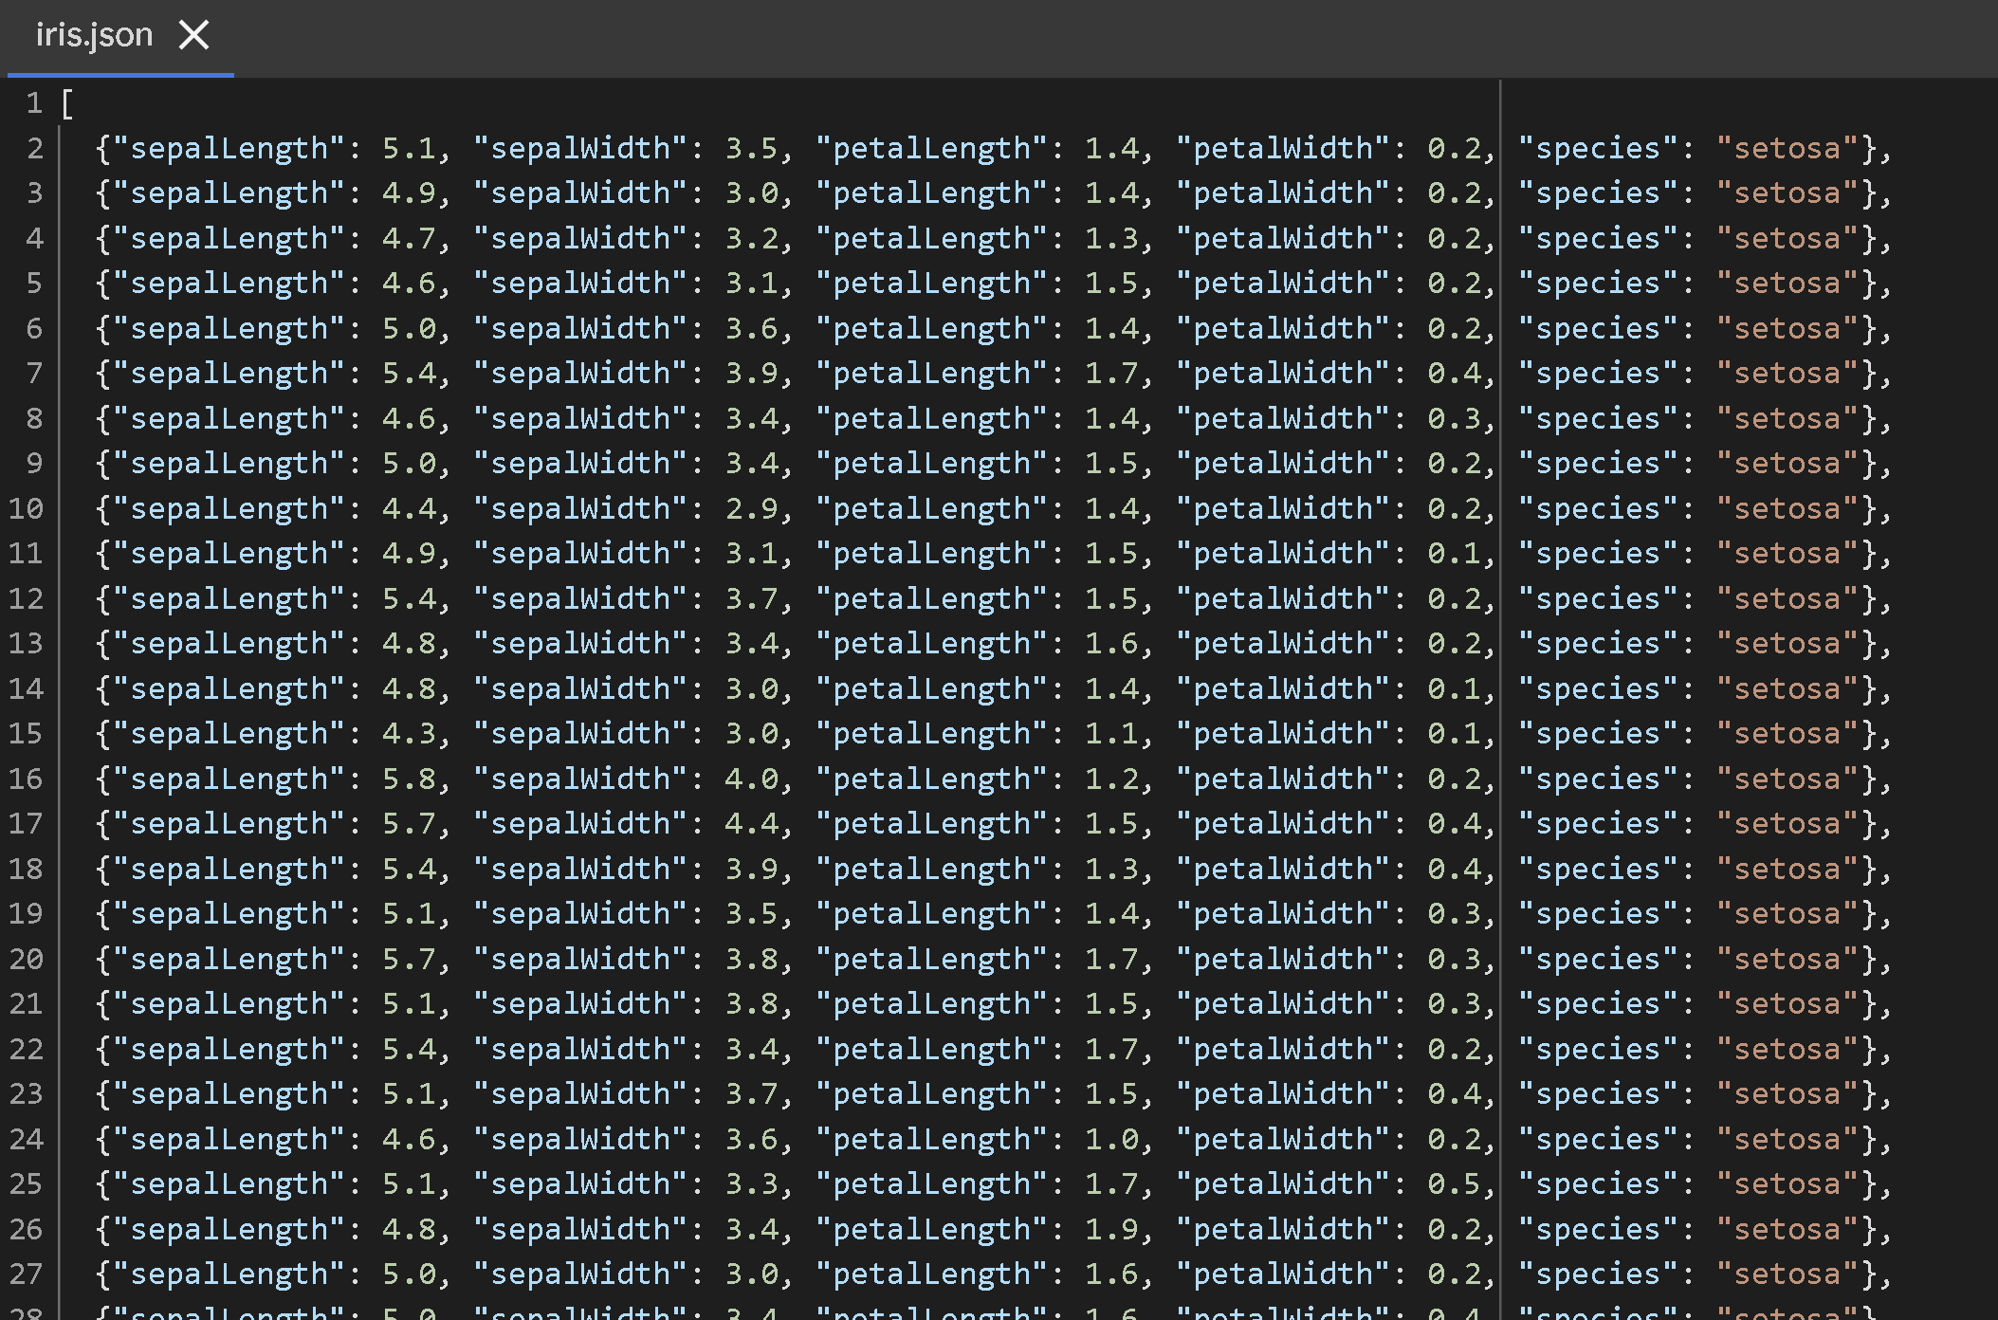
Download CSV

Slide 13
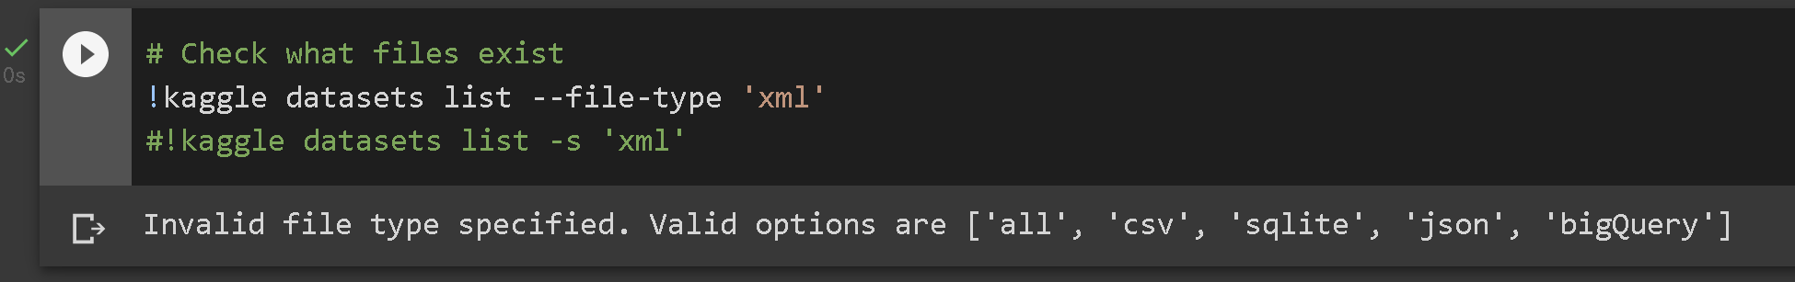
Download CSV

Slide 14
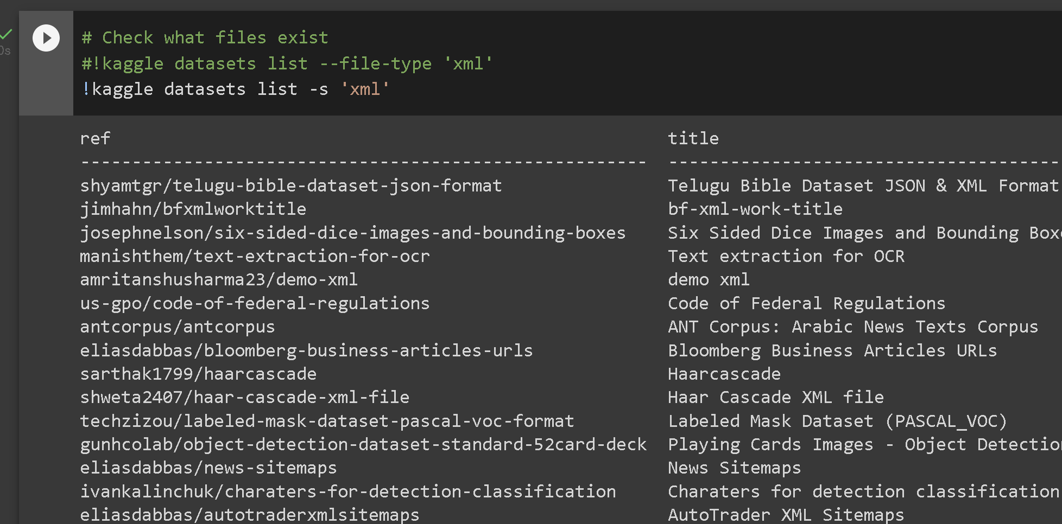
Download CSV

Slide 15
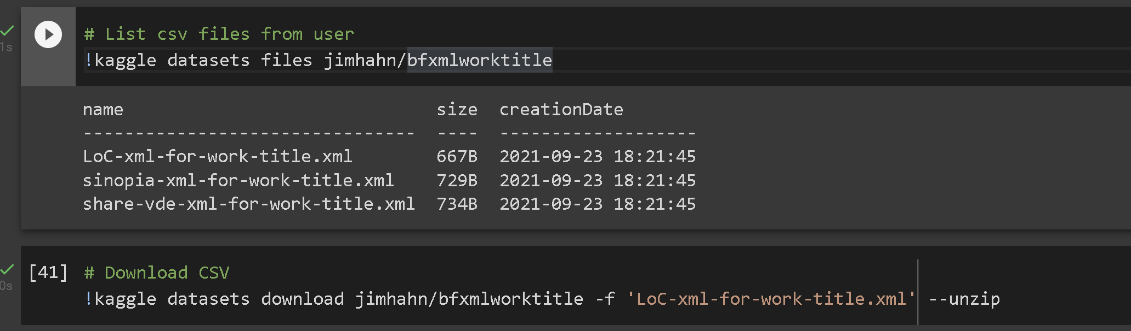
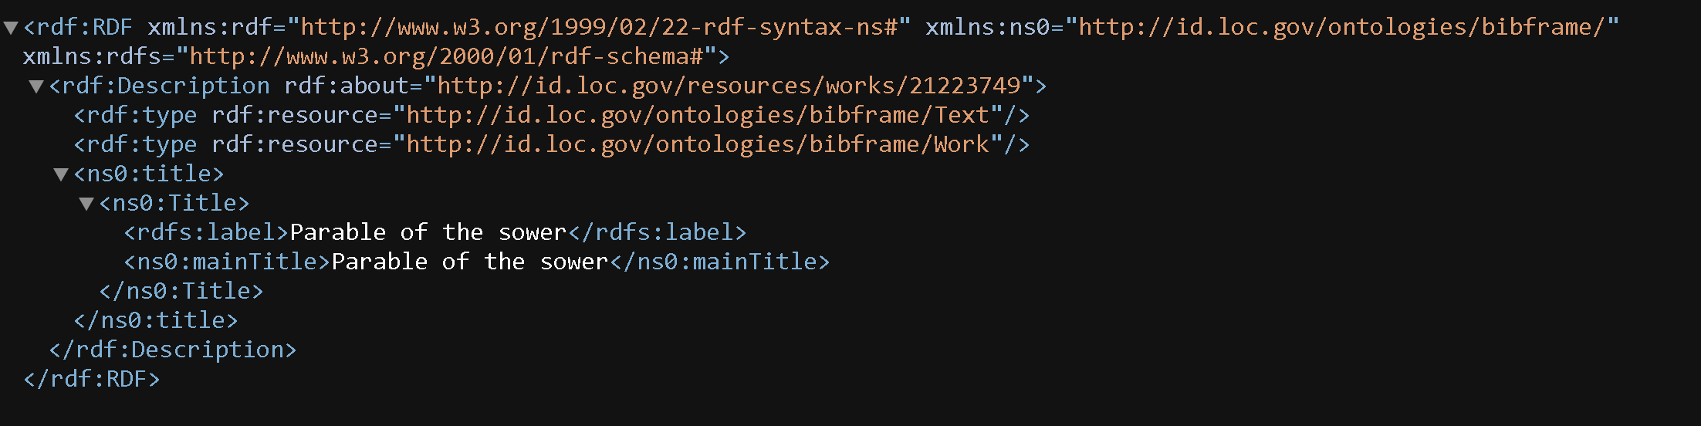
Download CSV

