Slide 1

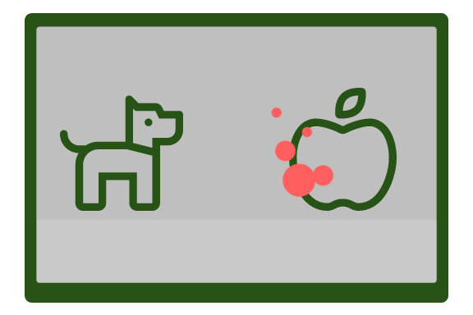
P1-D-80
All Eyes on Word Comprehension.
A Comparative Analysis of Infant Looking While Listening Measures
Andrea Sander-Montant, Laia Fibla, Krista Byers-Heinlein
Concordia University
The Looking-While-Listening procedure is popular to measure word comprehension in infants. Where they see two images on a screen and one gets labelled while their eye gaze is being recorded.
BUT
There are many possible outcome measures that can be derived from LWL
AND
It is unknown if they all index the same construct and which measures are most robust and valid.
SO
It is We bridge this gap by comparing LWL measures across 5 merged datasets.
155
French-English bilinguals
14-48 months
(M = 24.26, SD = 8.11, 63 female)
11
LWL measures averaged by subjects across all trials.

