Slide 1
Progetto ISS Elyndor
Andrea Angelo Segreto
Alessandro Bombace
Pietro Sposimo

Slide 2
Elyndor
The Setting (Lore) In the magical world of Elyndor, war has been replaced by ritual duels. Summoners do not fight to destroy, but to prove the strength of their bond with their creatures, unlocking spiritual energy to fuel their attacks.
Competitive Drafting: Players build teams from a shared pool of monsters. Once a unit is picked, it is denied to the opponent, requiring tactical improvisation.
Tactical Depth: Exploits elemental weaknesses, stats, buffs, and debuffs.
Dynamic Evolution: Unlike traditional games, monsters grow during combat. As the battle lengthens, moves level up and evolve to unlock ultimate abilities: Moves +.
Win Condition: Defeat the opposing team’s lineup.

Slide 3
Technical & Functional Requirements
Non-Functional (Performance & UX)
Aesthetics: 8-bit pixel art style with a minimalist UI to ensure high readability of essential stats (HP, Energy).
Performance Goals: Stable rendering at > 30 FPS with low-latency input response (< 100ms).
Accessibility: Full keyboard navigation and high-contrast color palettes for visual clarity.
Functional (The Core Loop)
Implementation: Built entirely in Pygame (handling input, rendering, and game loop).
Combat System: Sequential turn-based logic. Players alternate between Attack phases (dealing damage/buffing via Power-Ups) and Defense phases (mitigation/taking damage).
Game State: Real-time HP tracking leads to a specific Win Condition (Zero HP = Victory Screen).

Slide 4
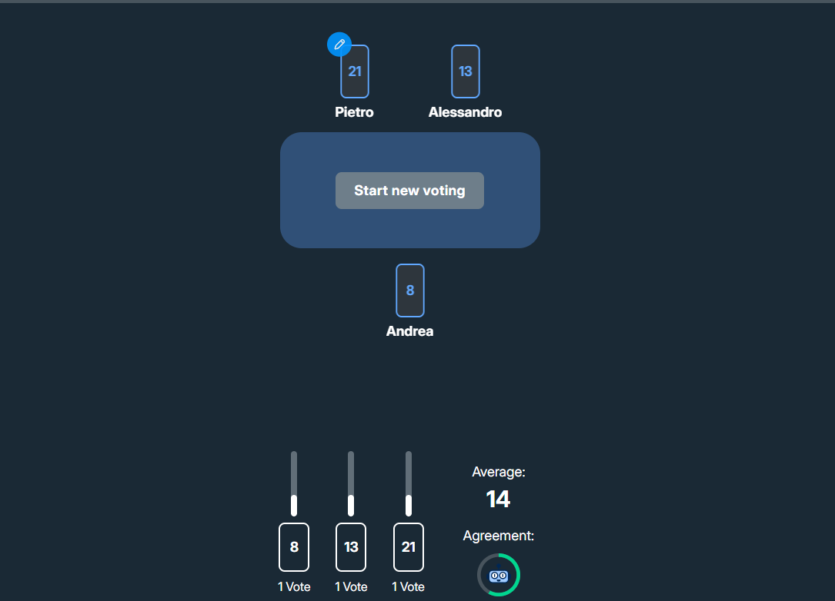
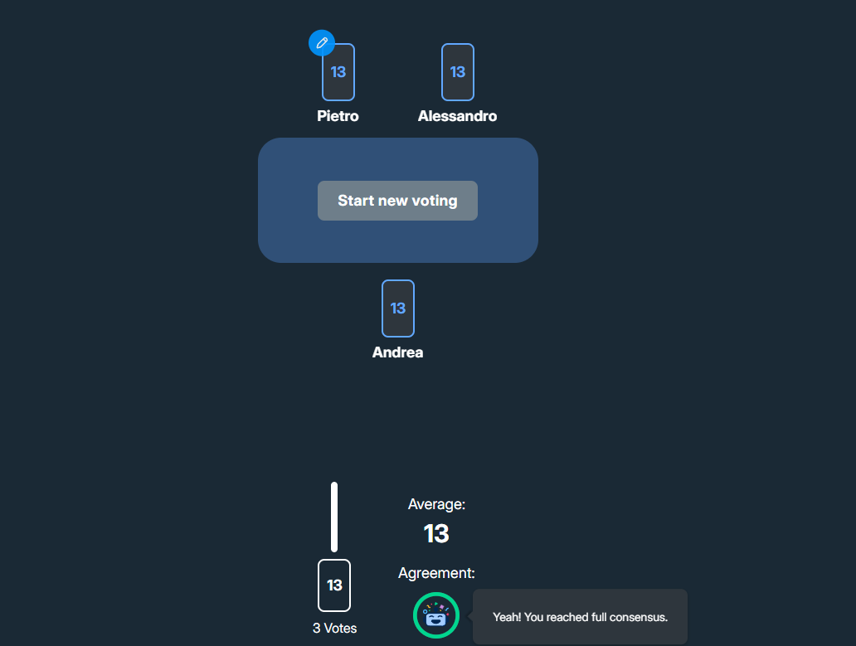


User stories
Project Management & Agile Process
Baseline Definition: Identified minimal User Stories for the MVP.
Tracking: Transitioned from Excel to Jira for advanced ticket management.
Estimation: Applied Planning Poker to assess story complexity.

Slide 5
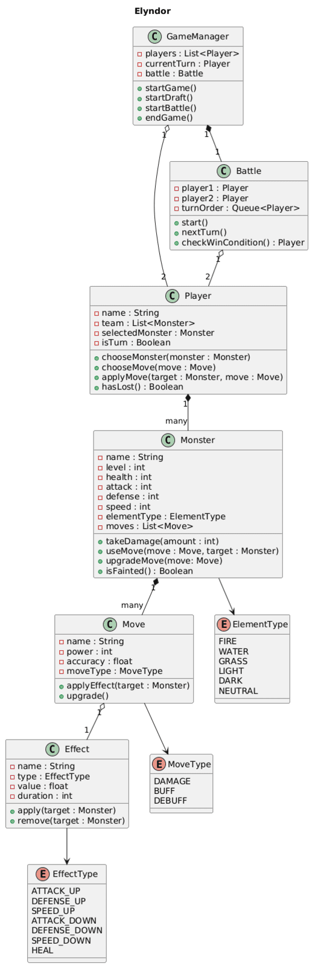
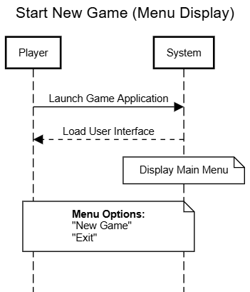
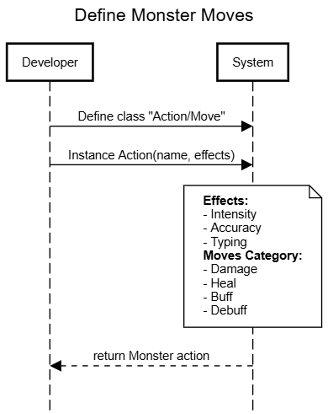
Sequence Diagram
We realiazed some sequence diagram for choosen US.
We used the website sequencediagram.org that through a particulay syntax is able to develop and create diagrams.

Slide 6
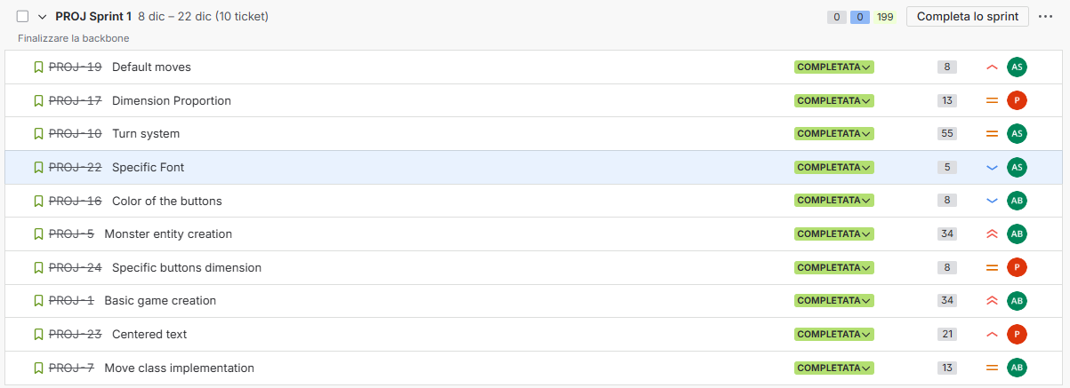
First Sprint
We decided that our first sprint lenght would be 2 weeks long.
We chose 10 US and completed them based on their Acceptance criteria (AC).

Slide 7
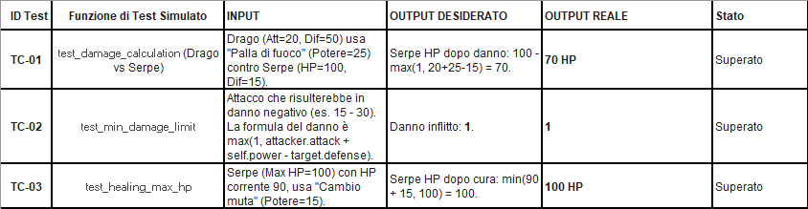
Test Design
We designed some test to assess how our functions should work.
Later in the development we checked if the test was successful

Slide 8
Design Patterns
Structural & State Management
Singleton: The Game class acts as the central point of access for global state.
Facade: Game provides a simplified interface to coordinate Monsters, Turns, and UI.
State: Dynamically handles menu transitions and layout changes based on the game phase.
Flyweight: Optimizes memory by sharing common data across multiple Move instances.
Behavior & Logic
Strategy: Allows swapping monster actions and button behaviors at runtime.
Command: Encapsulates UI logic; buttons trigger specific operations via an execute() method.
Creational Pattern
Factory Method: Decouples the creation logic for Monsters, Moves, and Buttons from the main code.

Slide 9
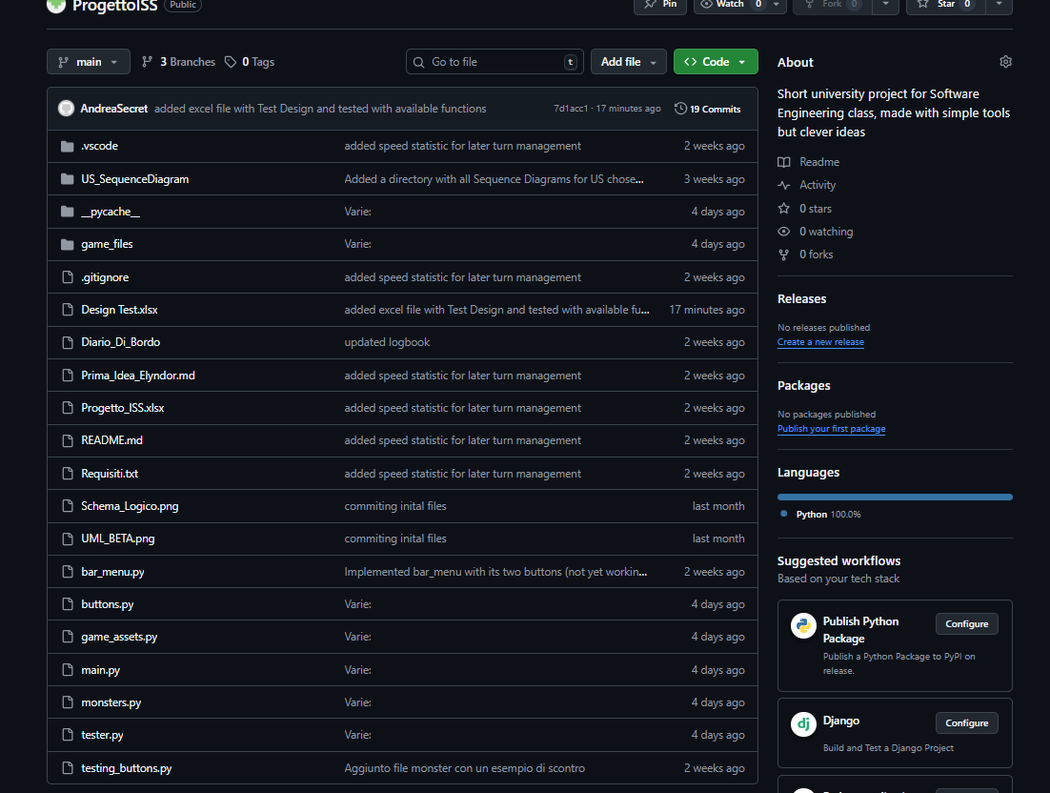
Versioning Control
Workflow Management (Git)
Source Control: Used Git to track all code changes and maintain version history.
Collaboration: Facilitated a distributed workflow, allowing the team to work in parallel and split the workload efficiently.
Repository Hosting (GitHub)
Remote Storage: The project is hosted on GitHub.
Visibility: The repository is public, allowing for open access and code review.

