Slide 1
Midway Project Presentation: Temporal Language Grounding for Visual Question Answering on CGM Data
Andrea Tang

Slide 2
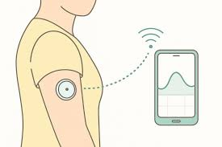
Project Definition
Continuous Glucose Monitoring (CGM) generates large amounts of time-series data
CGM data are commonly interpreted through graphs
Current CGM systems mainly provide:
glucose value
simple alerts
But users often want to ask natural language questions
Example:
Did glucose spike after dinner?
When did glucose decrease overnight?

Slide 3
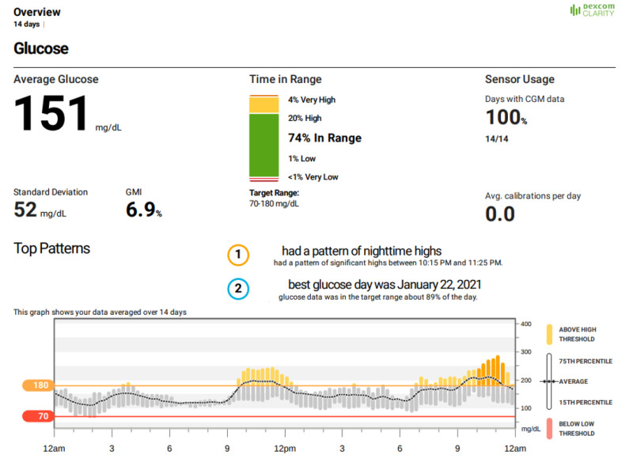
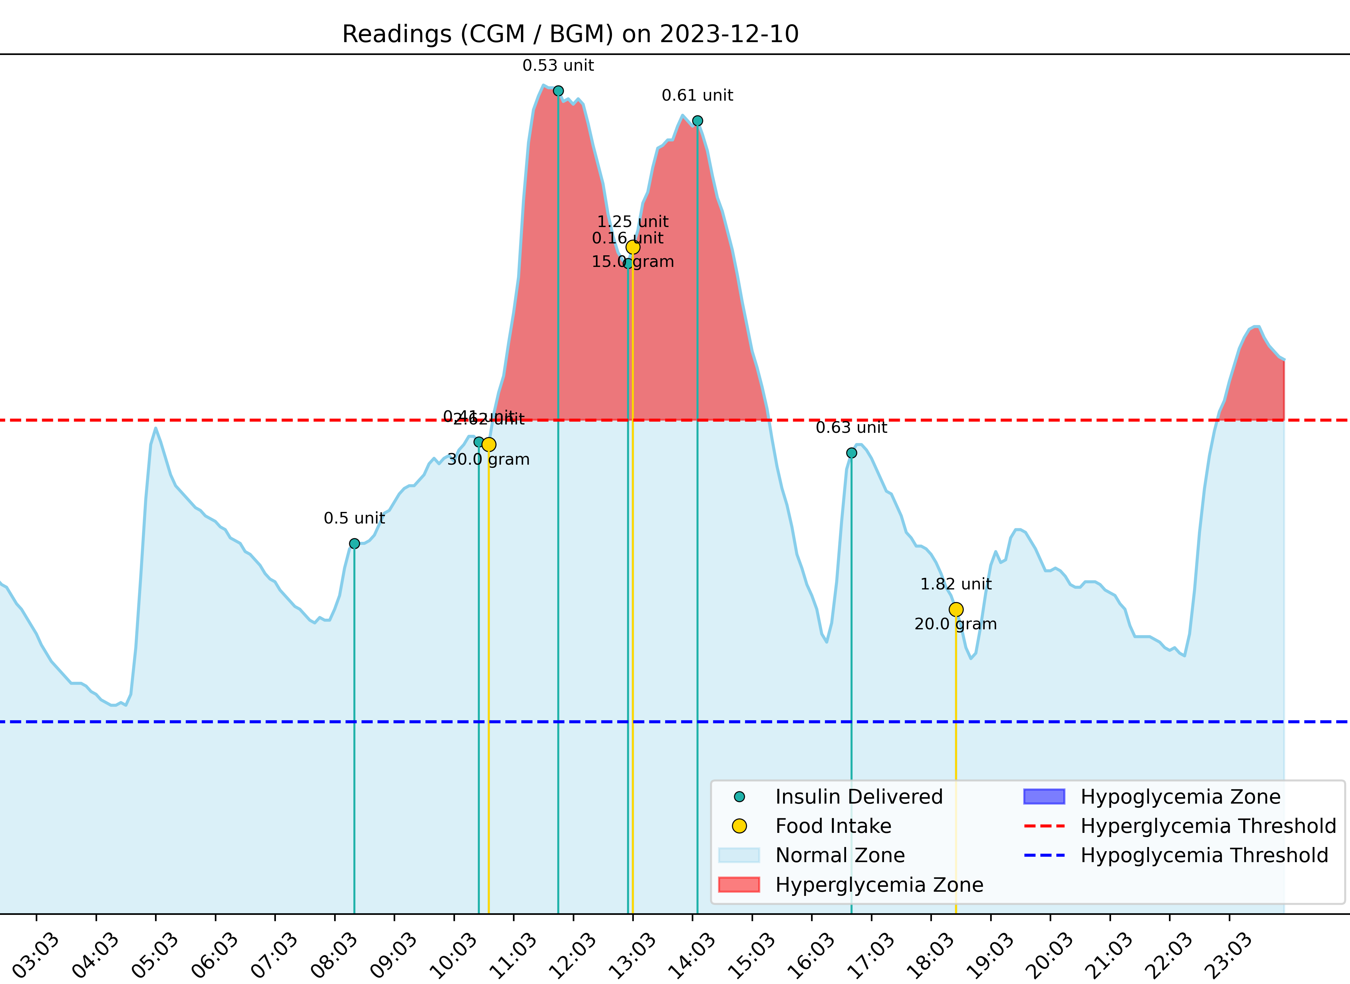
Example of CGM Graph

Slide 4
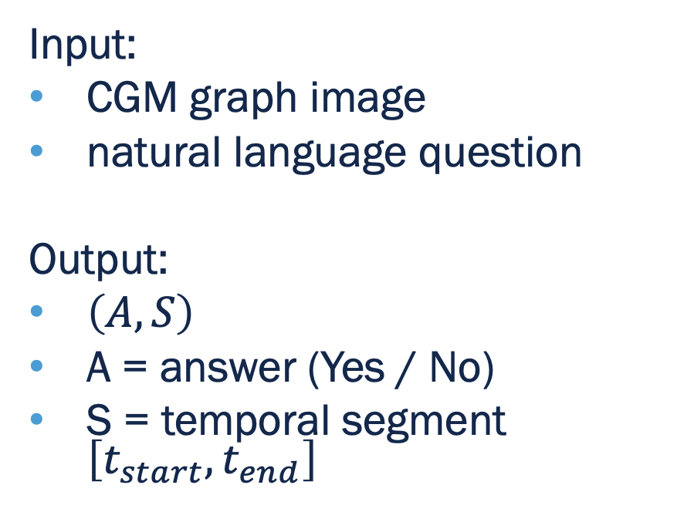
Project Goal
Goal:
Evaluate whether vision-language models can:
Answer questions about CGM graphs
Ground temporal expressions to the correct time segment
Input:
CGM graph image
natural language question
Output:
$\left(A,S\right)$
A = answer (Yes / No)
S = temporal segment $\left[t_{start},t_{end}\right]$

Slide 5
Proposed Approach
CGM Data → CGM Graph Image → VLM → Answer + Temporal Segment
Steps:
Build CGM graph dataset
Design question set (Yes/No + Temporal questions)
Annotate ground truth
Evaluate VLM predictions
Metrics:
Answer accuracy
Temporal grounding score (IoU)

Slide 6
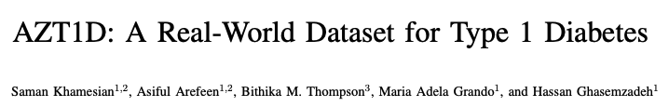
Dataset & Benchmark Design
Dataset: AZT1D
25 T1D patients
26 days (24hrs) per subject
Metadata: insulin, food intake
Generate 25 CGM graphs randomly
Benchmark Annotation:
1 sample = 1 graph + 1 question → 100 samples total
Each graph is paired with natural language questions:
2 yes/no questions
2 temporal grounding questions

Slide 7
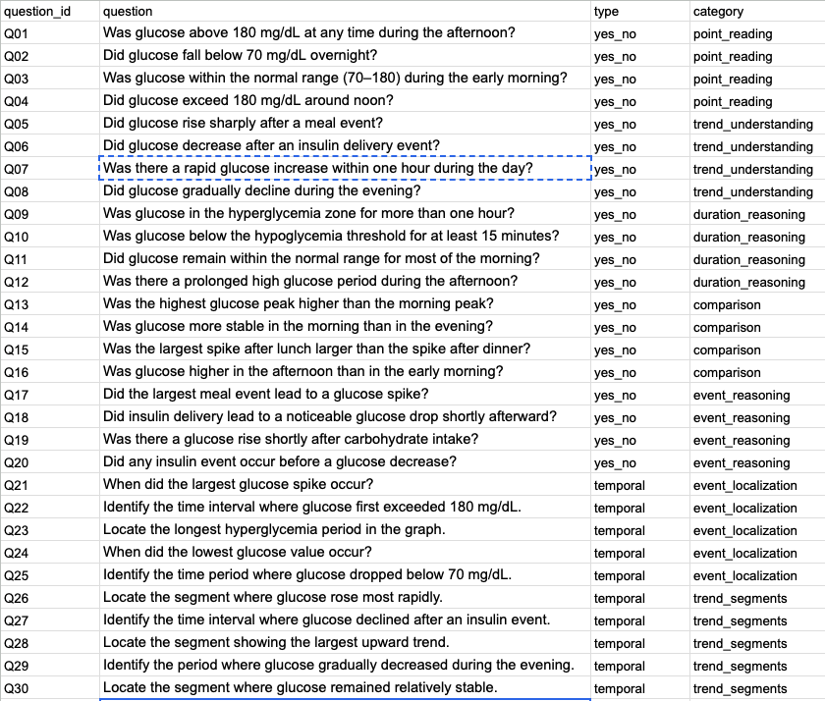
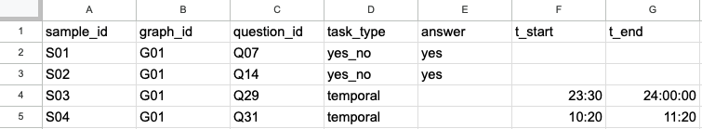
Examples

Slide 8
Models
Vision-Language Models:
Qwen2-VL
LLaVA
DeepSeek-VL
Chart-based models:
PlotQA models
ChartQA models

Slide 9
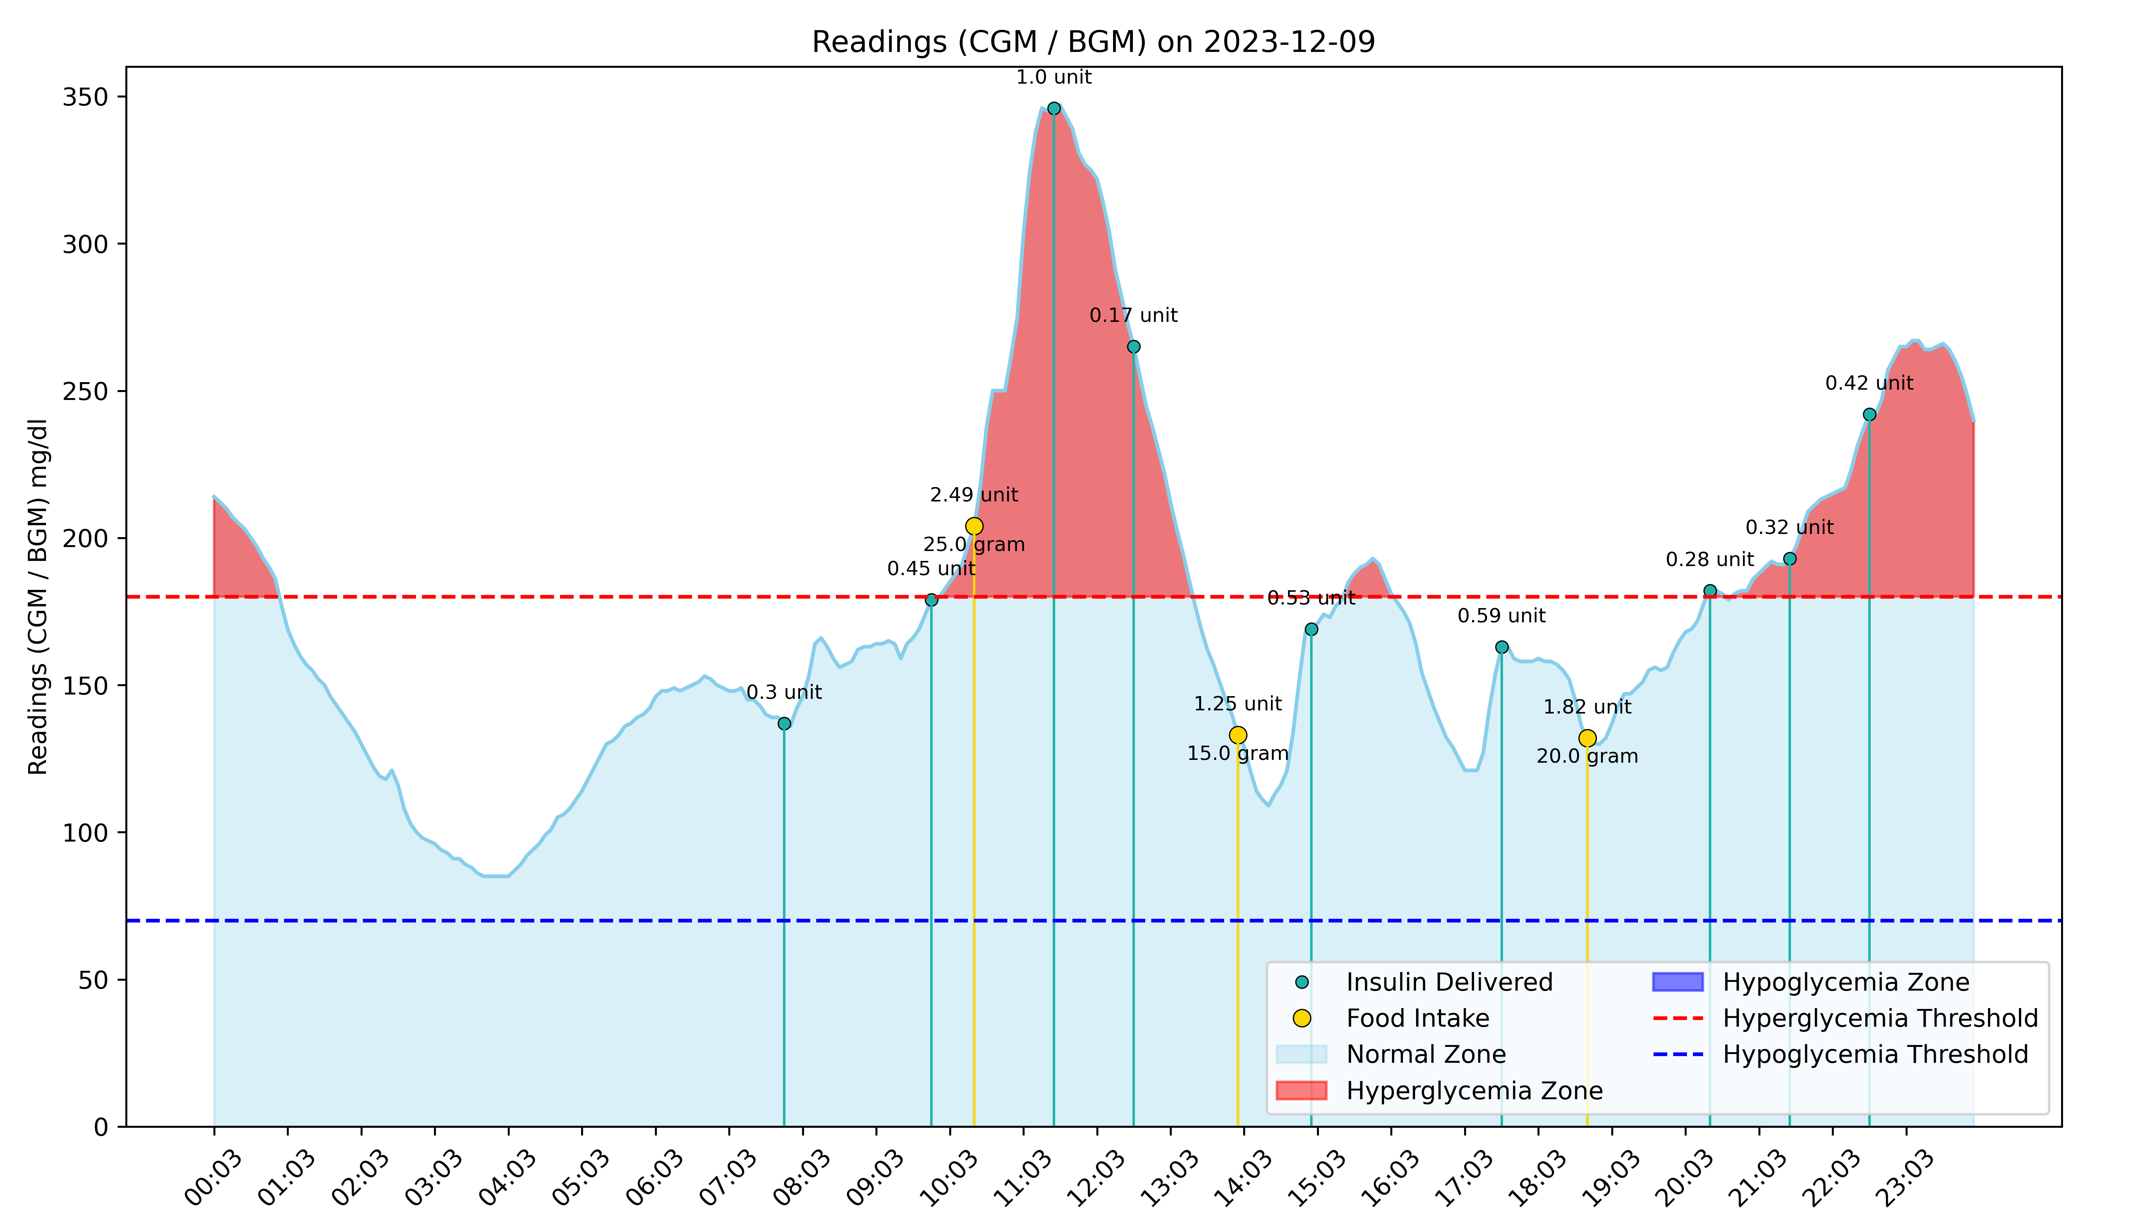
Example
[
{
"sample_id": "S01",
"graph_id": "G01",
"question_id": "Q07",
"task_type": "yes_no",
"answer": "yes",
"t_start": null,
"t_end": null
},
{
"sample_id": "S02",
"graph_id": "G01",
"question_id": "Q14",
"task_type": "yes_no",
"answer": "yes",
"t_start": null,
"t_end": null
},
{
"sample_id": "S03",
"graph_id": "G01",
"question_id": "Q29",
"task_type": "temporal",
"answer": null,
"t_start": "23:30",
"t_end": "24:00"
},
{
"sample_id": "S04",
"graph_id": "G01",
"question_id": "Q31",
"task_type": "temporal",
"answer": null,
"t_start": "10:20",
"t_end": "11:20"
}
]
Q07: Was there a rapid glucose increase within one hour during the day?
Q14: Was glucose more stable in the morning than in the evening?
Q29: Identify the period where glucose gradually decreased during the evening.
Q31: Identify the time interval where glucose rose after a meal event.

Slide 10
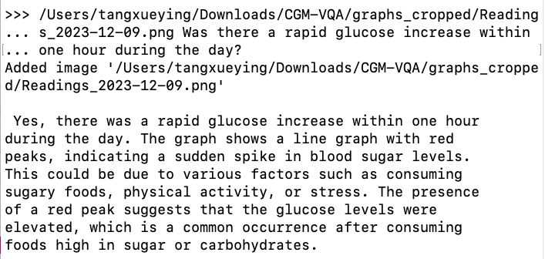
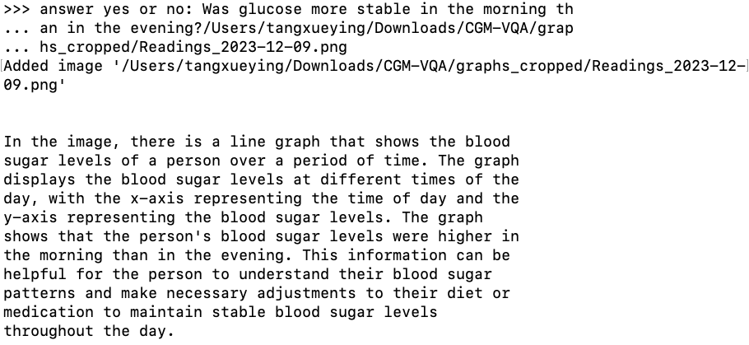
Model: moondream
flaky!

Slide 11
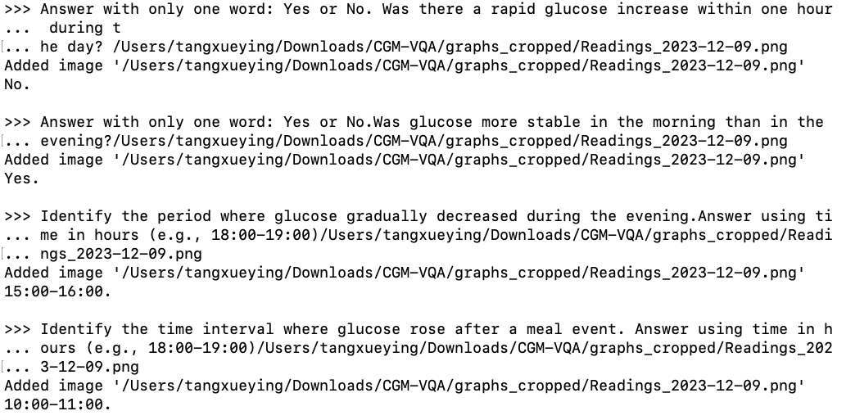
Model: minicpm-v

Slide 12
Progress So Far…
Completed:
Collected CGM graph dataset
Preprocessed graphs (cropping unnecessary regions)
Designed question categories
Built benchmark annotation structure
Created initial question set (40 questions)
Assigned questions to graphs
Started manual annotation
Tested several VLM models locally
Next steps:
Complete manual annotations
Run experiments across multiple VLMs
Evaluate temporal grounding performance
Analyze failure cases
Write final report and analysis

Slide 13
Adjustments/ Challenges
Challenges:
Annotating temporal segments precisely
Limited number of CGM graphs
Some lightweight VLMs lack chart understanding
Adjustments:
Normalize temporal annotations to [0,1]
Simplify question categories
Focus on lightweight models for initial experiments

