Slide 1
Path Planning using Constrained Differential Dynamic Programming
Gael Colas, Ianis Bougdal-Lambert
6/8/18

Slide 2
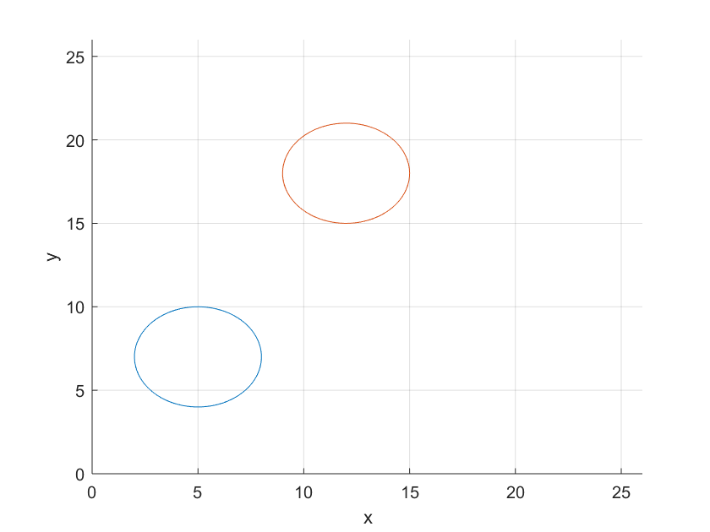
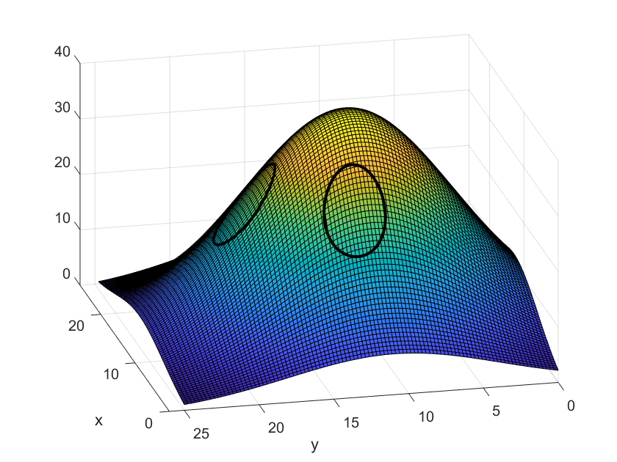
Problem Statement
Simple model:
Given a 2D map with non-linear obstacles, find the shortest path from A to B that avoids obstacles.
Obstacles can be nonlinear (e.g. circles).
More complex model:
The map is now a 3D level surface.
The cost of traversing a point is proportional to its elevation.
Find the shortest path that also minimizes the total effort along the path.

Slide 3
State-of-the-art
For simple path finding: A* very efficient.
A* can be adapted to take into account the space-varying cost by adding a cost to each node.
For optimal control problems, many options: Direct Methods, Indirect Methods, Differential Dynamic Programming…
Indirect Methods are very accurate but difficult to set up and do not handle well inequality constraints.
Differential Dynamic Programming is widely used.
Can handle nonlinear cost function.

Slide 4
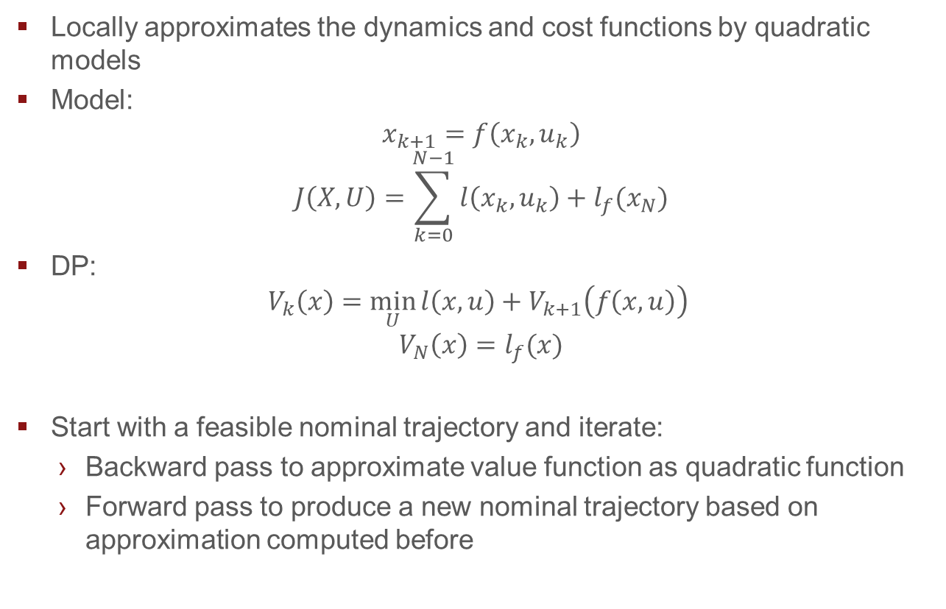
Differential Dynamic Programming
Locally approximates the dynamics and cost functions by quadratic models
Model:
$$x_{k+1}=f\left(x_{k},u_{k}\right)$$
$$J\left(X,U\right)=\sum_{k=0}^{N−1}{l\left(x_{k},u_{k}\right)+l_{f}(x_{N})}$$
DP:
$$V_{k}\left(x\right)=\min_{U}{l\left(x,u\right)+V_{k+1}\left(f\left(x,u\right)\right)}$$
$$V_{N}\left(x\right)=l_{f}(x)$$
Start with a feasible nominal trajectory and iterate:
Backward pass to approximate value function as quadratic function
Forward pass to produce a new nominal trajectory based on approximation computed before
Notes:
DDP is Differential Programming but instead of having the exact value function V(x), we approximate V by a quadratic function along the path, going backwards.
Then we move forward and solve QP problems at each time step to find the optimal control input.

Slide 5
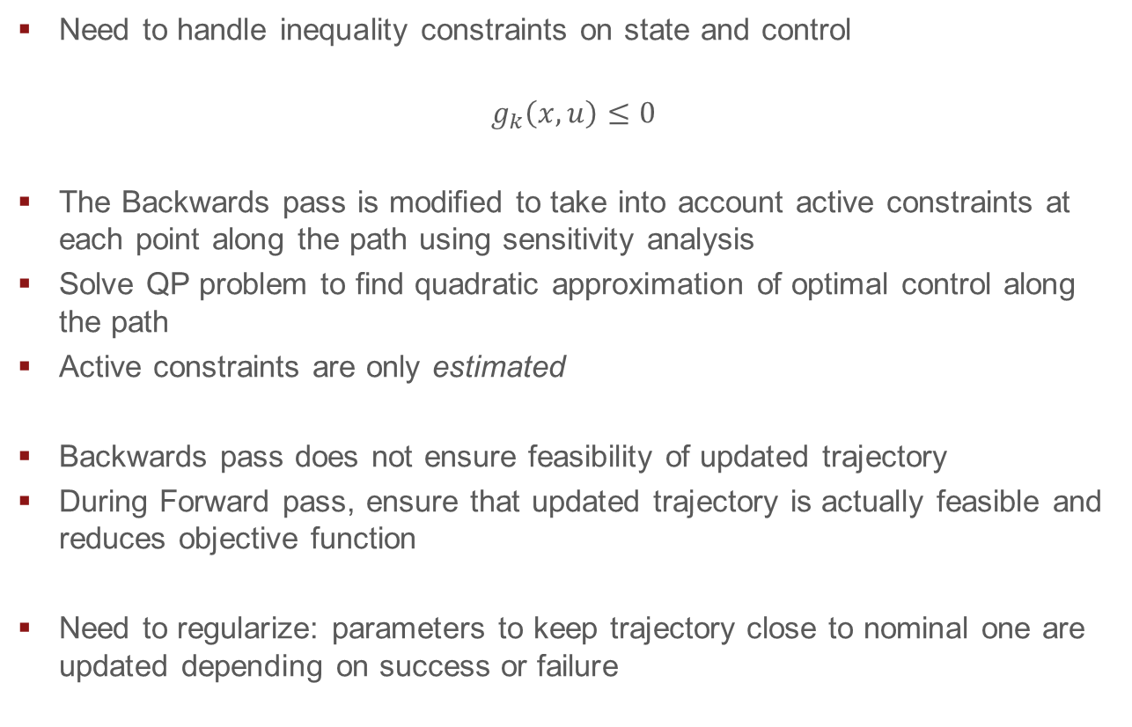
Constrained DDP
Need to handle inequality constraints on state and control
$$g_{k}\left(x,u\right)≤0$$
The Backwards pass is modified to take into account active constraints at each point along the path using sensitivity analysis
Solve QP problem to find quadratic approximation of optimal control along the path
Active constraints are only estimated
Backwards pass does not ensure feasibility of updated trajectory
During Forward pass, ensure that updated trajectory is actually feasible and reduces objective function
Need to regularize: parameters to keep trajectory close to nominal one are updated depending on success or failure
Notes:
When a better path is successfully computed, the trust region is widened and at the following iteration, we allow exploration further from the nominal traj.
When the cost is worse, the trust region is shrinked and we force the next iteration to be closer to the nominal trajectory.

Slide 6
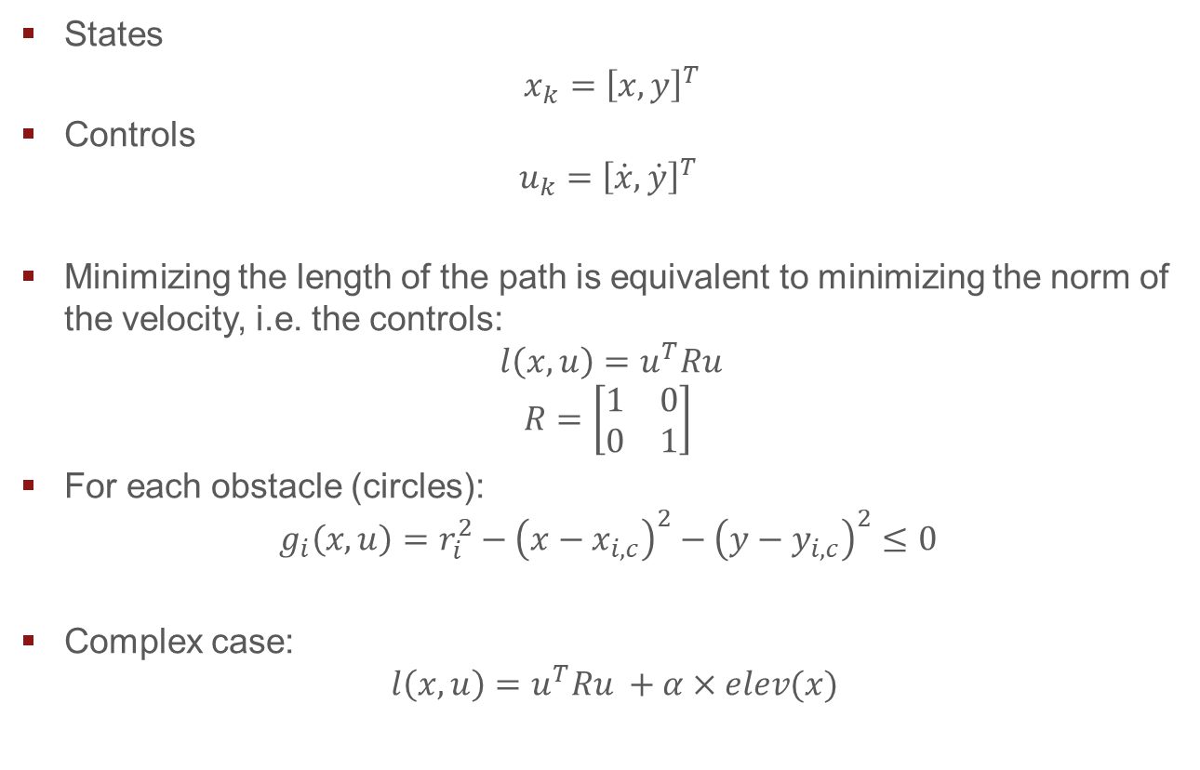
Modelization
States
$x_{k}={\left[x, y\right]}^{T}$
Controls
$$u_{k}={\left[\dot{x},\dot{y}\right]}^{T}$$
Minimizing the length of the path is equivalent to minimizing the norm of the velocity, i.e. the controls:
$${l\left(x,u\right)=u^{T}Ru }$$
$$R=\left[\begin{matrix}1 & 0 \\ 0 & 1\end{matrix}\right]$$
For each obstacle (circles):
$$g_{i}\left(x,u\right)=r_{i}^{2}−{\left(x−x_{i,c}\right)}^{2}−{\left(y−y_{i,c}\right)}^{2}≤0$$
Complex case:
$${l\left(x,u\right)=u^{T}Ru }+α×elev(x)$$
Notes:
We want to minimize length of the path (arclength) = integral of norm of velocity.
Model: state is position vector, control is velocity. Minimize sum (ie. integral) of norm of control.
When terrain is taken into account, add the elevation to the running cost

Slide 7
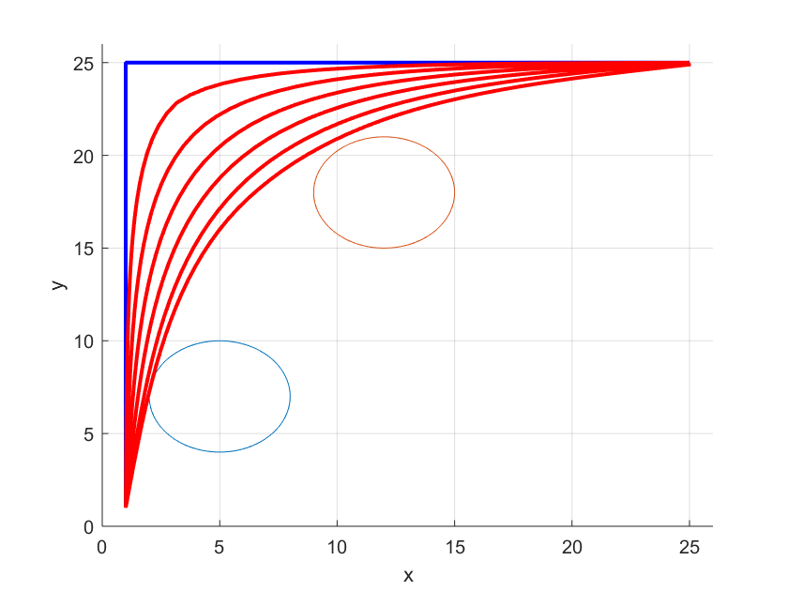
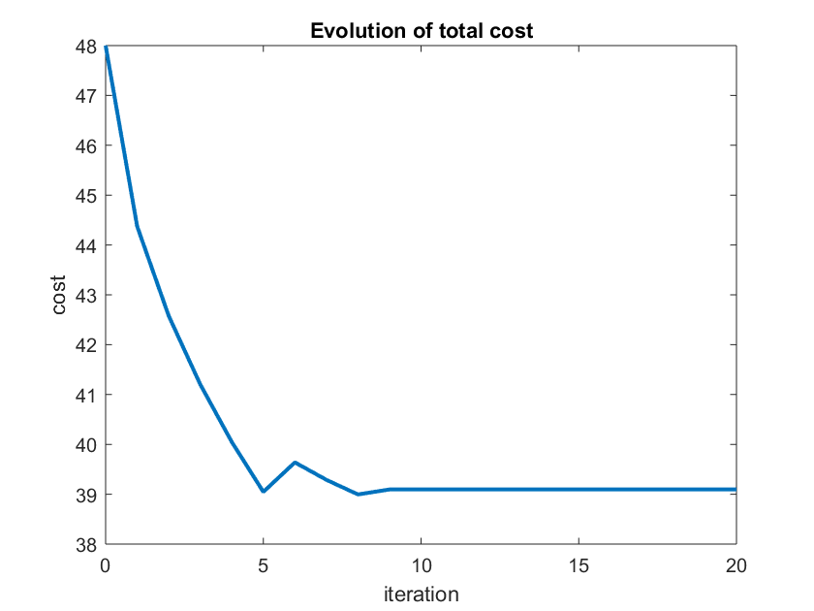
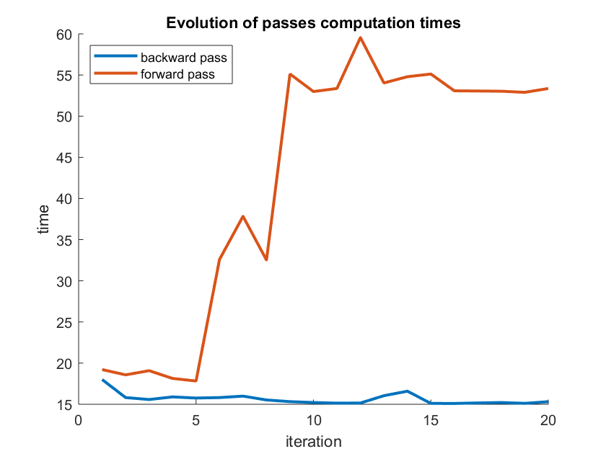
Results – Simple Model
Slow Convergence (QP solving)
1 min per iteration
10 min to convergence
Depends on initialization
Cannot “jump” an obstacle
Very sensitive to parameters
Trust region updating
Notes:
Very slow, many iterations unsuccessfull
Depending on parameters, can converge to suboptimal trajectory
Cannot go beyond the obstacles
Infinity of combination of parameters

Slide 8
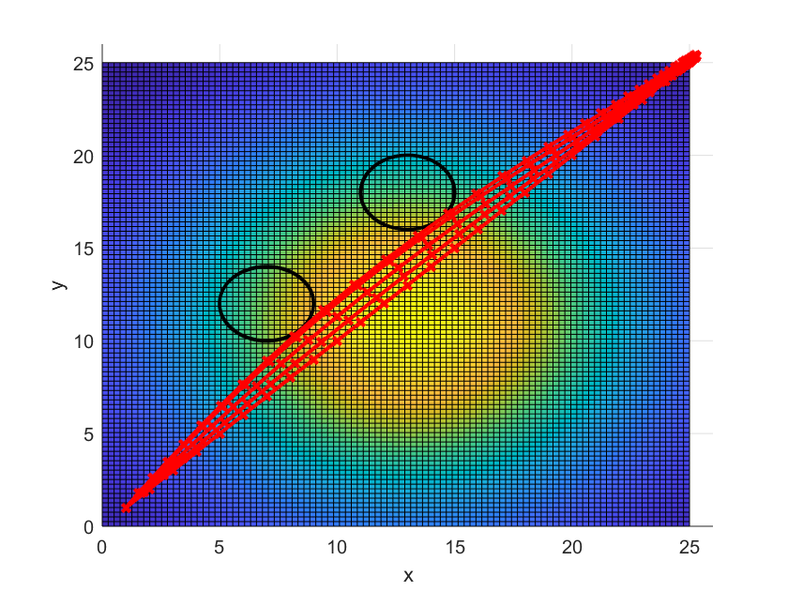
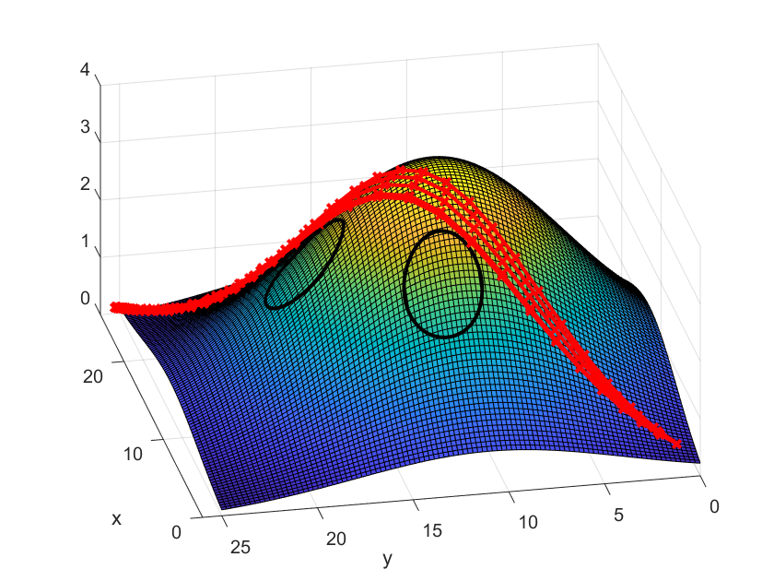
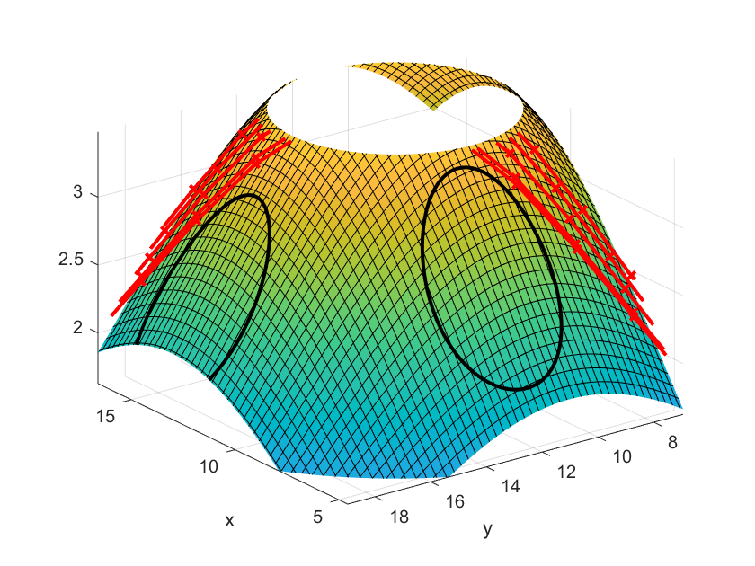
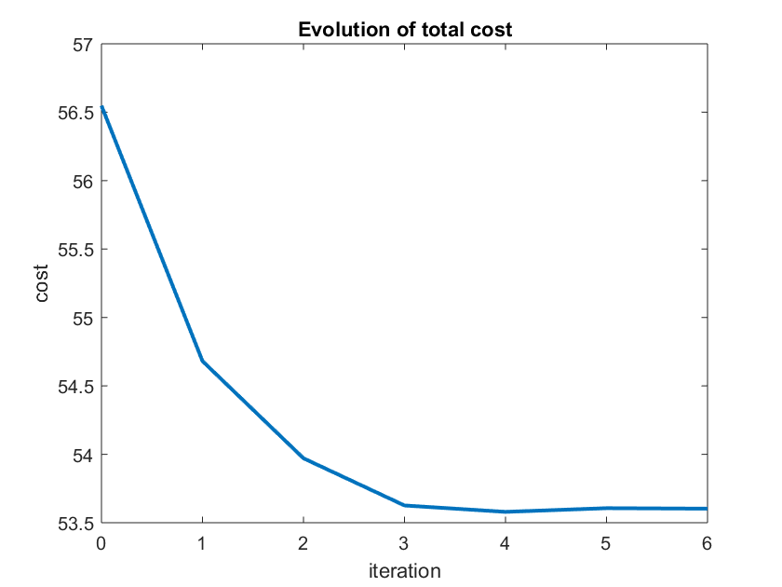
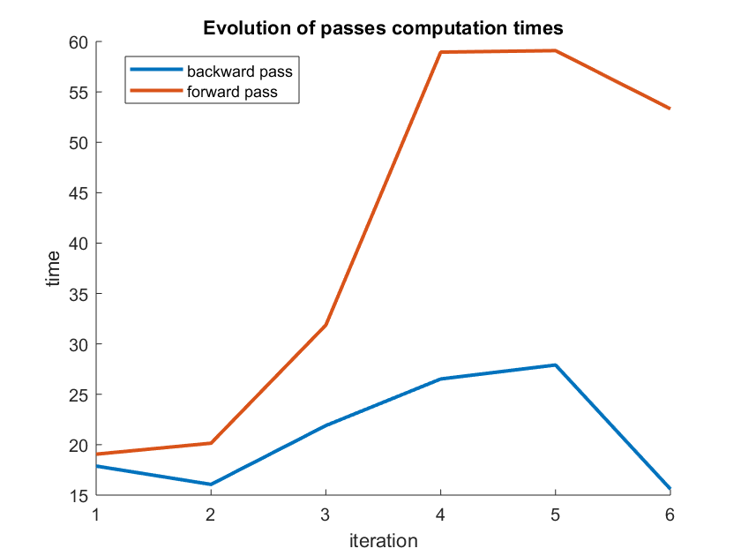
Results – Complex Model
Notes:
Basically the same analysis

Slide 9
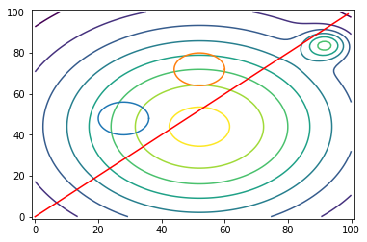
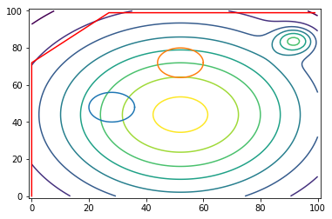
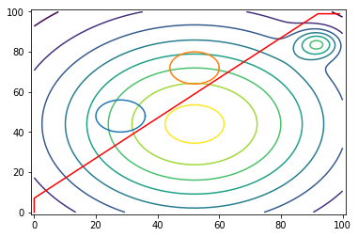
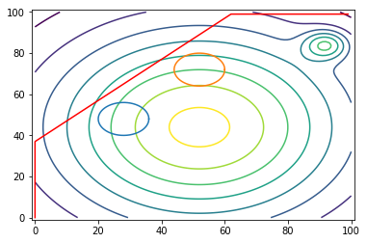
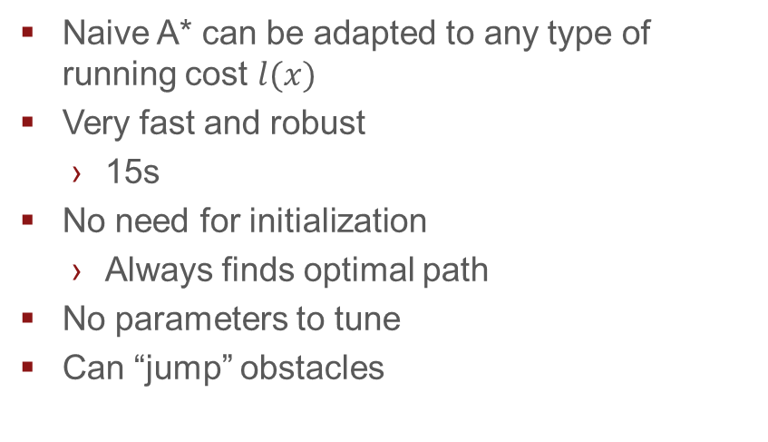
Comparison with A*
Length only
elevation only
Length + 1.12*elevation
Naive A* can be adapted to any type of running cost $l(x)$
Very fast and robust
15s
No need for initialization
Always finds optimal path
No parameters to tune
Can “jump” obstacles
Length + 1.13*elevation
Notes:
Implemented in Python
Much simpler, faster and more robust
Works well as long as the cost is a function of space (it is the case here)
We modify the naïve algorithm: cost of going from one node to a neighbor is the distance between the 2 + elevation at the neighbor’s location
Very simple: no initial path, no parameters
Can jump behind obstacles

Slide 10
Conclusion
C-DDP is an interesting improvement to DDP
Tailored for motion planning
Needs a lot of tuning and an initial, feasible, suboptimal path
Could use a fast method to initialize the path (RRT)
A* much more efficient
Probably more interesting when the cost is also a function of the control inputs and in higher dimensions

