Slide 1
Politecnico di Milano - A.Y. 2015/2016
ICT FOR CONTROL SYSTEMS ENGINEERING
Authors:
Valenti Matteo - 823695
Verzaglia Andrea - 823568
MODEL IDENTIFICATION:
Identification of Transfer Function Models plus Time-delay of a quadrotor helicopter pitch dynamics

Slide 2
MODEL IDENTIFICATION: Identification of Transfer Function Models plus Time-delay of a quadrotor helicopter pitch dynamics
PROJECT GOAL

Slide 3


MODEL IDENTIFICATION: Identification of Transfer Function Models plus Time-delay of a quadrotor helicopter pitch dynamics
PROJECT GOAL
Black-box continuous-time model identification in a bootstrap manner to estimate simultaneously the time-delay and transfer function parameters of a quadrotor helicopter roll dynamic
GOAL
DATA
Set of data collected during an experiment on the plant
Identified model with tdsrivc algorithm
TOOLS
Matlab
Github:

Slide 4
MODEL IDENTIFICATION: Identification of Transfer Function Models plus Time-delay of a quadrotor helicopter pitch dynamics
PROJECT GOAL
REMARK: unlike the situation in DT identification, where the time-delay is assumed to be an integral number of sampling intervals and is often absorbed into the definition of the numerator polynomial, the time-delay parameter for CT system model is normally associated directly with the input signal and can have a non integral value. As a result, the estimation of the time-delay parameter in CT identification deserves special attention.

Slide 5
MODEL IDENTIFICATION: Identification of Transfer Function Models plus Time-delay of a quadrotor helicopter pitch dynamics
IDENTIFICATION
CYCLE

Slide 6
MODEL IDENTIFICATION: Identification of Transfer Function Models plus Time-delay of a quadrotor helicopter pitch dynamics
IDENTIFICATION CYCLE
EXPERIMENT
DATA PROCESSING AND ANALYSIS
MODEL
IDENTIFICATION
VALIDATION
CROSS VALIDATION
IS THE MODEL OK?

Slide 7
MODEL IDENTIFICATION: Identification of Transfer Function Models plus Time-delay of a quadrotor helicopter pitch dynamics
EXPERIMENT

Slide 8
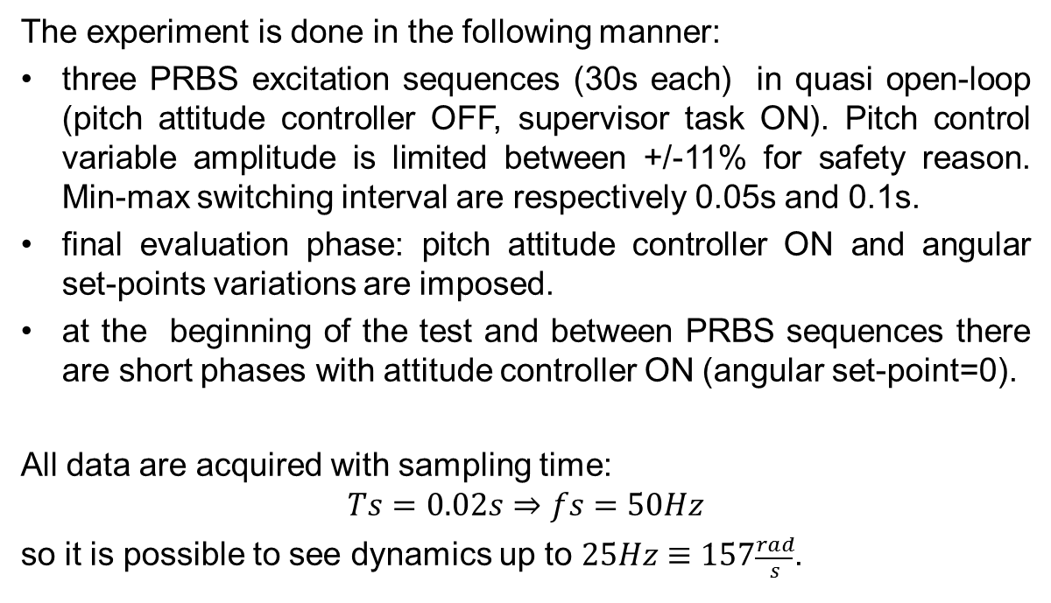
MODEL IDENTIFICATION: Identification of Transfer Function Models plus Time-delay of a quadrotor helicopter pitch dynamics
EXPERIMENT
The experiment is done in the following manner:
three PRBS excitation sequences (30s each) in quasi open-loop (pitch attitude controller OFF, supervisor task ON). Pitch control variable amplitude is limited between +/-11% for safety reason. Min-max switching interval are respectively 0.05s and 0.1s.
final evaluation phase: pitch attitude controller ON and angular set-points variations are imposed.
at the beginning of the test and between PRBS sequences there are short phases with attitude controller ON (angular set-point=0).
All data are acquired with sampling time:
$$Ts=0.02s⇒fs=50Hz$$
so it is possible to see dynamics up to $25Hz≡157\frac{rad}{s}$.

Slide 9
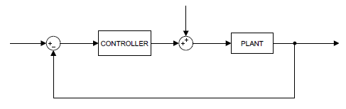
MODEL IDENTIFICATION: Identification of Transfer Function Models plus Time-delay of a quadrotor helicopter pitch dynamics
EXPERIMENT
BLOCK DIAGRAM
r(t)
sp(t)
u(t)
q(t)

Slide 10
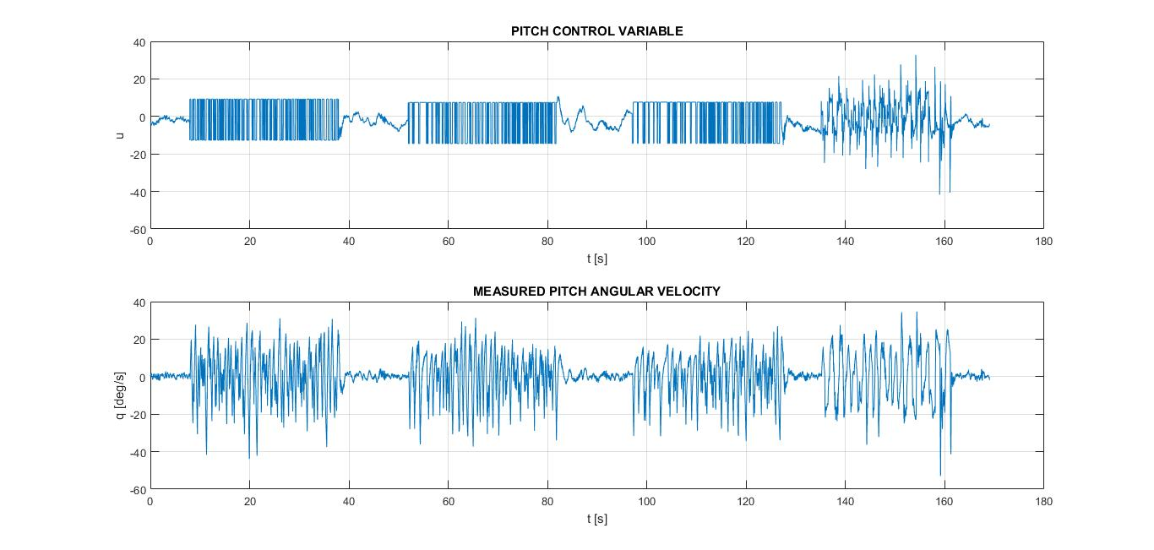
MODEL IDENTIFICATION: Identification of Transfer Function Models plus Time-delay of a quadrotor helicopter pitch dynamics
EXPERIMENT
COLLECTED DATA
N.B. u is expressed as the % difference between front and back rotor command

Slide 11
MODEL IDENTIFICATION: Identification of Transfer Function Models plus Time-delay of a quadrotor helicopter pitch dynamics
DATA PROCESSING
AND ANALYSIS

Slide 12
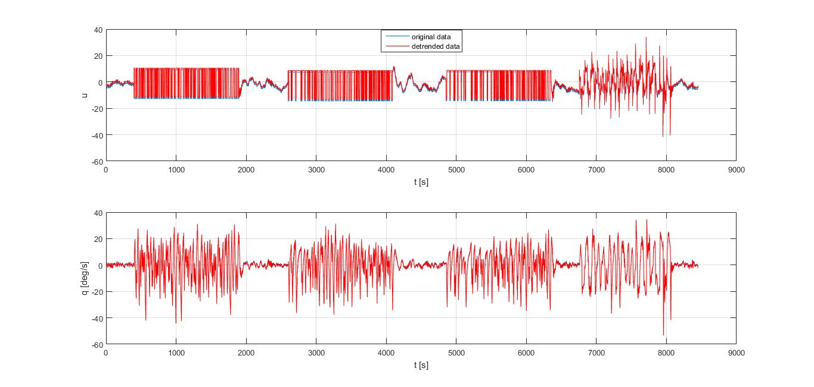
MODEL IDENTIFICATION: Identification of Transfer Function Models plus Time-delay of a quadrotor helicopter pitch dynamics
DATA PROCESSING AND ANALYSIS
In black-box modeling some pre-processing operations are needed to obtain satisfying results.
For example:
TREND REMOVING
Trough the Matlab function detrend the mean value (zero order trend) is removed in order to focus on the system dynamics.

Slide 13
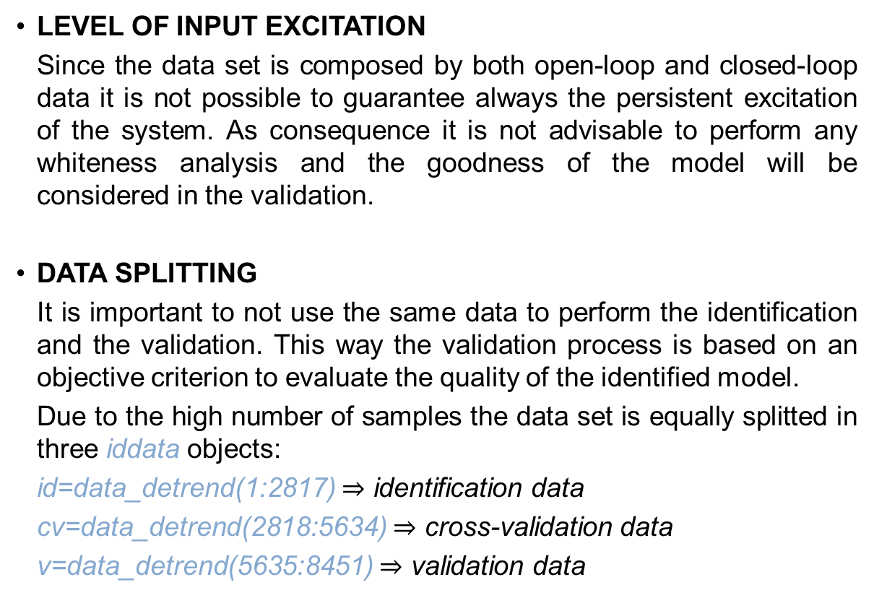
MODEL IDENTIFICATION: Identification of Transfer Function Models plus Time-delay of a quadrotor helicopter pitch dynamics
DATA PROCESSING AND ANALYSIS
LEVEL OF INPUT EXCITATION
Since the data set is composed by both open-loop and closed-loop data it is not possible to guarantee always the persistent excitation of the system. As consequence it is not advisable to perform any whiteness analysis and the goodness of the model will be considered in the validation.
DATA SPLITTING
It is important to not use the same data to perform the identification and the validation. This way the validation process is based on an objective criterion to evaluate the quality of the identified model.
Due to the high number of samples the data set is equally splitted in three iddata objects:
id=data_detrend(1:2817) $⇒$ identification data
cv=data_detrend(2818:5634) $⇒$ cross-validation data
v=data_detrend(5635:8451) $⇒$ validation data

Slide 14
MODEL IDENTIFICATION: Identification of Transfer Function Models plus Time-delay of a quadrotor helicopter pitch dynamics
MODEL
IDENTIFICATION

Slide 15
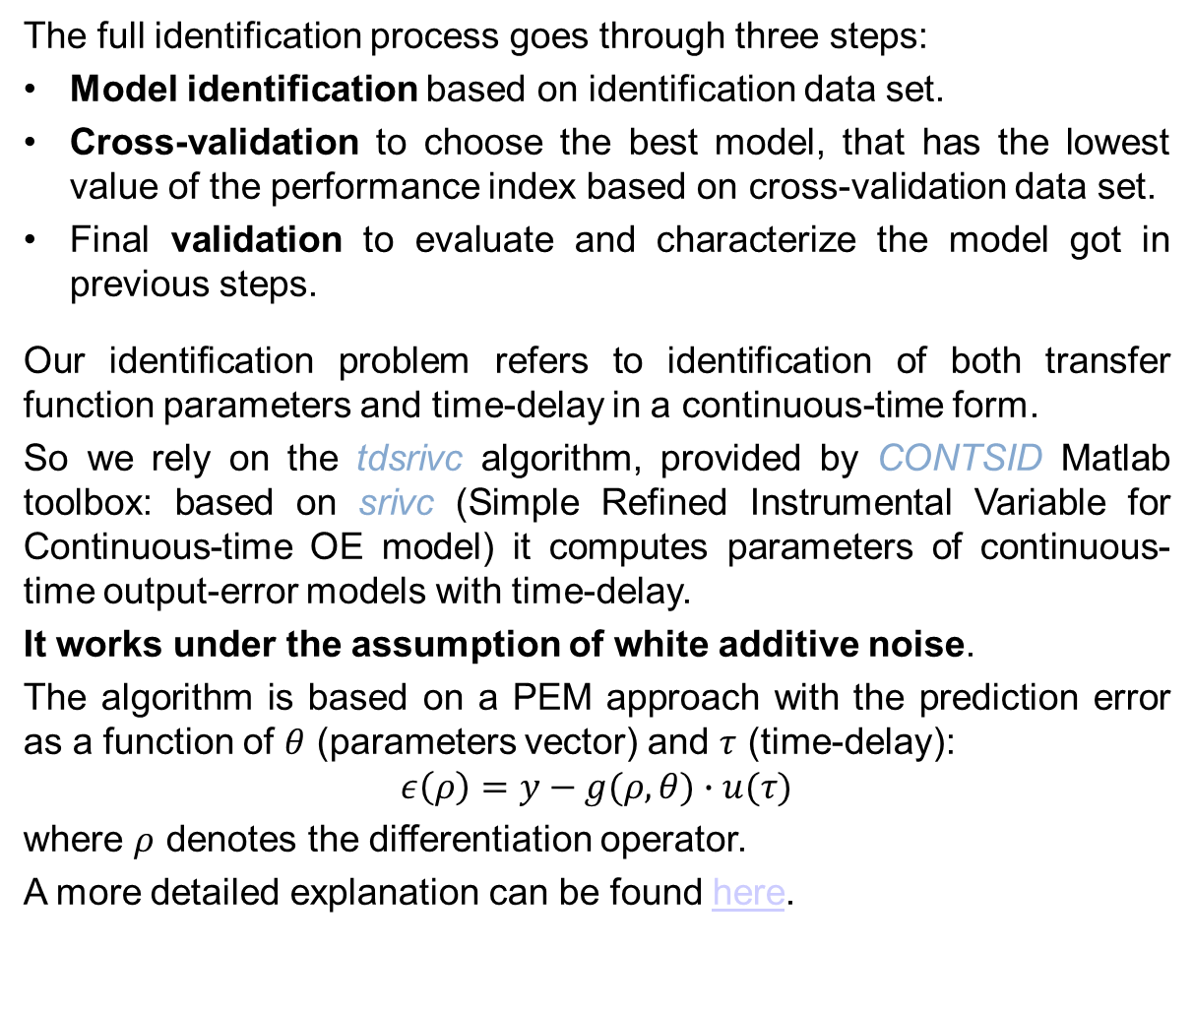
MODEL IDENTIFICATION: Identification of Transfer Function Models plus Time-delay of a quadrotor helicopter pitch dynamics
MODEL IDENTIFICATION
The full identification process goes through three steps:
Model identification based on identification data set.
Cross-validation to choose the best model, that has the lowest value of the performance index based on cross-validation data set.
Final validation to evaluate and characterize the model got in previous steps.
Our identification problem refers to identification of both transfer function parameters and time-delay in a continuous-time form.
So we rely on the tdsrivc algorithm, provided by CONTSID Matlab toolbox: based on srivc (Simple Refined Instrumental Variable for Continuous-time OE model) it computes parameters of continuous-time output-error models with time-delay.
It works under the assumption of white additive noise.
The algorithm is based on a PEM approach with the prediction error as a function of $θ$ (parameters vector) and $τ$ (time-delay):
$$ε\left(ρ\right)=y−g(ρ,θ)∙u(τ)$$
where $ρ$ denotes the differentiation operator.
A more detailed explanation can be found here.

Slide 16
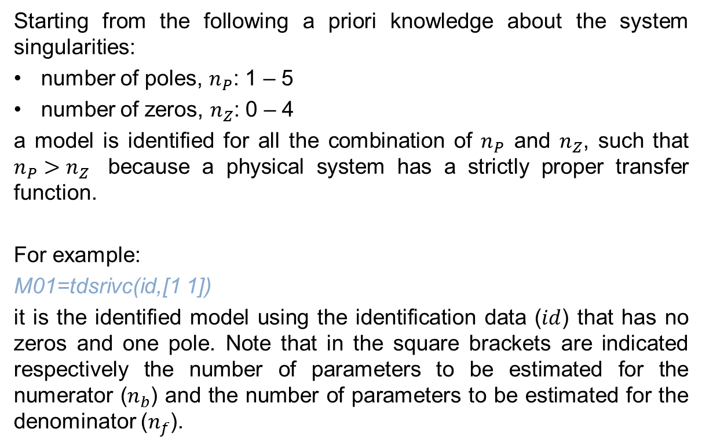
MODEL IDENTIFICATION: Identification of Transfer Function Models plus Time-delay of a quadrotor helicopter pitch dynamics
MODEL IDENTIFICATION
Starting from the following a priori knowledge about the system singularities:
number of poles, $n_{P}$: 1 – 5
number of zeros, $n_{Z}$: 0 – 4
a model is identified for all the combination of $n_{P}$ and $n_{Z}$, such that $n_{P}>n_{Z}$ because a physical system has a strictly proper transfer function.
For example:
M01=tdsrivc(id,[1 1])
it is the identified model using the identification data ($id$) that has no zeros and one pole. Note that in the square brackets are indicated respectively the number of parameters to be estimated for the numerator ($n_{b}$) and the number of parameters to be estimated for the denominator ($n_{f}$).

Slide 17
MODEL IDENTIFICATION: Identification of Transfer Function Models plus Time-delay of a quadrotor helicopter pitch dynamics
CROSS
VALIDATION

Slide 18
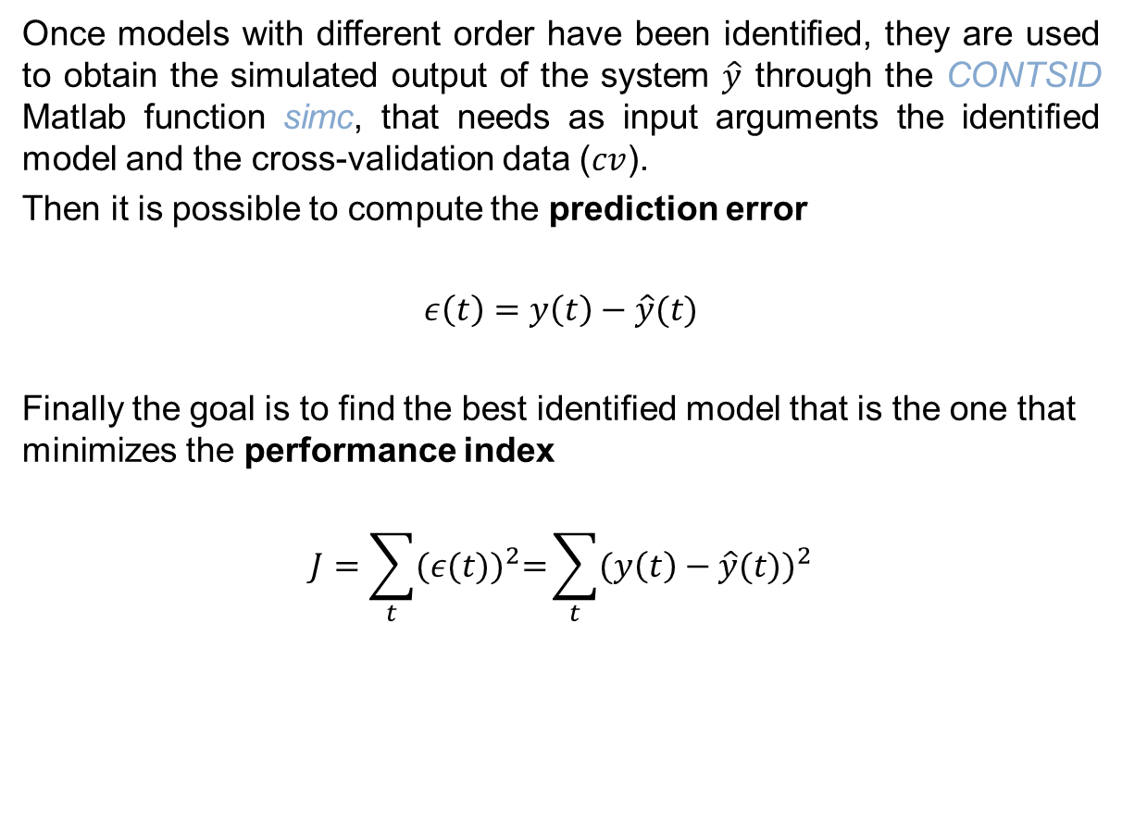
MODEL IDENTIFICATION: Identification of Transfer Function Models plus Time-delay of a quadrotor helicopter pitch dynamics
CROSS
VALIDATION
Once models with different order have been identified, they are used to obtain the simulated output of the system $\hat{y}$ through the CONTSID Matlab function simc, that needs as input arguments the identified model and the cross-validation data ($cv$).
Then it is possible to compute the prediction error
$ε\left(t\right)=y\left(t\right)−\hat{y}(t)$
Finally the goal is to find the best identified model that is the one that minimizes the performance index
$$J=\sum_{t}{{(ε(t))}^{2}=}\sum_{t}{{(y\left(t\right)−\hat{y}(t))}^{2}}$$

Slide 19
MODEL IDENTIFICATION: Identification of Transfer Function Models plus Time-delay of a quadrotor helicopter pitch dynamics
CROSS
VALIDATION
The results are summarized in the table below:
MODEL | PERFORMANCE INDEX J
M14 | 68486,31752
M34 | 98820,99315
M05 | 107002,3321
M04 | 108316,0255
M23 | 109265,1101
M02 | 115401,7536
M24 | 118373,2626
M25 | 121434,0435
M01 | 125367,2828
M13 | 130515,7119
M15 | 142868,3063
M12 | 147324,3621
M45 | 147873,0723
M03 | 152924,7823
M35 | 176808,8231

Slide 20
MODEL IDENTIFICATION: Identification of Transfer Function Models plus Time-delay of a quadrotor helicopter pitch dynamics
VALIDATION

Slide 21
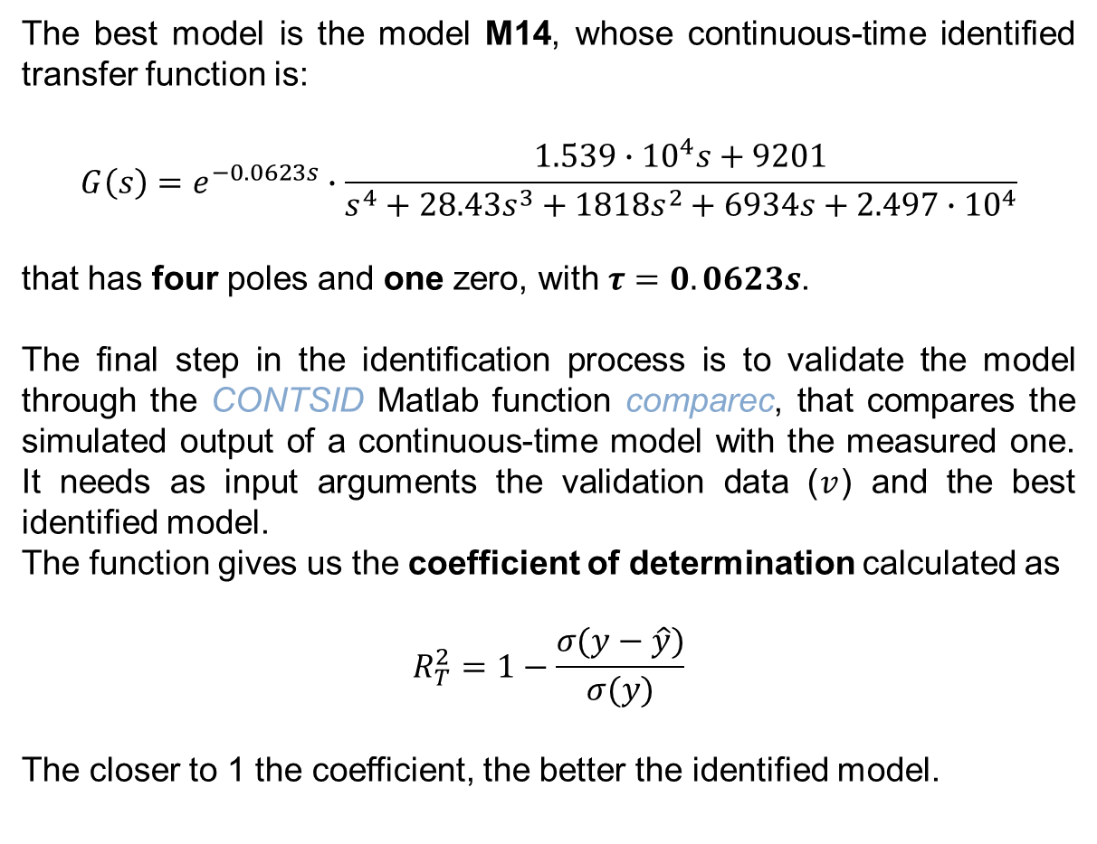
MODEL IDENTIFICATION: Identification of Transfer Function Models plus Time-delay of a quadrotor helicopter pitch dynamics
VALIDATION
The best model is the model M14, whose continuous-time identified transfer function is:
$$G\left(s\right)=e^{−0.0623s}∙\frac{1.539∙{10}^{4}s+9201}{s^{4}+28.43s^{3}+1818s^{2}+6934s+2.497∙{10}^{4}}$$
that has four poles and one zero, with $τ=0.0623s$.
The final step in the identification process is to validate the model through the CONTSID Matlab function comparec, that compares the simulated output of a continuous-time model with the measured one. It needs as input arguments the validation data ($v$) and the best identified model.
The function gives us the coefficient of determination calculated as
$$R_{T}^{2}=1−\frac{σ(y−\hat{y})}{σ(y)}$$
The closer to 1 the coefficient, the better the identified model.

Slide 22
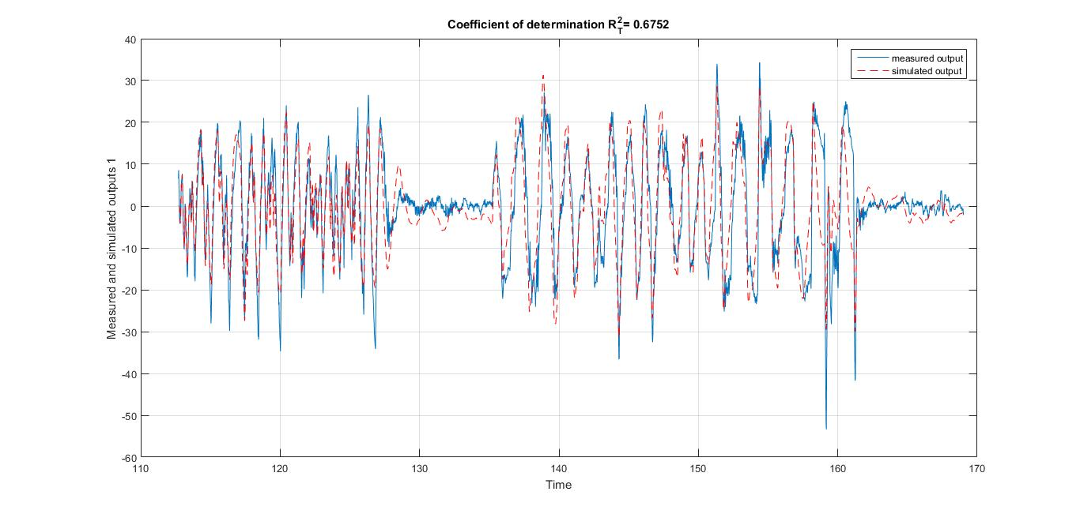
MODEL IDENTIFICATION: Identification of Transfer Function Models plus Time-delay of a quadrotor helicopter pitch dynamics
VALIDATION
FPE=21.71
MSE=21.60

Slide 23
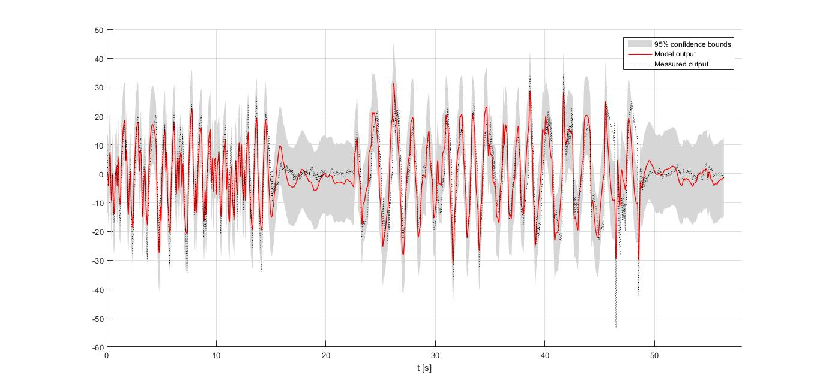
MODEL IDENTIFICATION: Identification of Transfer Function Models plus Time-delay of a quadrotor helicopter pitch dynamics
VALIDATION

Slide 24
MODEL IDENTIFICATION: Identification of Transfer Function Models plus Time-delay of a quadrotor helicopter pitch dynamics
ADDITIONAL
IDENTIFICATION

Slide 25
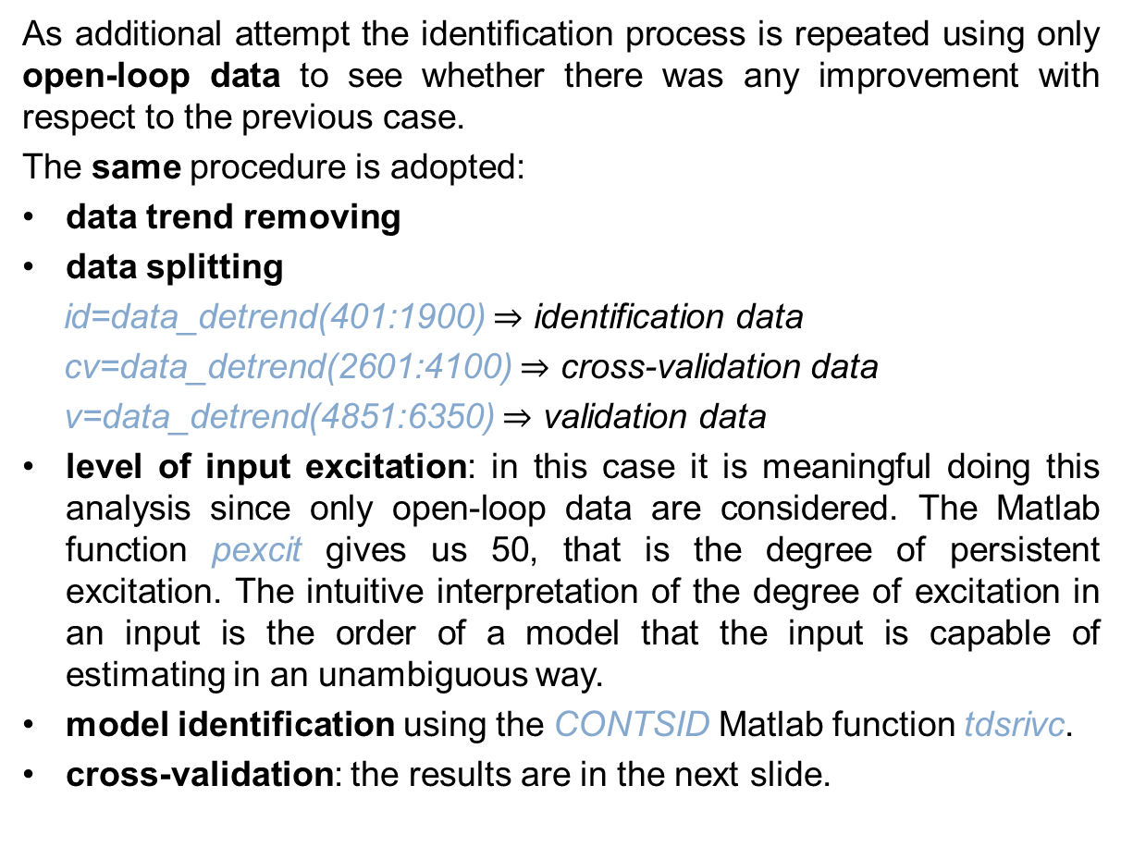
MODEL IDENTIFICATION: Identification of Transfer Function Models plus Time-delay of a quadrotor helicopter pitch dynamics
ADDITIONAL
IDENTIFICATION
As additional attempt the identification process is repeated using only open-loop data to see whether there was any improvement with respect to the previous case.
The same procedure is adopted:
data trend removing
data splitting
id=data_detrend(401:1900) $⇒$ identification data
cv=data_detrend(2601:4100) $⇒$ cross-validation data
v=data_detrend(4851:6350) $⇒$ validation data
level of input excitation: in this case it is meaningful doing this analysis since only open-loop data are considered. The Matlab function pexcit gives us 50, that is the degree of persistent excitation. The intuitive interpretation of the degree of excitation in an input is the order of a model that the input is capable of estimating in an unambiguous way.
model identification using the CONTSID Matlab function tdsrivc.
cross-validation: the results are in the next slide.

Slide 26
MODEL IDENTIFICATION: Identification of Transfer Function Models plus Time-delay of a quadrotor helicopter pitch dynamics
ADDITIONAL
IDENTIFICATION
MODEL | PERFORMANCE INDEX J
M14 | 33197,97264
M34 | 33515,15025
M15 | 33550,50839
M25 | 44185,20299
M23 | 50057,54879
M24 | 52618,81977
M04 | 53703,25829
M45 | 55340,70165
M02 | 55967,26254
M13 | 56314,92714
M01 | 56867,03833
M05 | 60415,18003
M35 | 61102,73758
M12 | 62348,4976
M03 | 63493,62889

Slide 27
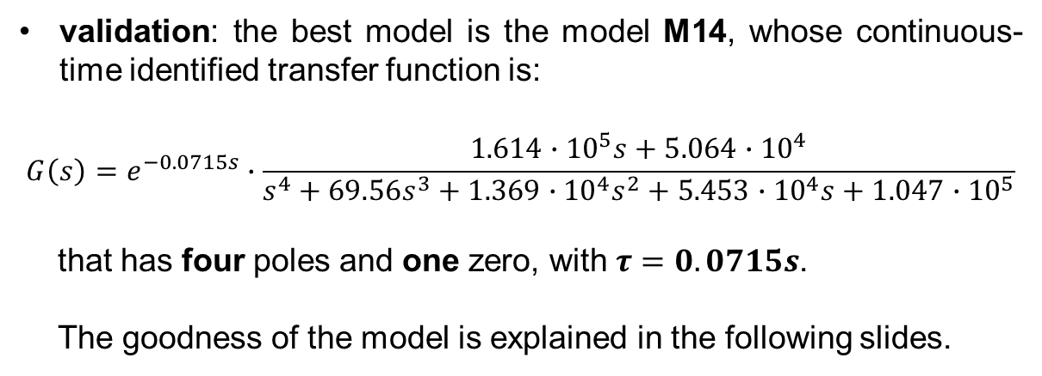
MODEL IDENTIFICATION: Identification of Transfer Function Models plus Time-delay of a quadrotor helicopter pitch dynamics
ADDITIONAL
IDENTIFICATION
validation: the best model is the model M14, whose continuous-time identified transfer function is:
$$G\left(s\right)=e^{−0.0715s}∙\frac{1.614∙{10}^{5}s+5.064∙{10}^{4}}{s^{4}+69.56s^{3}+1.369∙{10}^{4}s^{2}+5.453∙{10}^{4}s+1.047∙{10}^{5}}$$
that has four poles and one zero, with $τ=0.0715s$.
The goodness of the model is explained in the following slides.

Slide 28
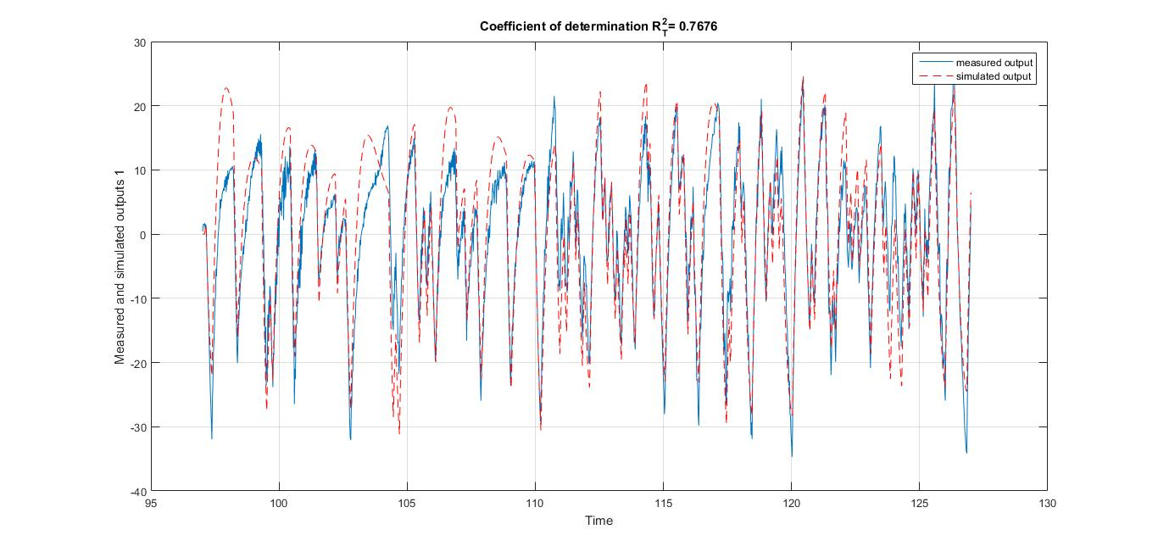
MODEL IDENTIFICATION: Identification of Transfer Function Models plus Time-delay of a quadrotor helicopter pitch dynamics
ADDITIONAL
IDENTIFICATION
FPE=17.79
MSE=17.63

Slide 29
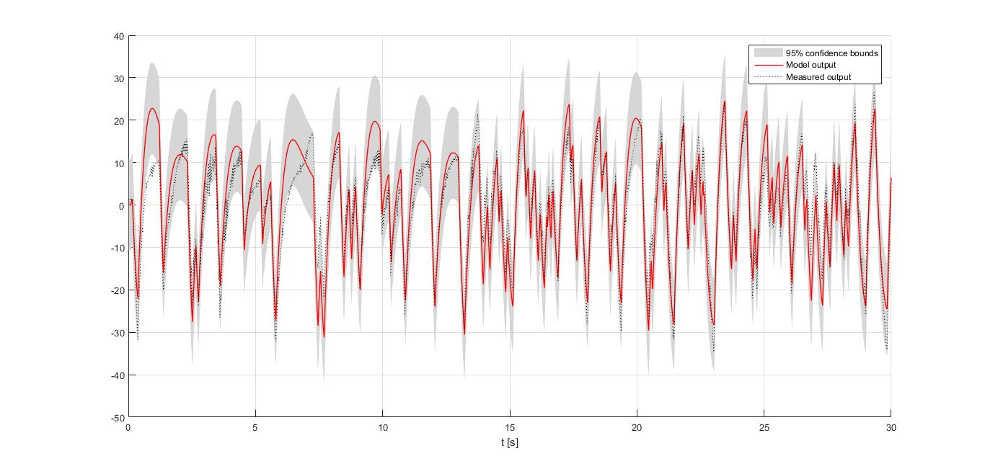
MODEL IDENTIFICATION: Identification of Transfer Function Models plus Time-delay of a quadrotor helicopter pitch dynamics
ADDITIONAL
IDENTIFICATION

Slide 30
MODEL IDENTIFICATION: Identification of Transfer Function Models plus Time-delay of a quadrotor helicopter pitch dynamics
CONCLUSION

Slide 31
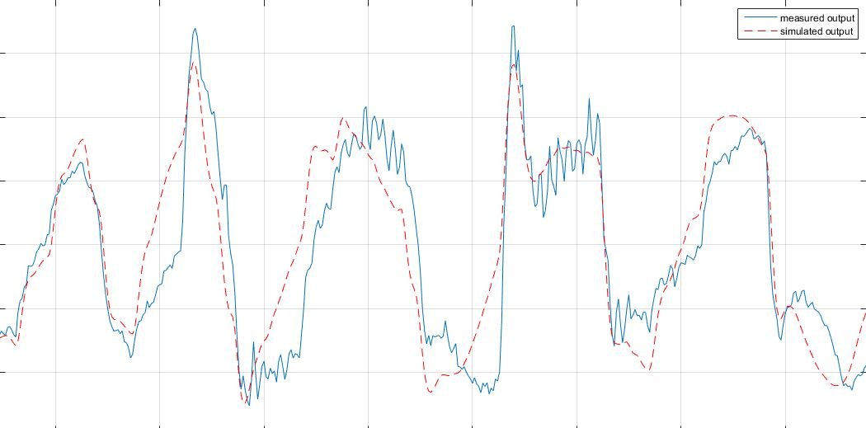
MODEL IDENTIFICATION: Identification of Transfer Function Models plus Time-delay of a quadrotor helicopter pitch dynamics
CONCLUSION
In both approaches the identified models are 4th order system with time-delay of the same order of magnitude.
The models give quite good results in terms of measured output tracking if variations are not too fast as can be seen in the plot below.
This behavior is showed also in the confidence bounds graphs.
BAD TRACKING
GOOD TRACKING

Slide 32
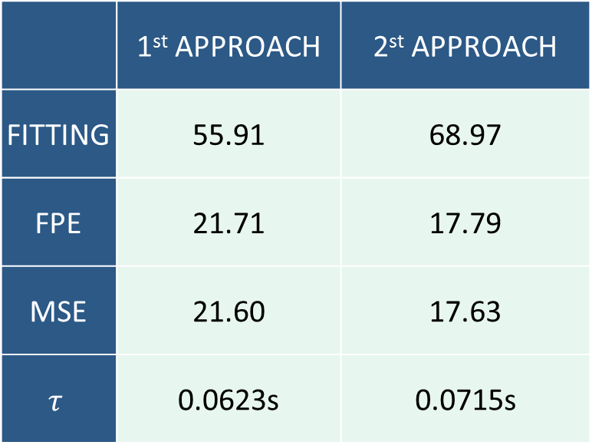
MODEL IDENTIFICATION: Identification of Transfer Function Models plus Time-delay of a quadrotor helicopter pitch dynamics
CONCLUSION
The second approach leads to better data fitting with lower FPE and MSE due to the absence of the closed-loop data that have more sudden variations.
The final results are summarized in the following table:
 | 1st APPROACH | 2st APPROACH
FITTING | 55.91 | 68.97
FPE | 21.71 | 17.79
MSE | 21.60 | 17.63
$$τ$$ | 0.0623s | 0.0715s

Slide 33
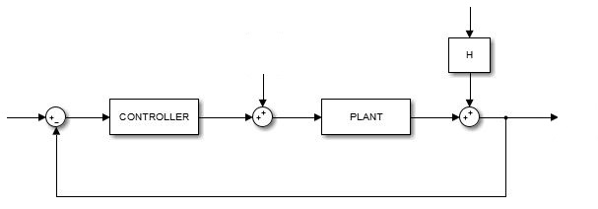

MODEL IDENTIFICATION: Identification of Transfer Function Models plus Time-delay of a quadrotor helicopter pitch dynamics
OTHER IDEAS
Since the tdsrivc algorithm works under the assumption of white additive noise, the obtained results could not be optimal because this constraint could not be suitable for the system being discussed, namely the noise is colored ($|H\left(jω\right)|≠1$). With colored noise the spectrum is not flat.
Possible solutions can be to estimate the additive noise transfer function and then adding a whitening filter or to do the identification with a Box-Jenkins model.
e(t)
r(t)
sp(t)
u(t)
q(t)

