Slide 1
What Happens when taking the ACT Exam is a State Requirement? Exploring the Relationship Between Participation Rates and Average Total Scores
PROJECT 1: Standardized Testing, Statistical Summaries, and Inference
Presented by Andrea Yoss

Slide 2
Roadmap
Problem Statement
Methodology
Primary Findings
Conclusions/ Next Steps
Questions

Slide 3
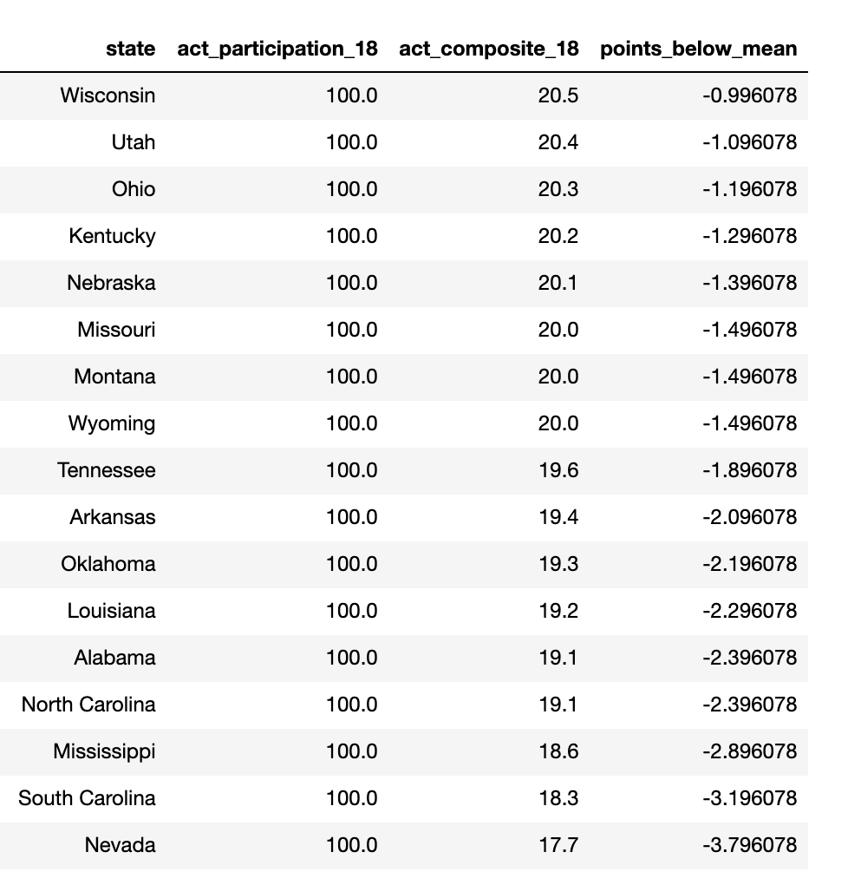
Problem Statement
Table 1: ACT Composite for States with 100% Participation Rates
For ALL states that require ACT:
Composite Score < mean value of 21.5
Why is this the case? Who is to blame?
Notes:
Revision of the SAT exam in 2016,

Slide 4
Methodology
Analyzed SAT and ACT data by state from 2017 and 2018 to
Compared participation rates, respective section averages, & total/ composite averages
Conducted Exploratory Data Analysis (EDA). Recognized some important relationships between:
SAT Participation Rates and ACT Participation Rates
SAT Participation Rates and SAT Total Score
ACT Participation Rates and ACT Composite Score

Slide 5
Primary Findings
All 17 states with 100% participation in the ACT in 2018 fell below the mean
Both exams have a negative relationship between their participation rates and their total scores
Not determined by state or curriculum, but by participation rate
Includes ALL students compared to those
who choose to take it
Participation Rate
Average Scores

Slide 6
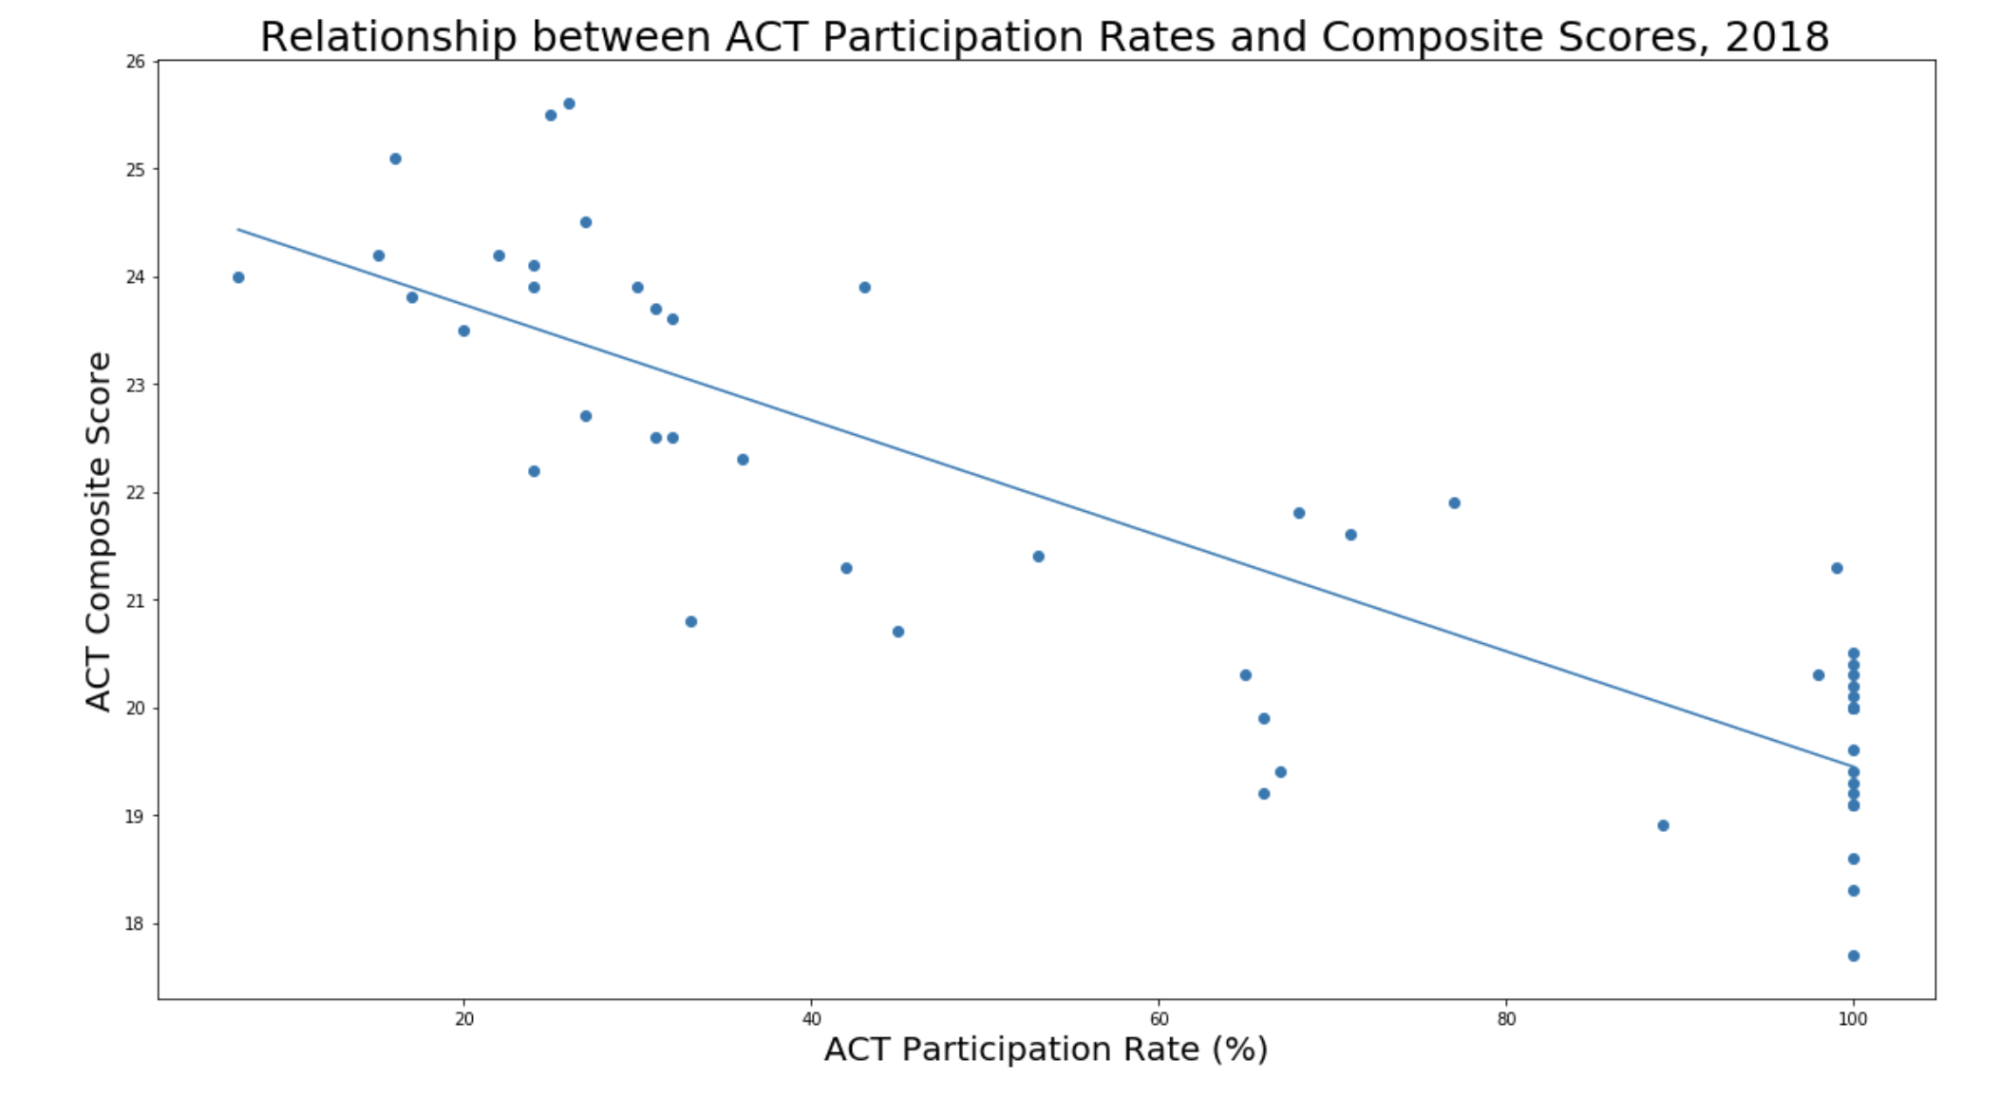
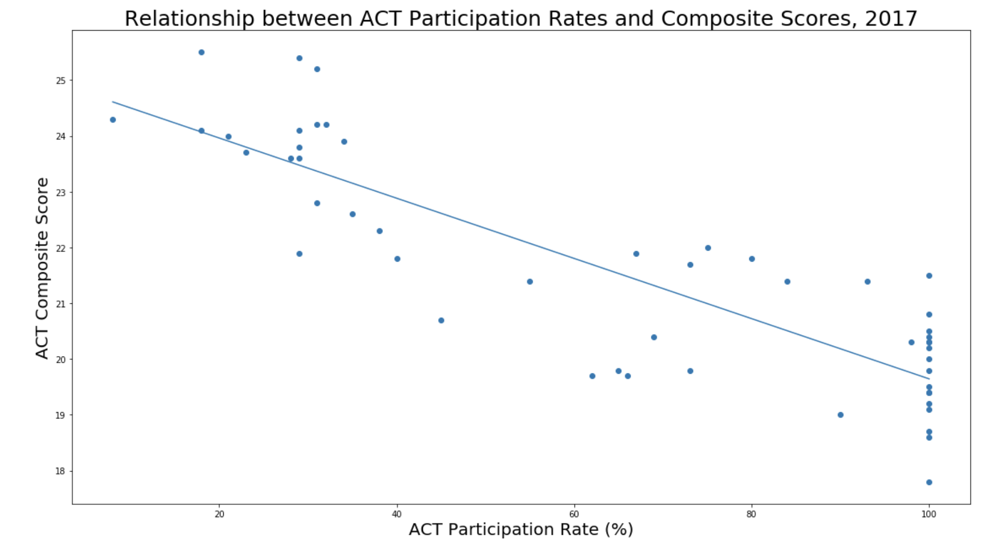
Strong Negative Relationship between ACT Participation Rates and ACT Composite Scores.
Correlation = -0.86
Notes:
There is a negative relationship between ACT participation rates and

Slide 7
Conclusion/ Next Steps
States with 100% participation in the ACT in 2018 APPEAR to be, on average, the worst performing states
HOWEVER this is due to the strong negative relationship between participation rate and composite scores NOT a reflection of the states school systems
Benefits to test takers in these states
Accessibility
College readiness
Next Steps: Look at individual States and subpopulations
Can reason higher number test takers these states BUT need this data to understand the spread of the ACT Composite scores
Use the ACT/SAT Concordance to standardize across all States

Slide 8
Thank you for your time.
Questions?

Slide 9
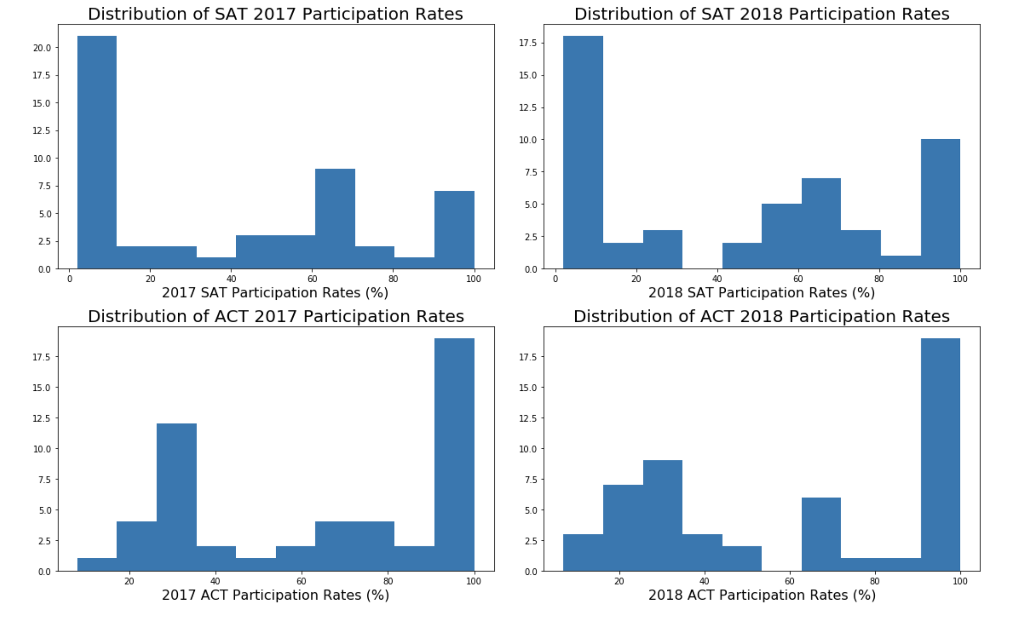
A Closer Look at Participation Rates

Slide 10
Presentation Rubric
Is the problem statement clearly presented?
Does a strong narrative run through the presentation building toward a final conclusion?
Are the conclusions/recommendations clearly stated?
Is the level of technicality appropriate for the intended audience?
Is the student substantially over or under time?
Does the student appropriately pace their presentation?
Does the student deliver their message with clarity and volume?
Are appropriate visualizations generated for the intended audience?
Are visualizations necessary and useful for supporting conclusions/explaining findings?

