Slide 1
DATA MINING & MACHINE LEARNING
HitPredictor-Steam
Data Mining & Machine Learning Project M.Sc. in Artificial Intelligence and Data Engineering — Academic Year 2025–2026
[Pedro Carneiro Junior — ID: 724961] | [Andrea Zanin— ID: 635350]
[28/07/2026]

Slide 2
OVERVIEW
Presentation Outline
01
Problem & Dataset
PART 1
Task definition · features
02
Pipeline & Experiments
Preprocessing · model selection · hyperparameter optimization
03
Evaluation & Results
Metrics · cross-validation · final model performance
04
Explainability
PART 2
Global & local techniques · consistency with domain knowledge
05
Critical Discussion
Error analysis · limitations · future directions

Slide 3
PART 1 — TECHNICAL
Problem, Pipeline & Results
Problem definition · feature engineering · model selection
hyperparameter optimization · evaluation · test-set results

Slide 4
PROBLEM
Problem Definition & Dataset
The Problem
Dataset at a Glance
The Steam PC gaming market sees thousands of annual releases, with commercial performance following a steep power-law distribution
A tiny fraction of titles capture massive adoption; the vast majority remain in the long-tail with minimal sales
HitPredictor-Steam delivers an Classifier ML pipeline to predict commercial adoption trajectories ("hit status") using storefront metadata
Two models have been developed: one works pre-release, predicting a game's end users before its launch. The post-release model instead classifies the popularity of already-released games, allowing for market analysis.
Primary objective: equip independent developers and publishers with data-driven decision tools prior to capital allocation
Task
Multiclass Classification
Dataset
Steam Store and SteamSpy Data (Kaggle)
Target
Owners – Range of players who purchased the game
Features
Numerical, Categorical, Textual
Missing values
17.89% missing values, before cleaning and text mining
Class balance
Heavily unbalanced, class 0 contains 69% of the data
Split
5 splits for outer loop, 3 for inner loop
Metric(s)
QWK (Quadratic Weighted Kappa), F1-macro

Slide 5
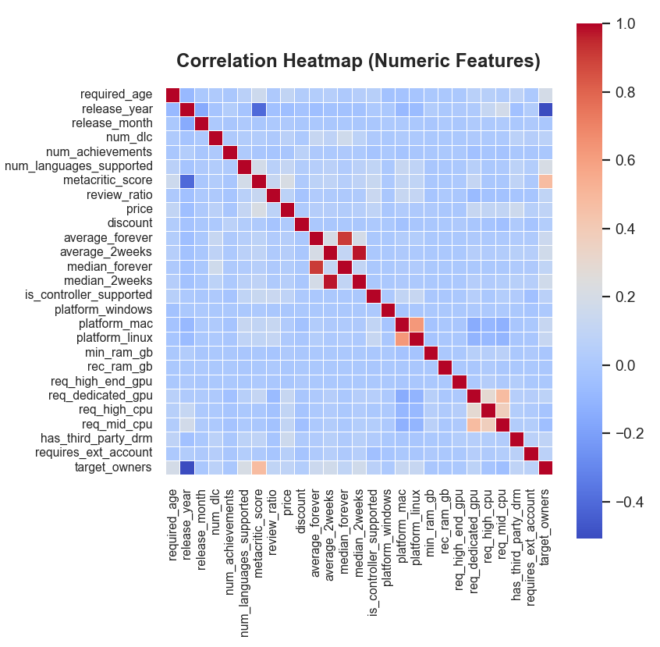
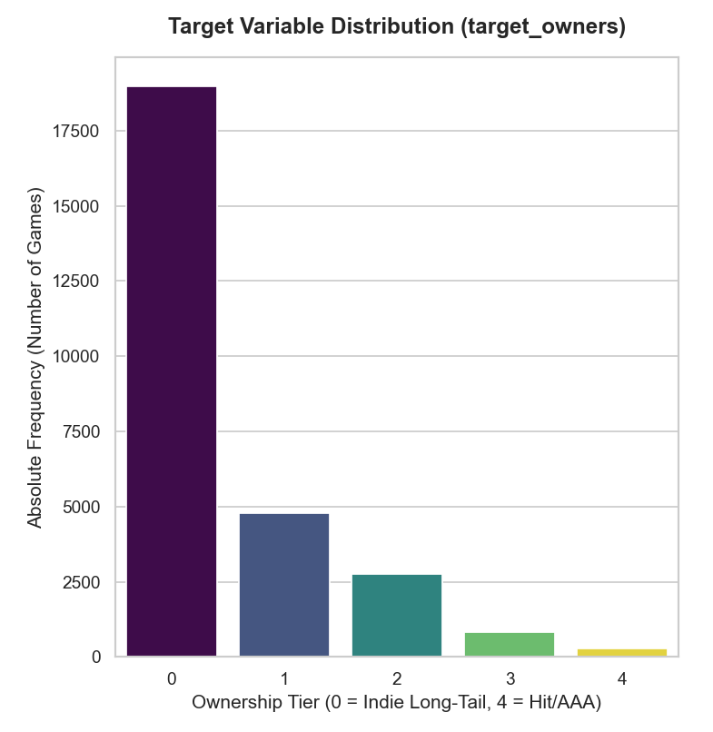
PROBLEM
Exploratory Data Analysis
[ YOUR FIGURE HERE ]
[ YOUR FIGURE HERE ]
Correlation heatmap or scatter matrix
Key findings from EDA:
Severe class imbalance is present, with the Indie Long-Tail (Tier 0) dominating the dataset at over 69%
The original 13 high-variance classes representing the owner ranges have been engineered into 5 ordinal macro-tiers to enable effective classification.
To prevent target leakage, post-launch engagement features (like reviews and concurrent users) must be bifurcated from pre-launch metadata, creating two operational models.

Slide 6
PIPELINE
Feature Engineering & Selection
Engineering
Selection Method
Hardware specifications (e.g. RAM) were parsed textual requirements into standardized gigabytes (GB) and CPU/GPU requirements into binary indicators.
Textual fields underwent vectorization via TF-IDF and deep semantic embedding (frozen SentenceTransformer), followed by PLS-DA compression.
JSON-like columns (platforms, metacritic, achievements) were extracted and categories genres tags publishers developers normalized into token lists
Continuous numeric features received NaN imputation within an imbpipeline, avoiding data leakage
Supervised dimensionality reduction via Partial Least Squares Discriminant Analysis (PLS-DA) was used to project feature spaces onto latent component directions.
An internal SelectFromModel step pruned irrelevant features dynamically during Bayesian optimization.
Why These Features?
Features such as price, language support, and system specifications are intrinsic metadata acting as proxies for development budget and scope, which are crucial for early predictions
Post-launch metrics (e.g., positive/negative reviews, Concurrent Connected Users) were strictly removed in the Pre-Release mode to prevent target leakage, as they are unobservable prior to launch

Slide 7
PIPELINE
ML Pipeline: Avoiding Data Leakage & Bias
Raw
Data
Preprocessing and data cleaning
Hyperparameter Tuning and Feature
Selection
Model
Training and Weights Calibration using Differential Evolution
Validation
(held-out fold) and Evaluation
Final
Training over entire dataset
▶
▶
▶
▶
▶
Data Leakage Prevention
Class Imbalance Handling
Metric Justification
All preprocessing fitted only on training folds to avoid data leakage
Strict sequence:
- hardware specification extraction
- Unicode/noise filtering
- continuous feature imputation
- text vectorization (TF-IDF + Frozen SentenceTransformer) followed by PLS-DA compression
Dynamic Majority Undersampling for Class 0, SMOTENC restricted exclusively to the extreme minority (Tier 4), and Tomek Links for spatial boundary cleaning
Resampling operations were strictly applied inside the training splits of each cross-validation fold
Metric used: Quadratic Weighted Kappa (QWK) and Macro-F1
QWK is the primary metric because it heavily penalizes predictions that land far from the true ordinal tier compared to adjacent-tier misclassifications
Misclassifying a long-tail indie game (Tier 0) as an AAA hit (Tier 4) leads to severe capital misallocation for publishers. QWK mathematically minimizes these extreme off-diagonal errors
Additional metrics reported for completeness: F1-score, accuracy, precision, and recall (Macro)

Slide 8
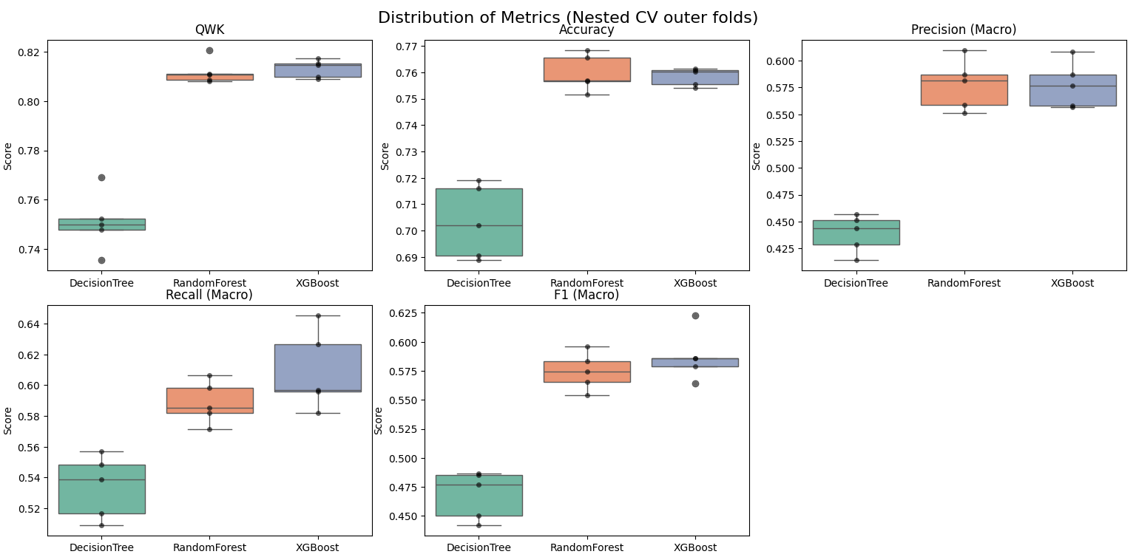
PIPELINE
Model Selection & Hyperparameter Optimization
Key Decisions
Candidate models | Decision Trees, Random Forests, and XGBoost
CV strategy | 5x3 Nested Cross-Validation (5 Outer Folds, 3 Inner Folds)
Selection criterion | Quadratic Weighted Kappa (QWK)
Chosen model | XGBoost, as it achieved an optimal QWK of ~0.817 and demonstrated tight variance with high median performance
Search strategy | Bayesian Optimization via Optuna coupled with a Cached Unified Grid Search
Search space | Tree ensemble architecture (n_estimators, max_depth), learning dynamics, and regularization bounds
Best config | n_estimators=397, max_depth=5, learning_rate≈0.107, min_child_weight=5, subsample≈0.965, reg_lambda≈0.825
Statistical test | Friedman Test for global significance, followed by Wilcoxon Signed-Rank Test. Due to N=5 folds, absolute dominance yielded a minimum achievable p-value of 0.0625.
[ YOUR FIGURE HERE ]
Box plot of cross-validated scores across candidate models
(e.g., F1-macro or RMSE per CV fold per model)

Slide 9
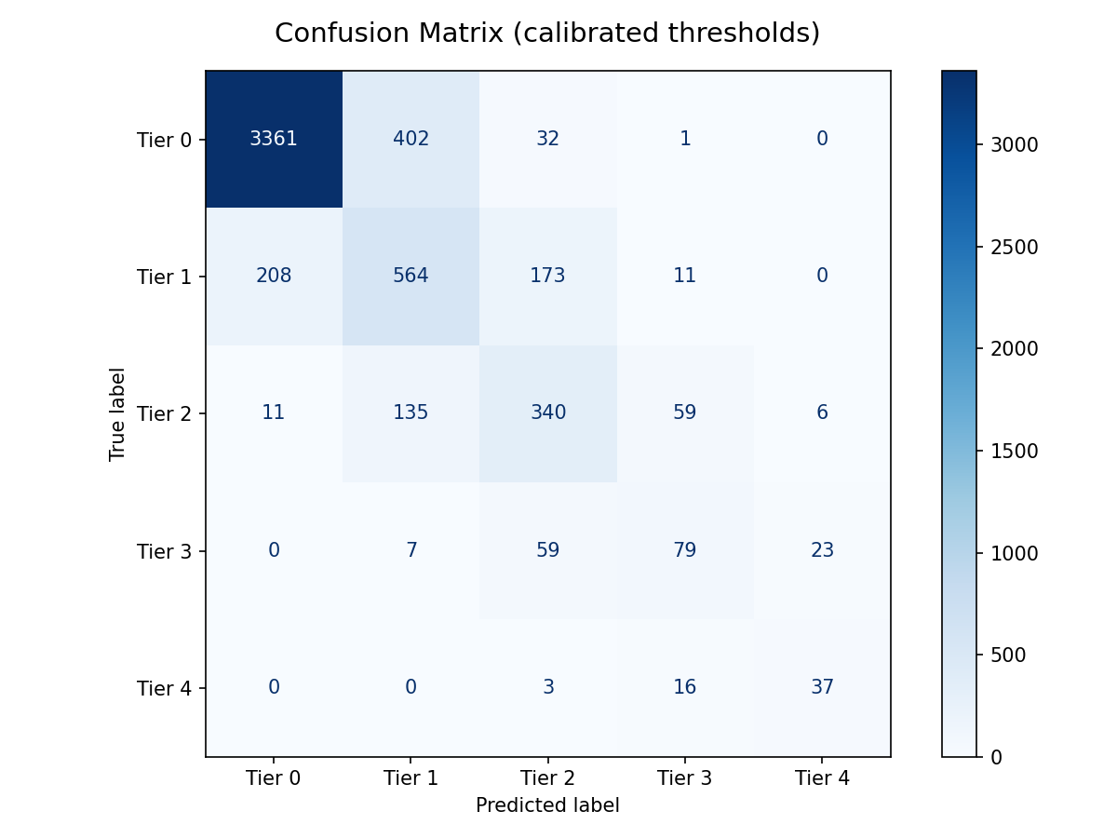
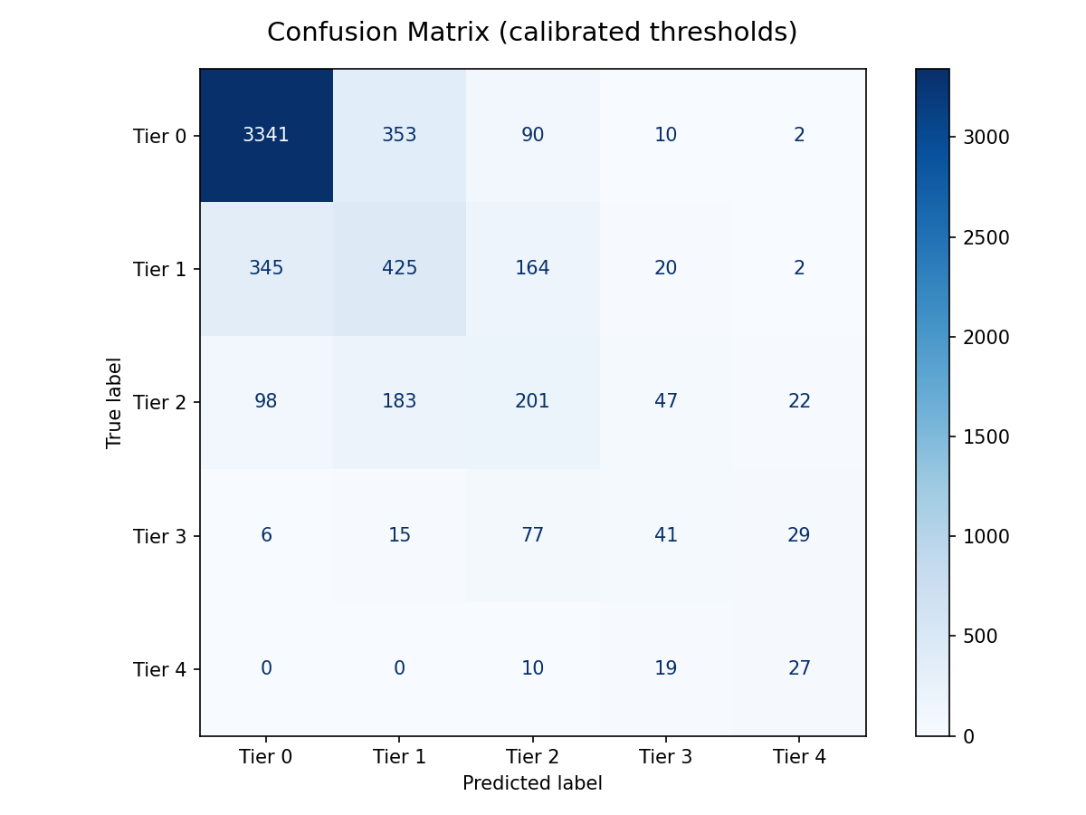
RESULTS
Test-Set Results
XGBoost confusion matrix post-release
XGBoost confusion matrix pre-release
[ YOUR FIGURE HERE ]
Key Metrics (Test Set)
Post-Release: 0.840 Pre-Release: 0.721
Post-Release: 0.624 Pre-Release: 0.469
Post-Release: 0.808 Pre-Release: 0.700
Post-Release: 0.769 Pre_Release: 0.544
QWK XGBoost
Macro-F1 XGBoost
QWK Random Forest
QWK Decision Tree

Slide 10
PART 2 — CRITICAL ANALYSIS
Explainability &
Critical Discussion
How does the model work? · What did it get wrong and why?
Limitations · future directions · domain impact

Slide 11
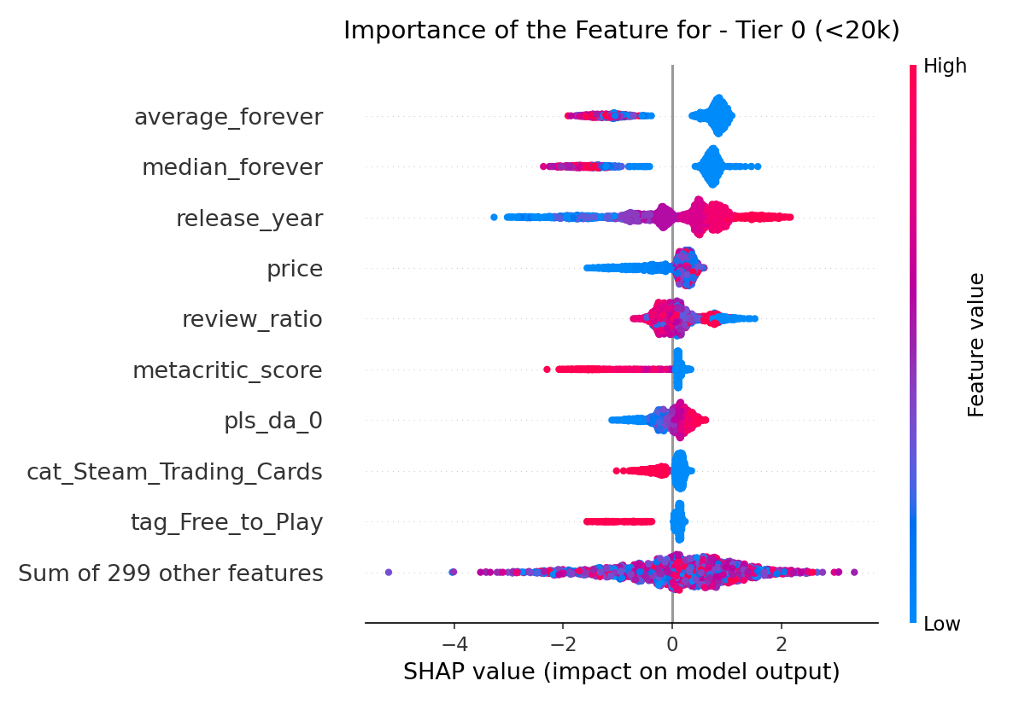
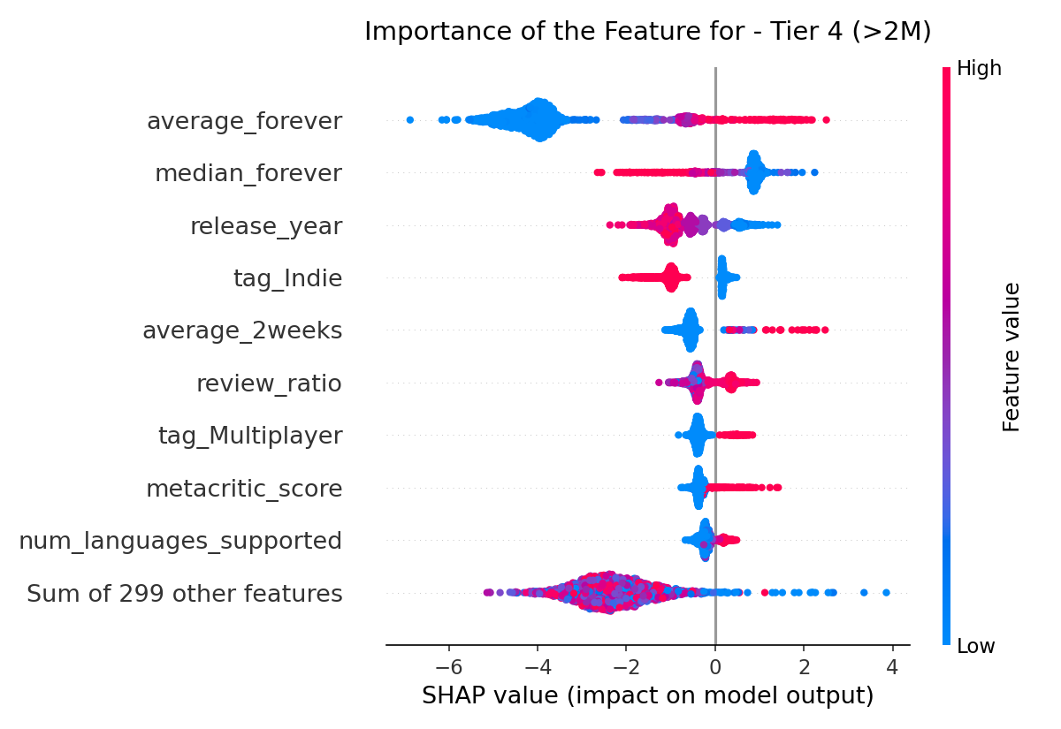
EXPLAINABILITY
Global Explainability: What Drives the Model Overall?
Interpretation
SHAP (TreeExplainer) was used because XGBoost is a complex, non-linear ensemble. An Inverse Scaling Mechanism was applied to convert perturbed instances back to human-readable real-world units
High base pricing and extensive language localization systematically push predictions toward Tier 4 (AAA Hit), acting as reliable proxies for high-budget, high-effort development
When Post-Launch features are evaluated, community engagement metrics (e.g., average playtime) completely dominate the decision tree splits, proving they are mathematically far more predictive than day-zero metadata
The global explanation strongly supports the model logic. Features that actively suppress a game into Tier 0 (e.g., lack of languages) are the exact inverted signals required to push a title into Tier 4

Slide 12
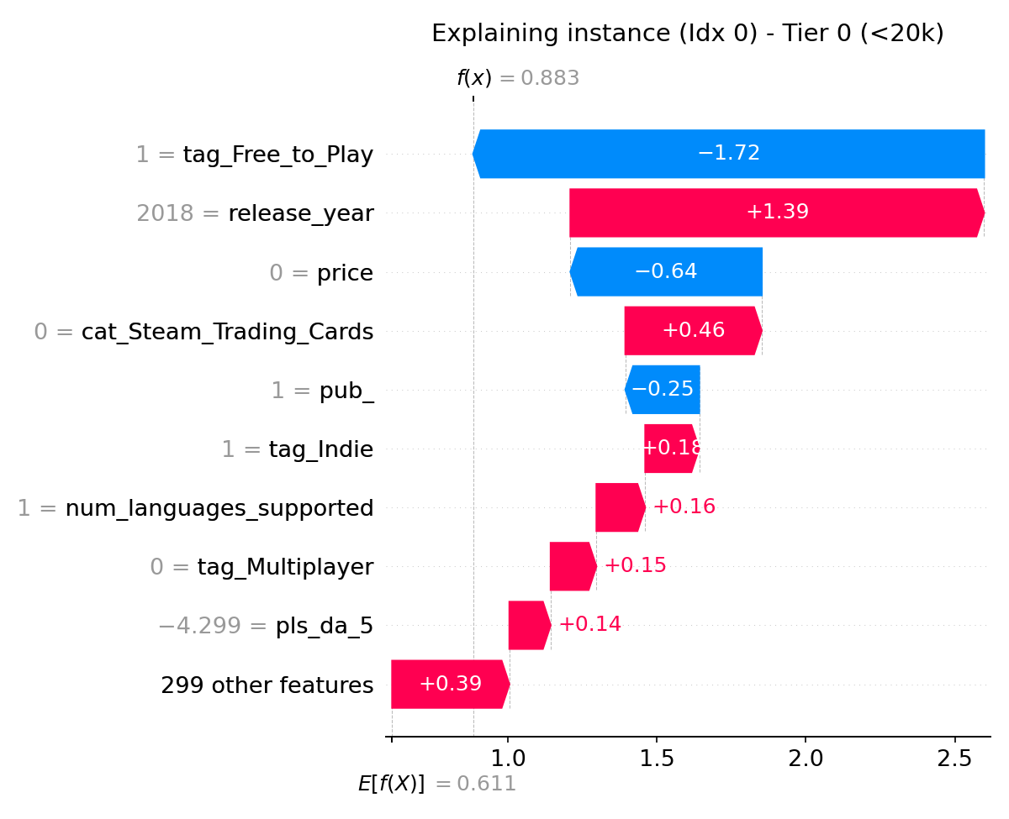
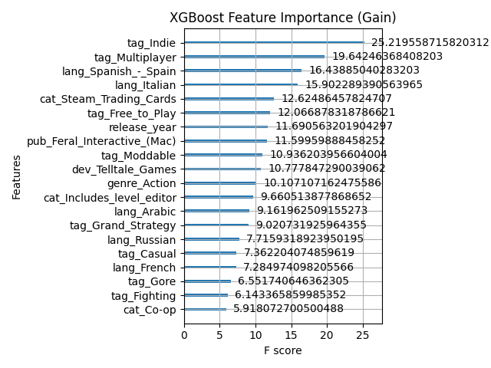
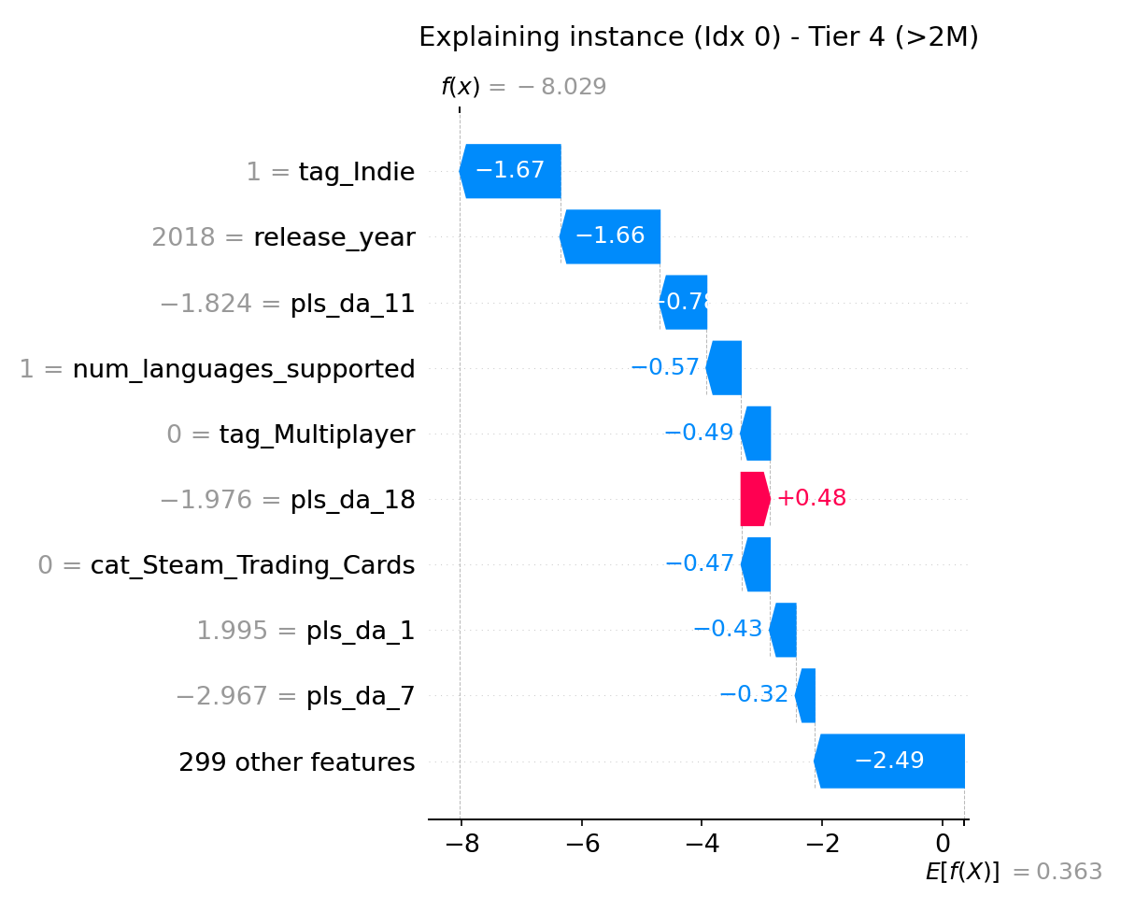
EXPLAINABILITY
Local Explainability: Why This Specific Prediction?
Case Analysis
The analyzed represents a game of the "Indie Long-Tail" market (titles with the lowest adoption bracket).
Key features driving this instance include: Release Year: 2018 Monetization: Free (tag_Free_to_Play = 1 and price = 0). Game Characteristics: Indie category, no multiplayer, and no Steam Trading Cards

Slide 13
CRITICAL DISCUSSION
Error Analysis: What Did the Model Get Wrong and Why?
Reverse-Engineering Errors
XGBoost confusion matrix pre-release
Classification noise is almost entirely confined to adjacent classes (e.g., a true Tier 1 game misclassified as Tier 0 or Tier 2)
The errors stem not from unusual intrinsic features, but from the absence of extrinsic data. The model cannot see unmodeled external market forces like marketing budgets, streamer adoption, or viral momentum
SHAP and LIME plots reveal that fundamentally identical games based on day-zero metadata (e.g. RAM requirements, textual descriptions and genres) can have drastically different real-world outcomes if one goes viral, making them mathematically indistinguishable in this latent space
The most important fail: pre-release model struggles to differentiate between mid-tier games (e.g., Tier 2 vs Tier 3)
[ YOUR FIGURE HERE ]
Error characterization figure
e.g., misclassified samples in feature space,
error histogram, SHAP for wrong predictions

Slide 14
CRITICAL DISCUSSION
Domain Impact, Limitations & Future Directions
Domain Impact
Limitations
Future Directions
This system can be used as a forecasting tool to equip independent developers and publishers with data-driven decision capabilities prior to capital allocation
It supports targeted 'what-if' analyses during pre-production, allowing developers to adjust game design thanks to textual descriptions, localization, and pricing strategies to elevate their prototype's tier
Human oversight is required to contextualize predictions with external macroeconomic signals (e.g, social media trends) that the model cannot observe. Predicting a long-tail failure as a major hit leads to financial misallocation for publishers
The dataset reflects an extreme power-law distribution where over 69% of games reside in the lowest adoption bracket, requiring aggressive dynamic undersampling and SMOTENC
Extrinsic macroeconomic signals, marketing budget allocations, viral social media momentum, and streamer adoption rates are fundamentally missing
Evaluation limitations: The non-parametric statistical significance testing (Wilcoxon) was mathematically underpowered and constrained by the limited sample size of the outer cross-validation (N=5 folds)
Implementing an auxiliary regression pipeline to predict community Approval Rating (review_ratio)
Developing a 2D Market Fit Matrix projecting prototypes across Volume (X-Axis) and Sentiment (Y-Axis) to visually identify Niche Critical Darlings vs. High-Risk Flops
Multi-Modal Expansion incorporating deep architectures like CNNs for analyzing promotional screenshots and sequence models for gameplay trailer aesthetics

Slide 15
Thank You
Conclusions:
The HitPredictor-Steam project successfully models the commercial trajectory of digital PC games using structured storefront metadata and post-release community engagement signals
An XGBoost ensemble, optimized via Bayesian Optuna, rigorously validated through a 5x3 Nested Cross-Validation framework to guarantee zero data leakage
Explainability revealed that lack of language support and low prices anchor games to Tier 0, and that classification noise is strictly confined to adjacent tiers due to unmodeled viral market forces
The model lacks visibility into external marketing momentum; future work will focus on a 2D Market Fit Matrix (Volume vs. Sentiment) and multi-modal expansion using deep learning for visual assets
Andrea Zanin · a.zanin@studenti.unipi.it
Pedro Carneiro · p.carneirojunior@studenti.unipi.it

