Slide 1
Social Network Analysis Project
Facebook Food mutual likes exploration
Andrea Ierardi
Andrea Ierardi Code: GitHub

Slide 2
Dataset
Data collected about Facebook pages (November 2017).
These datasets represent blue verified Facebook page networks of different categories.
Nodes represent the pages and edges are mutual likes among them.
Food category pages
Reference: http://networkrepository.com/fb-pages-food.php
Andrea Ierardi Code: GitHub

Slide 3
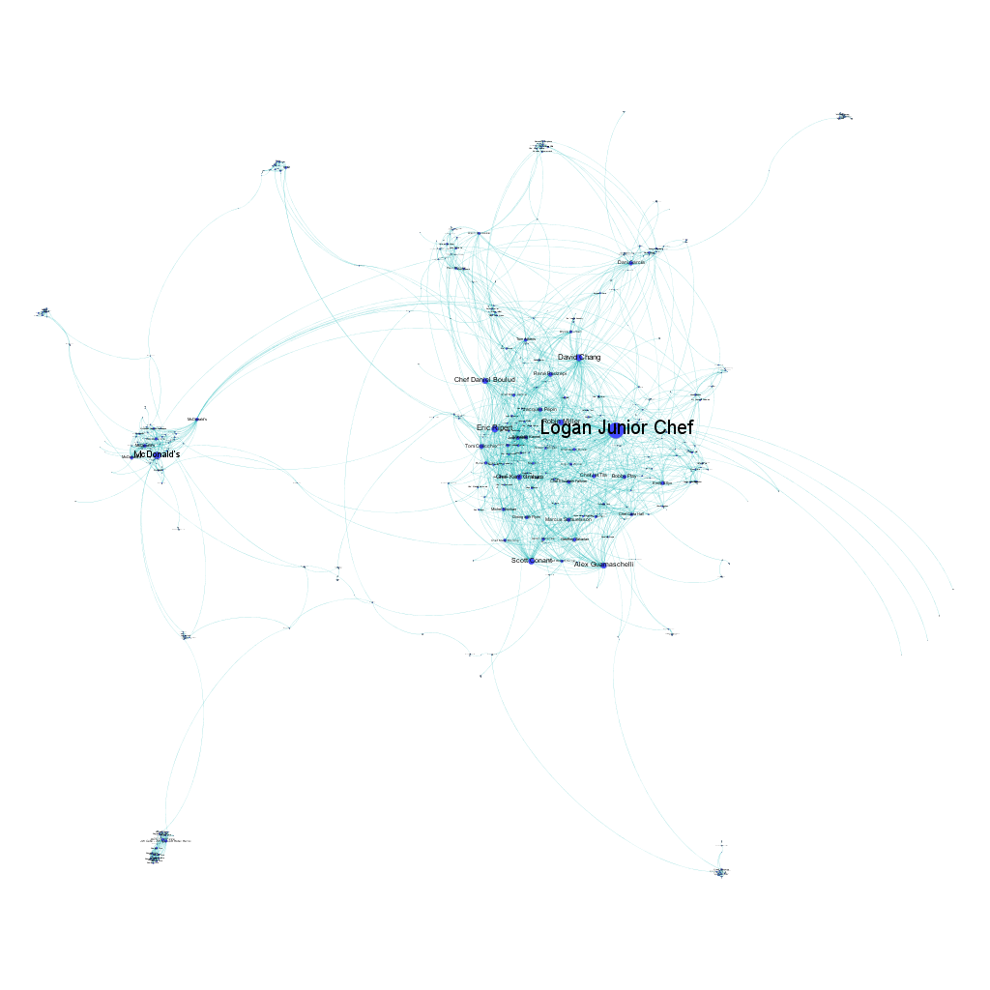
Visualisation
Number of nodes: 620
Number of links: 2102
Undirected
Unweighted
No Isolated components
Andrea Ierardi Code: GitHub

Slide 4
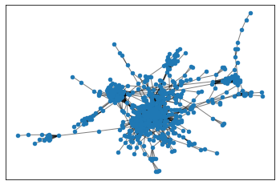
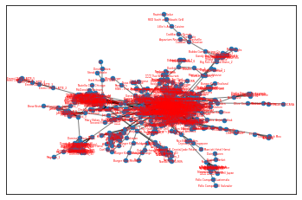
Exploration of the network
Density: 0.01
Standard deviation: 9.47
Mean: 6.78
Median: 4.0
Min: 1
Max: 134
Assortativity coefficient: - 0.028
Assortativity is a preference for a network's nodes to attach to others that are similar in some way
Andrea Ierardi Code: GitHub

Slide 5
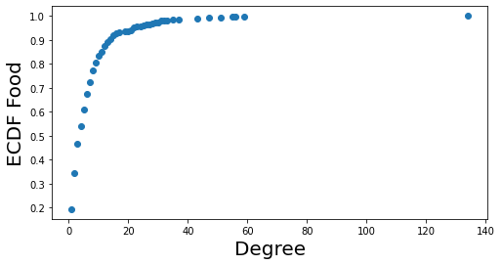
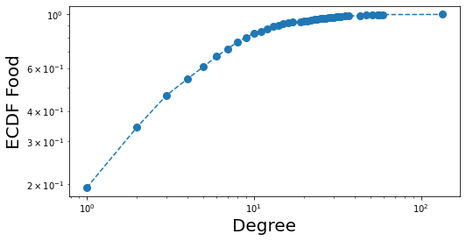
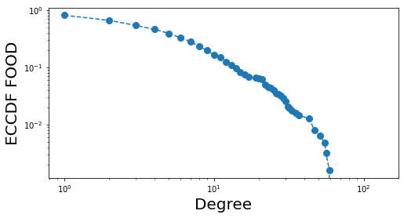
Connectivity
ECDF in linear scale
No Isolated components
Number of connected components is 1
The number of triangle is 8805
ECDF in log scale
ECCDF
Andrea Ierardi Code: GitHub

Slide 6
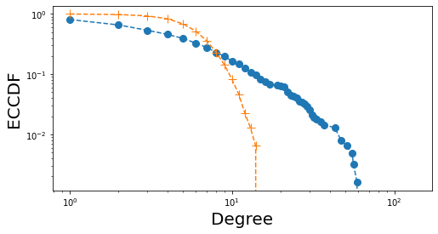
Comparison with Random Network
This is a case of a scale-free network: follow power law Degree distribution
Using a Random Network with:
Number of nodes: 620
Number of links: 2117
Standard deviation: 2.5
Mean: 6.823
Median: 7.0
Min: 1
Max: 15
P = Density = Real-network density
Real-network vs Random Network
Andrea Ierardi Code: GitHub

Slide 7
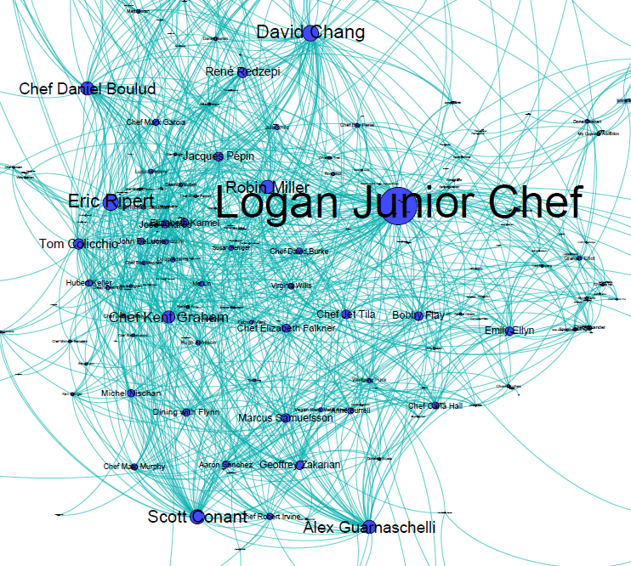
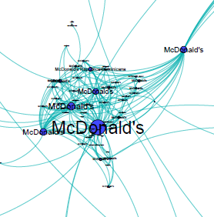
HUBS
99-Percentile degree is about 47
8 nodes has a degree >= 47:
'Logan Junior Chef','Robin Miller', 'Scott Conant', "McDonald's_6", 'Eric Ripert', 'Alex Guarnaschelli', 'David Chang', 'Chef Daniel Boulud'
Andrea Ierardi Code: GitHub

Slide 8
Transitivity and Clustering
Transitivity value is : 0.223
Average Clustering coefficient is: 0.331
Andrea Ierardi Code: GitHub

Slide 9
Centrality
This is based on the assumption that important nodes have many connections
Degree Centrality
Eigenvector Centrality
10 most important nodes for Degree Centrality:
('Logan Junior Chef', 0.21647819063004847)
("McDonald's_6", 0.09531502423263329)
('David Chang', 0.09046849757673668)
('Eric Ripert', 0.0888529886914378)
('Scott Conant', 0.08239095315024234)
('Robin Miller', 0.07592891760904685)
('Alex Guarnaschelli', 0.07592891760904685)
('Chef Daniel Boulud', 0.07592891760904685)
('Chef Kent Graham', 0.06946688206785137)
('Tom Colicchio', 0.05977382875605816)
10 most important nodes for Eigenvector Centrality:
('Logan Junior Chef', 0.3257521783526796)
('Scott Conant', 0.2212476362249716)
('Eric Ripert', 0.21990111769744997)
('David Chang', 0.2073087464245374)
('Alex Guarnaschelli', 0.20600750503290316)
('Robin Miller', 0.18493902862814815)
('Chef Kent Graham', 0.17958444309886806)
('Chef Daniel Boulud', 0.17605019181207027)
('Jacques Pépin', 0.16176590042363934)
('René Redzepi', 0.15717739346300846)
Betweennes Centrality
Page Rank Centrality
10 most important nodes for Betweennes Centrality:
('Logan Junior Chef', 0.3499076661737777)
("McDonald's_51", 0.1619605706800918)
("McDonald's_6", 0.14456288292404343)
('Subway', 0.09327260616363368)
('Chef Robert Irvine', 0.09141807568331686)
('foodpanda - 空腹熊貓', 0.07911166993681569)
('Dani García', 0.07229884637101391)
('達美樂披薩', 0.05838784338316884)
('Marcus Samuelsson', 0.057229302697032476)
('Chef Lorena Garcia', 0.057020665866287595)
10 most important nodes for Page Rank:
('Logan Junior Chef', 0.025287363082514766)
("McDonald's_6", 0.014547869032715707)
('David Chang', 0.008860842463979819)
('Eric Ripert', 0.008394578695731944)
('Scott Conant', 0.00765590500196909)
('Chef Daniel Boulud', 0.007613723777791042)
('Robin Miller', 0.007566138546930535)
('Dani García', 0.007270498839968533)
("McDonald's_29", 0.007234882262368256)
('Alex Guarnaschelli', 0.007152129703475652)
Andrea Ierardi Code: GitHub

Slide 10
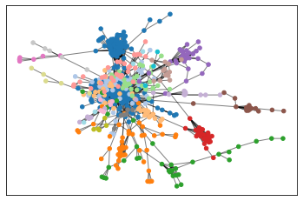
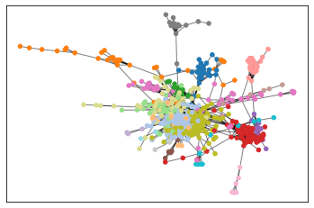
Communities
Using set of greedy partition we obtain 21 communities
Using set of Louvain partition we obtain 17 communities
Andrea Ierardi Code: GitHub

Slide 11
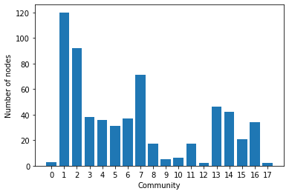
Coverage, modularity and performance
The coverage of a partition is the ratio of the number of intra-community edges to the total number of edges in the graph.
Greedy
---
Coverage 0.8686964795432921
Modularity 0.6331957195403588
Performance 0.8936682474334254
---
Louvain
---
Coverage 0.845861084681256
Modularity 0.655844621723138
Performance 0.9072906352597843
---
The performance of a partition is the ratio of the number of intra-community edges plus inter-community non-edges with the total number of potential edges.
Louvain Distribution
Andrea Ierardi Code: GitHub

Slide 12
Conclusions
No Isolated components and only one connected component
Scale-free network
8 identified major HUBS
Identified most important nodes using different Centrality methods
Identified communities:
Louvain perform slightly better than Greedy in terms of performance and modularity
Andrea Ierardi Code: GitHub

