Slide 1
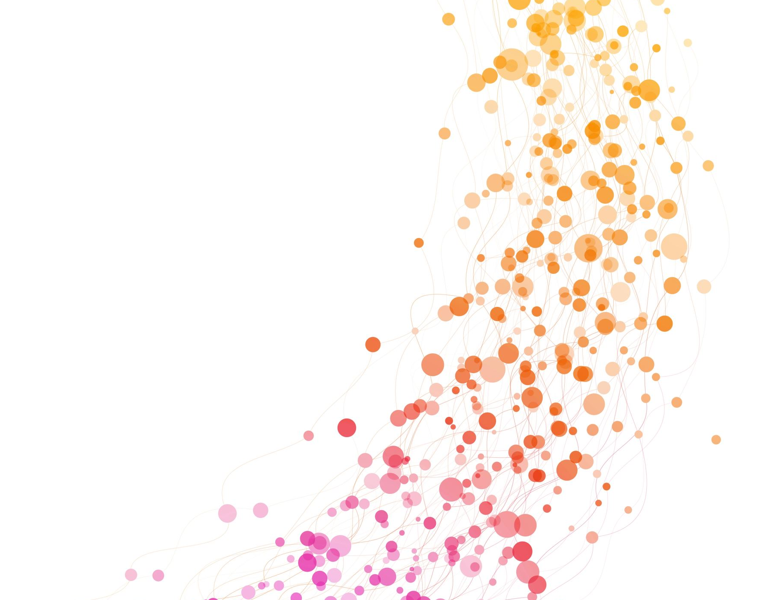
Lyrics Emotion Detection App
Andrea Ierardi
Student’s ID: 960188

Slide 2
Project aim
Build prediction models to detect emotions in song lyrics.
Build Algorithm for song suggestion
Build a simple Web Application to display the results

Slide 3
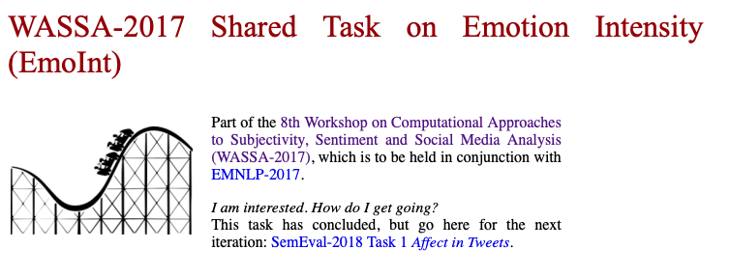

Datasets
Two datasets chosen:
Training and testing model:
WASSA-2017 SharedTask on Emotion Intensity (EmoInt)
Emotion detection lyrics:
Music Dataset: Lyrics and Metadata from 1950 to 2019

Slide 4
Models
Logistic Regression Classifier
Random Forest Classifier
Multi-layer Perceptron Classifier
Neural Networks

Slide 5
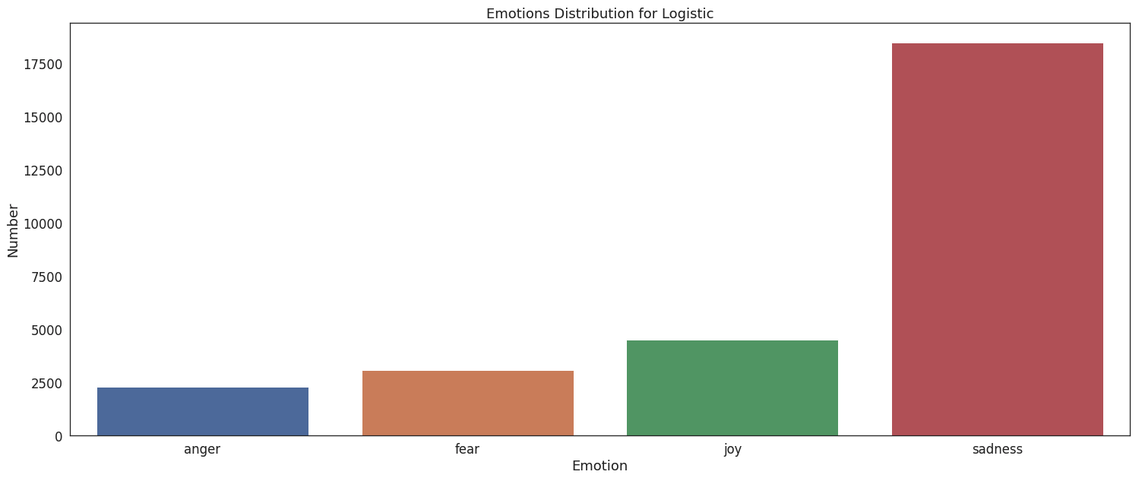
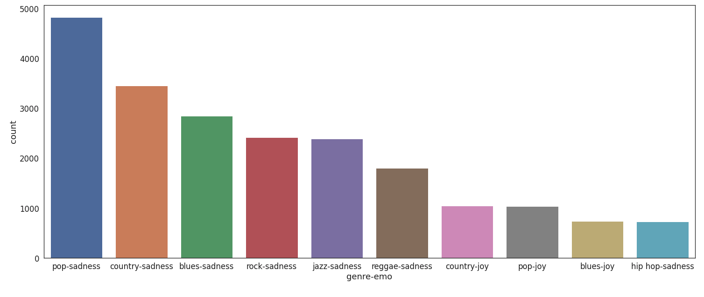
Logistic regression
F1 score : 0.8263
Averaged for multi-class problem
Most predicted emotion is sadness:
It is predicted 60% more than the others

Slide 6
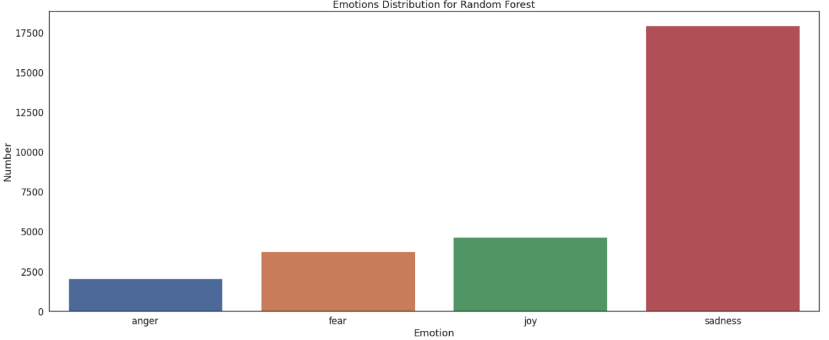
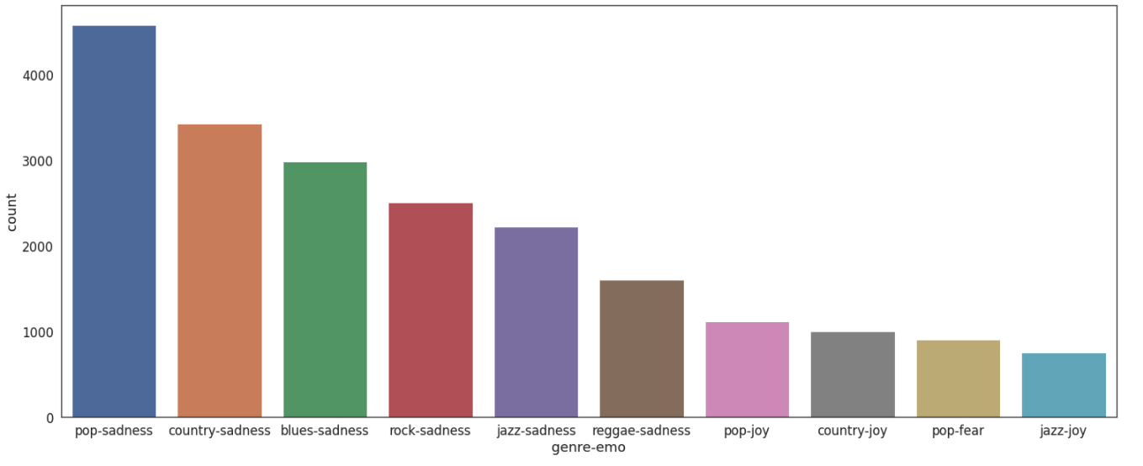
Random Forest
F1 score: 0.802
Averaged for multi-class problem
Most predicted emotion is sadness:
It is predicted 60% more than the others

Slide 7
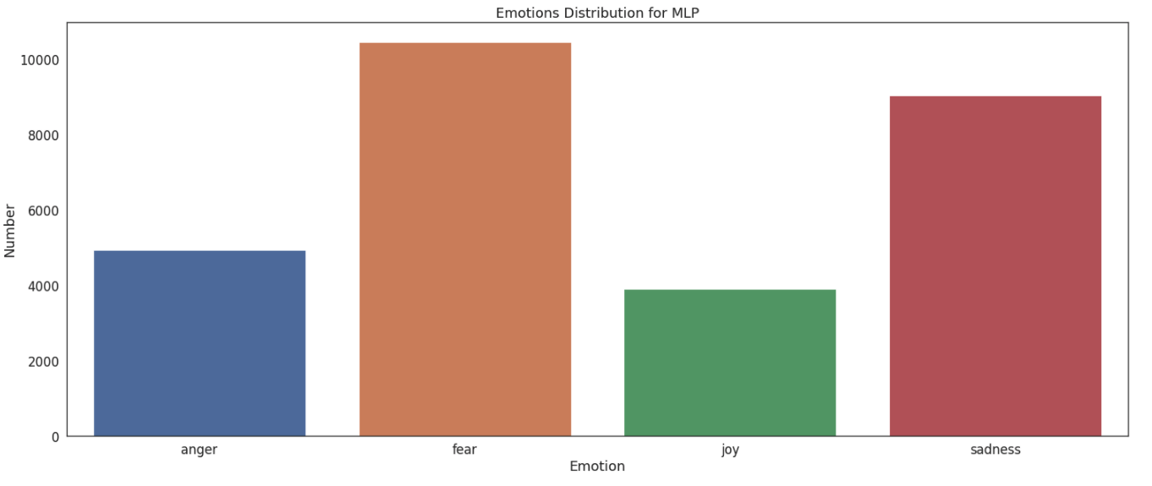
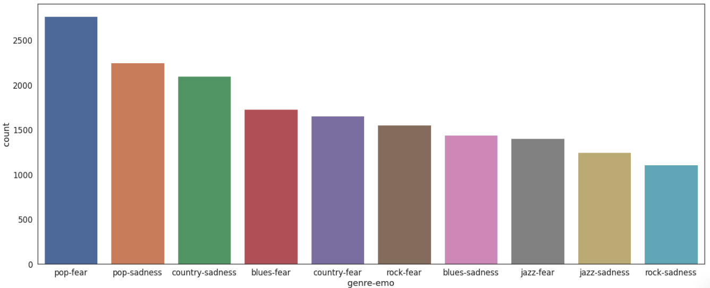
Multi-Layer Perceptron
F1 score: 0.803
Averaged for multi-class problem
Most predicted emotion is Fear and Sadness

Slide 8
Neural Networks
Dense Neural Networks: 3 dense layers with different number of nodes.
Neural Networks with Embeddings: Embedding layer and two Dense layers
Simple Feed Forward Neural Networks: 1 dense layers
Tuned Dense Neural Networks with Grid Cross Validation

Slide 9
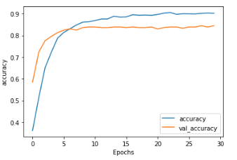
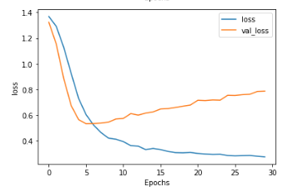
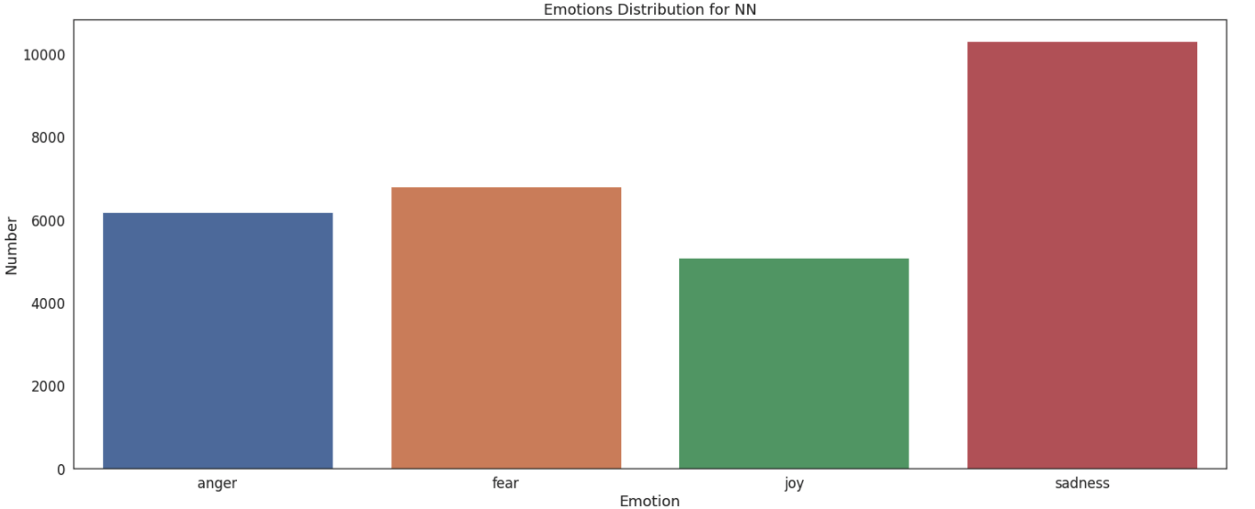
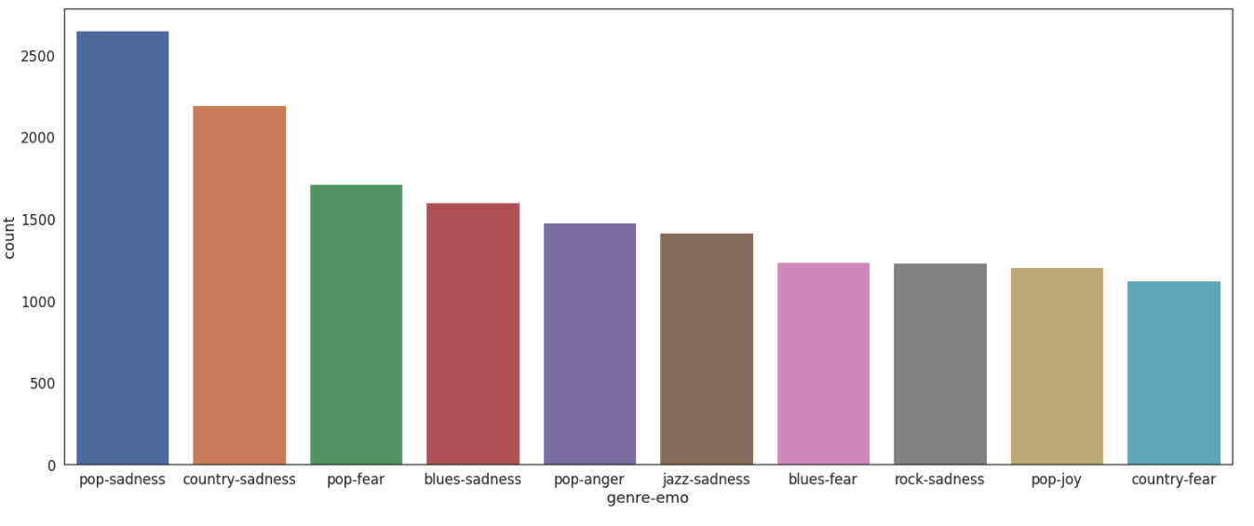
Best Neural Network result
Tuned Neural Networks output the best f1 score: 0.826
Most predicted emotion is sadness
Prediction are more balanced

Slide 10
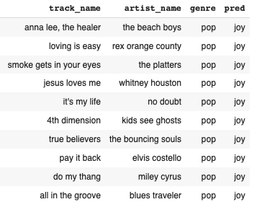
Song Suggestion
Simple random song suggestion Algorithm
Algorithm:
User input: genre and emotion
Retrieve from Emotion detection lyrics dataset songs predicted with the same genre and emo as input
Return randomly 10 songs

Slide 11
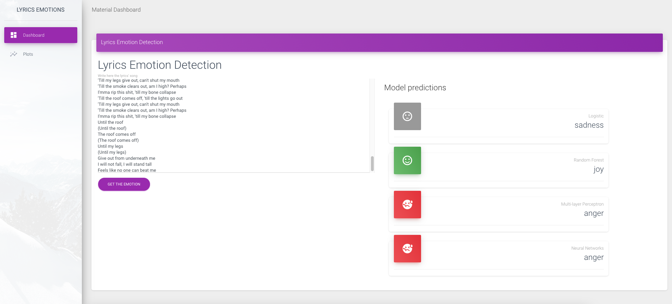
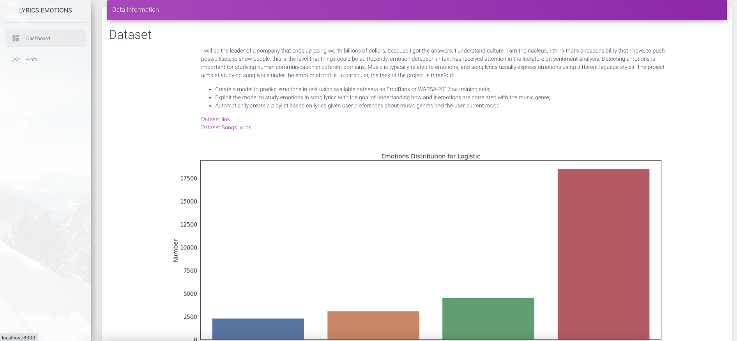
Web Application
Main page:
Form for lyrics test
Model prediction results
Plot page:
Dataset description
Plots

Slide 12
Simple tests
Good day
Bad day
Evil

Slide 13
Real world tests
Blackbirds The Beatles
Good Day Sunshine The Beatles
Till I collapse Eminem

Slide 14
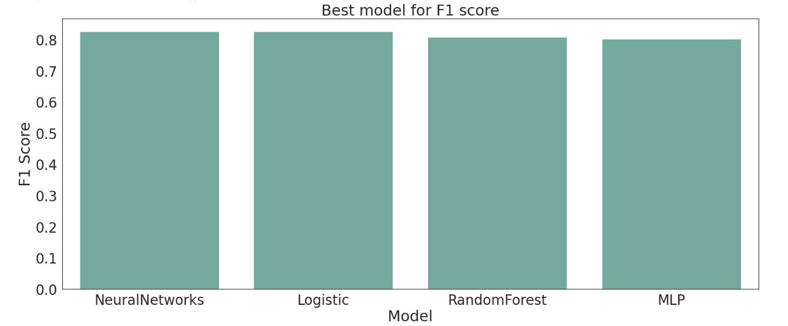
Conclusions
Neural Networks and Logistic outputs similar results according to the F1 score.
In real world example MLP and Neural Networks outputs better predictions

Slide 15

Questions?

