Slide 1
NTT STARTUP
CHALLENGE 2026
Partnership & Investment
Pitch Deck
BABOO KOS
Platform Hunian Digital untuk Anak Rantau Indonesia

Slide 2
Introduction
01
Content
Outline
About us: digital concierge boarding search, trusted since 2021
The Problems We Solve
02
Why now — friction in finding rental rooms in Indonesia
Product & Solution
03
4-step digital concierge, plus the social impact it creates
Our Traction
04
Organic growth, trusted by thousands across Indonesia
Market Size & Opportunity
05
A large, still-fragmented short-term rental market
Competitive Landscape
06
Why a human-first concierge wins where marketplaces can't
Team
07
The people behind Baboo Kos
Golden Slide
08
Baboo Kos x NTT DOCOMO Ventures synergy
Financial Ask & Roadmap
09
Funding needs and collaboration timeline with NTT Group
Baboo Kos | NTT Startup Challenge 2026
02

Slide 3
About Baboo Kos
Digital concierge for boarding searches, trustworthy since 2021
01
02
03
Vision
Mission
Business Model
Making every boarder's dream come true: finding the perfect place to live — honest and hassle-free.
Acting as the fastest digital platform connecting housing seekers with boarding house owners through a highly user-friendly service — while helping owners improve operational quality through digitalization.
A WhatsApp-based concierge service for finding boarding accommodation — customers pay a service fee (e.g., IDR 110,000) to receive curated recommendations within 2-6 days.
Baboo Kos | NTT Startup Challenge 2026
03

Slide 4
Problems
We Solve
We started during COVID-19 — while others built marketplaces, we took a different path: manual, relationship-first.
Why now? Digital trust adoption among Gen Z renters has hit a tipping point, and NTT's new Synexia Ventures fund is actively seeking AI/IoT housing partners in Indonesia — the timing has never been better.
01
02
03
04
Opaque Information
Risk of Fraud & Zonk
Wasted Time and Effort
Owners Not Yet Digital
The photos do not match reality, prices fluctuate, and the actual facilities are unclear.
Online booking is prone to scams; many prospective tenants end up with a 'dud' boarding room after paying.
Conducting manual surveys across multiple locations is time-consuming, especially for newcomers to the city.
Thousands of boarding house owners still rely on manual promotion, struggling to reach prospective tenants.
Baboo Kos | NTT Startup Challenge 2026
04

Slide 5
Product & Solution
How It Works
1
Contact via WhatsApp
2
Communicate Criteria
3
Paid & Processed
4
Receive Recommendations
Customer contacts the Baboo Kos Admin via WA/Instagram/TikTok.
Admin guides entry of criteria: location, budget, facilities, room type.
Following payment, the team searches and curates the best options.
CS sends a curated list matching the criteria within 2-6 days.
Social Impact
Fairer Housing Access
Creating Jobs
Boosting Owner Economy (UMKM)
Protecting Against Scams
Healthier Urbanization
Migrants, students & new arrivals no longer fumble alone to find safe, budget-friendly rentals.
Admin, CS, and field-survey roles provide genuine livelihoods, not just a lean-startup headcount.
Boarding house owners get faster occupancy and a real digital channel.
Manual verification makes Baboo Kos a layer of consumer protection in a fraud-prone sector.
Easier mobility for education and work supports more equitable economic growth.
Baboo Kos | NTT Startup Challenge 2026
05

Slide 6
Our
Traction
Organic growth, trusted by thousands of people living away from home across Indonesia.
40rb+
33rb+
4,7/5
70+
Residential seekers who trust Baboo Kos
Customers satisfied with the service received
Average user satisfaction rating
Strategic cities and areas across Indonesia
Source of Income
Network Distribution
Search service fee per transaction (fee-based, paid by customer)
Collaboration and partnerships with boarding house owners
Baboo Villa expansion line for the premium housing segment
Jakarta, Bandung, Semarang, Yogyakarta, Surabaya, Malang, Bali, Medan, Makassar, Palembang, Balikpapan, and dozens of other cities — a continuously growing national reach.
Baboo Kos | NTT Startup Challenge 2026
06

Slide 7
Market Size &
Opportunity
Indonesia: a large and still-fragmented short-term rental market.
Millions of university students and young professionals migrate to major cities every academic/career cycle, all needing temporary housing.
Illustrative Market Size (TAM)
Most boarding houses in Indonesia are still managed manually (offline) and are hard to find through trusted channels.
10.75M
Rp700K-2.5M
Registered students in Indonesia, 2025 (Kemdiktisaintek/PDDikti)
Average monthly kos price range nationally
Urbanization and a mobile young middle class are driving demand for flexible housing beyond conventional long-term rentals.
~Rp38 Trillion/year
The opportunity: solutions that combine trust, human curation, and technology — a gap perfectly filled by Baboo Kos.
Estimated bottom-up TAM from the student segment alone (assuming 30% live in a kos at ~Rp1M/month) — excludes young-professional migrants.
Illustrative calculation based on national enrollment data; not an official published industry figure.
Baboo Kos | NTT Startup Challenge 2026
07

Slide 8
Competitive Landscape
Everyone else built a marketplace. We built trust.
Mamikos
Rukita
RedDoorz / KoolKost
RoomMe
Largest marketplace listing (~6M renters/month, ~150K properties)
Full-service co-living & property management
Budget-hotel-style kos network
Managed kos with standardized comfort
vs. Baboo Kos:
vs. Baboo Kos:
vs. Baboo Kos:
vs. Baboo Kos:
Self-service — users search & verify alone
Manages only its own units, not cross-platform search
Corporate-standardized, less personal touch
Small scale (~2,000 rooms), Jakarta-focused
“We're not trying to out-list Mamikos. We're building the trust layer they can't replicate at scale.”
Baboo Kos | NTT Startup Challenge 2026
08

Slide 9

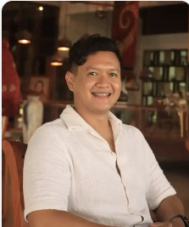


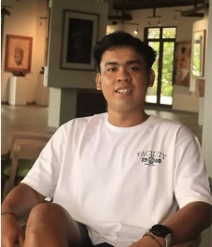
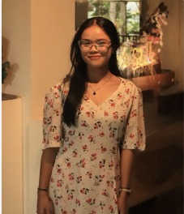


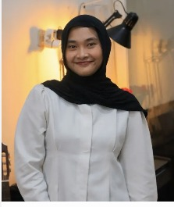
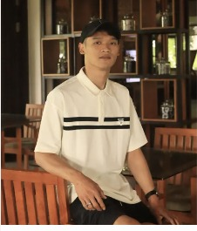
Team
The people building trust, one conversation at a time
Pranayama Sukma F. W.
Afifa Nur Aulia Viranti
Meliani Ananda Ginting
Muchammad Akmal Mustofa
Kisfa Azka Khalisha
Dominikus Ivan Ardianto
Administrator (ADM)
HR Development (HRD)
Head of Customer Service
Head of Content Creator
Content Manager (CM)
Content Creative (CCR)
Yucha Pratama
Chief Executive Officer
Atikah Azra Wahdah
Difa Aisyah Putri
Andrean Yogha Saputra
Social Media Specialist
Marketing Executive (ME)
Web Dev / Digital Support
9 people run daily operations — CS, content, marketing & tech — the human-first engine a marketplace can't replicate. Technical execution for the AI platform is the core value the NTT partnership brings.
Baboo Kos | NTT Startup Challenge 2026
09

Slide 10
Baboo Kos
x
NTT DOCOMO Ventures
Building Digital Infrastructure for Urban Living
WHAT BABOO KOS OFFERS
40,000+
70+
Strong
Real
Boarding House Seekers
Cities Coverage
Digital Community
Housing Demand Data
What Do We Want to Build Together?
AI-based housing platform
01
02
03
04
05
Discover
Match
Assist
Empower
Connect
AI understands what people actually need.
Personalized recommendations by budget, location, lifestyle.
AI housing assistant helps search, compare, decide.
Owners get intelligence on demand, pricing, occupancy.
Future integration with IoT and smart-living tech.
“Baboo understands the market. NTT brings the technology. Together, we can transform how people discover, choose, and experience their homes.”
Baboo Kos | NTT Startup Challenge 2026
10

Slide 11
Financial Ask & Roadmap
Seed stage — accelerating expansion and technology strengthening with NTT Group
Funding Ask
Roadmap Collaboration
SEED STAGE
Oct 2026
Top 20 — online pitch presenting the collaboration concept to NTT Group
Revenue run-rate
[To be filled — current monthly/annual figure]
Unit economics
[To be filled — avg. fee x monthly transactions]
Nov 2026
Grand Final Jakarta — finalize Golden Slide & discuss partnership terms
Growth trajectory
[To be filled — MoM / YoY growth %]
Funding ask
[To be filled — specific nominal amount]
Q1 2027
Pilot project with one NTT operating company (data / infrastructure)
Use of Funds:
Expansion into new cities & regions
Digital platform development & AI matching integration
Strengthening operations & customer service teams
Smart-living infrastructure pilot with NTT partners
Q2-Q3 2027
Scale-up: new city expansion & full technology integration
Baboo Kos | NTT Startup Challenge 2026
11

Slide 12
Thank You!
Baboo Kos is ready to serve as the distribution and pilot ground partner
for NTT Group's smart-living solutions in Indonesia.
Yucha Pratama, CEO | babookos.com | wa.me/6287785338441
Baboo Kos | NTT Startup Challenge 2026
12

