Slide 1


Slide 2
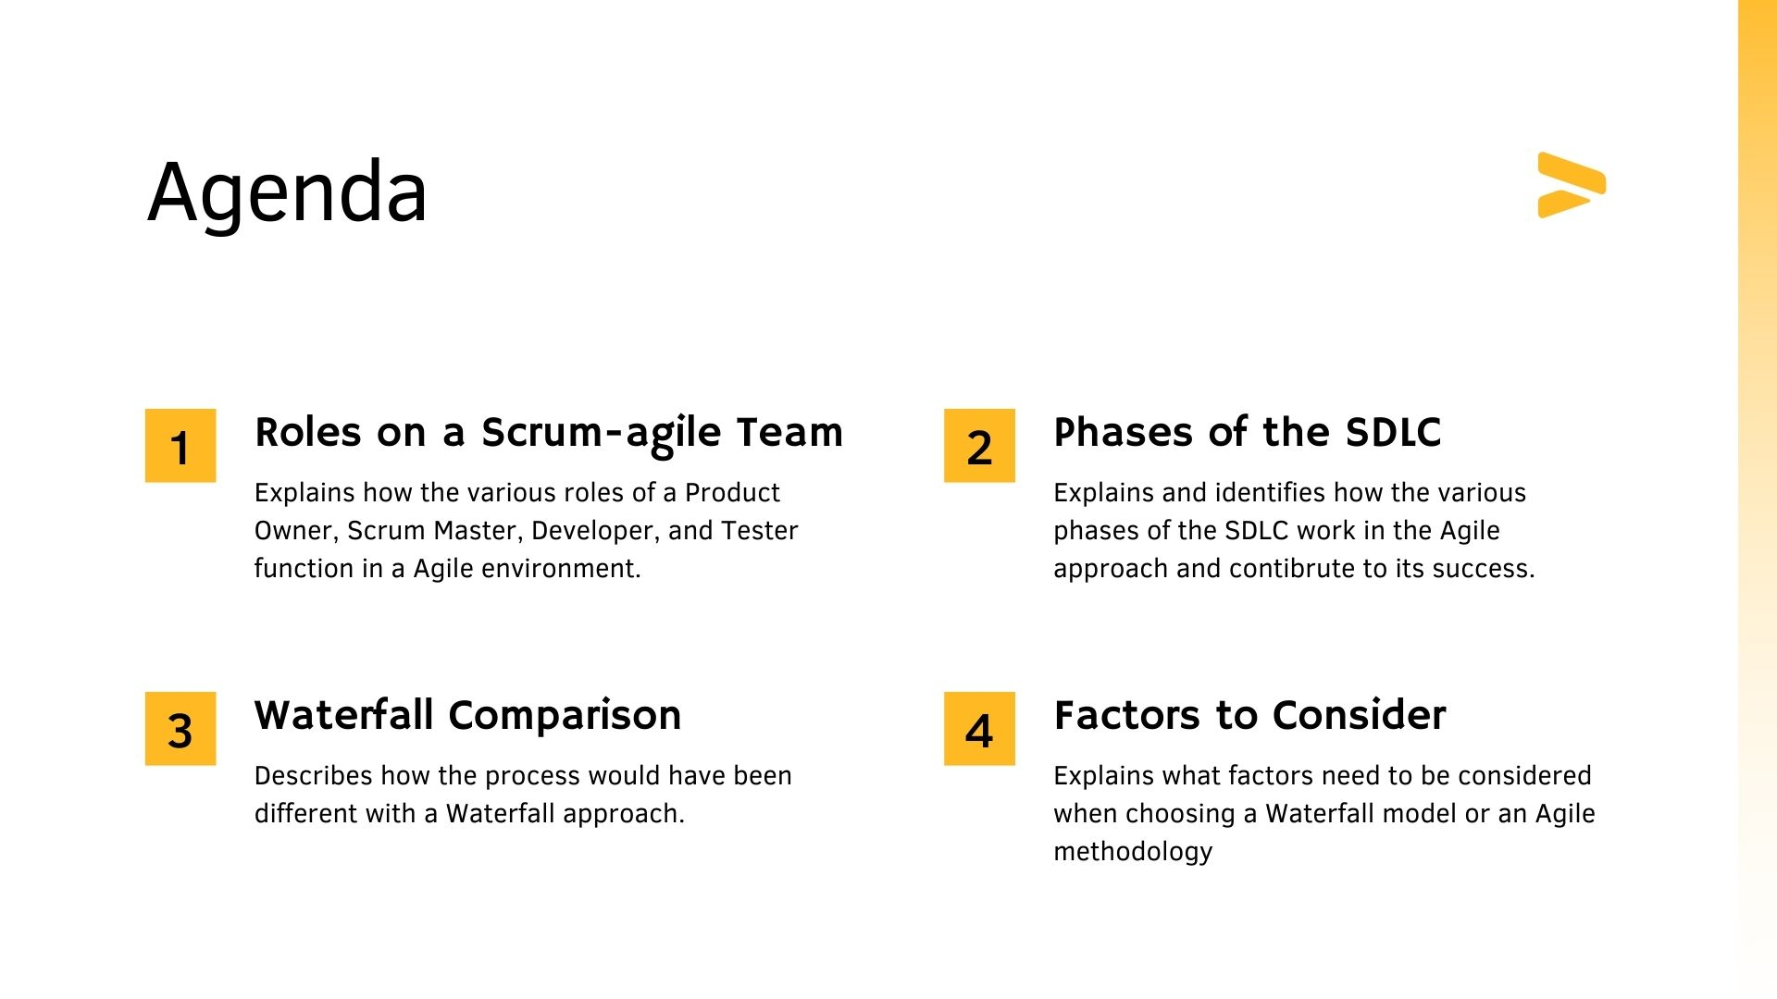

Slide 3
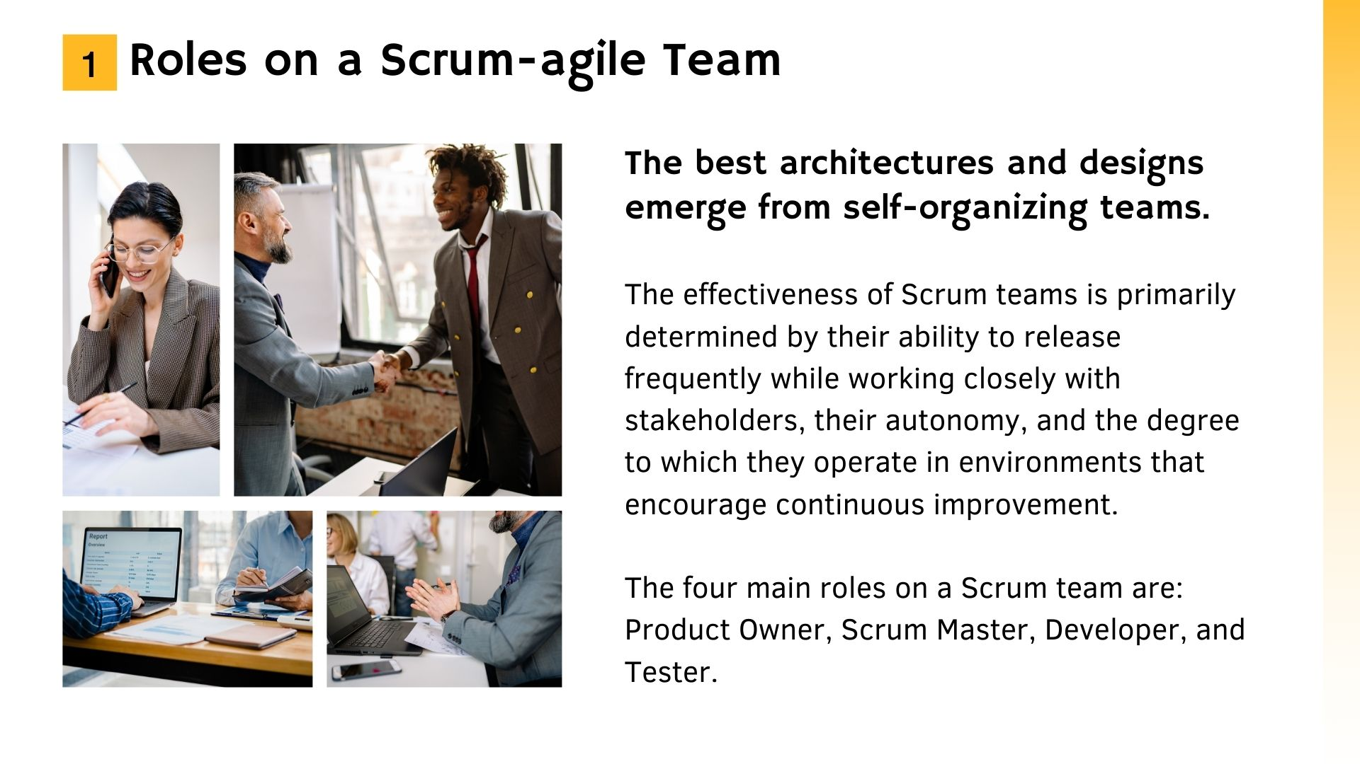
(Beck et al., 2001)
(Schwaber & Sutherland, 2013)

Slide 4
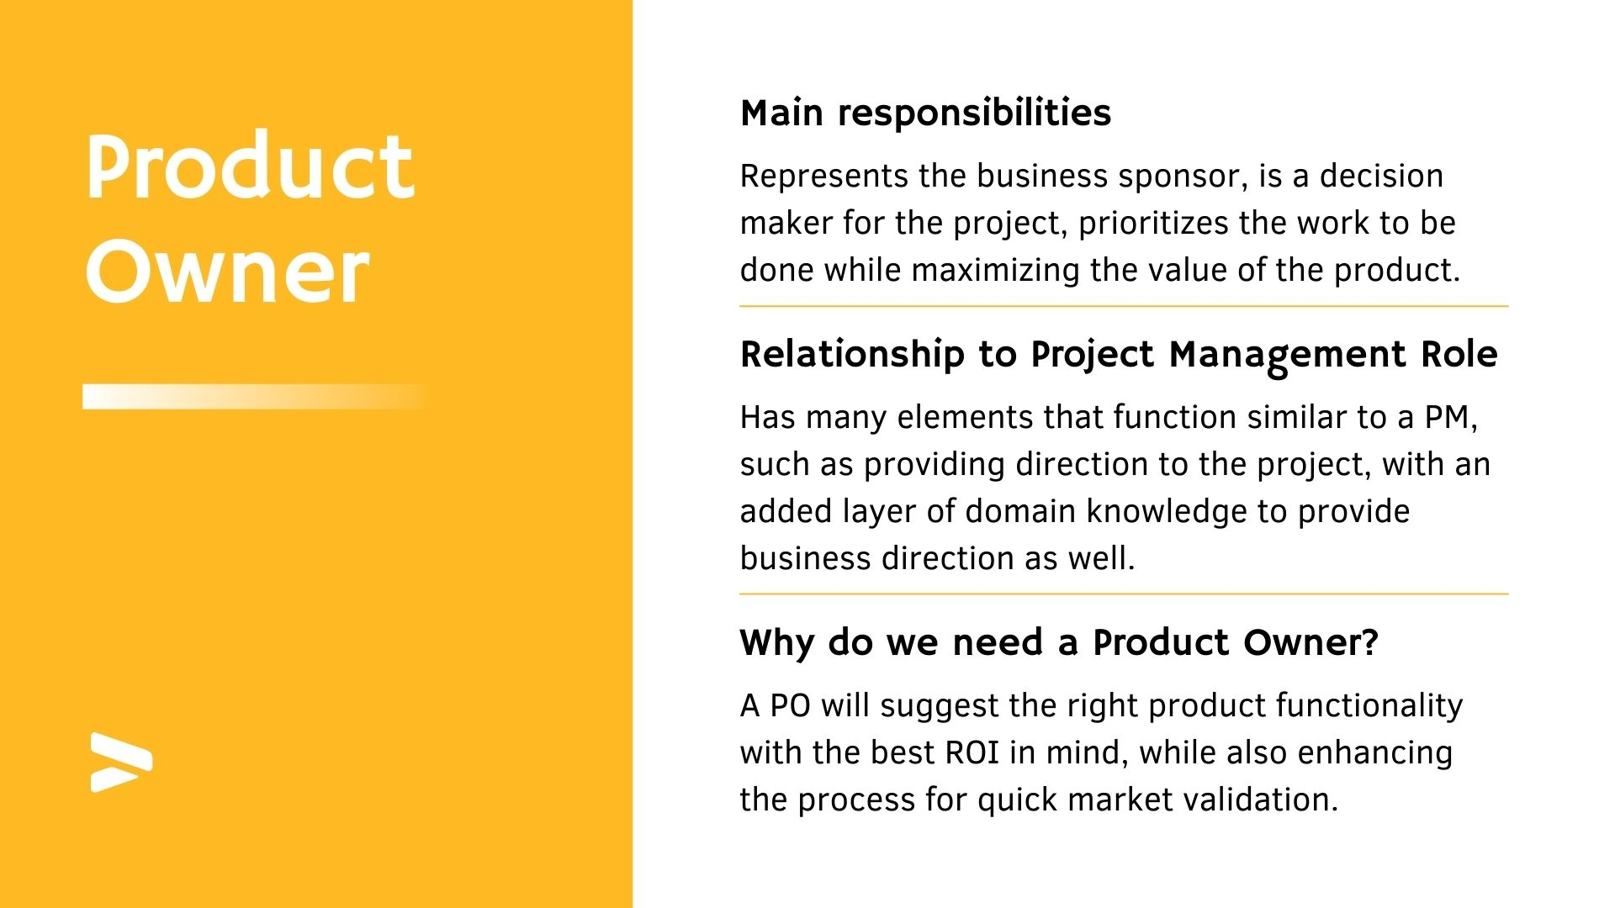
(Cobb, 2015)

Slide 5
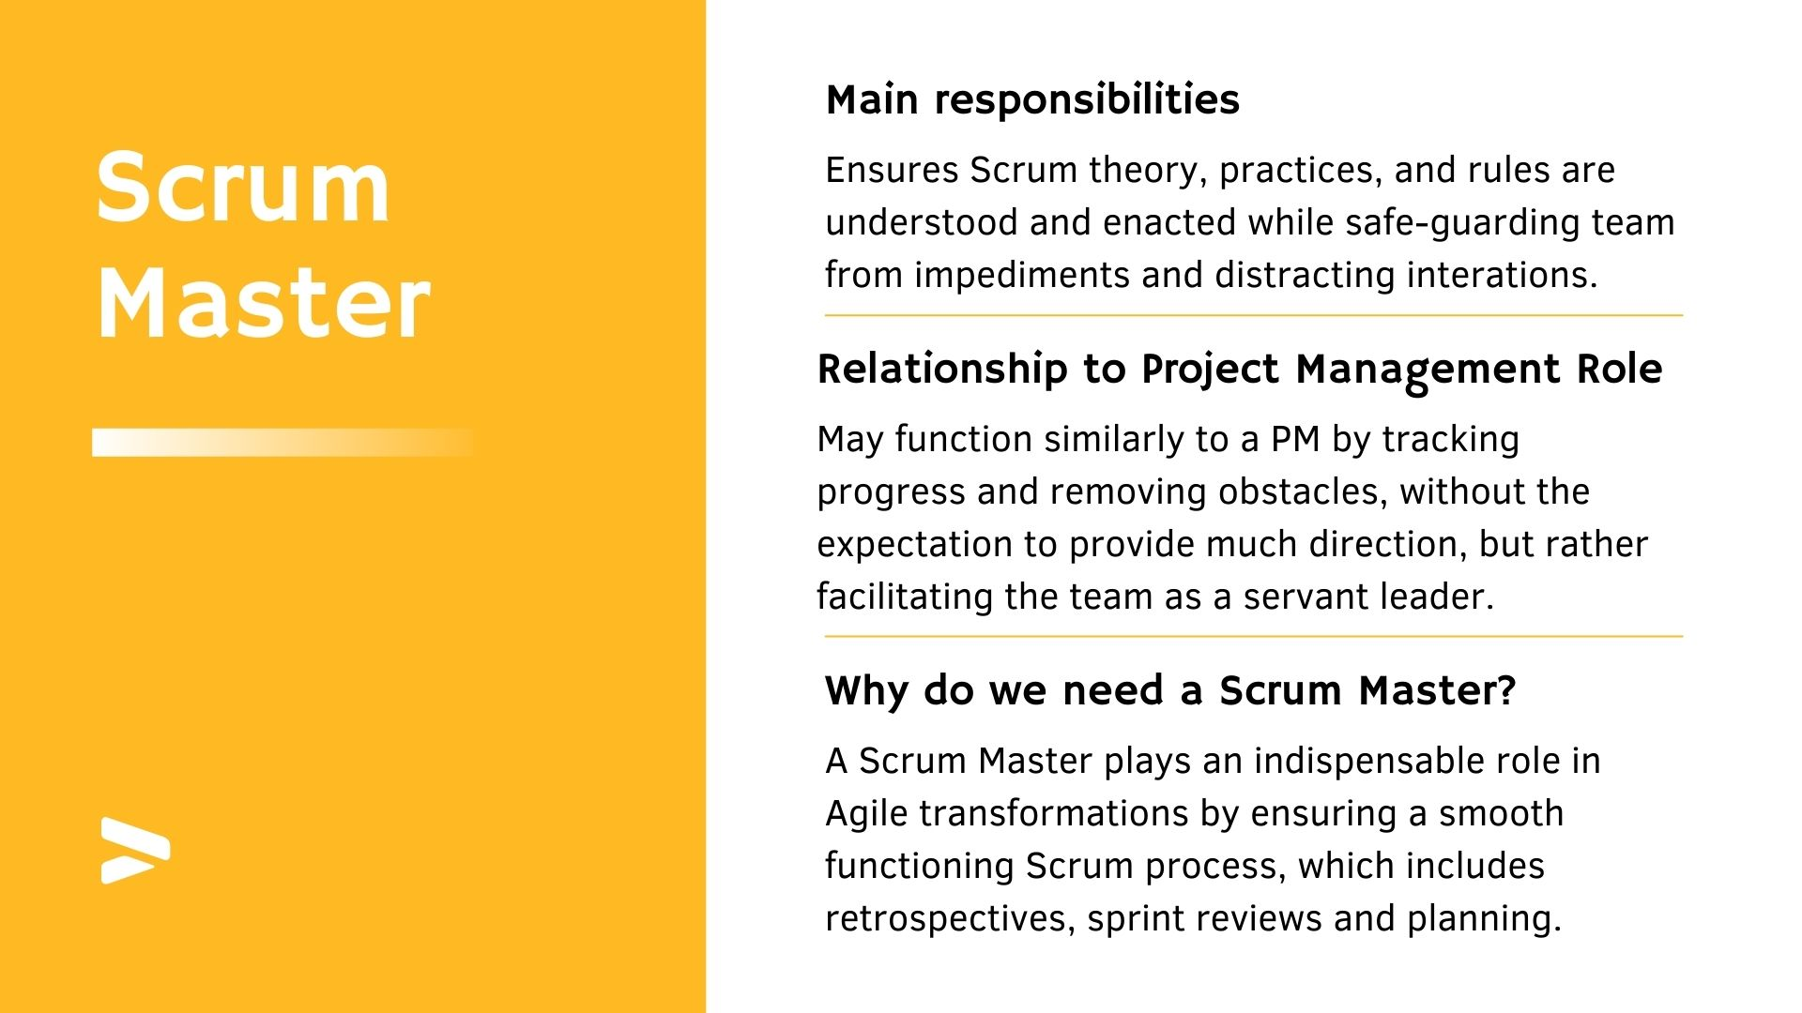
(Cobb, 2015)

Slide 6
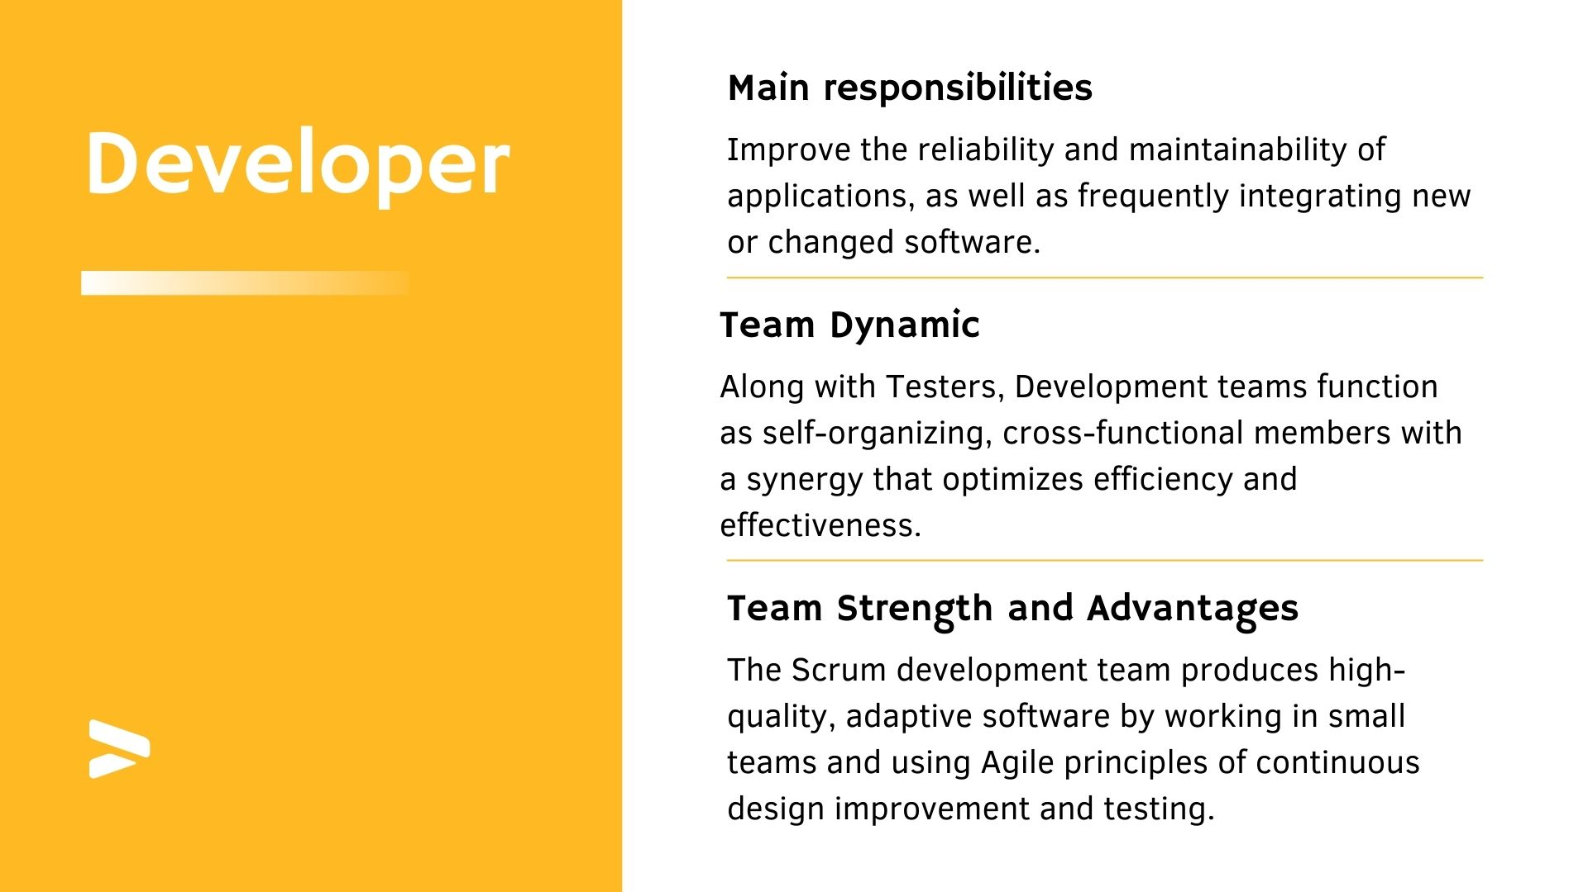
(Cobb, 2015)

Slide 7
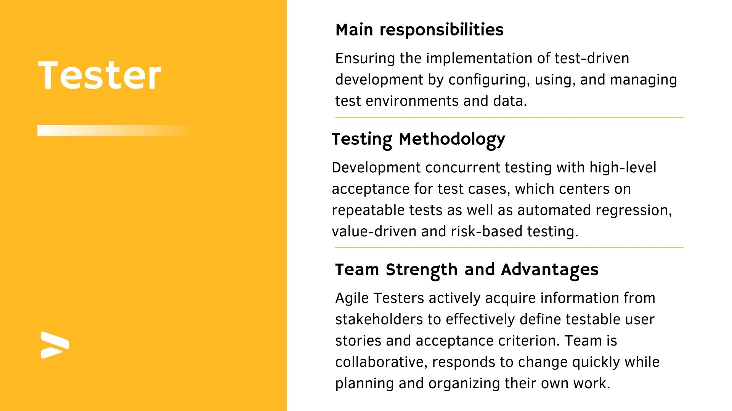
(Cobb, 2015)

Slide 8
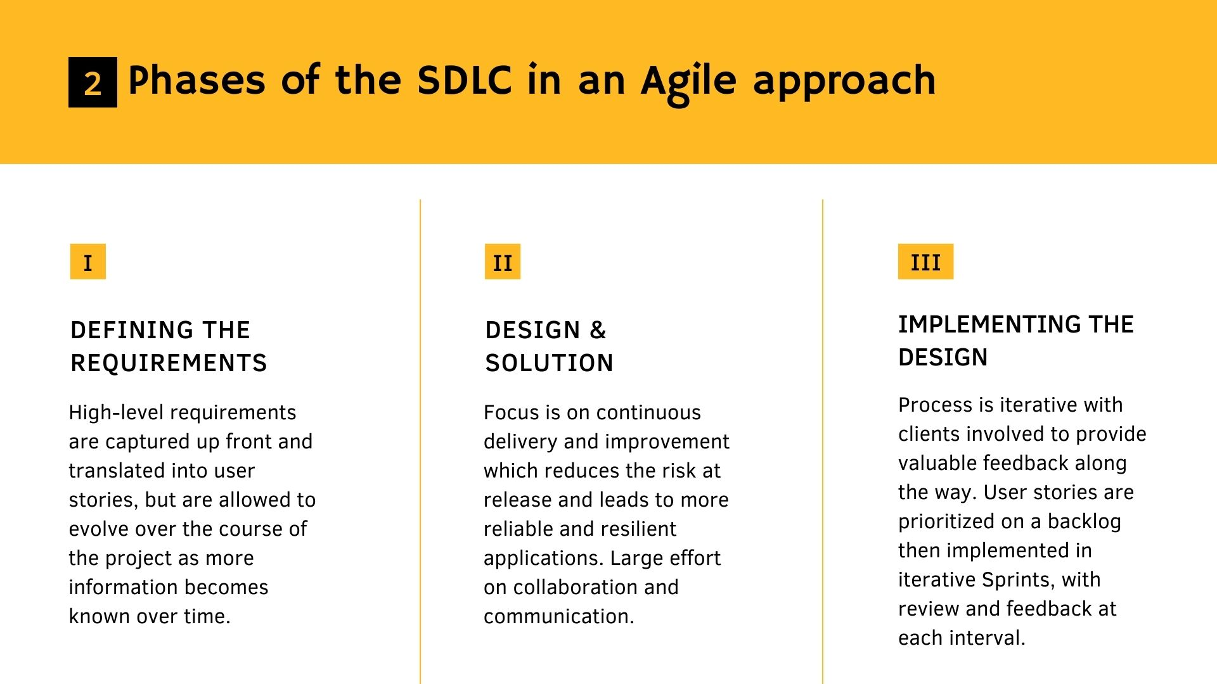

Slide 9
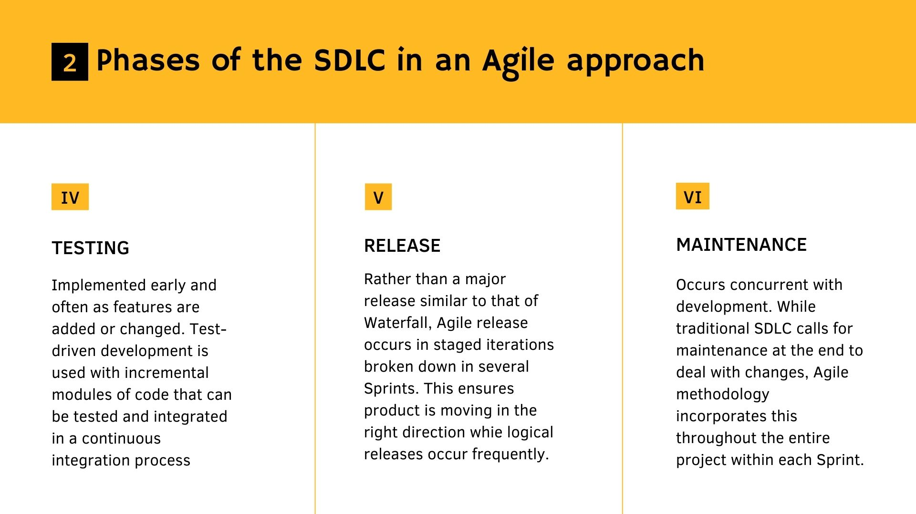

Slide 10
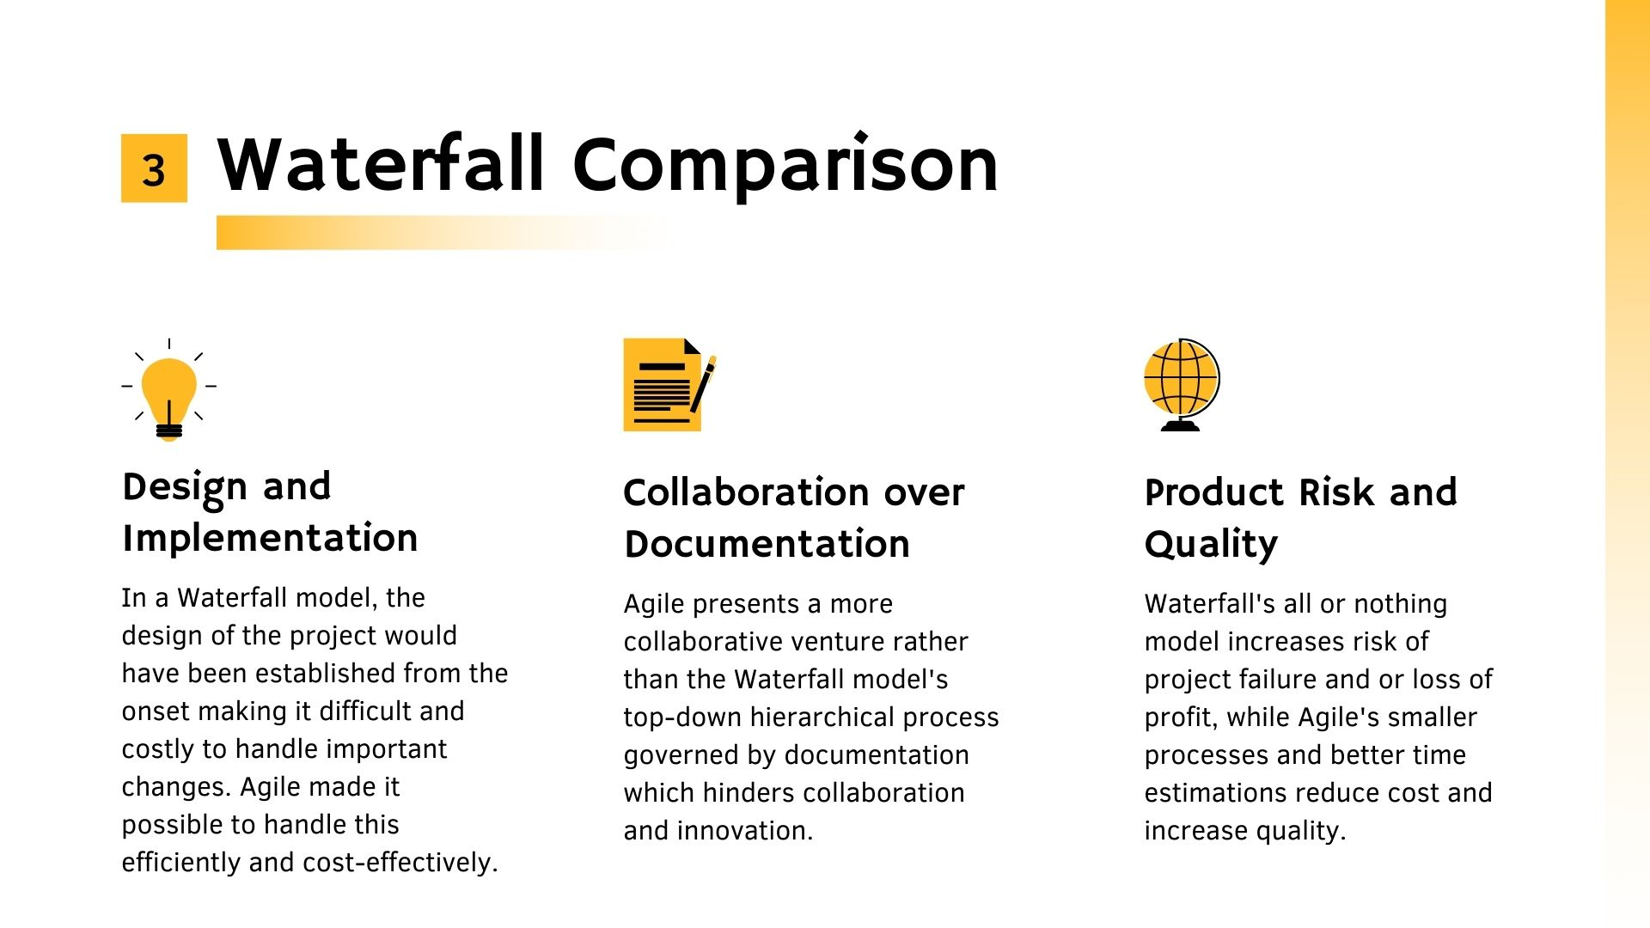

Slide 11


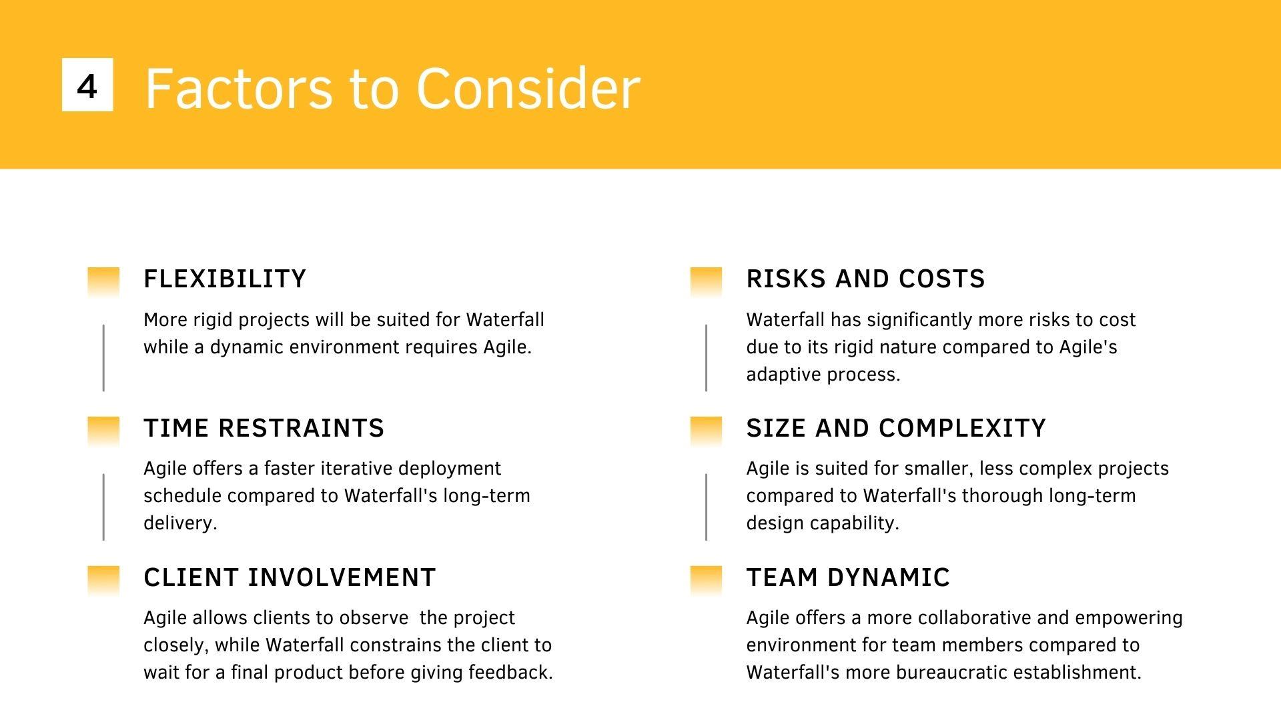

Slide 12


Slide 13


Slide 14


Slide 15


