Slide 1


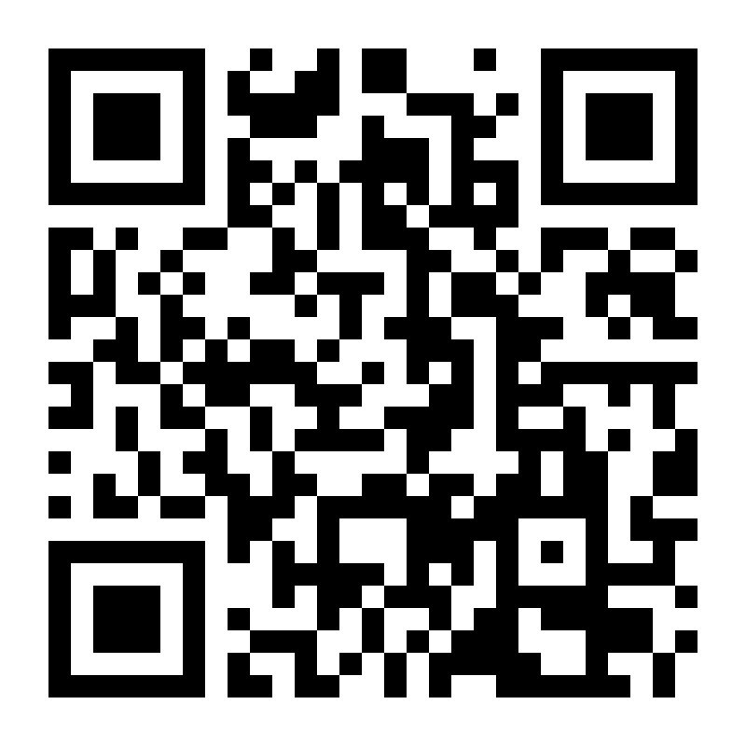
Praktikum Entwicklung von Mediensystemen: Entwicklung von interaktiven Geräten zur Erfassung von Medien
Human-Centered Ubiquitous Media
MidiIdentifier™ – know your earworm!
Karsten Schick & Andreas Scholz
What it is
Do you now that feeling when you’ve got a song stuck in your head, and you just can’t remember what it’s called?
You can play piano?
Then we have the solution for you! Just play the song, and the MidiIdentifier™ will tell you what it’s called and even play it for you!*
*Only works on selected songs. No guarantees. None. Seriously.
The design
If your childhood was spent in the 70s and 80s, you may recognize parts of the design. Inspiration was mainly drawn from the Apple II. The slight upward angle at the bottom front, as well as the slightly upward angled keyboard are iconic. The screen design should also be familiar – the font and color design was inspired by the Apple II. Back then, however, the huge cathode ray tube could not be folded back into the case.
How it works
On the hardware side, there isn’t anything special: A midi piano, speakers and a 7” LCD touch screen all connected to a Raspberry Pi 3 Model B.
The software side is more interesting: The individual notes you hear when pressing a piano key are generated in real-time, rather than being prerecorded audio files. Once the recording is finished, the midi data is converted into a much simpler format in order to save space and increase processing speed. The midi file library we use is processed in the exact same way so that both the user input and the midi library have the same format. To identify the played song, we developed several different compare algorithms. In the end, the best results were achieved by comparing tone differences with one another without taking absolute tone heights into account. However, given the fact that self-played music identification is still a largely unsolved problem, we too don’t achieve a 100% success rate.*
*Not even close. ;)
Want to build it yourself?
GitHub Link: http://goo.gl/RudPcd
Contact: karsten.schick@campus.lmu.de
Contact: andreas.scholz@campus.lmu.de

