Slide 1


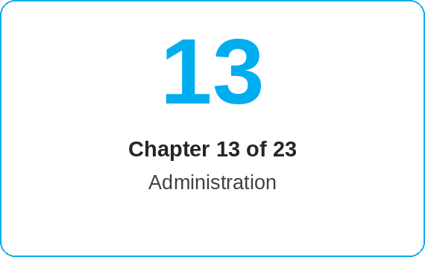
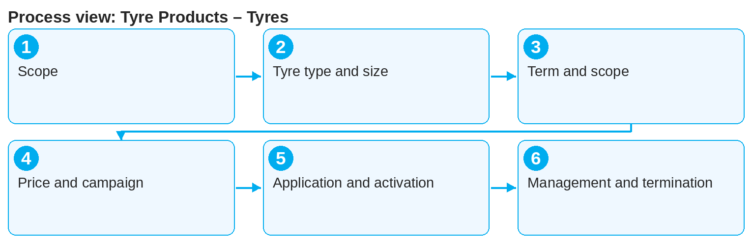
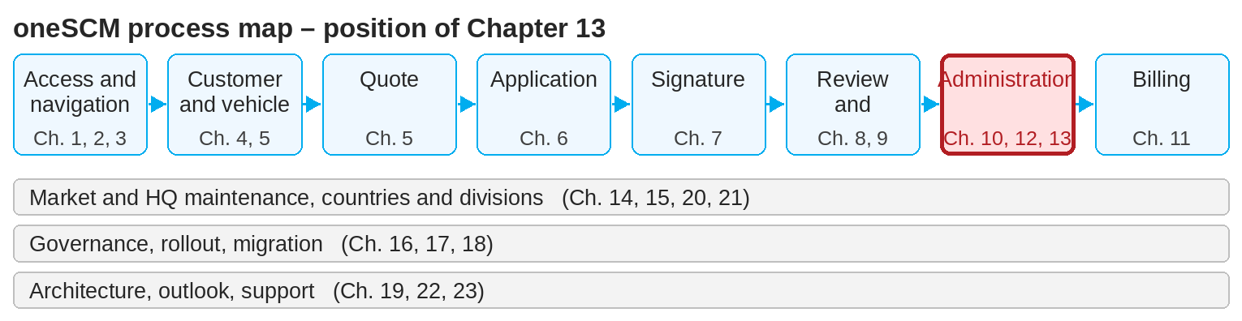
oneSCM – Tyre Products – Tyres
oneSCM
for Cars
Purpose and benefit
You position tyre products relative to the standard process, select product, tyre type and tyre size, configure term, mileage and scope of services, check price, options and campaigns, carry out application, documents and activation and manage the contract through to termination (Chapter 13.1 to 13.7).
How to proceed
References to handbook chapters and systems are highlighted; e-mail addresses are provided as links.
Recognize the distinction (13.1): tyre products follow the standard process but have their own product and price parameters.
Select the tyre product as well as tyre type and tyre size matching the vehicle (13.2).
Configure term, mileage and scope of services (13.3) and check price, options and campaigns (13.4).
Topics at a glance
13.1 – 13.4 Product
Positioning and distinction from the standard process
Product, tyre type and tyre size
Term, mileage and scope of services
Price, options and campaigns
13.5 – 13.7 Contract
Application, documents and activation
Ongoing management and claiming services
Renewal and termination
!
Tyre size and tyre type must match the vehicle equipment. Deviations lead to rejection in the MO Check and prevent services from being claimed.
Create the application, obtain the signature and upload the documents (13.5, as in Chapters 6 to 8).
During the active contract, services are claimed via the workshop (13.6).
Before the end of the term, check renewal or termination (13.7).
Note: This Quick Guide summarizes Chapter 13 of the oneSCM handbook. Details, screenshots and evidence can be found in the handbook.
AS OF: 2026-10-11 | 1/2

Slide 2
oneSCM – Tyre Products – Tyres
oneSCM
for Cars
Roles and prerequisites
Frequently asked questions and answers
Can I combine tyres and service in one contract? This depends on the market's product offering (Chapters 13.1 and 14.8).
Where does the tyre size come from? From the vehicle data; check it against the actual equipment (13.2).
How are services claimed? Via the workshop with reference to contract and coverage (13.6 and 19.9).
Roles involved
Dealer: offer, apply for and manage tyre contracts
Market: maintain tyre products, sizes and prices
MO: check and activation
Prerequisites
Vehicle data loaded (Chapter 5)
Tyre type and tyre size of the vehicle known
Tyre product is released in the market
Important links and contacts
oneSCM handbook – Complete chapters with screenshots, role, status and scope matrices (Appendix D).
VEGA – Contract, coverage and claim (Chapter 19.9).
FAQ and troubleshooting – Chapter 23 with questions per process phase and known errors per market and release.
Support and escalation – Report a support case with reference number, market, division and screenshot (Chapters 23.4 and 23.5).
Checklist before completion
☐ Tyre product available in the market
☐ Tyre type and size correct
☐ Term and mileage configured
☐ Application activated, services can be claimed
Notes and pitfalls
Technical options and coverage codes are maintained centrally (Chapter 15.7).
Observe division differences Cars/Vans (Chapter 21).
Campaigns for tyre products depend on market and time (Chapter 14.13).
Note: This Quick Guide summarizes Chapter 13 of the oneSCM handbook. Details, screenshots and evidence can be found in the handbook.
AS OF: 2026-10-11 | 2/2

