Slide 1


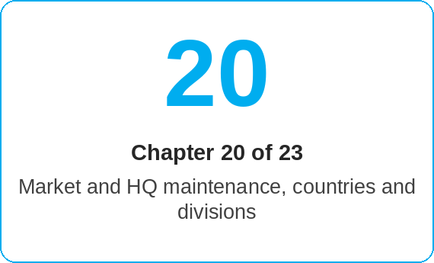
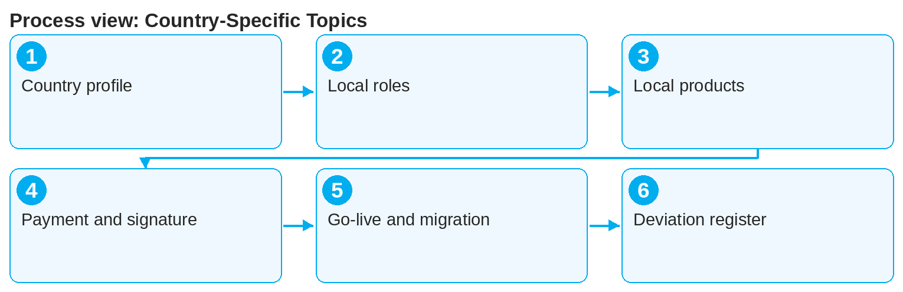

oneSCM – Country-Specific Topics
oneSCM
for Cars
Purpose and benefit
You read the country and market profile, know local roles and access variants, local products, prices and campaigns, payment, documents and signature per country, the country-specific go-live and migration as well as the country deviation register (Chapter 20.1 to 20.6).
References to handbook chapters and systems are highlighted; e-mail addresses are provided as links.
How to proceed
Read the country and market profile of your country (20.1).
Check local roles and access variants (20.2) against Chapter 2.
Observe local products, prices and campaigns (20.3) and their maintenance by the Market (Chapter 14).
Topics at a glance
20.1 – 20.3 Profile and products
Country and market profile
Local roles and access variants
Local products, prices and campaigns
20.4 – 20.6 Processing and quality
Payment, documents and signature per country
Country-specific go-live and migration
Country deviation register and quality
!
Undocumented country deviations are not permitted. In case of doubt, the Blueprint applies; deviations are added to the register via Market and HQ.
Apply the country-specific rules for payment, documents and signature (20.4), e.g. language variants and permitted signature types.
Follow the go-live and migration of your country (20.5, Chapters 17 and 18).
Check every deviation in the country deviation register (20.6); only documented deviations apply.
Note: This Quick Guide summarizes Chapter 20 of the oneSCM handbook. Details, screenshots and evidence can be found in the handbook.
AS OF: 2026-10-11 | 1/2

Slide 2
oneSCM – Country-Specific Topics
oneSCM
for Cars
Roles and prerequisites
Frequently asked questions and answers
Does my Quick Guide apply in every country? The standard process does; country-specific deviations are in the country profile and register (20.1 and 20.6).
Who enters deviations? The Market requests, HQ approves (15.3 and 20.6).
Which signature types exist in my country? See Chapter 20.4 and the country profile.
Roles involved
Market: maintain country profile and deviation register
HQ: approve deviations (Chapter 15.3)
Dealer/MO: apply local rules
Prerequisites
Own country and market are known (Chapter 2.4)
Access to the country deviation register
Knowledge of the Blueprint (Chapter 15.2)
Important links and contacts
Country deviation register – Chapter 20.6.
oneSCM handbook – Complete chapters with screenshots, role, status and scope matrices (Appendix D).
FAQ and troubleshooting – Chapter 23 with questions per process phase and known errors per market and release.
Support and escalation – Report a support case with reference number, market, division and screenshot (Chapters 23.4 and 23.5).
Checklist before completion
☐ Country profile read
☐ Local roles and access checked
☐ Local product and payment rules known
☐ Deviations checked in the register
Notes and pitfalls
For each deviation, the register contains reason, approval and validity.
Signature types and document languages may differ per country (Chapters 7.4 to 7.6).
Known errors with market reference are listed in Chapter 23.2.
Note: This Quick Guide summarizes Chapter 20 of the oneSCM handbook. Details, screenshots and evidence can be found in the handbook.
AS OF: 2026-10-11 | 2/2

