Slide 1


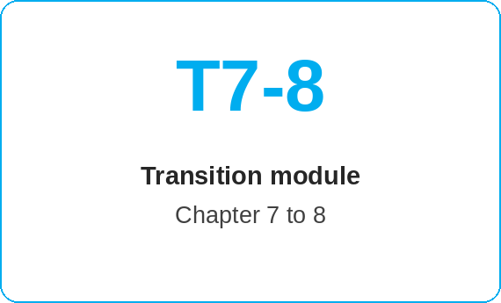
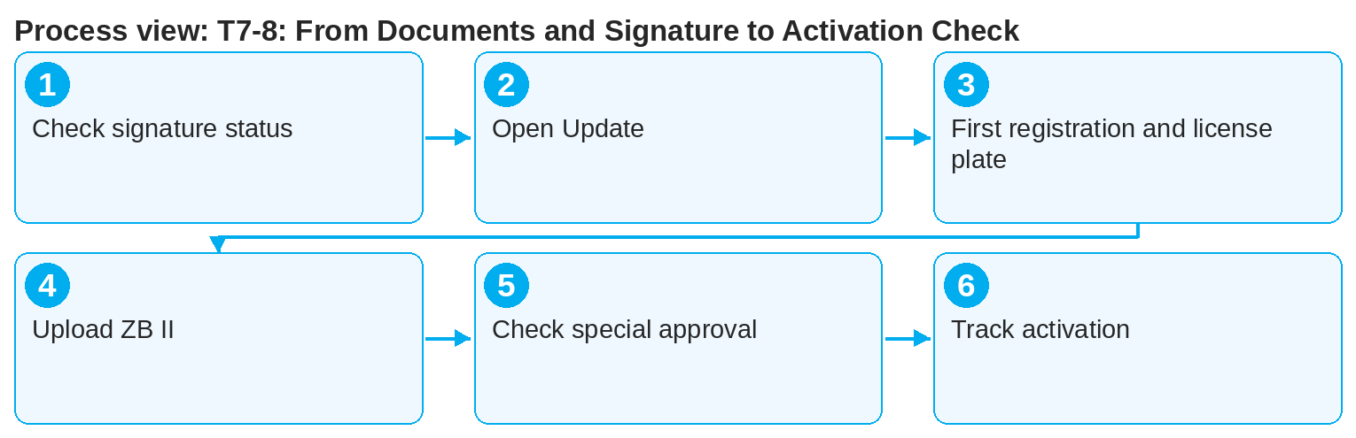
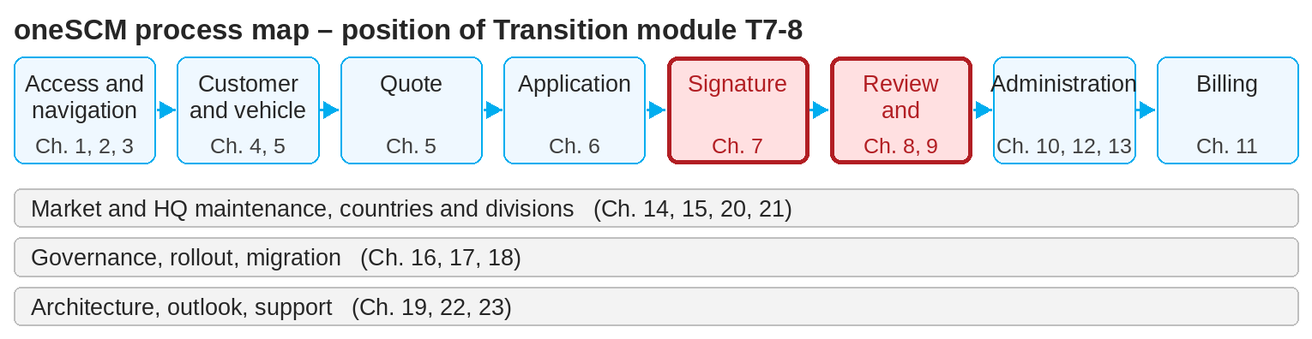
oneSCM – T7-8: From Documents and Signature to Activation Check
oneSCM
for Cars
Purpose and benefit
This module links Chapter 7 (signature and documents available) with Chapter 8 (track and activate application). You make sure that all activation prerequisites are met before Customer Management reviews.
References to handbook chapters and systems are highlighted; e-mail addresses are provided as links.
How to proceed
Transition at a glance
Check the signature and document status in Application Management (Chapters 7.8 and 8.1).
Open the "Update" action via "…" and add the first registration date and license plate (Chapter 8.3).
In the "Communication" tab, upload the copy of ZB I/ZB II and, for the print variant, the signed document.
Starting point (Chapter 7)
Signature obtained digitally or manually
Documents filed in the system or uploaded
Payment data complete
Target (Chapter 8)
First registration and license plate added
ZB II uploaded
Application fully submitted, activation done
!
Without first registration, license plate and ZB II, no activation takes place, even if the application is signed. The upload is not a mandatory field in the system.
Make sure that no open special approval is blocking activation (Chapters 6.5 and 9).
Track the application status until activation and respond to queries from Customer Management (Chapters 8.6 and 8.7).
Note: This Quick Guide summarizes transition module T7-8 of the oneSCM handbook. Details, screenshots and evidence can be found in the handbook.
AS OF: 2026-10-11 | 1/2

Slide 2
oneSCM – T7-8: From Documents and Signature to Activation Check
oneSCM
for Cars
Roles and prerequisites
Frequently asked questions and answers
The customer has signed, but the application is not active. Why? Usually first registration, license plate or ZB II is missing; see Chapter 8.3.
Can I submit the ZB II later? Yes, at any time via Application Management › Reference number › Communication.
Who activates the contract? The system if data are complete, otherwise Customer Management after review (Chapter 8.5).
Roles involved
Dealer: complete data and documents
Customer Management/MO: review and activation
System: automatic activation when complete
Prerequisites
Signature status "signed" (Chapter 7.8)
Contract document and SEPA mandate filed
First registration, license plate and ZB II available
Important links and contacts
Chapter 7 – Payment data, documents and signature.
Chapter 8 – Track and activate application.
oneSCM Handbook – Complete chapters with screenshots, role, status and scope matrices (Appendix D).
Support and escalation – Report a support case with reference number, market, division and screenshot (Chapters 23.4 and 23.5).
Checklist before completion
☐ Signature and document status checked
☐ First registration and license plate added
☐ ZB II uploaded
☐ No open special approval
Notes and pitfalls
With e-signature and e-mail signature, the contract documents are filed automatically; with print, they must be uploaded.
Incorrect applications are rejected; the customer is informed.
The limit of 12 months or 50,000 km after first registration applies (Chapter 23.1).
Note: This Quick Guide summarizes transition module T7-8 of the oneSCM handbook. Details, screenshots and evidence can be found in the handbook.
AS OF: 2026-10-11 | 2/2

