Slide 1


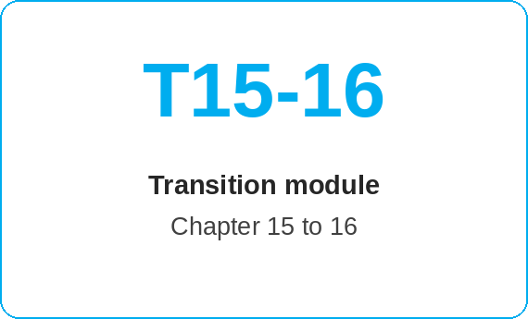
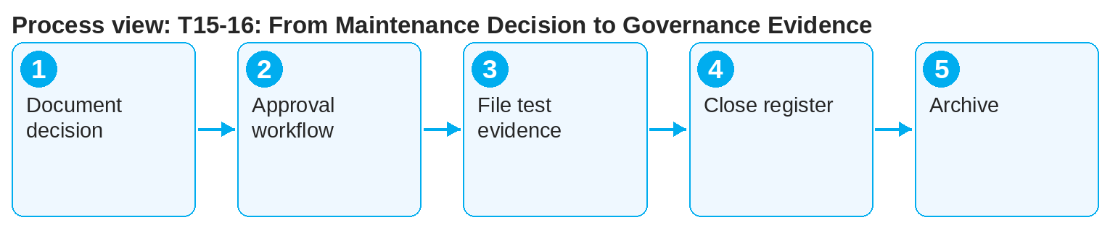
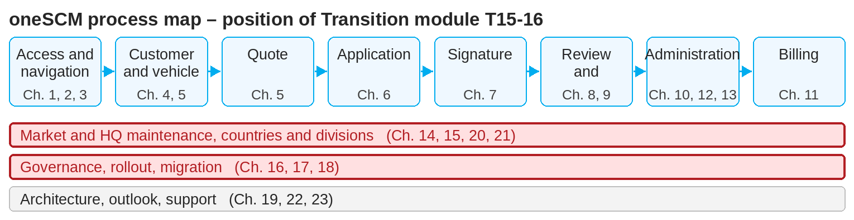
oneSCM – T15-16: From Maintenance Decision to Governance Evidence
oneSCM
for Cars
Purpose and benefit
This module links the HQ maintenance decision (Chapter 15) with the governance evidence (Chapter 16): every decision receives a source, test evidence, approval and version so that it can be audited and archived.
How to proceed
Document the decision with justification, source and ticket reference (Chapter 16.6).
Go through the approval workflow with functional review (Chapter 16.3).
File test evidence and set the functional baseline (Chapter 16.4).
References to handbook chapters and systems are highlighted; e-mail addresses are provided as links.
Transition at a glance
Decision (Chapter 15)
Blueprint change or country deviation
Technical options, SA matching, coverage codes
Governance and approval at HQ level
Evidence (Chapter 16)
Functional review and approval workflow
Test evidence and functional baseline
Sources, tickets, versions, clarification register, archiving
!
A decision without evidence is not approved. Only with source, test evidence and documented approval does it become part of the productive functional baseline.
Close open entries in the clarification register and update the version (Chapter 16.7).
Archive the approved version; working documents remain in document management (Chapter 16.5).
Note: This Quick Guide summarizes transition module T15-16 of the oneSCM handbook. Details, screenshots and evidence can be found in the handbook.
AS OF: 2026-10-11 | 1/2

Slide 2
oneSCM – T15-16: From Maintenance Decision to Governance Evidence
oneSCM
for Cars
Roles and prerequisites
Frequently asked questions and answers
What evidence does a coverage code change need? Source, test evidence per affected division and HQ approval (Chapters 15.7, 16.4).
Who archives? The editorial team after approval (Chapter 16.5).
How do I find the decision later? Via version control and the clarification register (Chapter 16.6, Appendix F).
Roles involved
HQ: make and evidence the decision
Editorial team: maintain sources, versions, registers
Market/MO: use and supplement evidence
Prerequisites
Maintenance decision available (Chapter 15.4)
Approval workflow known (Chapter 16.3)
Access to clarification register and version control
Important links and contacts
Chapter 15 – HQ role, Blueprint and central master data.
Chapter 16 – Governance, quality, data protection and archiving.
Sources and clarification register – Appendix F.
oneSCM Handbook – Complete chapters with screenshots, role, status and scope matrices (Appendix D).
Checklist before completion
☐ Decision documented with source
☐ Approval workflow completed
☐ Test evidence and functional baseline set
☐ Register closed, version archived
Notes and pitfalls
Evidence is the basis for rollout and training (Chapter 17).
Data protection also applies to evidence and test data (Chapter 16.1, Appendix I.3).
The change overview (Chapter 22.4) is fed by this evidence.
Note: This Quick Guide summarizes transition module T15-16 of the oneSCM handbook. Details, screenshots and evidence can be found in the handbook.
AS OF: 2026-10-11 | 2/2

