Slide 1


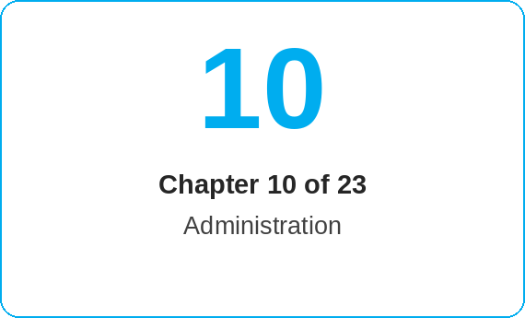
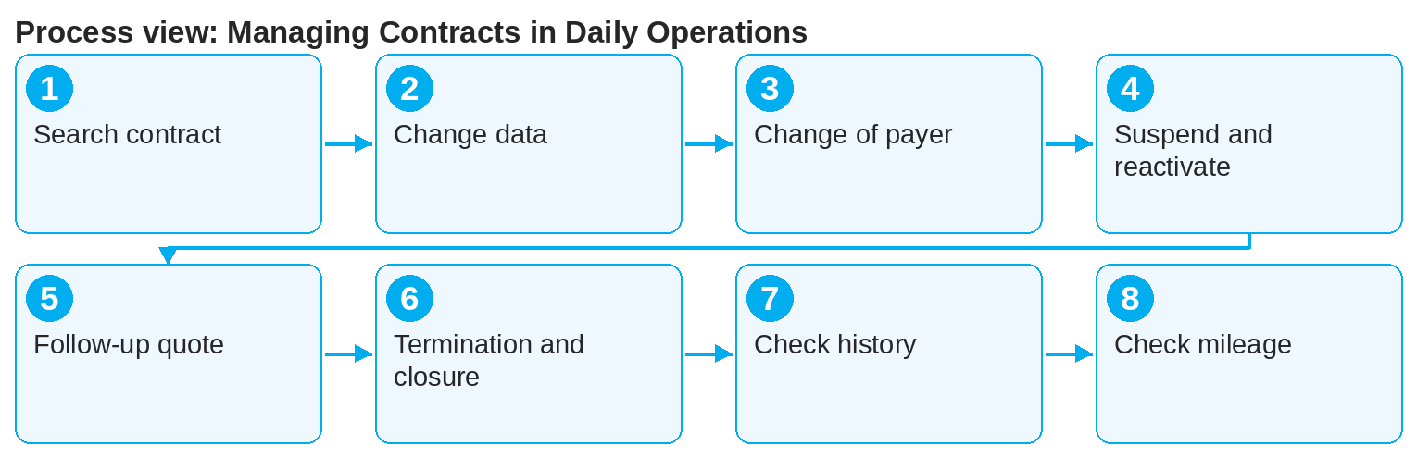
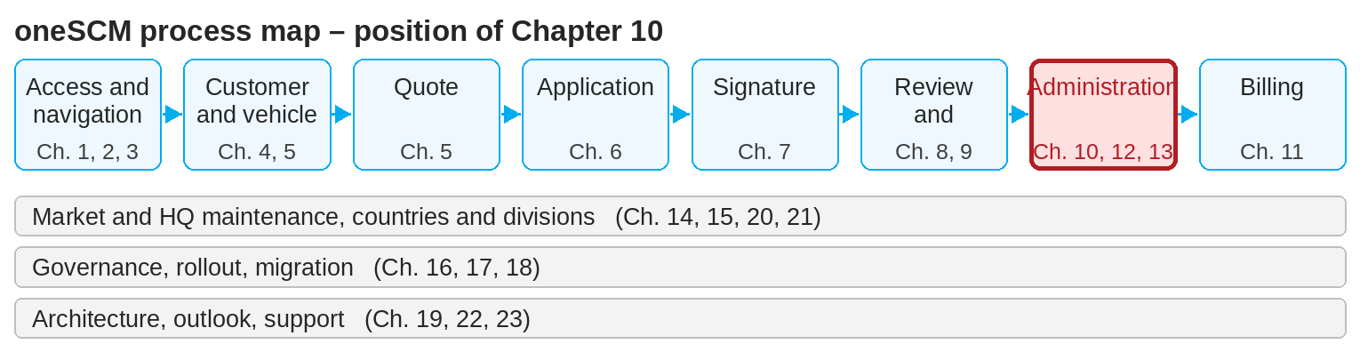
oneSCM – Managing Contracts in Daily Operations
oneSCM
for Vans
Purpose and benefit
You search for contracts, change contract, customer and payment data, carry out change of payer and transfer, suspend and reactivate, extend or close contracts and use the change history (Chapter 10.1 to 10.8).
References to handbook chapters and systems are highlighted; e-mail addresses are provided as links.
How to proceed
Topics at a glance
Search for the contract via reference number, VIN or customer and check the details (10.1).
Change contract, customer or payment data via the permitted actions (10.2); the payment interval can later only be changed to "one-time".
Carry out a change of payer or contract transfer with the required evidence (10.3).
Suspend or reactivate for legitimate reasons (10.4).
10.1 – 10.4 Changing
Searching for contracts and checking details
Changing contract, customer and payment data
Change of payer and contract transfer
Suspend and reactivate
10.5 – 10.9 Ending and tracing
Extension, follow-up quote and follow-up contract
Termination, cancellation and closure
Financial consequences and closing evidence
Change history and traceability
Mileage, mileage history and projection
!
Changes to product, term or mileage require a new contract. Cancellations and closures have financial consequences (Chapter 11.6) and are irreversible.
Before the end of the term, create a follow-up quote or a follow-up contract (10.5).
For termination, cancellation or closure, check the financial consequences and secure the closing evidence (10.6 and 10.7).
Check the change history (10.8); every change is traceable with time, role and reason.
Check the mileage history and trigger the mileage projection when MIC data is missing (10.9); it is a reference value and does not end the contract.
Note: This Quick Guide summarizes Chapter 10 of the oneSCM handbook. Details, screenshots and evidence can be found in the handbook.
AS OF: 2026-10-11 | 1/2

Slide 2
oneSCM – Managing Contracts in Daily Operations
oneSCM
for Vans
Roles and prerequisites
Frequently asked questions and answers
Can I increase the mileage? Not in the current contract; this requires a new contract or follow-up contract (10.2 and 10.5).
What is the difference between cancellation and termination? Cancellation voids the contract, termination ends it at a set date; both have their own financial consequences (10.6 and 10.7).
Where can I see who changed something? In the contract's change history (10.8).
Roles involved
Dealer: initiate changes, create follow-up quotes
MO: review of changes (Chapter 9.7)
Finance department: financial consequences and evidence
Prerequisites
Contract is active (Chapter 8)
Reason and time of the change are known
Customer consent is available where required
Important links and contacts
oneSCM handbook – Complete chapters with screenshots, role, status and scope matrices (Appendix D).
Calculation examples and finance reference – Appendix I.2.
FAQ and troubleshooting – Chapter 23 with questions per process phase and known errors per market and release.
Support and escalation – Report a support case with reference number, market, division and screenshot (Chapter 23.4 and 23.5).
Checklist before completion
☐ Contract uniquely identified
☐ Permitted change selected, evidence available
☐ Financial consequences checked
☐ Change documented in the history
Notes and pitfalls
Changes go through the MO Check according to Chapter 9.7.
A mileage from a workshop invoice above the contract mileage sets the status "expired by mileage" (10.6).
The history is the basis for reporting and governance (Chapter 16).
Note: This Quick Guide summarizes Chapter 10 of the oneSCM handbook. Details, screenshots and evidence can be found in the handbook.
AS OF: 2026-10-11 | 2/2

