Slide 1


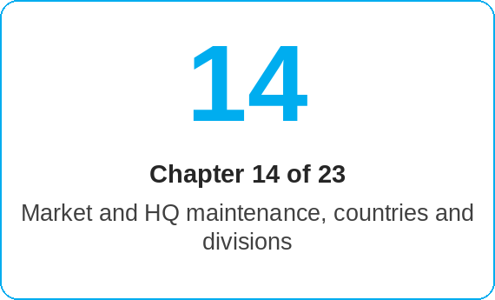
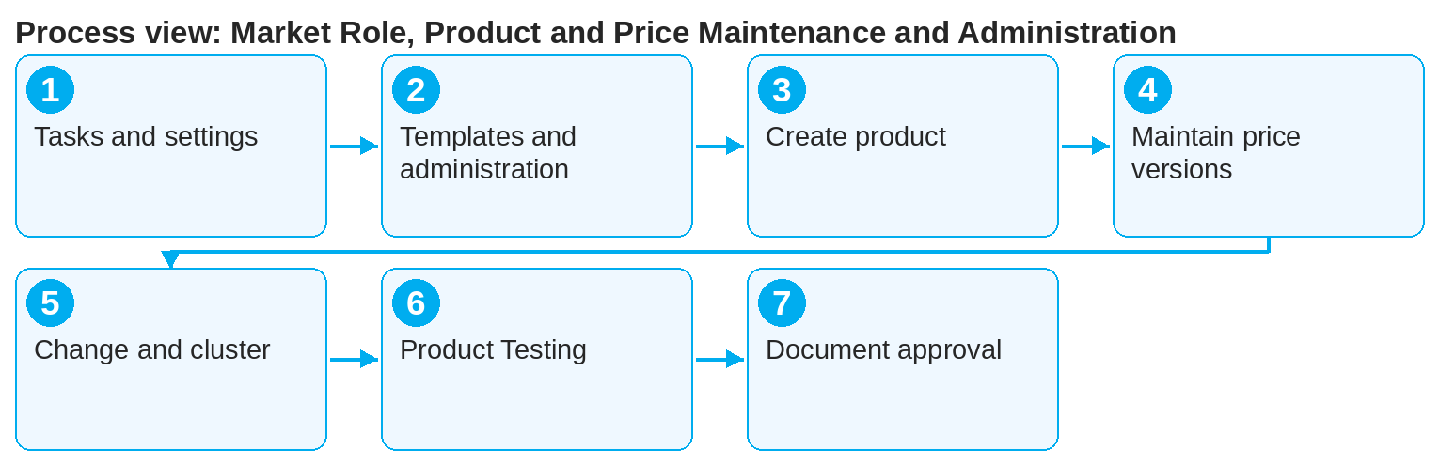
oneSCM – Market Role, Product and Price Maintenance and Administration
oneSCM
for Vans
Purpose and benefit
You know the tasks and scope of the Market role, maintain market-specific settings, templates, products, price versions, vehicle groups and campaigns, use Product Testing and document changes and approvals (Chapter 14.1 to 14.14).
References to handbook chapters and systems are highlighted; e-mail addresses are provided as links.
How to proceed
Topics at a glance
Clarify tasks and scope relative to the HQ role (14.1) and maintain market-specific settings and country deviations (14.2 and 14.3).
Manage templates (14.4) and use only the permitted actions in the administration area (14.5); check visibility and authorizations (14.6).
Define products, create them and publish them (14.8).
Maintain price versions, clusters and factor limits as well as price components, Cost Unit Split and inflation (14.9 and 14.14).
14.1 – 14.7 Market and administration
Tasks and scope of the Market role
Market-specific settings
Country deviations from the Blueprint
Template administration and template management
Administration area and permitted actions
Market-related visibility and authorizations
Check, approve and document changes
14.8 – 14.14 Product, price, campaign
Product definition, creation and publication
Price versions, clusters and factor limits
Product change, versioning and effect on existing contracts
Vehicle groups and Van model series clustering
Product Testing as a work area
Campaign creation and discount maintenance
Price components, Cost Unit Split and inflation
!
Published price versions take effect immediately on new quotes. Check factor limits and the effect on existing contracts in Product Testing before you publish.
For product changes, observe versioning and the effect on existing contracts (14.10); cluster vehicle groups and Van model series (14.11).
Test changes in Product Testing (14.12) before you create campaigns and discounts (14.13).
Check, approve and document every change (14.7).
Note: This Quick Guide summarizes Chapter 14 of the oneSCM handbook. Details, screenshots and evidence can be found in the handbook.
AS OF: 2026-10-11 | 1/2

Slide 2

oneSCM – Market Role, Product and Price Maintenance and Administration
oneSCM
for Vans
Roles and prerequisites
Roles involved
Market: product, price and campaign maintenance, administration
HQ: Blueprint and approvals (Chapter 15)
MO/Dealer: feedback from checks and sales
Prerequisites
Market role with administration rights (Chapter 2)
Blueprint and country deviations known (Chapters 15 and 20)
Market's approval process clarified (Chapter 16.3)
Frequently asked questions and answers
What may the Market change without HQ? Market-specific settings, prices, campaigns and templates within the Blueprint; deviations require HQ approval (14.3 and 15.4).
How do I test a new product? In Product Testing with test data from Appendix I.3, before it is published (14.12).
What is a Cost Unit Split? The split of the price into cost components, e.g. for inflation adjustments (14.14).
Checklist before completion
☐ Change checked in Product Testing
☐ Price version, cluster and factor limits plausible
☐ Effect on existing contracts assessed
☐ Approval documented
Important links and contacts
Transition module T14-15 – Connecting market maintenance and central requirements.
Test data catalog – Appendix I.3.
oneSCM handbook – Complete chapters with screenshots, role, status and scope matrices (Appendix D).
Support and escalation – Report a support case with reference number, market, division and screenshot (Chapters 23.4 and 23.5).
Notes and pitfalls
A cluster for the relative base price requires a price factor (14.9).
Vehicle groups: the product with a current price version is preselected, expired price versions are not shown; on request the system generates name and description from the filters (14.11).
When a campaign is duplicated, the system resets the External Campaign ID; deactivated campaigns remain editable (14.13).
Depending on versioning, product changes affect only new contracts or existing contracts as well (14.10).
Note: This Quick Guide summarizes Chapter 14 of the oneSCM handbook. Details, screenshots and evidence can be found in the handbook.
AS OF: 2026-10-11 | 2/2

