Slide 1


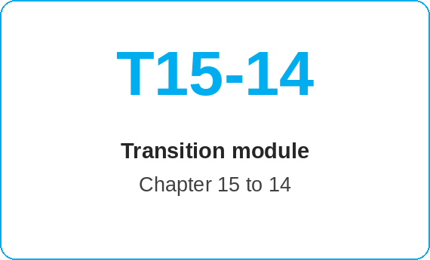
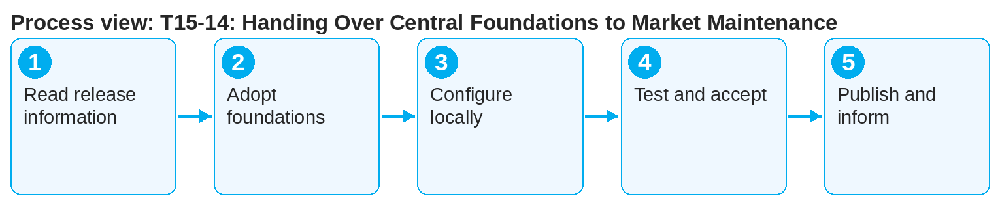
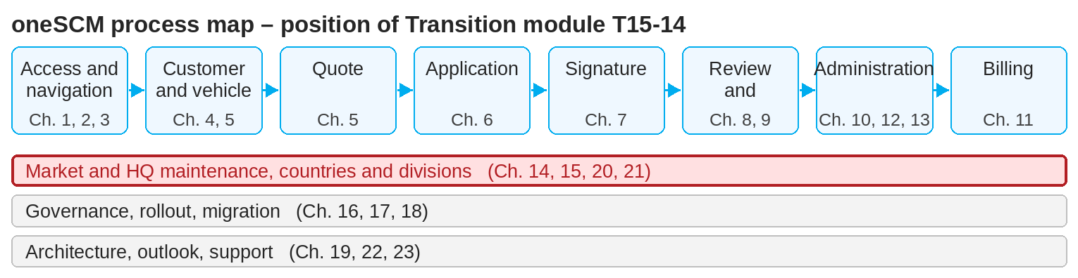
oneSCM – T15-14: Handing Over Central Foundations to Market Maintenance
oneSCM
for Vans
Purpose and benefit
This module describes the path from HQ (Chapter 15) to the market (Chapter 14): how Blueprint changes, new products, coverage codes and technical options are provided centrally and adopted, configured locally and published by the market.
How to proceed
Read the HQ release information: what changes in the Blueprint, and from when does it apply (Chapter 22.4)?
Adopt product definitions and coverage codes into market maintenance (Chapters 14.8, 15.7).
Configure locally: price versions, clusters, vehicle groups, campaigns (Chapters 14.9 to 14.13).
References to handbook chapters and systems are highlighted; e-mail addresses are provided as links.
Transition at a glance
HQ provides (Chapter 15)
Blueprint version and change overview
Product definitions, coverage codes, technical options
Requirements for price components and factor limits
Market adopts (Chapter 14)
Market-specific settings and templates
Price versions, clusters, vehicle groups
Product Testing, approval, publication
!
Central changes apply from the date named by HQ. A market that delays adoption offers products outside the valid Blueprint.
Test in Product Testing and document the functional acceptance (Chapters 14.12, 17.3).
Publish and inform MO and dealers; update training materials (Chapters 14.7, 22.3).
Note: This Quick Guide summarizes transition module T15-14 of the oneSCM handbook. Details, screenshots and evidence can be found in the handbook.
AS OF: 2026-10-11 | 1/2

Slide 2
oneSCM – T15-14: Handing Over Central Foundations to Market Maintenance
oneSCM
for Vans
Roles and prerequisites
Frequently asked questions and answers
Does the market have to adopt every Blueprint change? Yes, unless an approved country deviation says otherwise (Chapter 15.3).
Who maintains the prices for a new product? The market in its price versions (Chapter 14.9) based on the HQ requirements.
How are dealers informed? Via the RetailPortal and the release information (Chapter 22.4).
Roles involved
HQ: provide and communicate central foundations
Market: adopt, configure locally, test, publish
MO/Dealer: information about changes
Prerequisites
Approved Blueprint change or new product (Chapter 15.2)
HQ release information (Chapter 22.4)
Market role with maintenance rights (Chapter 14)
Important links and contacts
Chapter 15 – HQ role, Blueprint and central master data.
Chapter 14 – Market role, product and price maintenance.
oneSCM RetailPortal – System news and training material.
oneSCM Handbook – Complete chapters with screenshots, role, status and scope matrices (Appendix D).
Checklist before completion
☐ Release information read
☐ Central foundations adopted
☐ Configured locally and tested
☐ Published and communicated
Notes and pitfalls
Counterpart to T14-15 (market requests deviation from HQ).
Note the effect of product changes on existing contracts (Chapter 14.10).
Division reference: Vans model series clustering (Chapter 14.11).
Note: This Quick Guide summarizes transition module T15-14 of the oneSCM handbook. Details, screenshots and evidence can be found in the handbook.
AS OF: 2026-10-11 | 2/2

