Slide 1


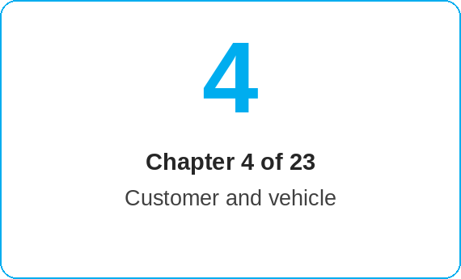
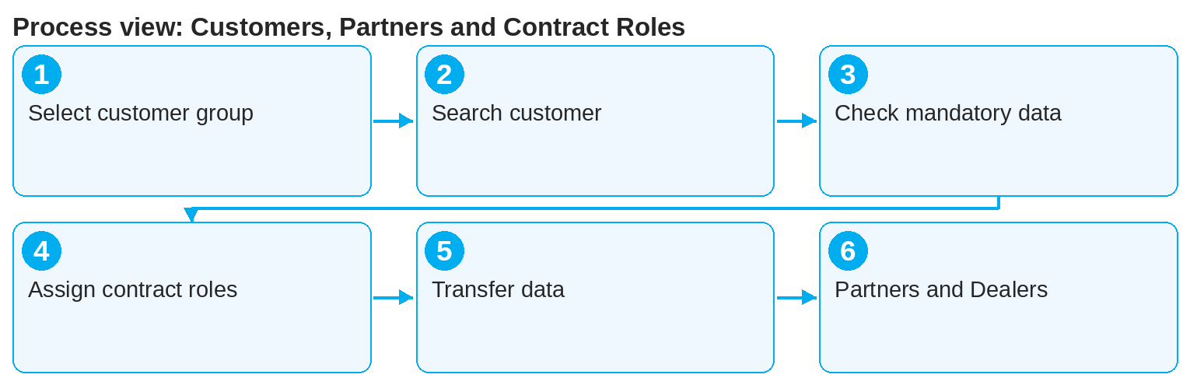
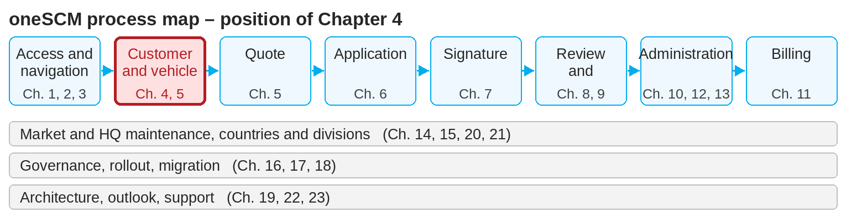
oneSCM – Customers, Partners and Contract Roles
oneSCM
for Cars
Purpose and benefit
You distinguish private and business customers, find existing customers, check mandatory data, assign the contract roles (holder, payer, user, contact, invoice recipient) and avoid duplicates (Chapter 4.1 to 4.8).
This document is interactive – references to handbook chapters and systems are provided as links.
How to proceed
Topics at a glance
Select the customer group (4.1). "KAM-managed key accounts" only for individual price requests or FS 140+.
First search for the customer and select them; only create a new record if needed (4.2). Identification is based on:
  Private customer: first and last name, phone number, e-mail address or Mercedes me ID
  Business customer: company name, VAT ID
Check mandatory data and plausibility (4.3): address, contact details, legal form; errors block later checks.
4.1 – 4.3 Entering customers
Private customers and business customers
Searching for and assigning existing customers
Checking customer data and mandatory data
4.4 – 4.6 Roles and quality
Contract holder, payer, user, contact, invoice recipient
Data transfer from connected systems
Duplicates and conflicting master data
4.7 – 4.8 Partners
Partner and Dealer relationships
Dealer onboarding and partner process
!
Contract holder and registered keeper of the vehicle must be identical. A different contract holder is not permitted; only payer and invoice recipient may differ.
Assign the contract roles (4.4): contract holder, payer, user, contact and invoice recipient may differ, but must be permitted per market.
Transfer data from connected systems (4.5, e.g. oneERP) instead of retyping it; check for duplicates and conflicts (4.6).
Maintain partner and Dealer relationships (4.7); new dealers go through Dealer onboarding (4.8).
Note: This Quick Guide summarizes Chapter 4 of the oneSCM handbook. Details, screenshots and evidence can be found in the handbook.
AS OF: 2026-10-11 | 1/2

Slide 2
oneSCM – Customers, Partners and Contract Roles
oneSCM
for Cars
Roles and prerequisites
Frequently asked questions and answers
May the payer differ from the contract holder? Yes, the payer and the invoice recipient may differ; the contract holder must be the registered keeper.
What to do about conflicting master data? Do not overwrite; document the deviation and pass it to the leading system or to support (Chapter 4.6).
How is a new Dealer connected? Via the partner process and the market's Dealer onboarding (Chapter 4.8).
Roles involved
Dealer: customer search, new creation, role assignment
MO: review of master data and duplicates
Market: Dealer onboarding and partner process
Prerequisites
Customer group is known (private, business, KAM-managed key accounts)
Customer identification data is available
Data protection notes are observed (Chapter 16.1)
Important links and contacts
Customer Account Center – Customer accounts and special cases (Chapter 12.8).
oneERP – Customer and finance integration (Chapter 19.11).
oneSCM handbook – Complete chapters with screenshots, role, status and scope matrices (Appendix D).
Support and escalation – Report a support case with reference number, market, division and screenshot (Chapter 23.4 and 23.5).
Checklist before completion
☐ Customer searched, no duplicate created
☐ Customer group selected correctly
☐ Mandatory data complete and plausible
☐ Contract roles assigned and permitted
Notes and pitfalls
Duplicates usually result from creating new records without searching first; the MO can reject them.
Personal data does not belong in comments or screenshots (Chapter 16.1).
When transferring data from external systems, the leading system is authoritative (Chapter 16.2).
Note: This Quick Guide summarizes Chapter 4 of the oneSCM handbook. Details, screenshots and evidence can be found in the handbook.
AS OF: 2026-10-11 | 2/2

