Slide 1


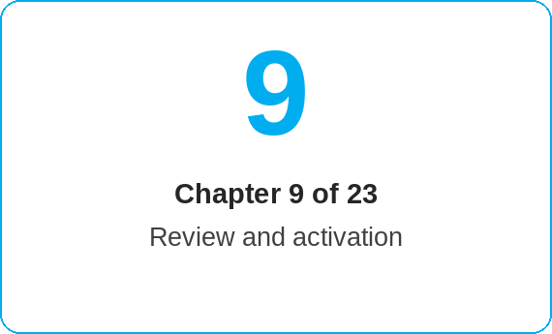
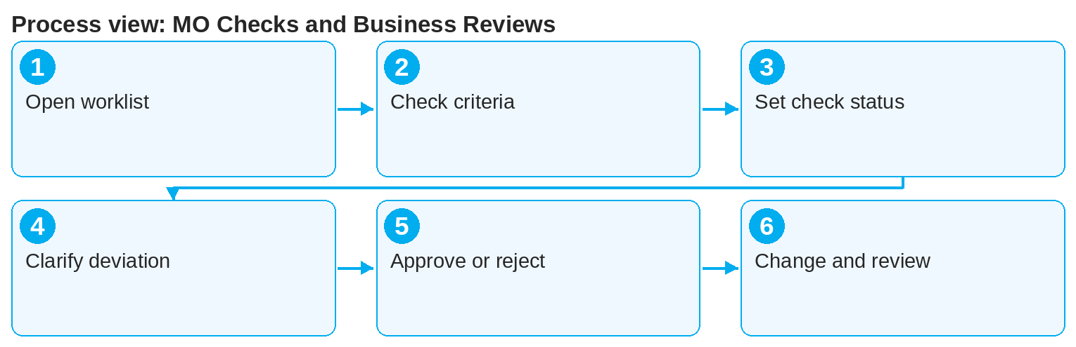
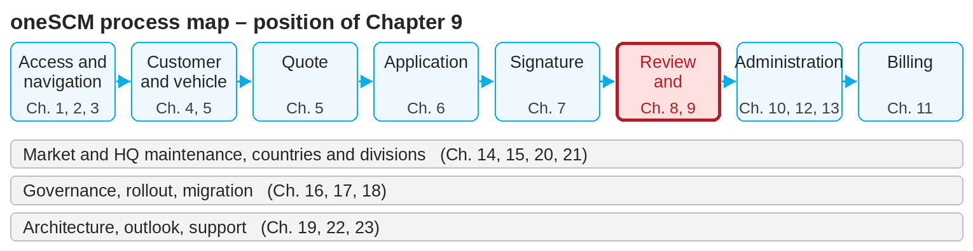
oneSCM – MO Checks and Business Reviews
oneSCM
for Cars
Purpose and benefit
You know the tasks and scope of the MO role, carry out MO Checks within contract creation, assess check status and reasons, ensure quality, handle deviations and hand over to decision or support (Chapter 9.1 to 9.8).
This document is interactive – references to handbook chapters and systems are provided as links.
How to proceed
Topics at a glance
Open the MO Check worklist and select the application (9.2).
Check vehicle data, customer data, documents and signature against the check criteria (9.2 and 9.4); system checks indicate deviations.
Set the check status and enter the reason (9.3). Open checks remain visible in the worklist.
9.1 – 9.4 Review
Tasks and scope of the MO role
MO Checks within contract creation
Check status, reasons and open checks
Quality assurance and system checks
9.5 – 9.8 Result
Deviations and re-check
Handover for decision or to support
MO Checks for contract changes
Contract Review: profiles and overview
!
A rejection is only permitted with a comment. The reason must be comprehensible for the Dealer and is saved in the history.
In case of deviations, request corrections from the Dealer and check again (9.5).
Approve or reject; hand over disputed cases for decision or to support (9.6).
Check contract changes by the same rules (9.7) and use the Contract Review profiles for the overview (9.8).
Note: This Quick Guide summarizes Chapter 9 of the oneSCM handbook. Details, screenshots and evidence can be found in the handbook.
AS OF: 2026-10-11 | 1/2

Slide 2
oneSCM – MO Checks and Business Reviews
oneSCM
for Cars
Roles and prerequisites
Frequently asked questions and answers
What exactly does the MO check? Completeness and plausibility of customer, vehicle, product, payment data, documents and signature (9.2 and 9.4).
Can the Dealer see the check status? Yes, in Application Management as a status and in Communication as feedback.
How often can a re-check be done? As often as corrections are submitted; every check is traceable in the history (9.5).
Roles involved
MO (Market Operation): business review, approval, rejection
Dealer: subsequent delivery of data and documents
HQ/Market: check rules and Contract Review profiles
Prerequisites
MO role is activated (Chapter 2)
Application is signed and fully submitted (Chapter 7 and 8)
The market's check criteria are known
Important links and contacts
Transition module T9-10 – From check result to ongoing contract management.
Role/status/scope matrices – Appendix D.
oneSCM handbook – Complete chapters with screenshots, role, status and scope matrices (Appendix D).
Support and escalation – Report a support case with reference number, market, division and screenshot (Chapter 23.4 and 23.5).
Checklist before completion
☐ All check criteria assessed
☐ Check status and reason entered
☐ Deviations documented and reported back
☐ Decision approved or rejected
Notes and pitfalls
The MO reviews business aspects; technical faults go to support (Chapter 23).
Comments are visible internally or externally; check the visibility before saving (Chapter 12.7).
Checks are part of the approval workflow according to Chapter 16.3.
Note: This Quick Guide summarizes Chapter 9 of the oneSCM handbook. Details, screenshots and evidence can be found in the handbook.
AS OF: 2026-10-11 | 2/2

