Slide 1


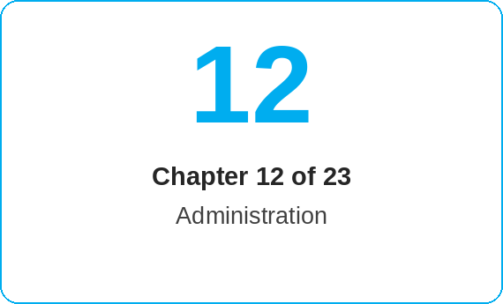
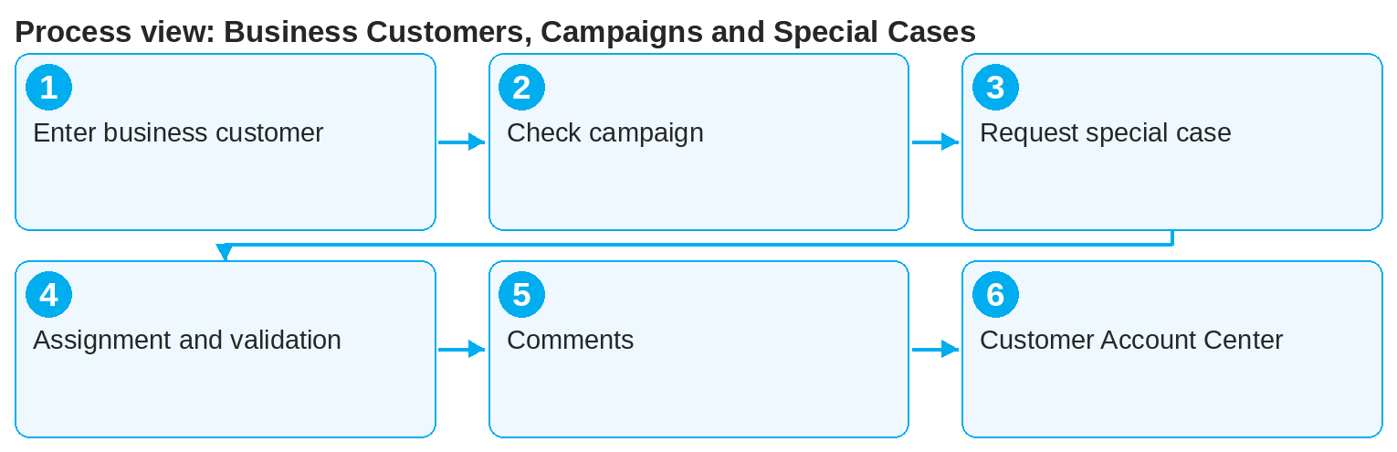
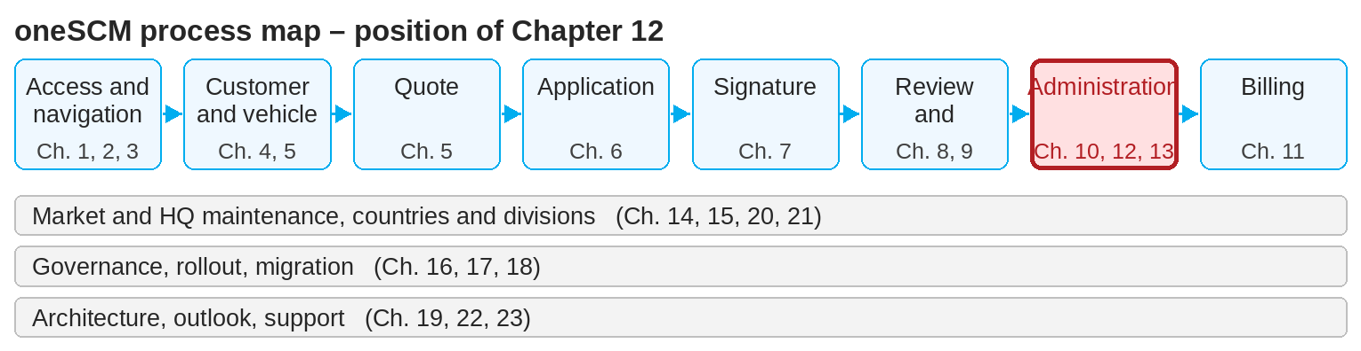
oneSCM – Business Customers, Campaigns and Special Cases
oneSCM
for Cars
Purpose and benefit
You know the additional requirements for business customers and fleets, apply campaigns and special conditions, submit special case requests with a justification, understand dealer assignment, validation and approval as well as comments and the Customer Account Center (Chapter 12.1 to 12.8).
This document is interactive – references to handbook chapters and systems are provided as links.
How to proceed
For business customers, enter the company name and VAT ID and, if applicable, the industry (12.1); for fleets, check the customer constellation (12.2).
Select campaigns or special conditions only if the eligibility described is met (12.3).
For deviations from the standard, submit a special case request with a comprehensible justification (12.4).
Topics at a glance
12.1 – 12.4 Business customers and special case
Additional requirements for business customers
Fleet and special customer constellations
Campaigns and special conditions
Special case request and justification
12.5 – 12.8 Processing
Dealer assignment and further processing
Validation, approval and rejection
Internal and external comments
Customer Account Center
!
The customer group "KAM-managed key accounts" is to be used only for individual price requests, i.e. for KAM-managed customers or for FS 140+.
The request is assigned to the responsible Dealer or processor (12.5) and validated, approved or rejected by MO or Market (12.6).
Use internal comments for coordination and external comments for feedback to the customer (12.7).
Manage customer accounts and special cases in the Customer Account Center (12.8).
Note: This Quick Guide summarizes Chapter 12 of the oneSCM handbook. Details, screenshots and evidence can be found in the handbook.
AS OF: 2026-10-11 | 1/2

Slide 2
oneSCM – Business Customers, Campaigns and Special Cases
oneSCM
for Cars
Roles and prerequisites
Frequently asked questions and answers
When do I need a special case request? When conditions, customer constellation or product deviate from the standard (12.4).
Who decides on the special case? MO or Market after validation; you see the result in the application and in the comments (12.6).
What is the Customer Account Center? The area for managing customer accounts, relationships and special cases (12.8).
Roles involved
Dealer: special case request, campaign selection, comments
MO/Market: validation, approval or rejection
KAM: managed key accounts and individual price requests
Prerequisites
Customer group "Business customer" or "KAM-managed key accounts" is selected correctly (Chapter 4.1)
Campaign eligibility is given as described
Justification for the special case is available
Important links and contacts
oneSCM handbook – Complete chapters with screenshots, role, status and scope matrices (Appendix D).
Practical examples along the contract process – Appendix I.1.
FAQ and troubleshooting – Chapter 23 with questions per process phase and known errors per market and release.
Support and escalation – Report a support case with reference number, market, division and screenshot (Chapters 23.4 and 23.5).
Checklist before completion
☐ Customer group and additional details correct
☐ Campaign eligibility checked
☐ Special case justified and submitted
☐ Comment visibility observed
Notes and pitfalls
Special approvals always trigger an MO check (Chapters 6.5 and 9).
External comments are visible to the customer; do not enter internal information.
Campaigns are maintained by the Market (Chapter 14.13).
Note: This Quick Guide summarizes Chapter 12 of the oneSCM handbook. Details, screenshots and evidence can be found in the handbook.
AS OF: 2026-10-11 | 2/2

