Slide 1


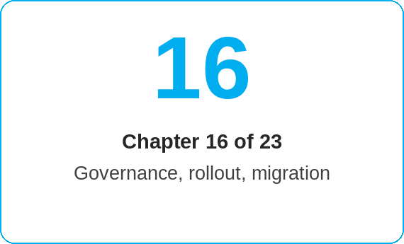


oneSCM – Governance, Quality, Data Protection and Archiving
oneSCM
for Cars
Purpose and benefit
You observe data protection and safe sample data, ensure data quality and data ownership, use the approval workflow, document test evidence, distinguish document management and archiving, maintain sources, tickets and versions as well as the clarification register (Chapter 16.1 to 16.8).
This document is interactive – references to handbook chapters and systems are provided as links.
How to proceed
Use only safe sample data in training, tickets and screenshots; no real customer or bank details (16.1).
Observe data ownership (16.2): the leading system (e.g. oneERP for customers) is authoritative; corrections are made there.
Go through the approval workflow (16.3): functional review, approval, documentation.
Store test evidence and record the productive functional baseline (16.4).
Topics at a glance
16.1 – 16.4 Data protection and quality
Data protection and safe sample data
Data quality and data ownership
Functional review and approval workflow
Test evidence and productive functional baseline
16.5 – 16.8 Evidence
Distinguishing document management and archiving
Sources, ticket references and version control
Contradictions, gaps and clarification register
Dealer governance and reporting evidence
!
Personal data never belongs in comments, tickets or screenshots. Use the test data catalog (Appendix I.3) and anonymize examples.
Distinguish document management (ongoing process) from archiving (legally secure filing) (16.5).
Maintain sources, ticket references and versions (16.6) and enter contradictions and gaps in the clarification register (16.7).
Ensure dealer governance and reporting evidence (16.8).
Note: This Quick Guide summarizes Chapter 16 of the oneSCM handbook. Details, screenshots and evidence can be found in the handbook.
AS OF: 2026-10-11 | 1/2

Slide 2
oneSCM – Governance, Quality, Data Protection and Archiving
oneSCM
for Cars
Roles and prerequisites
Frequently asked questions and answers
May I send a screenshot with customer data to Support? Only anonymized or with test data; real data must be redacted (16.1).
What is the difference between document management and archiving? Document management accompanies the process; archiving is the legally secure, immutable filing (16.5).
Where do I report a contradiction in the handbook? In the clarification register with chapter, source and ticket reference (16.7 and Appendix F).
Roles involved
All roles: data protection and data quality
Market/HQ: approval workflow, version control, governance
Dealer: dealer governance and reporting evidence
Prerequisites
Knowledge of the group's data protection rules
Access to clarification register and ticket references
Market's approval levels known
Important links and contacts
Sources and clarification register – Appendix F.
Test data catalog and evidence – Appendix I.3.
oneSCM handbook – Complete chapters with screenshots, role, status and scope matrices (Appendix D).
Support and escalation – Report a support case with reference number, market, division and screenshot (Chapters 23.4 and 23.5).
Checklist before completion
☐ Examples anonymized
☐ Leading system observed
☐ Approval documented
☐ Clarification register updated
Notes and pitfalls
Archived documents are immutable; corrections create new versions.
Every handbook statement has a source or ticket reference (Appendix F).
The clarification register is required reading before releases (Chapter 22).
Note: This Quick Guide summarizes Chapter 16 of the oneSCM handbook. Details, screenshots and evidence can be found in the handbook.
AS OF: 2026-10-11 | 2/2

