Slide 1


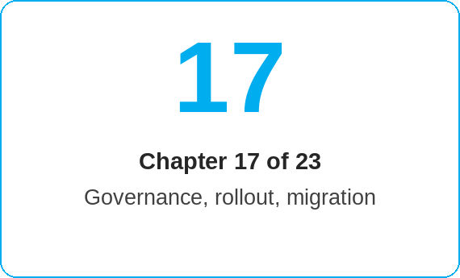
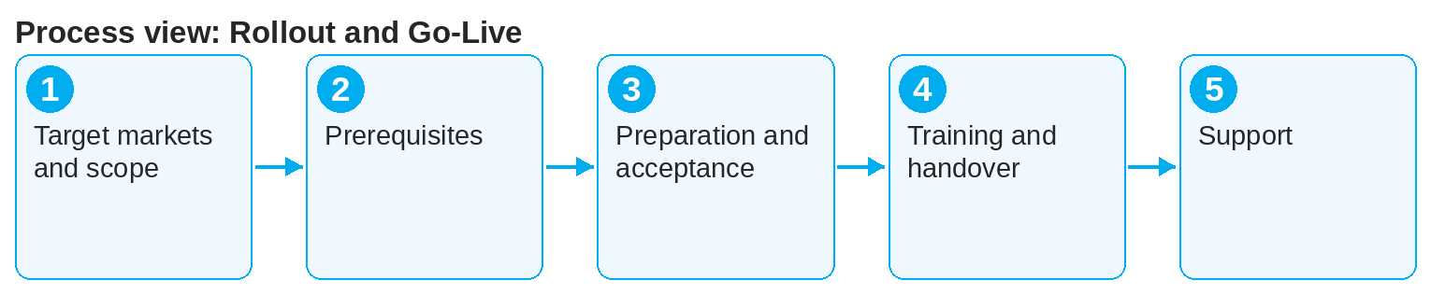

oneSCM – Rollout and Go-Live
oneSCM
for Cars
Purpose and benefit
You know the target markets and go-live scope, the prerequisites for access, configuration and training, the market preparation with functional acceptance, the training and handover to operations as well as the support after go-live (Chapter 17.1 to 17.5).
How to proceed
Clarify target markets and go-live scope (17.1): which divisions, products and roles go live when?
Ensure the prerequisites (17.2): access, market configuration, training environment.
Carry out the market preparation and document the functional acceptance with test evidence (17.3, Chapter 16.4).
This document is interactive – references to handbook chapters and systems are provided as links.
Topics at a glance
17.1 – 17.3 Preparation
Target markets and go-live scope
Prerequisites for access, configuration and training
Market preparation and functional acceptance
17.4 – 17.5 Operations
Training and handover to operations
Support after go-live and open items
!
Without documented functional acceptance there is no productive start in the market. Acceptance, test evidence and training status are prerequisites for the handover to operations.
Train the roles with the handbook, Quick Guides and knowledge checks (Appendix H) and hand over to operations (17.4).
Support the go-live (hypercare) and track open items in the clarification register (17.5).
Note: This Quick Guide summarizes Chapter 17 of the oneSCM handbook. Details, screenshots and evidence can be found in the handbook.
AS OF: 2026-10-11 | 1/2

Slide 2
oneSCM – Rollout and Go-Live
oneSCM
for Cars
Roles and prerequisites
Frequently asked questions and answers
Who accepts the market? The Market functionally, HQ for Blueprint conformity; both are documented (17.3).
Which training materials are available? Handbook, Quick Guides per chapter, knowledge checks (Appendix H) and training material in the RetailPortal.
How long does the support after go-live last? According to the market's rollout plan; open items are tracked in the register until closed (17.5).
Roles involved
Project/HQ: rollout planning and acceptance
Market: market preparation, configuration, training
Dealer/MO: participation in training and acceptance
Prerequisites
Rollout plan with target markets is available
Authorizations for training and production system requested (Chapter 2)
Market configuration completed according to Chapter 14
Important links and contacts
oneSCM RetailPortal – System news and training material.
Knowledge checks and solutions – Appendix H.
oneSCM handbook – Complete chapters with screenshots, role, status and scope matrices (Appendix D).
Support and escalation – Report a support case with reference number, market, division and screenshot (Chapters 23.4 and 23.5).
Checklist before completion
☐ Target markets and scope confirmed
☐ Access and configuration ready
☐ Acceptance documented
☐ Training carried out, open items recorded
Notes and pitfalls
Country-specific go-live and migration are covered in Chapters 20.5 and 18.
Everyday checklists for getting started can be found in Appendix B.
Release information on the functional baseline in Chapter 22.4.
Note: This Quick Guide summarizes Chapter 17 of the oneSCM handbook. Details, screenshots and evidence can be found in the handbook.
AS OF: 2026-10-11 | 2/2

