Slide 1


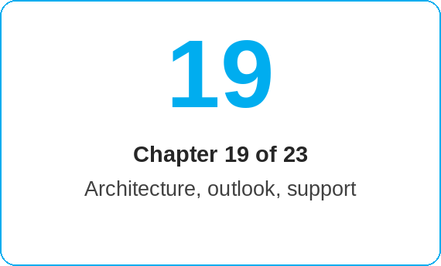
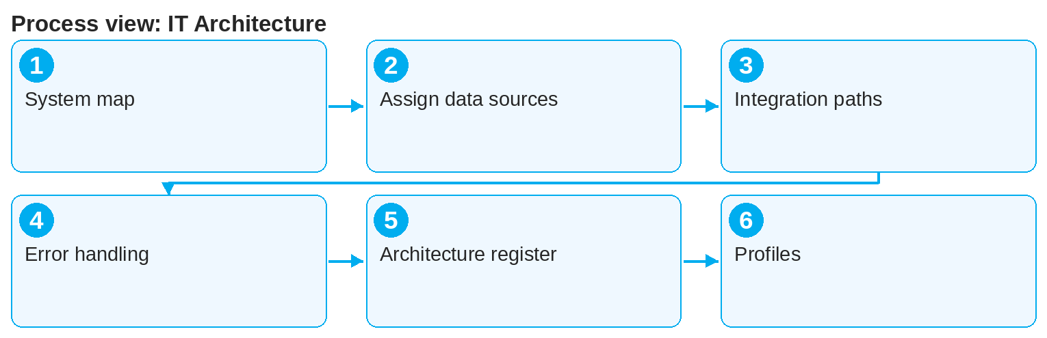
oneSCM – IT Architecture
oneSCM
for Cars
Purpose and benefit
You know the system map and the connected systems for order, vehicle, contract, finance, payment and authorization data, the integration paths, the interface operation with error handling as well as the individual system profiles (Chapter 19.1 to 19.31).
This document is interactive – references to handbook chapters and systems are provided as links.
How to proceed
Start with the architecture overview and system map (19.1).
Assign the data sources per process step:
  Vehicle and order: GO, AFAB, CEPRO, OTR, MIC, DSB (19.2 to 19.8)
  Contract and services: VEGA, BS4/SDB4, Warranty-and-Goodwill-API (19.7, 19.9, 19.10)
  Customer and finance: oneERP, CoFiCo, SWT, NEMESIS, MPay (19.11 to 19.15)
  Access: ALICE (19.16); manual handover: DATIX (19.17)
Know the technical integration paths (19.21) and the interface operation with error handling (19.22).
Topics at a glance
Order and vehicle (19.2 – 19.10)
GO – Cars order information
AFAB – Vans order information
CEPRO – Vans vehicle master data
OTR – Order and vehicle reference
DSB – Mileage reading
Warranty-and-Goodwill-API, MIC
VEGA – Contract, coverage, claim
BS4 or SDB4
Finance, payment, authorization (19.11 – 19.17)
oneERP – Customer and finance integration
CoFiCo and SWT – FI connection
NEMESIS – Accounting
MPay – Payment
ALICE – Authorizations
DATIX – Manual handover
Operation and profiles (19.18 – 19.31)
Other systems, data platforms, legacy
Integration paths and interface operation
Architecture register
Profiles: VeDoc, VERSO/VOM, oneDoC, Xentry, MBFS Bundling, POS channels, insurers, suppliers
!
Do not work around interface errors with manual duplicate maintenance. Report the error with reference number and system to Support; DATIX is only the documented manual handover path.
Use the architecture register for open evidence (19.23).
Look up the individual system profiles as needed (19.24 to 19.31).
Note: This Quick Guide summarizes Chapter 19 of the oneSCM handbook. Details, screenshots and evidence can be found in the handbook.
AS OF: 2026-10-11 | 1/2

Slide 2
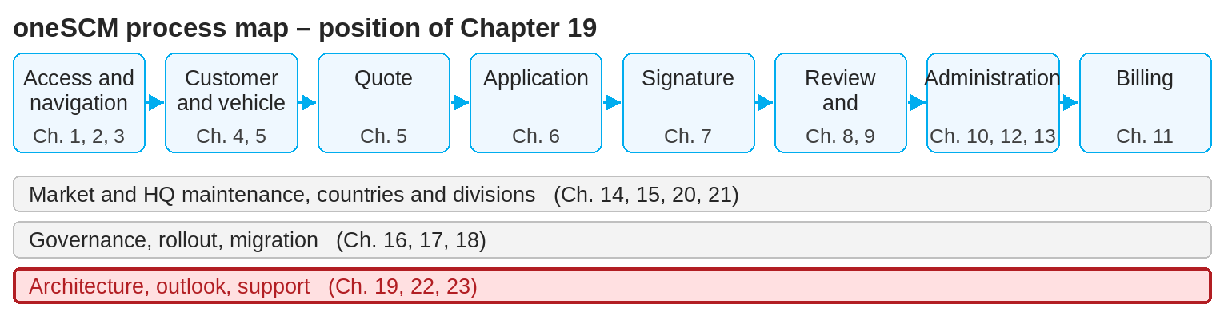
oneSCM – IT Architecture
oneSCM
for Cars
Roles and prerequisites
Roles involved
HQ/IT: architecture, interface operation
Market/MO: error handling and evidence
Dealer: understanding of data origin
Prerequisites
Basic understanding of the contract process (Chapter 3)
Access to the architecture register (19.23)
Support path for interface errors known (Chapter 23)
Frequently asked questions and answers
Where does the vehicle data in the application come from? Depending on the entry point, from OTR, GO or MIC (Chapter 19.2); Vans master data from CEPRO (19.4 to 19.8).
What does VEGA do? VEGA maintains contract, coverage and claim for claiming services (19.9).
When is DATIX used? Only for the documented manual handover when no automated path exists (19.17).
Checklist before completion
☐ System map understood
☐ Data source per process step known
☐ Error path for interface failures known
☐ Profile of the affected system read
Important links and contacts
Architecture register and open evidence – Chapter 19.23.
Interface operation and error handling – Chapter 19.22.
oneSCM handbook – Complete chapters with screenshots, role, status and scope matrices (Appendix D).
Support and escalation – Report a support case with reference number, market, division and screenshot (Chapters 23.4 and 23.5).
Notes and pitfalls
Cars and Vans use different order systems (GO or AFAB/CEPRO).
Data platforms and reporting (19.19) are connected read-only.
Legacy systems (19.20) run only until the cutover (Chapter 18.6).
Note: This Quick Guide summarizes Chapter 19 of the oneSCM handbook. Details, screenshots and evidence can be found in the handbook.
AS OF: 2026-10-11 | 2/2

