Slide 1


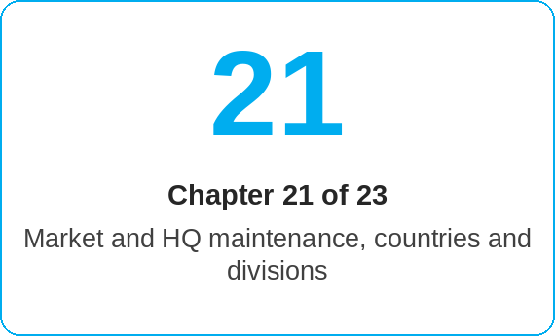
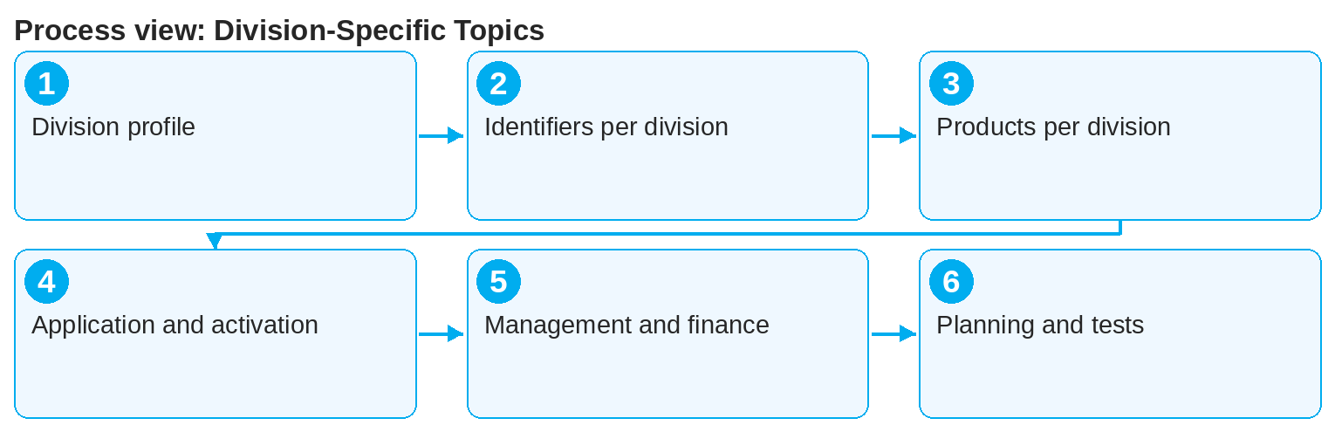

oneSCM – Division-Specific Topics
oneSCM
for Cars
Purpose and benefit
You know the division profile and the distinction Cars/Vans, the vehicle data and identifiers per division, products and price parameters per division, application, signature and activation per division, management and financial consequences as well as division planning, tests and approvals (Chapter 21.1 to 21.6).
This document is interactive – references to handbook chapters and systems are provided as links.
How to proceed
Read the division profile and the distinction Cars/Vans (21.1).
Use the identifiers per division (21.2):
  Cars: order data from GO (Chapter 19.2)
  Vans: order data from AFAB, master data from CEPRO, model series clustering (Chapters 19.3, 19.4, 14.11)
Select the division's products and price parameters (21.3).
Topics at a glance
21.1 – 21.3 Profile and data
Division profile and distinction Cars/Vans
Vehicle data and identifiers per division
Products and price parameters per division
21.4 – 21.6 Process and planning
Application, signature and activation per division
Management and financial consequences per division
Division planning, tests and approvals
!
Cars and Vans contracts use different order systems and identifiers. A wrong division context leads to wrong products and prices; check the context before the quote.
Carry out application, signature and activation according to the division rules (21.4).
Observe management and financial consequences per division (21.5).
Division planning, tests and approvals are the responsibility of Market and HQ (21.6).
Note: This Quick Guide summarizes Chapter 21 of the oneSCM handbook. Details, screenshots and evidence can be found in the handbook.
AS OF: 2026-10-11 | 1/2

Slide 2
oneSCM – Division-Specific Topics
oneSCM
for Cars
Roles and prerequisites
Frequently asked questions and answers
Can I create van contracts with the Cars role? No, this requires the Vans role and the matching context (Chapter 2.2).
Why do the entry points differ? Because Cars and Vans have different order and master data systems (21.2 and 19).
Where are the division tests? In Chapter 21.6 and in the test data catalog (Appendix I.3).
Roles involved
Dealer: entry in the correct division
Market: products and prices per division (Chapter 14.11)
HQ: division planning and approvals
Prerequisites
Role for the respective division enabled (e.g. oneSCM.DealerPKW)
Division context is set (Chapter 2.4)
Vehicle identifiers of the division known
Important links and contacts
Division profile Cars/Vans – Chapter 21.1.
oneSCM handbook – Complete chapters with screenshots, role, status and scope matrices (Appendix D).
FAQ and troubleshooting – Chapter 23 with questions per process phase and known errors per market and release.
Support and escalation – Report a support case with reference number, market, division and screenshot (Chapters 23.4 and 23.5).
Checklist before completion
☐ Division context correct
☐ Identifier of the division used
☐ Product of the division selected
☐ Division rules for signature and activation observed
Notes and pitfalls
This Cars edition is based on the Vans example "Application creation and management"; see Chapter 21.2 for car identifiers.
Van model series are clustered into vehicle groups (Chapter 14.11).
Cross-division special cases in Chapter 12.
Note: This Quick Guide summarizes Chapter 21 of the oneSCM handbook. Details, screenshots and evidence can be found in the handbook.
AS OF: 2026-10-11 | 2/2

