Slide 1


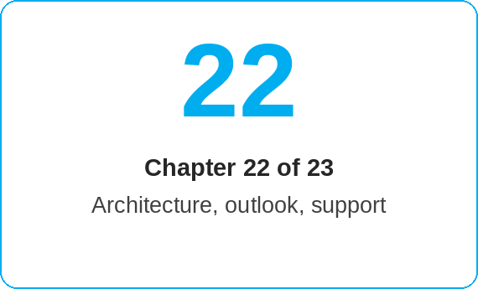
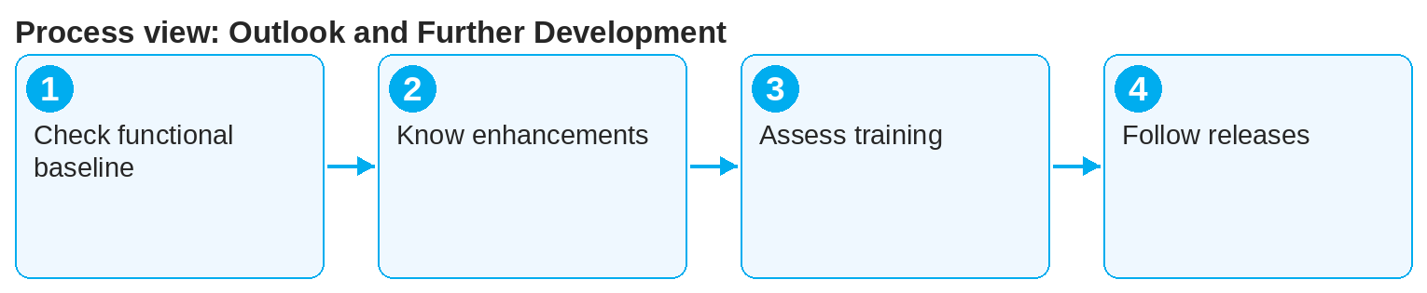
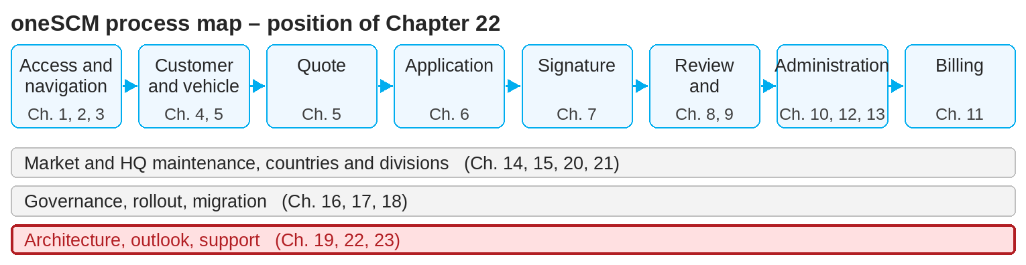
oneSCM – Outlook and Further Development
oneSCM
for Cars
Purpose and benefit
You know the confirmed functional baseline, the planned enhancements and open requirements, the impact on training and handbook as well as the release information and change overview (Chapter 22.1 to 22.4).
How to proceed
Check the confirmed functional baseline (22.1): only documented and tested functions count as productive (Chapter 16.4).
Read planned enhancements and open requirements (22.2); they are not part of the current process.
This document is interactive – references to handbook chapters and systems are provided as links.
Topics at a glance
22.1 – 22.2 Baseline and planning
Confirmed functional baseline
Planned enhancements and open requirements
22.3 – 22.4 Impact and release
Impact on training and handbook
Release information and change overview
!
Planned functions must not be trained or promised to customers before they are confirmed as the productive functional baseline.
Assess the impact on training and handbook (22.3) and plan updates to the Quick Guides.
Follow the release information and change overview (22.4) and align the version in the footer of the guides.
Note: This Quick Guide summarizes Chapter 22 of the oneSCM handbook. Details, screenshots and evidence can be found in the handbook.
AS OF: 2026-10-11 | 1/2

Slide 2
oneSCM – Outlook and Further Development
oneSCM
for Cars
Roles and prerequisites
Frequently asked questions and answers
How do I know whether a function is productive? From the confirmed functional baseline (22.1) and the test evidence (16.4).
How often are the Quick Guides updated? With every release that changes process steps (22.3 and 22.4).
Where do I report a new requirement? Via the clarification register and the Market to HQ (22.2 and 16.7).
Roles involved
HQ/Project: release planning and change overview
Market: assessment of the impact on training
All roles: knowledge of the valid functional baseline
Prerequisites
Current handbook version and release status known
Access to release information
Clarification register for open requirements (Appendix F)
Important links and contacts
Release information and change overview – Chapter 22.4.
oneSCM handbook – Complete chapters with screenshots, role, status and scope matrices (Appendix D).
FAQ and troubleshooting – Chapter 23 with questions per process phase and known errors per market and release.
Support and escalation – Report a support case with reference number, market, division and screenshot (Chapters 23.4 and 23.5).
Checklist before completion
☐ Functional baseline checked
☐ Open requirements known
☐ Training needs assessed
☐ Release changes read
Notes and pitfalls
Every change has a ticket reference (Chapter 16.6).
Release-related known errors are listed in Chapter 23.2.
The version of each Quick Guide is shown in the footer.
Note: This Quick Guide summarizes Chapter 22 of the oneSCM handbook. Details, screenshots and evidence can be found in the handbook.
AS OF: 2026-10-11 | 2/2

