Slide 1


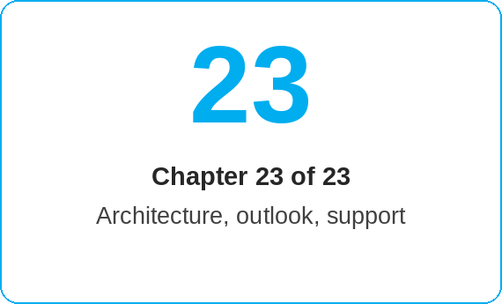
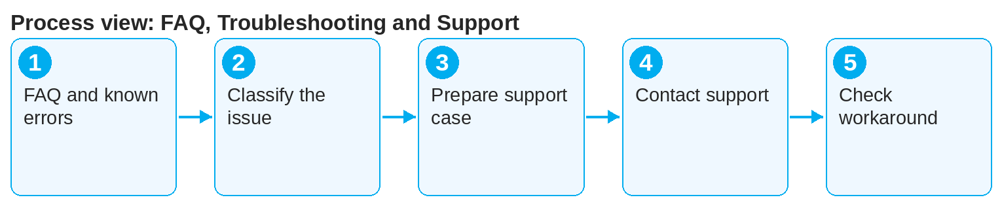
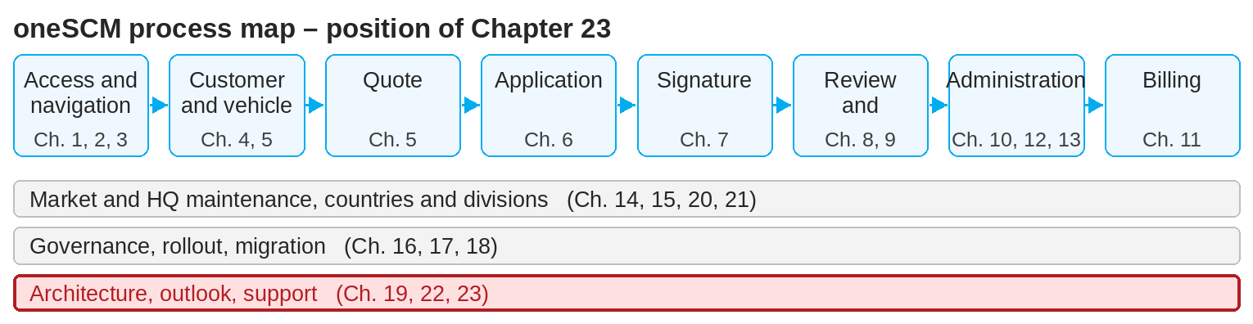
oneSCM – FAQ, Troubleshooting and Support
oneSCM
for Cars
Purpose and benefit
You find frequent questions per process phase and known errors by market and release, distinguish usage question, data deviation and incident, compile the information for a support case, and know the support and escalation paths and confirmed workarounds (Chapters 23.1 to 23.6).
How to proceed
First search the FAQ per process phase (23.1) and the known errors for your market and release (23.2).
Classify your issue (23.3):
  Usage question: handbook and Quick Guide
  Data deviation: leading system and business department (Chapter 16.2)
  Incident: support case
Compile the information for the support case (23.4):
  Reference number, VIN, market, division, role
  Time, step, error message, screenshot
This document is interactive – references to handbook chapters and systems are provided as links.
Topics at a glance
23.1 – 23.3 Classify
Frequently asked questions by process phase
Known errors by market and release
Usage question, data deviation and incident
23.4 – 23.6 Report and resolve
Information for a support case
Support and escalation paths
Confirmed workarounds and result check
!
Unconfirmed workarounds can damage contracts and data. Use only the solutions documented in Chapter 23.6.
Use the support and escalation paths (23.5): Vans service contract help via your market's support channel (Chapter 23.5); further paths per market.
Apply only confirmed workarounds and check the result (23.6).
Note: This Quick Guide summarizes Chapter 23 of the oneSCM handbook. Details, screenshots and evidence can be found in the handbook.
AS OF: 2026-10-11 | 1/2

Slide 2
oneSCM – FAQ, Troubleshooting and Support
oneSCM
for Cars
Roles and prerequisites
Frequently asked questions and answers
How long after first registration can a service contract be concluded? Up to 12 months and/or a maximum of 50,000 km, provided the vehicle has not yet had a service (exception: company and demonstration vehicles with a previous owner).
Can a service package be concluded for demonstration vehicles? Demonstration and company vehicles count as used vehicles; only a pure maintenance package is possible for them.
Can a person other than the registered keeper conclude the contract? No, contract holder and registered keeper must be identical.
Roles involved
All roles: self-help via FAQ and workarounds
Dealer/MO: support case with complete details
Support/Customer Management: processing and escalation
Prerequisites
Reference number, market, division and role known
Screenshot without personal data (Chapter 16.1)
Handbook chapter for the process step checked
Important links and contacts
Service contract support Cars: your market's support channel (Chapter 23.5)
oneSCM RetailPortal – System news and training material.
Ticket-to-chapter mapping – Appendix E.
oneSCM Handbook – Complete chapters with screenshots, role, status and scope matrices (Appendix D).
Checklist before completion
☐ FAQ and known errors checked
☐ Issue classified
☐ Support information complete
☐ Workaround confirmed, result checked
Notes and pitfalls
If information is incorrect, Customer Management will contact you; incorrect applications are rejected.
Ticket references help assign your issue to the right chapter (Appendix E).
Training material, videos and FAQ are available in the RetailPortal.
Note: This Quick Guide summarizes Chapter 23 of the oneSCM handbook. Details, screenshots and evidence can be found in the handbook.
AS OF: 2026-10-11 | 2/2

