Slide 1


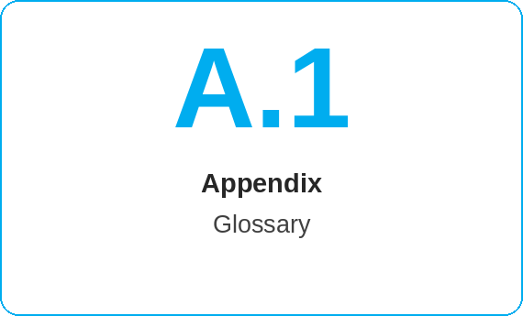
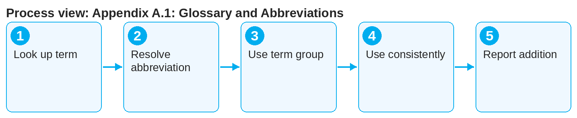

oneSCM – Appendix A.1: Glossary and Abbreviations
oneSCM
for Cars
Purpose and benefit
The glossary explains the terms and abbreviations of the oneSCM handbook consistently, from ALICE to ZB II. This guide shows how to use and cite the glossary and submit additions.
How to proceed
This document is interactive – references to handbook chapters and systems are provided as links.
Look up the term in the glossary; entries are sorted alphabetically and name the chapter in which the term is introduced.
Distinguish abbreviation (e.g. MO) from long form (Market Operation); the handbook gives the long form at first occurrence.
Use the term groups (roles, transactions, identifiers, systems, documents, status) to find related terms.
Contents at a glance
Term groups
Roles: Dealer, MO, Market, HQ, KAM
Transactions: price information, quote, application, contract
Identifiers: VIN, OTR deal ID, GO order number, model series
Systems and documents
Systems: ALICE, OTR, VEGA, oneERP, NEMESIS, MPay, DATIX
Documents: ZB I, ZB II, SEPA mandate, price information
Status: application, signature, contract, invoice, payment status
!
The term "contract holder" is not the same as "payer" or "user". Roles on the contract are defined separately (Chapter 4.4); use the glossary terms exactly.
Use the glossary terms in tickets, comments and training, not local paraphrases.
If a term is missing or a definition is contradictory, enter it in the clarification register (Appendix F, Chapter 16.7).
Note: This Quick Guide summarizes Appendix A.1 of the oneSCM handbook. Details, screenshots and evidence can be found in the handbook.
AS OF: 2026-10-11 | 1/2

Slide 2
oneSCM – Appendix A.1: Glossary and Abbreviations
oneSCM
for Cars
Roles and prerequisites
Frequently asked questions and answers
Where do I find the meaning of "MO"? In the glossary under M: Market Operation, the role for business review and activation (Chapter 9).
May I use my own abbreviations? In tickets and comments, please use glossary terms only; propose new terms via the clarification register.
Is the glossary also available in English? Language variants depend on the market (Chapter 20); see the note in the glossary.
Roles involved
All roles: look up terms
Editorial team: maintain and approve glossary
Market: local terms and language variants
Prerequisites
Handbook or online help open
Term or abbreviation from the process context
Additions via the clarification register (Appendix F)
Important links and contacts
Glossary – Appendix A with terms and abbreviations.
Sources and clarification register – Appendix F.
oneSCM Handbook – Complete chapters with screenshots, role, status and scope matrices (Appendix D).
Support and escalation – Report a support case with reference number, market, division and screenshot (Chapters 23.4 and 23.5).
Checklist before completion
☐ Term found in glossary
☐ Long form and abbreviation known
☐ Chapter reference checked
☐ Missing term reported
Notes and pitfalls
The glossary is part of the export and the online help (Chapter 3).
Language variants of the terms are documented per market (Chapter 20).
System abbreviations are explained in the profiles in Chapter 19.
Note: This Quick Guide summarizes Appendix A.1 of the oneSCM handbook. Details, screenshots and evidence can be found in the handbook.
AS OF: 2026-10-11 | 2/2

