Slide 1


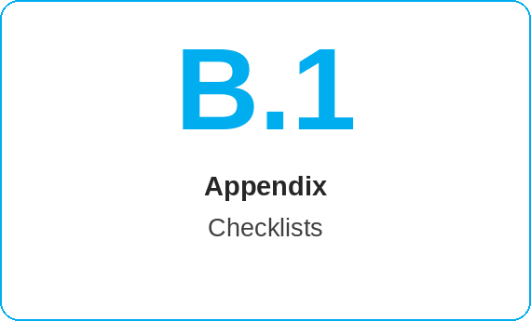
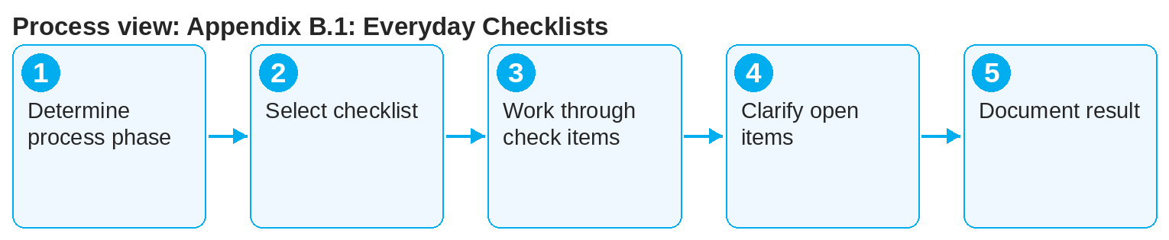
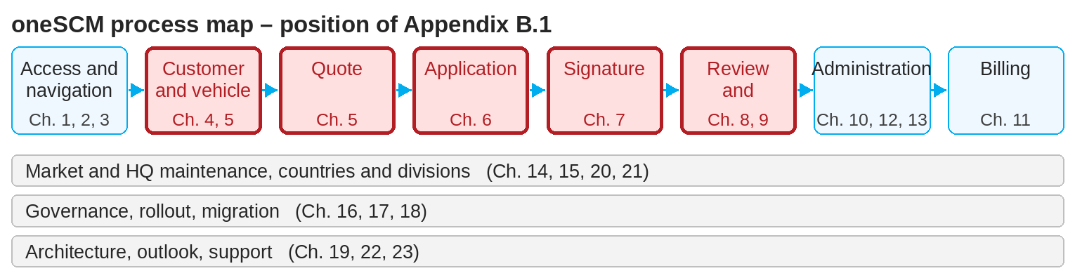
oneSCM – Appendix B.1: Everyday Checklists
oneSCM
for Cars
Purpose and benefit
The everyday checklists summarize, per process phase, the check items that must be met before the next step: from the quote through application and signature to activation and contract management.
How to proceed
This document is interactive – references to handbook chapters and systems are provided as links.
Select the checklist of the process phase your transaction is in (process map, Chapter 3.4).
Work through the check items in order; each item refers to the chapter with the description.
Mark open items and clarify them before the next step, not afterwards.
Contents at a glance
Contract process checklists
Before the quote (Chapters 4 and 5)
Before saving the application (Chapter 6)
Before the signature (Chapter 7)
Before the activation check (Chapters 8 and 9)
Operation and maintenance checklists
Before contract changes (Chapter 10)
Before handover to Finance (Chapter 11)
Before publishing product and price (Chapter 14)
Before approvals at HQ level (Chapter 15)
!
A completed checklist does not replace the system check. Validation rules (Chapter 6.4) and MO Checks (Chapter 9) apply regardless of the checklist.
For MO reviews, document the checklist result in the check status (Chapter 9.3).
If a check item is missing, report it via the clarification register (Appendix F).
Note: This Quick Guide summarizes Appendix B.1 of the oneSCM handbook. Details, screenshots and evidence can be found in the handbook.
AS OF: 2026-10-11 | 1/2

Slide 2
oneSCM – Appendix B.1: Everyday Checklists
oneSCM
for Cars
Roles and prerequisites
Frequently asked questions and answers
Are the checklists binding? They are working aids; the binding rules are the process rules of the chapters and the system checks.
Are the checklists available for printing? Yes, Appendix B.1 is included as a print version in the handbook export (Chapter 16.5).
How are checklists updated? With each release via the change overview (Chapter 22.4).
Roles involved
Dealer: checklists before quote, application and signature
MO: review checklist before approval
Market/HQ: checklists before publication and approval
Prerequisites
Relevant process chapter is known
Reference number or transaction at hand
Checklist in the current handbook version
Important links and contacts
Everyday checklists – Appendix B.1.
Practical examples – Appendix I.1.
oneSCM Handbook – Complete chapters with screenshots, role, status and scope matrices (Appendix D).
Support and escalation – Report a support case with reference number, market, division and screenshot (Chapters 23.4 and 23.5).
Checklist before completion
☐ Appropriate checklist selected
☐ All check items worked through
☐ Open items clarified before the next step
☐ Missing check items reported
Notes and pitfalls
The checklists correspond to the "Checklist before completion" sections in the chapters' Quick Guides.
Checklists are supplemented with local items per market (Chapter 20).
Practical examples for the checklists are in Appendix I.1.
Note: This Quick Guide summarizes Appendix B.1 of the oneSCM handbook. Details, screenshots and evidence can be found in the handbook.
AS OF: 2026-10-11 | 2/2

