Slide 1


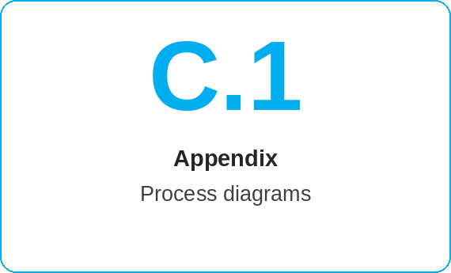
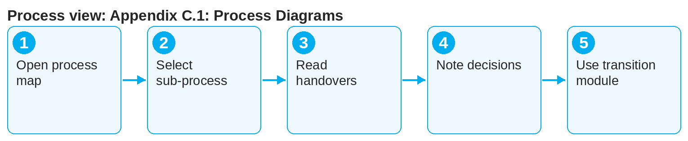
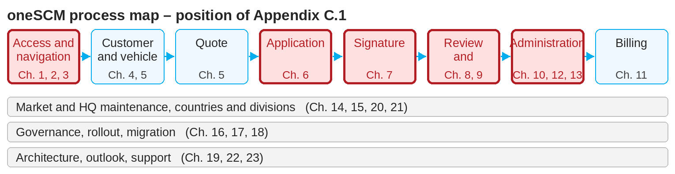
oneSCM – Appendix C.1: Process Diagrams
oneSCM
for Cars
Purpose and benefit
The process diagrams show the process map, the sub-processes from quote to contract end and the handovers between roles and systems. This guide explains how to read the diagrams and apply them to your transaction.
How to proceed
Start with the process map and find the phase of your transaction.
Open the sub-process diagram of the phase; each step names the chapter.
Read the handovers on the arrows: Which status must be reached, which role takes over?
This document is interactive – references to handbook chapters and systems are provided as links.
Contents at a glance
Diagrams
Process map (overall process)
Sub-processes: quote, application, signature, activation
Management, termination, billing
Market and HQ maintenance processes
Symbols
Rectangle: process step with chapter reference
Diamond: decision or check
Arrow: handover, labeled with status
Color: role that performs the step
!
Diagrams show the standard process. Country and division deviations (Chapters 20 and 21) are documented only there, not in the diagram.
Note the decisions (diamonds): special approval, MO Check and rejection lead to alternative paths.
Use the transition modules (T6-7 to T15-16) to move between chapters.
Note: This Quick Guide summarizes Appendix C.1 of the oneSCM handbook. Details, screenshots and evidence can be found in the handbook.
AS OF: 2026-10-11 | 1/2

Slide 2
oneSCM – Appendix C.1: Process Diagrams
oneSCM
for Cars
Roles and prerequisites
Frequently asked questions and answers
Which diagram do I need for application creation? Sub-process application (Chapter 6) with transition T6-7 to signature.
What do the colors mean? The role that performs the step: Dealer, MO, Market, HQ or system.
Can I export diagrams? Yes, via the handbook export (Chapter 16.5).
Roles involved
All roles: read diagrams and classify the transaction
Training: use diagrams as an introduction
HQ: maintain and approve diagrams
Prerequisites
Basic knowledge of the process map (Chapter 3.4)
Role and process phase known
Diagram symbols (legend) read
Important links and contacts
Process diagrams – Appendix C.1.
Role/status/scope matrices – Appendix D.
oneSCM Handbook – Complete chapters with screenshots, role, status and scope matrices (Appendix D).
Support and escalation – Report a support case with reference number, market, division and screenshot (Chapters 23.4 and 23.5).
Checklist before completion
☐ Phase found in the process map
☐ Sub-process read
☐ Handovers and status understood
☐ Alternative paths known
Notes and pitfalls
The diagrams are shown in the dashboard as a click path.
Status transitions in detail are in Appendix D.
Diagrams are reviewed with each release (Chapter 22).
Note: This Quick Guide summarizes Appendix C.1 of the oneSCM handbook. Details, screenshots and evidence can be found in the handbook.
AS OF: 2026-10-11 | 2/2

