Slide 1


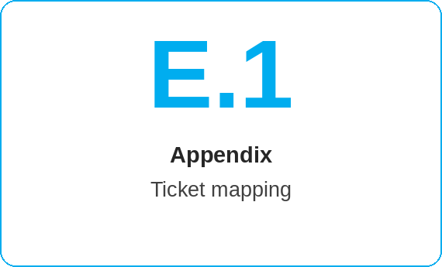
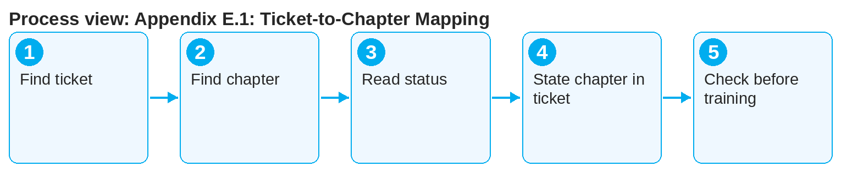
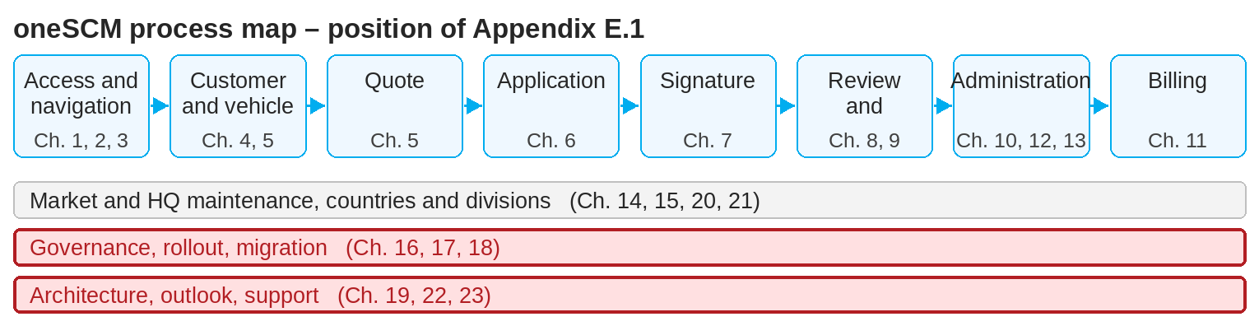
oneSCM – Appendix E.1: Ticket-to-Chapter Mapping
oneSCM
for Cars
Purpose and benefit
The ticket-to-chapter mapping links requirements, errors and clarifications (tickets) to the handbook chapters they affect. This lets you find the chapter for a ticket and the open tickets for a chapter.
How to proceed
This document is interactive – references to handbook chapters and systems are provided as links.
Find the ticket in the mapping table; the row names chapter, status and release.
Conversely: find the chapter and check which tickets are open or in progress.
Read the status: Only implemented tickets are part of the functional baseline (Chapter 22.1).
Contents at a glance
Mapping
Ticket → chapter: Which chapters does the ticket change?
Chapter → tickets: Which tickets are open?
Status: open, in progress, implemented, rejected
Benefit
Release preparation (Chapter 22)
Known errors per market and release (Chapter 23.2)
Evidence of sources (Chapter 16.6)
!
An open ticket does not change the valid process. Until implementation and documentation, the current version of the handbook chapter applies.
For a new ticket, state the affected chapter so that the mapping remains complete.
Before training sessions, check the chapter's open tickets (Chapter 22.3).
Note: This Quick Guide summarizes Appendix E.1 of the oneSCM handbook. Details, screenshots and evidence can be found in the handbook.
AS OF: 2026-10-11 | 1/2

Slide 2
oneSCM – Appendix E.1: Ticket-to-Chapter Mapping
oneSCM
for Cars
Roles and prerequisites
Frequently asked questions and answers
Where do I find all tickets for Chapter 7? In the mapping, filtered by chapter; status and release are given per row.
Who maintains the mapping? Editorial team and HQ as part of version control (Chapter 16.6).
How do I report a new ticket? Via the support path (Chapter 23.5), stating the chapter.
Roles involved
Editorial team/HQ: maintain mapping
Support: assign tickets to the chapter
All roles: look up ticket status for a topic
Prerequisites
Ticket number or chapter known
Access to the ticket system
Version control per Chapter 16.6
Important links and contacts
Ticket-to-chapter mapping – Appendix E.1.
Release information – Chapter 22.4.
oneSCM Handbook – Complete chapters with screenshots, role, status and scope matrices (Appendix D).
Support and escalation – Report a support case with reference number, market, division and screenshot (Chapters 23.4 and 23.5).
Checklist before completion
☐ Ticket assigned to chapter
☐ Status checked
☐ Release known
☐ Open tickets checked before training
Notes and pitfalls
The mapping is the basis of the change overview (Chapter 22.4).
Market-related tickets are also listed in Chapter 23.2.
Ticket references belong in the clarification register (Appendix F).
Note: This Quick Guide summarizes Appendix E.1 of the oneSCM handbook. Details, screenshots and evidence can be found in the handbook.
AS OF: 2026-10-11 | 2/2

