Slide 1


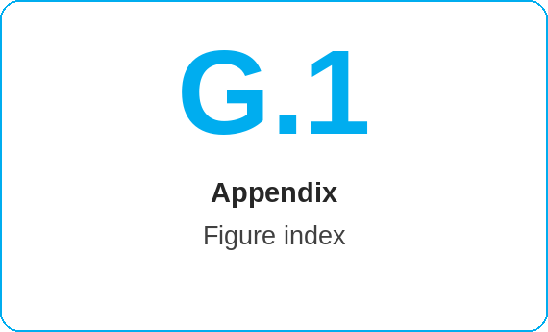
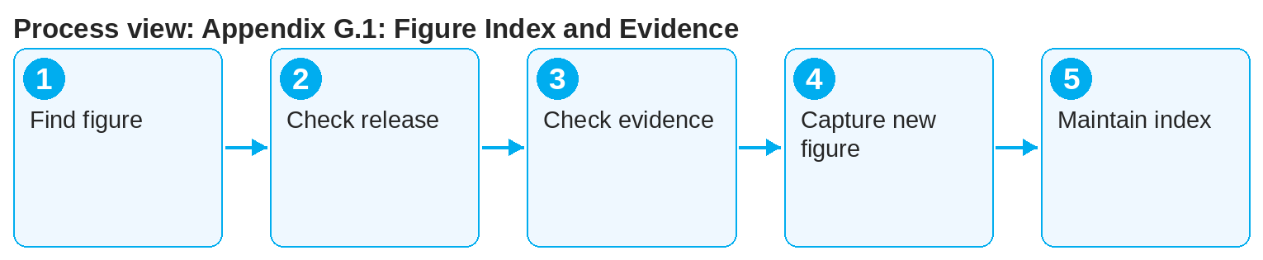

oneSCM – Appendix G.1: Figure Index and Evidence
oneSCM
for Cars
Purpose and benefit
The figure index lists all screenshots and graphics of the handbook with chapter, system, release and evidence. This guide shows how figures are found, checked and newly captured.
How to proceed
This document is interactive – references to handbook chapters and systems are provided as links.
Find the figure in the figure index by number or chapter.
Check release and date: A figure from an older release may differ from the current screen.
Check the evidence: environment, anonymized data, approval.
Contents at a glance
Index
Figure number, title, chapter
System and screen
Release and capture date
Evidence
Test environment or production system
Anonymized data
Approval by business department
!
Screenshots with real customer, vehicle or bank data must not go into the handbook. Use the test data catalog and redact any remaining data (Chapter 16.1).
For a new figure: capture the screen with test data (Appendix I.3), assign chapter and release, obtain approval.
Replace outdated figures and update the index (Chapter 16.6).
Note: This Quick Guide summarizes Appendix G.1 of the oneSCM handbook. Details, screenshots and evidence can be found in the handbook.
AS OF: 2026-10-11 | 1/2

Slide 2
oneSCM – Appendix G.1: Figure Index and Evidence
oneSCM
for Cars
Roles and prerequisites
Frequently asked questions and answers
Where do the images in the Quick Guides come from? Currently they are drawn process images; screenshots are added from the figure index.
May I use a screenshot from the production system? Only with test data or fully anonymized and with approval (Chapter 16.1).
How do I report an outdated figure? Via the clarification register with figure number and release (Appendix F).
Roles involved
All roles: assign figures to a chapter and release
Editorial team: maintain figure index
Market: supply local figure variants
Prerequisites
Figure number or chapter known
Release the figure refers to
Safe sample data in the figure (Chapter 16.1)
Important links and contacts
Figure index and evidence – Appendix G.1.
Test data catalog – Appendix I.3.
oneSCM Handbook – Complete chapters with screenshots, role, status and scope matrices (Appendix D).
Support and escalation – Report a support case with reference number, market, division and screenshot (Chapters 23.4 and 23.5).
Checklist before completion
☐ Figure found and release checked
☐ Evidence complete
☐ Data anonymized
☐ Index updated
Notes and pitfalls
The Quick Guides contain process images; screenshots follow from the figure index.
Figures may differ per market (Chapter 20).
The index is part of the export (Chapter 16.5).
Note: This Quick Guide summarizes Appendix G.1 of the oneSCM handbook. Details, screenshots and evidence can be found in the handbook.
AS OF: 2026-10-11 | 2/2

