Slide 1


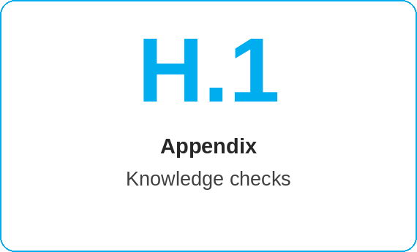
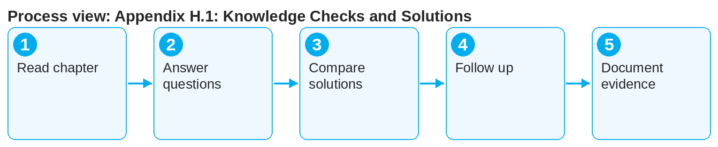

oneSCM – Appendix H.1: Knowledge Checks and Solutions
oneSCM
for Cars
Purpose and benefit
The knowledge checks test understanding per chapter with questions on process, roles and status; the solutions explain the correct answer with a chapter reference. This guide shows their use in training and self-study.
How to proceed
Read the chapter and Quick Guide before starting the knowledge check.
Answer the questions without aids; case examples refer to the practical examples in Appendix I.1.
Compare with the solutions and read the rationale with chapter reference.
This document is interactive – references to handbook chapters and systems are provided as links.
Contents at a glance
Structure
Questions per chapter with difficulty level
Question types: multiple choice, matching, case example
Solutions with rationale and chapter reference
Use
Self-study after the chapter
Training: introduction and wrap-up
Evidence for handover to operations (Chapter 17.4)
!
Knowledge checks do not replace an authorization. Access to oneSCM is granted via ALICE (Chapter 2.3), regardless of the training result.
Review the chapter sections for questions answered incorrectly.
Trainers document the result as training evidence (Chapter 17.4).
Note: This Quick Guide summarizes Appendix H.1 of the oneSCM handbook. Details, screenshots and evidence can be found in the handbook.
AS OF: 2026-10-11 | 1/2

Slide 2
oneSCM – Appendix H.1: Knowledge Checks and Solutions
oneSCM
for Cars
Roles and prerequisites
Frequently asked questions and answers
How many questions does a knowledge check have? About ten per chapter, depending on the chapter's scope.
Is there a minimum score? The market sets this for its training (Chapter 17.4).
Can I repeat the knowledge check? Yes, as often as you like; it serves as a self-check.
Roles involved
Learners: self-check after the chapter
Trainers: knowledge checks in training sessions (Chapter 17.4)
Editorial team: maintain and approve questions
Prerequisites
Chapter and Quick Guide read
Access to the knowledge checks (handbook or training material)
Time for about ten questions per chapter
Important links and contacts
Knowledge checks and solutions – Appendix H.1.
Practical examples – Appendix I.1.
oneSCM RetailPortal – System news and training material.
oneSCM Handbook – Complete chapters with screenshots, role, status and scope matrices (Appendix D).
Checklist before completion
☐ Chapter read
☐ Knowledge check completed without aids
☐ Solutions and rationales read
☐ Weak points followed up
Notes and pitfalls
Questions are reviewed with each release (Chapter 22.3).
Local variants of the questions exist per market (Chapter 20).
Solutions contain no personal sample data (Chapter 16.1).
Note: This Quick Guide summarizes Appendix H.1 of the oneSCM handbook. Details, screenshots and evidence can be found in the handbook.
AS OF: 2026-10-11 | 2/2

