Slide 1


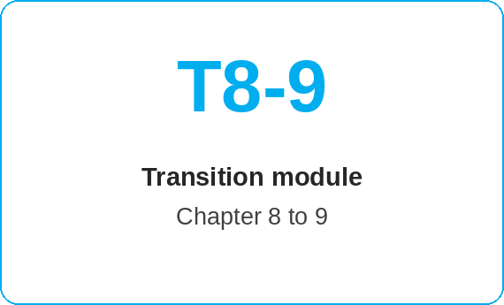
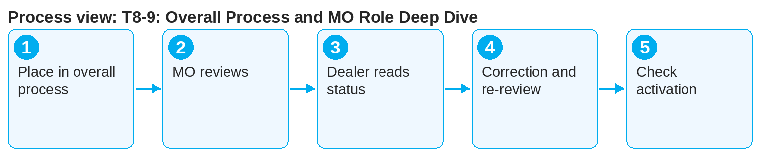
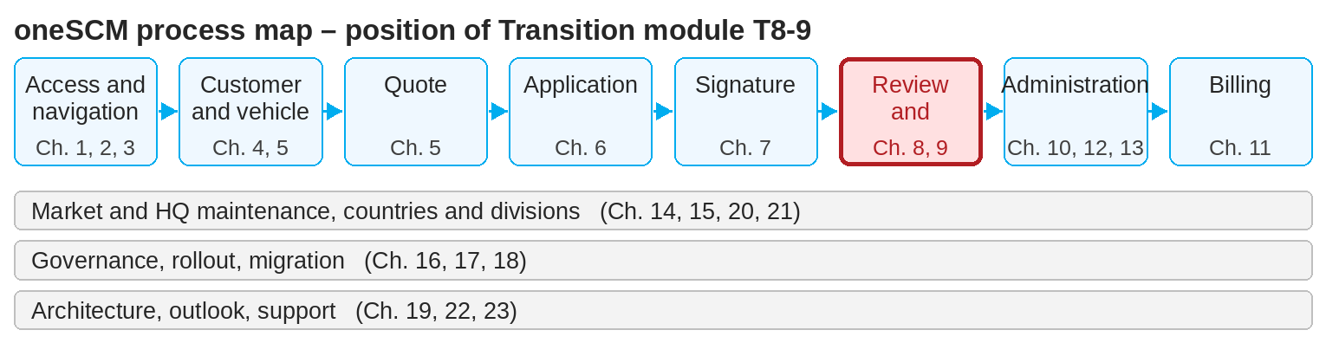
oneSCM – T8-9: Overall Process and MO Role Deep Dive
oneSCM
for Cars
Purpose and benefit
This module links the dealer view of the application (Chapter 8) with the MO view of the functional review (Chapter 9). You understand what the MO reviews, how feedback reaches the dealer and how both roles complete the overall process together.
How to proceed
Place the application in the overall process: submitted → under review → approved/rejected → active (Appendix D).
As MO, open the application from the work list and check it against the criteria (Chapters 9.2 and 9.4).
As dealer, read the check status and the reasons in the communication (Chapters 8.2 and 9.3).
This document is interactive – references to handbook chapters and systems are provided as links.
Transition at a glance
Dealer view (Chapter 8)
Track application and read status
Add missing data and documents
Rejection and resubmission
MO view (Chapter 9)
MO Check work list
Check criteria, check status, reasons
Approve, reject, hand over
!
Dealer and MO communicate via the application, not via private channels. Reasons and queries belong in the application's communication so they remain traceable.
On rejection, the dealer corrects and resubmits; the MO reviews again (Chapters 8.7 and 9.5).
After approval, activation takes place; both roles check the result (Chapters 8.6 and 9.6).
Note: This Quick Guide summarizes transition module T8-9 of the oneSCM handbook. Details, screenshots and evidence can be found in the handbook.
AS OF: 2026-10-11 | 1/2

Slide 2
oneSCM – T8-9: Overall Process and MO Role Deep Dive
oneSCM
for Cars
Roles and prerequisites
Frequently asked questions and answers
How does the dealer learn the review result? Via status and communication in Application Management (Chapter 8.2).
Can the MO correct data directly? The MO reviews; corrections to the application are made by the dealer (Chapter 9.5).
How long does an MO Check take? Depends on completeness and work list; complete applications are processed first.
Roles involved
Dealer: submit complete application, answer queries
MO: review, approval, rejection
Customer Management: activation and customer information
Prerequisites
Application fully submitted (Chapter 8)
MO role and check criteria known (Chapter 9.1)
Communication channel between dealer and MO clarified
Important links and contacts
Chapter 8 – Track and activate application.
Chapter 9 – MO Checks and functional reviews.
Role/status/scope matrices – Appendix D.
oneSCM Handbook – Complete chapters with screenshots, role, status and scope matrices (Appendix D).
Checklist before completion
☐ Application status in overall process known
☐ Check criteria clear to both roles
☐ Feedback documented via the application
☐ Result checked by both roles
Notes and pitfalls
Rejections always require a comment (Chapter 9).
Special approvals from Chapter 12 go through the same MO Check.
Contract Review profiles give the MO the overview (Chapter 9.8).
Note: This Quick Guide summarizes transition module T8-9 of the oneSCM handbook. Details, screenshots and evidence can be found in the handbook.
AS OF: 2026-10-11 | 2/2

