Slide 1


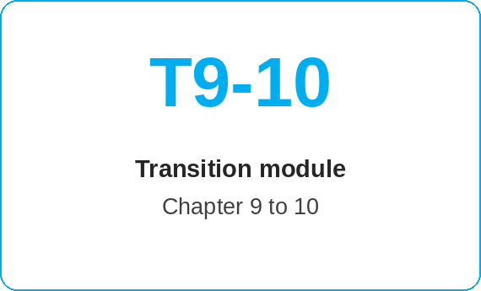
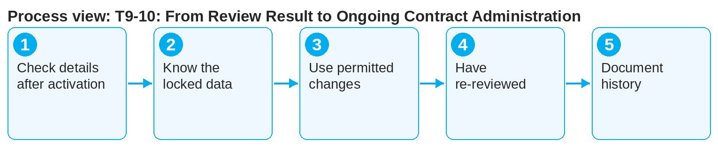
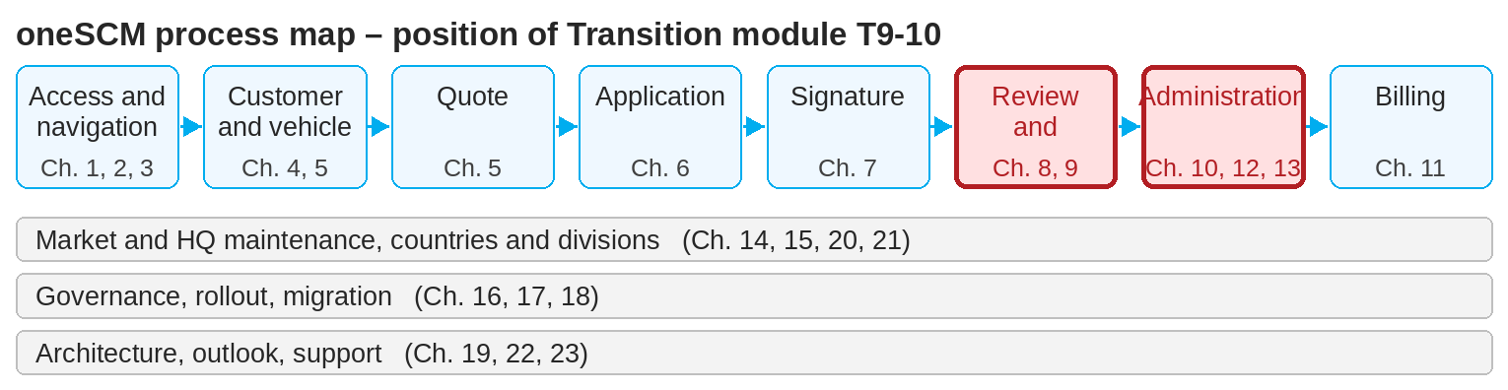
oneSCM – T9-10: From Review Result to Ongoing Contract Administration
oneSCM
for Cars
Purpose and benefit
This module links the review result (Chapter 9, approved and activated) with ongoing contract administration (Chapter 10). You know which data are locked upon activation, what remains changeable in day-to-day work and when changes are re-reviewed.
How to proceed
After activation, check the contract details and the payment plan (Chapters 10.1 and 11.1).
Know the locked data: product, term, mileage, payment interval (can only be changed to "one-time").
In day-to-day work, use the permitted actions: customer and payment data, change of payer, suspension, follow-up quote (Chapters 10.2 to 10.5).
This document is interactive – references to handbook chapters and systems are provided as links.
Transition at a glance
Starting point (Chapter 9)
Review completed, contract active
Check status and reasons in the history
Handover to support if disputed
Target (Chapter 10)
Search contract and check details
Know permitted changes
Have changes re-reviewed (Chapter 9.7)
!
Activation starts the payment plan and the service entitlement. Changes to product or term are only possible via a new contract; terminations have financial consequences (Chapters 10.6 and 11.6).
Changes requiring review go back into the MO Check (Chapter 9.7).
Document every change traceably in the history (Chapter 10.8).
Note: This Quick Guide summarizes transition module T9-10 of the oneSCM handbook. Details, screenshots and evidence can be found in the handbook.
AS OF: 2026-10-11 | 1/2

Slide 2
oneSCM – T9-10: From Review Result to Ongoing Contract Administration
oneSCM
for Cars
Roles and prerequisites
Frequently asked questions and answers
Can the MO revoke an active contract? No, after activation the rules in Chapter 10.6 for cancellation and termination apply.
Which changes trigger an MO Check? Change of payer, contract transfer and special conditions (Chapters 9.7 and 10.3).
Where can I see the review result later? In the change history of the contract (Chapter 10.8).
Roles involved
MO: complete review, review changes
Dealer: administer contract day to day
Finance department: payment plan and consequences
Prerequisites
Contract status "active" (Chapter 8.6)
Review result documented (Chapter 9.3)
Responsibilities for changes known (Chapter 10)
Important links and contacts
Chapter 9 – MO Checks and functional reviews.
Chapter 10 – Administer contracts day to day.
oneSCM Handbook – Complete chapters with screenshots, role, status and scope matrices (Appendix D).
Support and escalation – Report a support case with reference number, market, division and screenshot (Chapters 23.4 and 23.5).
Checklist before completion
☐ Contract details and payment plan checked after activation
☐ Locked data known
☐ Permitted changes known
☐ Change requiring review passed to MO
Notes and pitfalls
The review history from Chapter 9 remains visible on the contract.
Transition module T6-7 describes the start, this module the end of the application process.
Reporting on active contracts in Chapter 11.7.
Note: This Quick Guide summarizes transition module T9-10 of the oneSCM handbook. Details, screenshots and evidence can be found in the handbook.
AS OF: 2026-10-11 | 2/2

