Slide 1


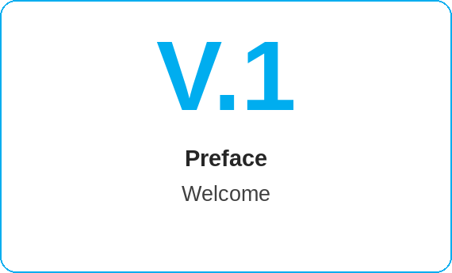
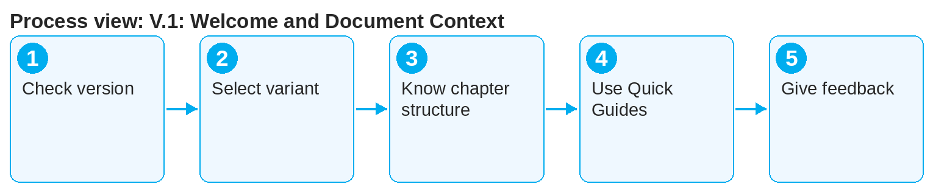

oneSCM – V.1: Welcome and Document Context
oneSCM
for Cars
Purpose and benefit
The preface explains who the oneSCM handbook is written for, which version applies, how variants per role, market and division are created and how to give feedback. This guide is the entry point before all chapters.
How to proceed
Check the version and date of the handbook; they appear in the footer of every page.
Select the variant for your role, your market and your division.
Get to know the chapter structure: purpose, prerequisites, roles, steps, result, special cases, notes, troubleshooting, sources.
This document is interactive – references to handbook chapters and systems are provided as links.
Contents at a glance
Document context
Target groups: Dealer, MO, Market, HQ
Validity: version, release, date
Variants per role, market and division
Working with the handbook
Chapter structure (purpose, prerequisites, steps, result, notes)
Quick Guides per chapter
Feedback and clarification register
!
Only the current version of the handbook is valid. Older exports may contain outdated processes; check date and release (Chapter 22.4).
Use the Quick Guides as a summary and the handbook for details.
Give feedback via the clarification register or the feedback function of the online help (Appendix F).
Note: This Quick Guide summarizes preface V.1 of the oneSCM handbook. Details, screenshots and evidence can be found in the handbook.
AS OF: 2026-10-11 | 1/2

Slide 2
oneSCM – V.1: Welcome and Document Context
oneSCM
for Cars
Roles and prerequisites
Frequently asked questions and answers
Who is the handbook for? For all roles in oneSCM: Dealer, MO, Market and HQ, with variants per market and division.
How do I recognize the valid version? By the date in the footer and the release information (Chapter 22.4).
Where do I give feedback? Via the clarification register (Appendix F) or the feedback function of the online help.
Roles involved
All roles: know the document context
Editorial team: maintain version and variants
Market: approve local variants
Prerequisites
Handbook version and date (see footer)
Your own role, market and division
Access to the handbook or the online help
Important links and contacts
Table of contents and reading paths – V.2.
Glossary – Appendix A with terms and abbreviations.
oneSCM Handbook – Complete chapters with screenshots, role, status and scope matrices (Appendix D).
Support and escalation – Report a support case with reference number, market, division and screenshot (Chapters 23.4 and 23.5).
Checklist before completion
☐ Version and date checked
☐ Appropriate variant selected
☐ Chapter structure known
☐ Feedback channel known
Notes and pitfalls
The reading path per role is in V.2.
Terms are explained in the glossary (Appendix A).
Data protection rules for examples in Chapter 16.1.
Note: This Quick Guide summarizes preface V.1 of the oneSCM handbook. Details, screenshots and evidence can be found in the handbook.
AS OF: 2026-10-11 | 2/2

