Slide 1


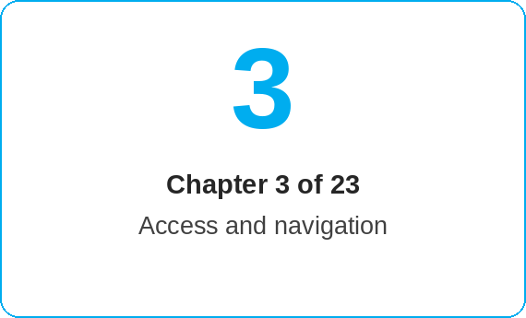


oneSCM – Basics, Navigation and Customer Journey
oneSCM
for Vans
Purpose and benefit
You find your way around the start page and menu, use search and filters, know the interaction patterns and place the contract process from price information to contract on the process map (Chapter 3.1 to 3.9).
This document is interactive – references to handbook chapters and systems are provided as links.
How to proceed
Topics at a glance
Start on the start page (3.1): The tiles lead to Contract Creation, Application Management, Customer Management as well as warranty packages and external portals.
Use search and filters (3.2): reference number, VIN, customer name or status narrow down lists. Columns such as "Actions" are reached via the horizontal slider.
Recognize the interaction patterns (3.3): step bar with check marks, toggles for optional entries, three-dot menu for actions, mandatory fields marked with an asterisk.
Place your case on the process map (3.4 and 3.5): price information → quote → application → contract.
3.1 – 3.3 User interface
Start page and menu
Search and filters
UI elements and interaction patterns
3.4 – 3.6 Customer Journey
Process map
Price information, quote, application and contract
Lead and CRM handover
3.7 – 3.9 Status and context
Interfaces and system handovers
Interpreting status information correctly
Personal work context and languages
!
A green check mark in the step bar does not mean that the contract is active. Only the contract status "active" after review and activation (Chapter 8) is binding.
Take over leads from the CRM and return results (3.6); note the system handovers to OTR, VEGA and oneERP (3.7).
Read status information correctly (3.8): application status, signature status and contract status are separate values.
Set your work context and language (3.9); documents follow the market's language variant (Chapter 7.4).
Note: This Quick Guide summarizes Chapter 3 of the oneSCM handbook. Details, screenshots and evidence can be found in the handbook.
AS OF: 2026-10-11 | 1/2

Slide 2
oneSCM – Basics, Navigation and Customer Journey
oneSCM
for Vans
Roles and prerequisites
Frequently asked questions and answers
Where can I find a saved application again? Under Contract Creation › Application Management via the reference number (Chapter 8.1).
What is the difference between a quote and an application? The quote is non-binding price information; the application is saved, signed, reviewed and activated.
Can I use the interface in another language? Yes, via the personal work context (3.9); contract documents follow the market's language variants.
Roles involved
All roles: navigation, search, understanding status
Dealer: customer journey from lead to contract
MO/Market: status information and system handovers
Prerequisites
Successful login with correct context (Chapter 2)
Basic knowledge of the process map
Personal work context and language are set
Important links and contacts
oneSCM handbook – Complete chapters with screenshots, role, status and scope matrices (Appendix D).
Process diagrams – Appendix C with process map and sub-processes.
Glossary – Appendix A with terms and abbreviations.
Support and escalation – Report a support case with reference number, market, division and screenshot (Chapter 23.4 and 23.5).
Checklist before completion
☐ Start page and main menu are known
☐ Search by reference number and VIN works
☐ Process phase of the case is clear
☐ Language and work context are set
Notes and pitfalls
The status overview with permitted transitions is in Chapter 8.2 and Appendix D.
The search only finds cases in your own market and dealership context.
Browser zoom below 100 % hides columns; use the slider.
Note: This Quick Guide summarizes Chapter 3 of the oneSCM handbook. Details, screenshots and evidence can be found in the handbook.
AS OF: 2026-10-11 | 2/2

