Slide 1


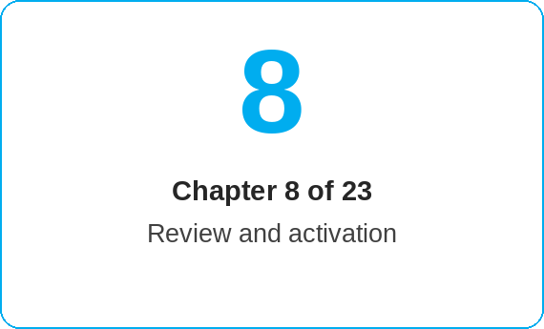
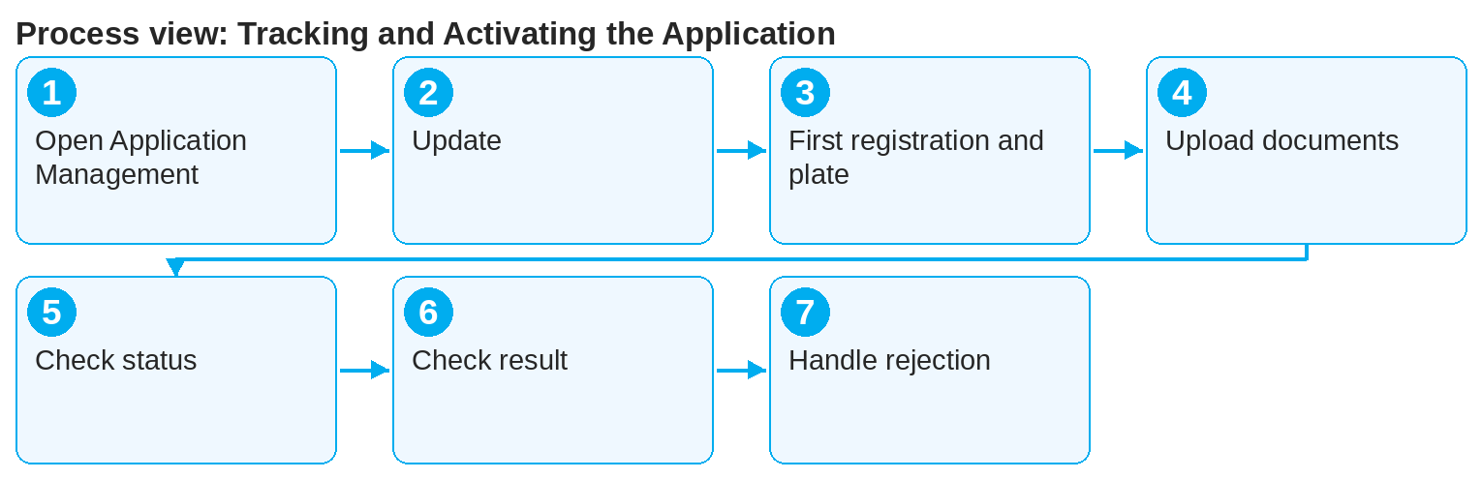
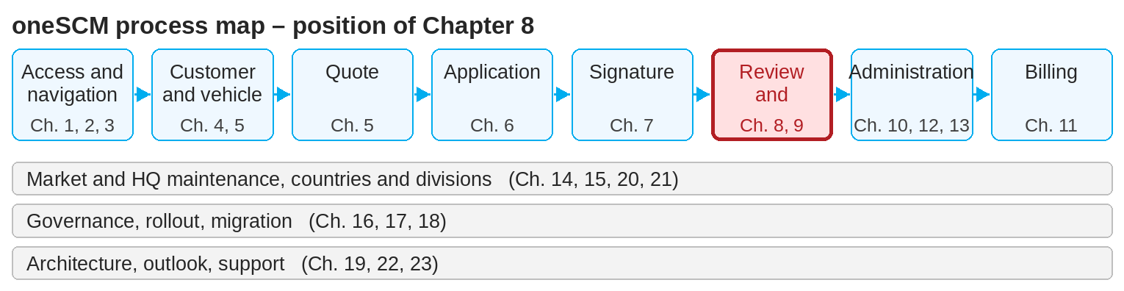
oneSCM – Tracking and Activating the Application
oneSCM
for Vans
Purpose and benefit
You search and filter applications, read the status overview, add missing vehicle data and documents, know the activation prerequisites and respond correctly to rejection, delay and resubmission (Chapter 8.1 to 8.7).
This document is interactive – references to handbook chapters and systems are provided as links.
How to proceed
Topics at a glance
Under Contract Creation, click "Application Management" and search for the application via the reference number (8.1).
Move the slider to the right to the "Actions" column, click "…" and select "Update".
Enter the first registration date and license plate (8.3).
Open the application via the reference number, switch to the "Communication" tab and use the upload icon to upload the copy of the ZB I/ZB II or the signed contract document.
8.1 – 8.3 Tracking
Searching, filtering and tracking applications
Status overview and permitted transitions
Adding missing vehicle data and documents
8.4 – 8.7 Activating
Approval process and activation prerequisites
Automatic and manual activation variants
Checking activation and result
Rejection, delay and resubmission
!
Uploading the ZB II is not a mandatory field in the system, but no activation takes place without the document. Incorrect applications are rejected and the customer is informed.
Check the status overview (8.2): only permitted transitions are possible; the application is reviewed and activated by Customer Management (8.4 and 8.5).
Check the result (8.6): contract status "active" and feedback in Communication.
In case of rejection, Customer Management will contact you; correct the data and resubmit the application (8.7).
Note: This Quick Guide summarizes Chapter 8 of the oneSCM handbook. Details, screenshots and evidence can be found in the handbook.
AS OF: 2026-10-11 | 1/2

Slide 2
oneSCM – Tracking and Activating the Application
oneSCM
for Vans
Roles and prerequisites
Frequently asked questions and answers
How long does activation take? With complete data, automatic activation takes place promptly; manual reviews by Customer Management take correspondingly longer (8.5).
My application was rejected. What to do? Read the rejection reason in Communication, correct the data and resubmit the application (8.7).
Can I filter by status? Yes, Application Management offers filters by status, date and customer (8.1).
Roles involved
Dealer: track application, submit missing data and documents
MO/Customer Management: review, approval and activation
System: automatic activation when data is complete
Prerequisites
Application is saved and signed (Chapter 6 and 7)
Reference number is available
First registration, license plate and ZB II are available
Important links and contacts
Transition module T8-9 – Overall process and MO role deep dive.
oneSCM handbook – Complete chapters with screenshots, role, status and scope matrices (Appendix D).
FAQ and troubleshooting – Chapter 23 with questions per process phase and known errors per market and release.
Support and escalation – Report a support case with reference number, market, division and screenshot (Chapter 23.4 and 23.5).
Checklist before completion
☐ Application found in Application Management
☐ First registration and license plate entered
☐ ZB II and contract document uploaded
☐ Contract status "active" checked
Notes and pitfalls
A service contract can be concluded up to 12 months and/or a maximum of 50,000 km after first registration, provided the vehicle has not yet received a service (exception: company and demonstrator vehicles with a previous owner).
The contract start corresponds to the date of first registration.
Status transitions are documented as a matrix in Appendix D.
Note: This Quick Guide summarizes Chapter 8 of the oneSCM handbook. Details, screenshots and evidence can be found in the handbook.
AS OF: 2026-10-11 | 2/2

