Slide 1


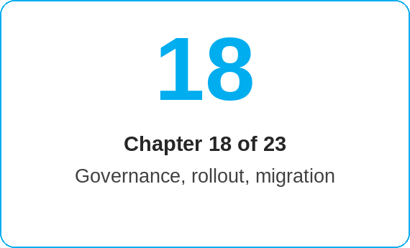
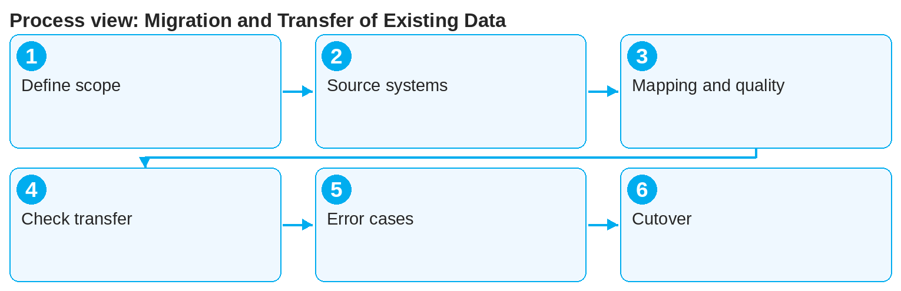

oneSCM – Migration and Transfer of Existing Data
oneSCM
for Vans
Purpose and benefit
You know the scope and boundaries of the migration, the source systems and data objects, the data mapping and quality check, check transferred customers and contracts, handle error cases and understand cutover and parallel operation (Chapter 18.1 to 18.6).
This document is interactive – references to handbook chapters and systems are provided as links.
How to proceed
Topics at a glance
Clarify scope and boundaries (18.1): which contracts, customers and documents are transferred, which remain in the legacy system?
Identify source systems and data objects (18.2), e.g. legacy systems from Chapter 19.20.
Check data mapping and quality using the check rules (18.3).
18.1 – 18.3 Preparation
Scope and boundaries of the migration
Source systems and data objects
Data mapping and quality check
18.4 – 18.6 Execution
Checking transferred customers and contracts
Error cases, correction paths and evidence
Cutover and parallel operation
!
During parallel operation, migrated contracts may be changed only in the leading system. Duplicate maintenance creates contradictions and blocks activation.
Check transferred customers and contracts on a sample basis and according to the error list (18.4).
Handle error cases via the defined correction paths and secure evidence (18.5).
Observe cutover and parallel operation (18.6): from the cutover date, oneSCM is the leading system.
Note: This Quick Guide summarizes Chapter 18 of the oneSCM handbook. Details, screenshots and evidence can be found in the handbook.
AS OF: 2026-10-11 | 1/2

Slide 2
oneSCM – Migration and Transfer of Existing Data
oneSCM
for Vans
Roles and prerequisites
Frequently asked questions and answers
Are all legacy contracts migrated? Only those defined in the migration scope; the rest run out in the legacy system (18.1).
What do I do with an incorrectly migrated contract? Report the error case via the correction path; do not rebuild it manually (18.5).
When does parallel operation end? On the cutover date defined in the cutover plan (18.6).
Roles involved
Project/HQ: migration scope, cutover
Market: data mapping and quality check
Dealer/MO: checking transferred customers and contracts
Prerequisites
Migration plan and source systems are known
Access to check and error lists
Correction paths and contact persons are defined
Important links and contacts
Legacy systems and transition architecture – Chapter 19.20.
oneSCM handbook – Complete chapters with screenshots, role, status and scope matrices (Appendix D).
FAQ and troubleshooting – Chapter 23 with questions per process phase and known errors per market and release.
Support and escalation – Report a support case with reference number, market, division and screenshot (Chapters 23.4 and 23.5).
Checklist before completion
☐ Migration scope confirmed
☐ Mapping and quality checked
☐ Samples checked
☐ Error cases corrected with evidence
Notes and pitfalls
Migrated contracts are marked as migrated in the history (Chapter 10.8).
Data ownership according to Chapter 16.2 also applies to legacy data.
Country-specific migration in Chapter 20.5.
Note: This Quick Guide summarizes Chapter 18 of the oneSCM handbook. Details, screenshots and evidence can be found in the handbook.
AS OF: 2026-10-11 | 2/2

