Slide 1


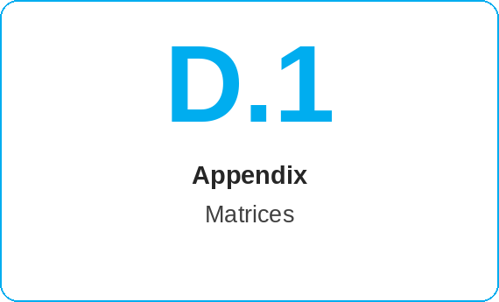
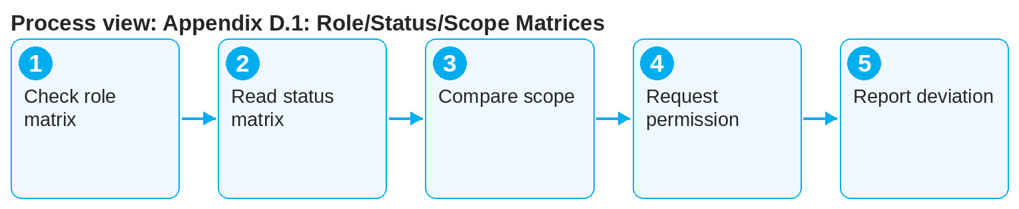
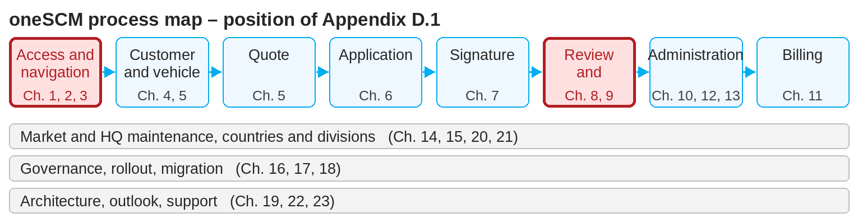
oneSCM – Appendix D.1: Role/Status/Scope Matrices
oneSCM
for Vans
Purpose and benefit
The matrices show which role may perform which action, which status transitions are permitted and which scope (market, division, dealership) applies to visibility and editing.
How to proceed
This document is interactive – references to handbook chapters and systems are provided as links.
Check in the role matrix whether your role may perform the desired action.
Read in the status matrix which transition is permitted from which status (Chapter 8.2).
Check in the scope matrix whether market, division and dealership of the transaction match your access (Chapter 2.4).
Contents at a glance
Matrices
Role matrix: action per role (Dealer, MO, Market, HQ)
Status matrix: permitted transitions per object (application, signature, contract)
Scope matrix: visibility per market, division and dealership
Application
Before an action: May my role do this?
For status questions: Which transition is possible?
If visibility is missing: Does the scope match?
!
The matrices are the binding reference for authorizations and status transitions. A transition visible in the system but not documented must be reported, not used.
If a permission is missing, request the role via ALICE (Chapter 2.3); if a transition is missing, a new contract or support is required.
Report deviations between matrix and system via the clarification register (Appendix F).
Note: This Quick Guide summarizes Appendix D.1 of the oneSCM handbook. Details, screenshots and evidence can be found in the handbook.
AS OF: 2026-10-11 | 1/2

Slide 2
oneSCM – Appendix D.1: Role/Status/Scope Matrices
oneSCM
for Vans
Roles and prerequisites
Frequently asked questions and answers
Why can't I activate an application? Activation is reserved for the MO or the system; see role matrix and Chapter 8.4.
Which transitions exist from "rejected"? Resubmission after correction (Chapter 8.7); see status matrix.
Why can't I see contracts of another dealership? The scope limits visibility to your dealership and market.
Roles involved
All roles: look up own permissions and status transitions
MO/Market: status matrix for reviews and changes
HQ: maintain matrices
Prerequisites
Role and scope of own access known (Chapter 2)
Current status of the transaction known
Matrix in current version
Important links and contacts
Role/status/scope matrices – Appendix D.1.
ALICE – authorization management – Chapter 19.16.
oneSCM Handbook – Complete chapters with screenshots, role, status and scope matrices (Appendix D).
Support and escalation – Report a support case with reference number, market, division and screenshot (Chapters 23.4 and 23.5).
Checklist before completion
☐ Role may perform the action
☐ Status transition is permitted
☐ Scope matches the transaction
☐ Deviation reported
Notes and pitfalls
Application, signature and contract status are separate matrices (Chapter 3.8).
Scope restrictions explain why transactions are missing from the search (Chapter 3.2).
The matrices are the basis of role training (Chapter 17).
Note: This Quick Guide summarizes Appendix D.1 of the oneSCM handbook. Details, screenshots and evidence can be found in the handbook.
AS OF: 2026-10-11 | 2/2

