Slide 1


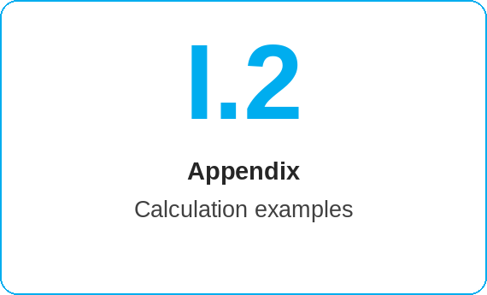
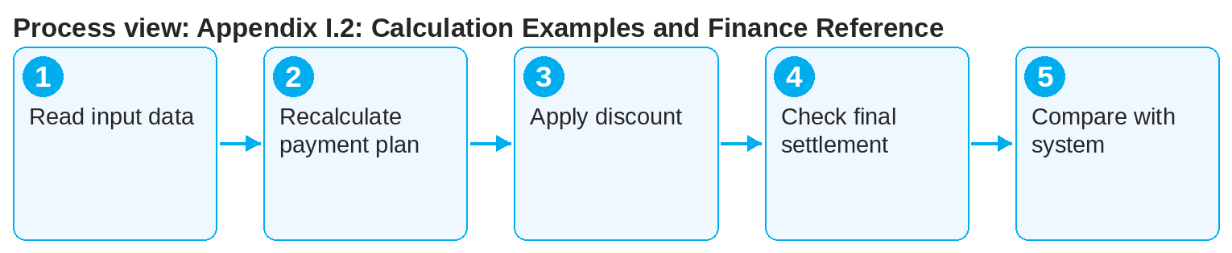
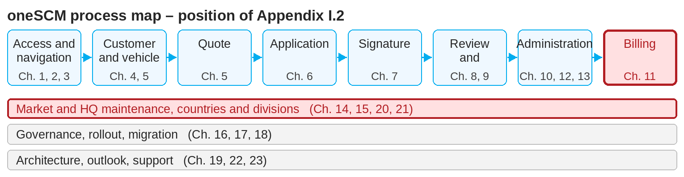
oneSCM – Appendix I.2: Calculation Examples and Finance Reference
oneSCM
for Vans
Purpose and benefit
The calculation examples show how price, payment interval, term and mileage affect the payment plan, final settlement and refund, and how discounts and campaigns take effect. This guide explains the examples step by step.
How to proceed
Read the example's input data: product, term, mileage, payment interval.
Follow the payment plan: total price, number and amount of installments, due dates.
Apply the campaign or discount and check the effect on the payment plan.
This document is interactive – references to handbook chapters and systems are provided as links.
Contents at a glance
Examples
Payment plan: one-off versus monthly
Term and mileage: effect on the price
Campaign and dealer discount in the quote
Early termination: final settlement and refund
Finance reference
Invoicing (Chapter 11.1)
Price components and Cost Unit Split (Chapter 14.14)
Posting in NEMESIS, payment via MPay (Chapter 19)
!
The calculation examples use sample prices. Only the market's price version and the price information from oneSCM are binding.
Recalculate the final settlement for early termination: used share, refund, correction (Chapter 11.6).
Compare your result with the price information (PDF) from the system (Chapter 5.6).
Note: This Quick Guide summarizes Appendix I.2 of the oneSCM handbook. Details, screenshots and evidence can be found in the handbook.
AS OF: 2026-10-11 | 1/2

Slide 2
oneSCM – Appendix I.2: Calculation Examples and Finance Reference
oneSCM
for Vans
Roles and prerequisites
Frequently asked questions and answers
Why does my result differ from the price information? Check price version, campaign conditions and rounding rules; in case of doubt, the system applies.
How is the refund calculated? Pro rata by term and mileage per Chapter 11.6; the example shows the steps.
Does the example apply to Cars and Vans? The calculation logic does; prices differ per division (Chapter 21.3).
Roles involved
Dealer: explain payment plan and price information
Finance department: final settlement and corrections
Market: price components and factors (Chapters 14.9, 14.14)
Prerequisites
Product and configuration of the sample contract
Market's price version known
Chapter 11 read
Important links and contacts
Calculation examples and finance reference – Appendix I.2.
Invoice, payment, costs – Chapter 11.
oneSCM Handbook – Complete chapters with screenshots, role, status and scope matrices (Appendix D).
Support and escalation – Report a support case with reference number, market, division and screenshot (Chapters 23.4 and 23.5).
Checklist before completion
☐ Input data understood
☐ Payment plan recalculated
☐ Discount effect checked
☐ Final settlement followed
Notes and pitfalls
The payment interval can later only be changed to "one-off" (Chapter 6).
Refunds are handled by the Finance department (Chapter 11.6).
Factor limits and clusters are described in Chapter 14.9.
Note: This Quick Guide summarizes Appendix I.2 of the oneSCM handbook. Details, screenshots and evidence can be found in the handbook.
AS OF: 2026-10-11 | 2/2

