Slide 1


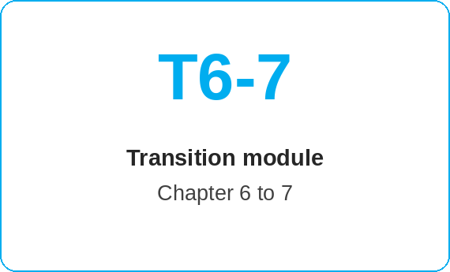
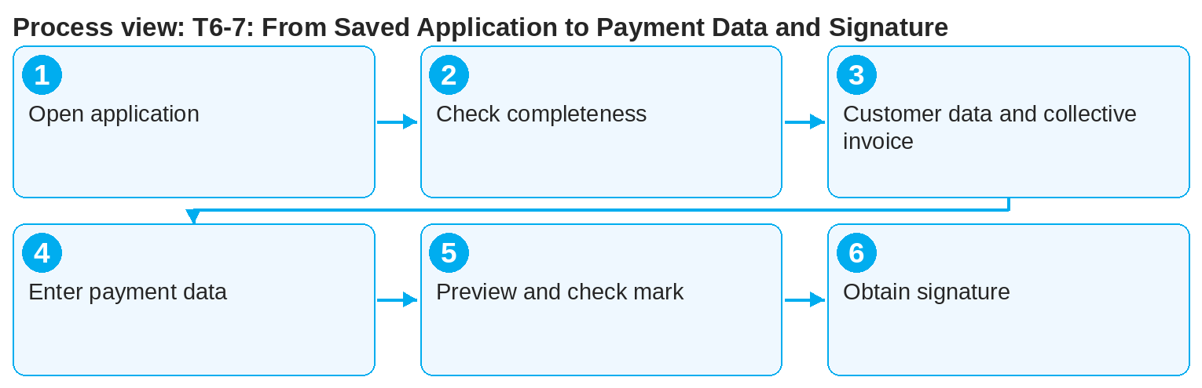
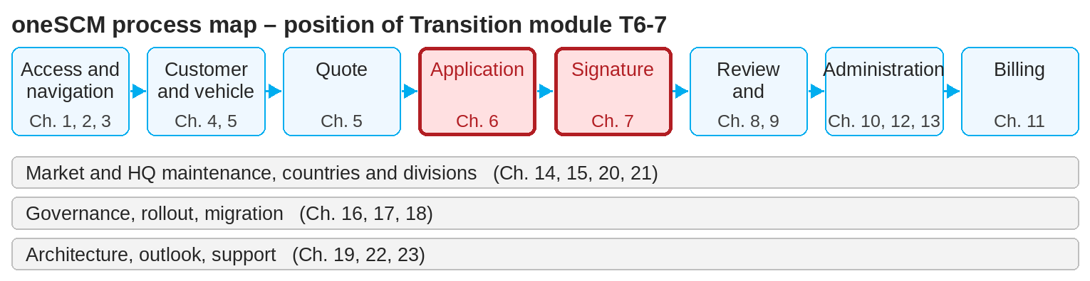
oneSCM – T6-7: From Saved Application to Payment Data and Signature
oneSCM
for Vans
Purpose and benefit
This module links Chapter 6 (application saved, reference number available) with Chapter 7 (payment data, documents, signature). You check what must be in place at the transition and avoid the typical breaks between application and signature.
This document is interactive – references to handbook chapters and systems are provided as links.
How to proceed
Transition at a glance
Open the saved application via the reference number (Chapter 8.1) and check the application status.
Make sure the application is complete: an application with open validation cannot proceed to signature.
Switch to the customer data check and activate the collective invoice if required (Chapters 6 and 7.2).
Starting point (Chapter 6)
Application saved, status "entered"
Customer, vehicle, product assigned
Special approval identified or not required
Target (Chapter 7)
Payment method, interval, payer and invoice recipient entered
SEPA mandate and documents generated
Signature obtained, status checked
!
After "Create application", product, term and mileage can no longer be changed. Errors from Chapter 6 cannot be corrected in the transition; they require a new contract.
Enter payment method, interval and bank details (Chapters 7.1 to 7.3).
Generate the application preview and click the check mark to sign (Chapter 7.4).
Select the signature type and check the signature status (Chapters 7.5 to 7.8).
Note: This Quick Guide summarizes transition module T6-7 of the oneSCM handbook. Details, screenshots and evidence can be found in the handbook.
AS OF: 2026-10-11 | 1/2

Slide 2
oneSCM – T6-7: From Saved Application to Payment Data and Signature
oneSCM
for Vans
Roles and prerequisites
Frequently asked questions and answers
Can I pause between saving and signature? Yes, the application remains accessible under its reference number in Application Management.
What if the customer wants to change the payment method? Change it before signature in Chapter 7.1; after signature, a new signature is required (Chapter 7.7).
Does the payer have to sign? The payer signs the SEPA mandate; the contract holder signs the contract (Chapter 7.2).
Roles involved
Dealer: carry out the transition
Customer: provide payment data and sign
MO: reads signature status during review
Prerequisites
Application saved, reference number noted (Chapter 6.7)
No red validation messages
Customer e-mail and mobile number in customer master data
Important links and contacts
Chapter 6 – Create service contract and complete application.
Chapter 7 – Payment data, documents and signature.
oneSCM Handbook – Complete chapters with screenshots, role, status and scope matrices (Appendix D).
Support and escalation – Report a support case with reference number, market, division and screenshot (Chapters 23.4 and 23.5).
Checklist before completion
☐ Application status checked
☐ Validation without red messages
☐ Payment data entered
☐ Signature route selected and status checked
Notes and pitfalls
The payment interval can later only be changed to "one-time".
With special approvals, activation waits for the MO Check; the signature can still be obtained.
Missing customer contact data block e-mail and SMS signature.
Note: This Quick Guide summarizes transition module T6-7 of the oneSCM handbook. Details, screenshots and evidence can be found in the handbook.
AS OF: 2026-10-11 | 2/2

