Slide 1


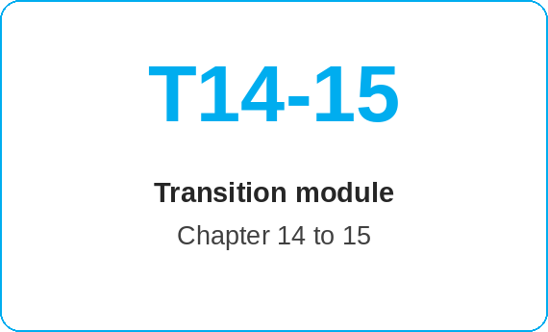
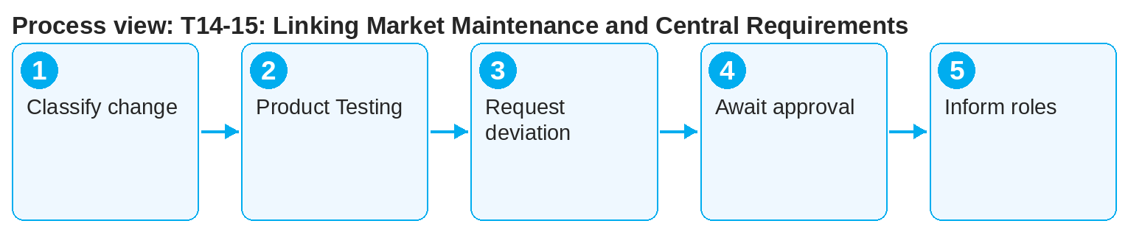
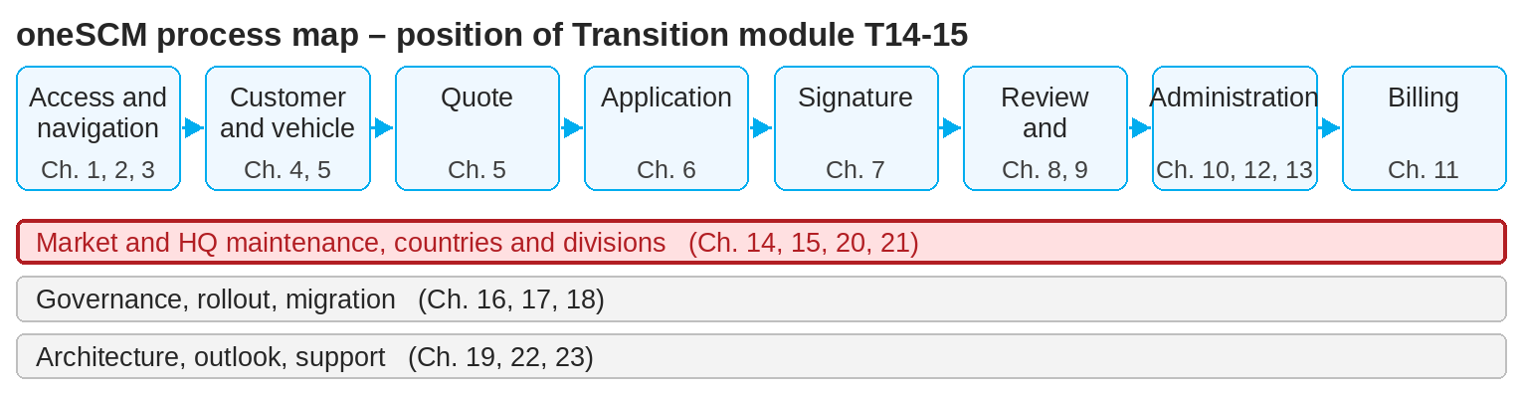
oneSCM – T14-15: Linking Market Maintenance and Central Requirements
oneSCM
for Vans
Purpose and benefit
This module links market maintenance (Chapter 14) with the central requirements of HQ (Chapter 15). You know which maintenance decisions the market makes alone, which need HQ approval and how country deviations are requested.
How to proceed
Classify the planned change: within the Blueprint (market decides) or deviation (HQ approval required).
Prepare the change in Product Testing and secure test evidence (Chapters 14.12, 16.4).
Request a country deviation from HQ with justification (Chapter 15.3) and enter it in the register (Chapter 20.6).
This document is interactive – references to handbook chapters and systems are provided as links.
Transition at a glance
Market decides (Chapter 14)
Market-specific settings and templates
Price versions, campaigns, discounts within the Blueprint
Product Testing and publication
HQ decides (Chapter 15)
Blueprint and global standards
Country deviations
Technical options, SA matching, coverage codes
!
No publication of a deviation before HQ approval. Unapproved deviations count as a Blueprint violation and are withdrawn.
Await HQ approval before publishing (Chapters 14.7 and 15.4).
Inform MO and dealers about effective changes (Chapter 15.5).
Note: This Quick Guide summarizes transition module T14-15 of the oneSCM handbook. Details, screenshots and evidence can be found in the handbook.
AS OF: 2026-10-11 | 1/2

Slide 2
oneSCM – T14-15: Linking Market Maintenance and Central Requirements
oneSCM
for Vans
Roles and prerequisites
Frequently asked questions and answers
May the market create a campaign without HQ? Yes, within the Blueprint (Chapter 14.13); deviating conditions need HQ approval.
How long does HQ approval take? According to the HQ governance process (Chapter 15.4); the status is in the register.
What happens on rejection? The change remains unpublished; the market can request again with a new justification.
Roles involved
Market: maintenance and request for deviation
HQ: Blueprint, approval, central master data
MO: feedback from review
Prerequisites
Market role with maintenance rights (Chapter 14.1)
Blueprint and country deviation register known (Chapters 15.2, 20.6)
Approval workflow clarified (Chapter 16.3)
Important links and contacts
Chapter 14 – Market role, product and price maintenance.
Chapter 15 – HQ role, Blueprint and central master data.
Country deviation register – Chapter 20.6.
oneSCM Handbook – Complete chapters with screenshots, role, status and scope matrices (Appendix D).
Checklist before completion
☐ Change classified as Blueprint or deviation
☐ Test evidence available
☐ Deviation requested and registered
☐ Approval awaited before publication
Notes and pitfalls
The counterpart T15-14 describes the handover of central foundations to the market.
Coverage codes and technical options affect all markets (Chapter 15.7).
Approvals are kept traceable in the clarification register (Appendix F).
Note: This Quick Guide summarizes transition module T14-15 of the oneSCM handbook. Details, screenshots and evidence can be found in the handbook.
AS OF: 2026-10-11 | 2/2

