Slide 1


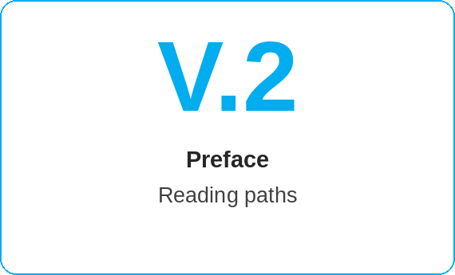
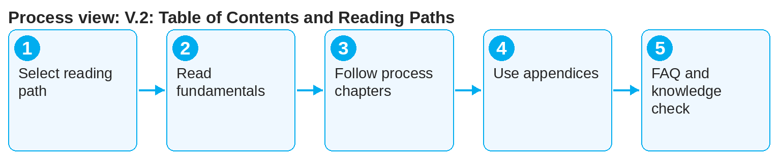

oneSCM – V.2: Table of Contents and Reading Paths
oneSCM
for Vans
Purpose and benefit
The table of contents shows the 23 chapters, appendices and transition modules; the reading paths recommend the order of chapters per role. This guide helps you quickly find the right entry point.
How to proceed
This document is interactive – references to handbook chapters and systems are provided as links.
Select the reading path for your role and read the fundamentals first (Chapters 1 to 3).
Follow the process chapters in the order of the reading path; the transition modules link them.
For each chapter, use the Quick Guide as a summary and checklist.
Contents at a glance
Reading paths
Dealer: 1, 2, 3, 4, 5, 6, T6-7, 7, T7-8, 8, 10, 12, 23
MO: 1, 2, 3, 8, T8-9, 9, T9-10, 10, 11, 16
Market: 1, 2, 14, T14-15, 15, 20, 21, 17
HQ: 1, 15, T15-14, T15-16, 16, 19, 22
Structure
Main part: Chapters 1 to 23
Transition modules T6-7 to T15-16
Appendices A to I
Preface V.1 and V.2
!
The reading paths are recommendations, not authorizations. Which chapters you may carry out in the system is determined by role and scope (Appendix D).
Consult the appendices as needed: glossary, checklists, matrices, practical examples.
Finish with Chapter 23 (FAQ and support) and the knowledge check (Appendix H).
Note: This Quick Guide summarizes preface V.2 of the oneSCM handbook. Details, screenshots and evidence can be found in the handbook.
AS OF: 2026-10-11 | 1/2

Slide 2
oneSCM – V.2: Table of Contents and Reading Paths
oneSCM
for Vans
Roles and prerequisites
Frequently asked questions and answers
Do I have to read all 23 chapters? No, the reading path for your role names the relevant chapters; the others are for reference.
Where are the transition modules? Between the chapters they link, e.g. T6-7 between Chapters 6 and 7.
Are there reading paths per market? Reading paths apply per role; market specifics are in Chapter 20.
Roles involved
Dealer: reading path contract process
MO: reading path review and administration
Market/HQ: reading path maintenance and governance
Prerequisites
Your own role known (Chapter 1.3)
Access to the handbook
Fundamentals Chapters 1 to 3 read or scheduled
Important links and contacts
Welcome and document context – V.1.
Handbook dashboard – Structure and click path.
oneSCM Handbook – Complete chapters with screenshots, role, status and scope matrices (Appendix D).
FAQ and troubleshooting – Chapter 23 with questions per process phase and known errors per market and release.
Checklist before completion
☐ Reading path for the role selected
☐ Fundamentals read
☐ Process chapters worked through in order
☐ Appendices used as needed
Notes and pitfalls
The dashboard shows the structure and the click path interactively.
Country and division chapters (20, 21) supplement every reading path.
New chapters are added to the reading paths with releases (Chapter 22).
Note: This Quick Guide summarizes preface V.2 of the oneSCM handbook. Details, screenshots and evidence can be found in the handbook.
AS OF: 2026-10-11 | 2/2

