Slide 1


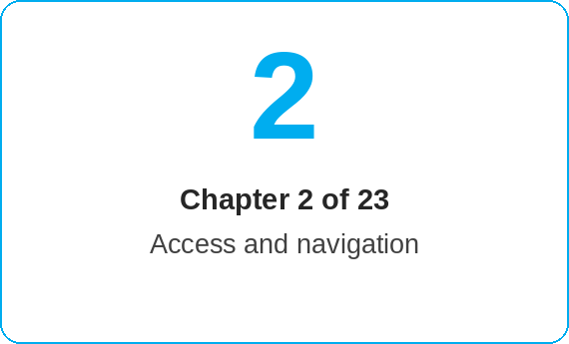
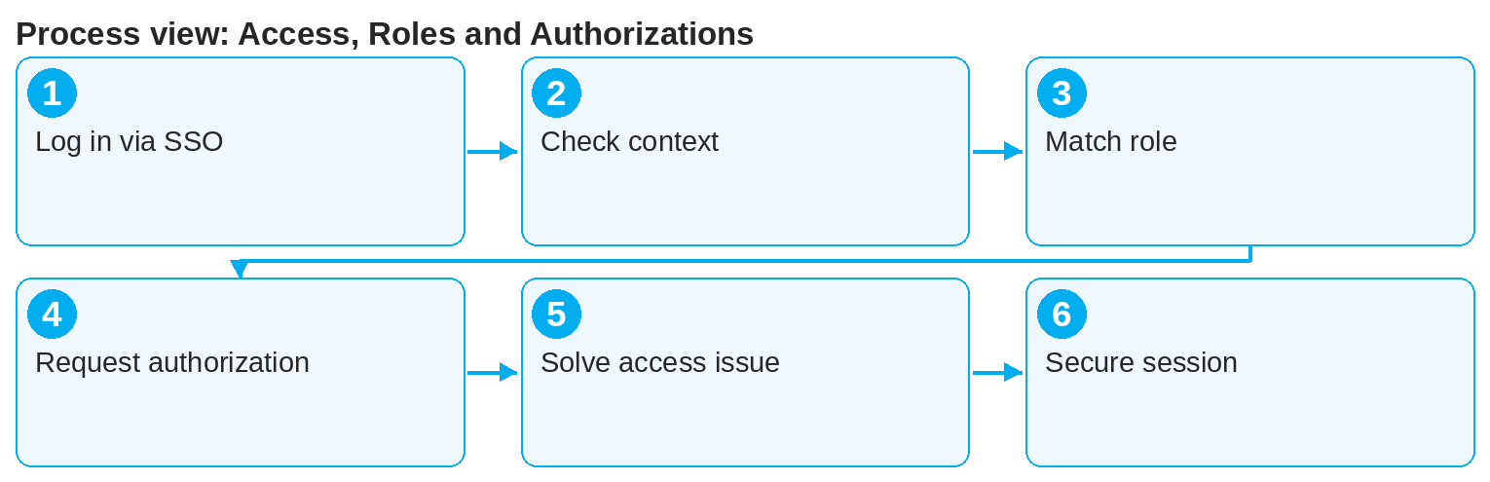

oneSCM – Access, Roles and Authorizations
oneSCM
for Cars
Purpose and benefit
You log in via Single Sign-on, check your business role and technical authorizations, and know how to request missing rights and solve access issues (Chapter 2.1 to 2.6).
References to handbook chapters and systems are highlighted; e-mail addresses are provided as links.
How to proceed
Topics at a glance
Open oneSCM via RetailPortal or via the direct link. Login is via Single Sign-on (2.1).
After login, check your market, division and dealership context (2.4): A wrong context means wrong products and prices.
Match your business role against your technical authorizations (2.2). Missing menu items indicate missing roles.
2.1 – 2.3 Login and roles
Login and Single Sign-on
Business roles and technical authorizations
Authorization request and approval
2.4 – 2.6 Context and security
Check market, division and dealership context
Missing authorizations and access issues
Secure handling of user account and session
!
Authorizations are never granted by e-mail or verbal request. Every role is requested, reviewed and approved via ALICE; the approval is documented traceably.
If an authorization is missing, submit the authorization request via ALICE (2.3). In the dealership, the ALICE dealership admin grants access.
For access issues (2.5): clear the browser cache, log in again, then report a support case with user ID and screenshot.
Lock your session when away and never share your account with others (2.6).
Note: This Quick Guide summarizes Chapter 2 of the oneSCM handbook. Details, screenshots and evidence can be found in the handbook.
AS OF: 2026-10-11 | 1/2

Slide 2
oneSCM – Access, Roles and Authorizations
oneSCM
for Cars
Roles and prerequisites
Frequently asked questions and answers
Why can't I see the Contract Creation menu item? The related role is missing. Request it via ALICE from your dealership admin.
How long does an approval take? Approval is given by the responsible admin; you can see the current status in the authorization request.
Can I have multiple roles? Yes, for example Dealer roles for Cars and Vans; the active context is shown in oneSCM.
Roles involved
User: login, context check, authorization request
ALICE dealership admin: activation of roles in the dealership
Market/HQ: role model and approvals
Prerequisites
Valid user account in the corporate directory
Assigned oneSCM role (e.g. oneSCM.DealerPKW)
Access via RetailPortal or direct link
Important links and contacts
ALICE – authorization management – Role request and approval (Chapter 19.16).
oneSCM RetailPortal – System news and training material.
oneSCM handbook – Complete chapters with screenshots, role, status and scope matrices (Appendix D).
Support and escalation – Report a support case with reference number, market, division and screenshot (Chapter 23.4 and 23.5).
Checklist before completion
☐ Login via SSO works
☐ Market, division and dealership are correct
☐ All required menu items are visible
☐ Contact person for ALICE is known
Notes and pitfalls
The oneSCM.DealerPKW role is a prerequisite for application creation in the Vans business.
After a role change, you need to log in again.
Multiple markets or divisions require multiple role assignments.
Note: This Quick Guide summarizes Chapter 2 of the oneSCM handbook. Details, screenshots and evidence can be found in the handbook.
AS OF: 2026-10-11 | 2/2

